Slide 1
World Religions
Unit One

Slide 2
World Religions: Overview
Our study of four of the world’s major religions will allow us to take a closer look at Hinduism, Judaism, Buddhism and Christianity. Throughout our study of these religions, we will examine the origins of each faith, the theistic beliefs of each faith, the major beliefs/values of each faith, and variations among the followers of each religion. We will further our study of each religion by looking at their primary holy texts, key figures, and key holidays. Finally, we will conclude our study of each faith by examining what is unique about each religion, and what is similar about it in regards to other religions.
Hinduism
Judaism
Buddhism
Christianity

Slide 3
But First… Let’s Look at Religion as a Whole!
How Do We Define Religion?
What did you write for the “Do Now” for a definition of religion?
Religion is define academically as a system of faith and worship
MONOTHEISTIC religions worship only ONE god
POLYTHEISTIC religions worship MANY gods
NONTHEISM is a belief in NO god(s)
Notes:
What are some religions that worship only 1 god? What are some that worship many gods? Are they any religions that do not worship any gods?

Slide 5
Hinduism
Section One

Slide 6
Setting the Stage
In Ancient India, the Aryans and non-Aryans followed their own forms of religion at first. But, between 2300 and 1500 BCE, as the groups mixed, the gods and forms of their religions also blended together, and resulted in the worship of thousands of gods. Over time, these religious ideas began to influence people and continue to influence millions of people today.

Slide 7
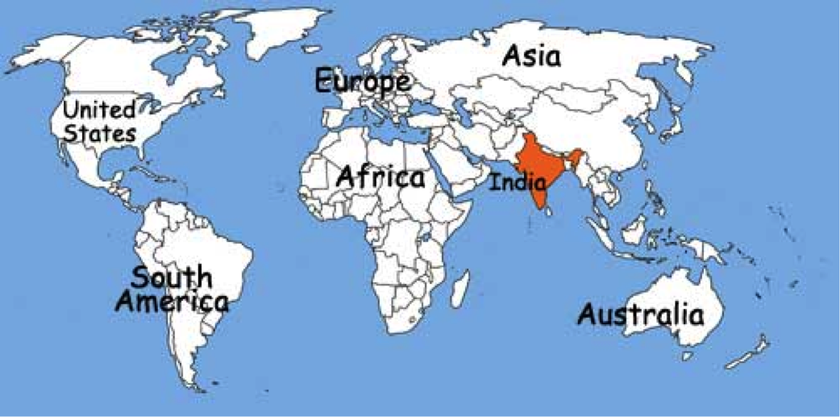
World Map View

Slide 8
Indus River Valley

Slide 9
Origins of Hinduism
Hinduism is a collection of religious beliefs that developed slowly over a long period of time
Hinduism cannot be traced back to one founder with a single set of ideas
Hindus share a common world view
Hindus see religion as a way of liberating the soul from the illusions, disappointments and mistakes of everyday existence
Hindu teachers worked to interpret the Vedas
VEDAS: sacred literature of the Aryans
UPANISHADS: collection of comments about the Vedas

Slide 10
Beliefs of Hinduism
Hindus believe that a person can achieve liberation from desires and suffering, known as moksha
MOKSHA: a state of perfect understanding of all things; enlightenment
Hindus believe that a person is reincarnated until he or she reaches moksha and that a soul’s karma follows from one reincarnation to another
A person’s karma is also believed to be connected to their darma
REINCARNATION: individual soul or spirit born again and again; rebirth
KARMA: deeds (good or bad) that follow the soul through reincarnation
DARMA: divine order and balance of things in one’s life

Slide 11
Hindu Deities
Hindus consider Brahman to be the world soul, or the creator
Often, Brahman is seen as three different gods in one:
Brahma – the creator
Vishnu – the protector
Shiva – the destroyer
Today, Hindus choose which, if any, deities they wish to follow and are free to choose between different paths to achieve moksha

Slide 12
Hinduism and Society
Hindu ideas about karma, darma and reincarnation strengthened the caste system
Beliefs of Hinduism and caste structure dominated every aspect of life

Slide 13
Judaism
Section Two

Slide 14
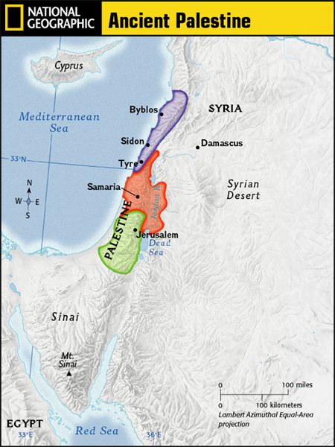
Setting the Stage
The history, legends and moral laws of the Jews have been a major influence on Western culture, and began a tradition also shared by Christianity and Islam.
Why do you think the location of Palestine is so important?
Notes:
1. By land, it connected the continents of Africa and Asia.
2. Its seaports opened onto the most important waterways, the Mediterranean Sea & Red Sea

Slide 15
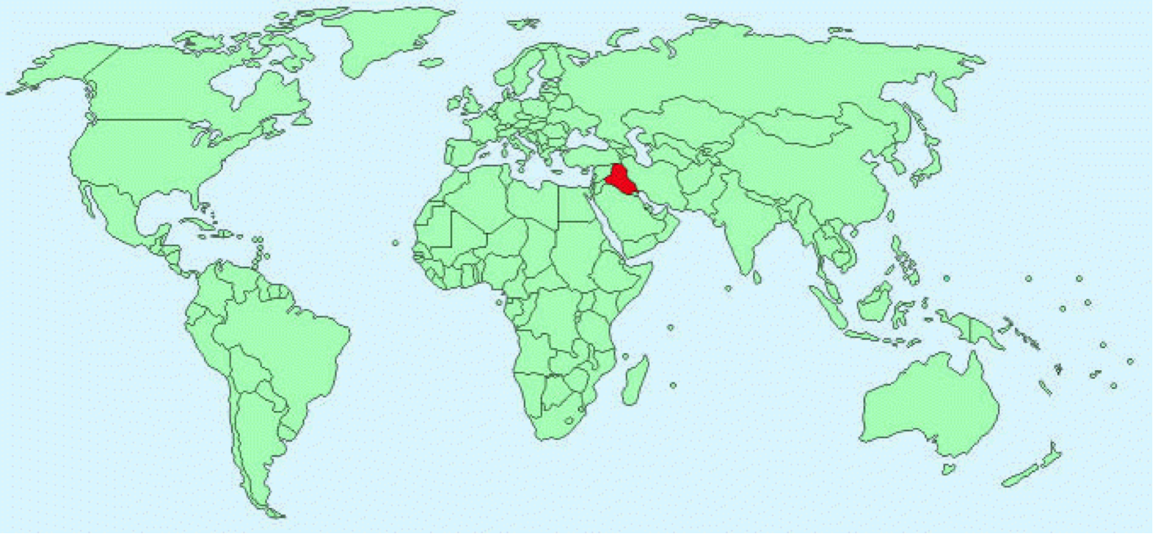
World Map View

Slide 16
City of Ur

Slide 17
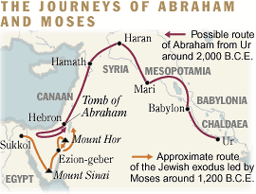
Abraham and the Jews
Abraham is known as the “father of the Hebrew people”
Abraham moved the Hebrew people to Canaan around 2000 BCE
In 1650 BCE, the Hebrew people moved to Egypt and were made into slaves
The Hebrews leaving Egypt is called the Exodus
During the Exodus, the Jews wandered for 40 years and were led back to Canaan by Moses

Slide 18
Beliefs of Judaism
Jews are monotheistic and believe that they are God’s chosen people
Ten Commandments (found in the Torah) are the basis for Jewish law and, along with other laws (also found in the Torah) guide Jewish behavior
Jews rest on the Sabbath, known as Shabbat, which runs from sundown Friday to sundown Saturday
There are 4 sects of Judaism: Reform, Reconstructionist, Conservative and Orthodox
The Jewish star is also known as the Star of David and is the symbol of Judaism
Jews worship in a synagogue

Slide 19
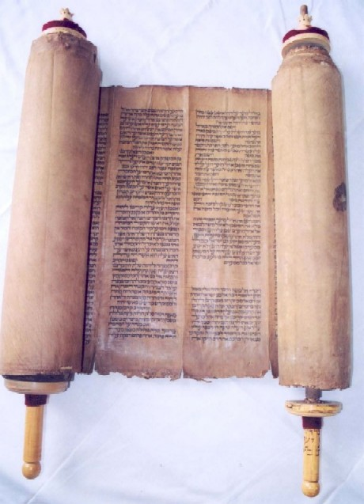
The Torah
Sacred literature in Judaism
5 Books: Genesis, Exodus, Leviticus, Numbers, Deuteronomy
Books describe events that occurred and tell stories that teach important lessons
Written in Hebrew, read from right to left
Notes:
These 5 books also make up the Old Testament of the Christian Bible

Slide 20
Buddhism
Section Three

Slide 21
Setting the Stage
By the 6th century BCE, Hinduism and the caste system had become a way of life in India. For Hindus, the only way to gain salvation was by obeying caste rules and following complex rituals performed by Brahmin priests. These rules and rituals, however, did not meet the needs of the common people. As a result, some Hindus began to listen to the message of a rising religious teacher.

Slide 22
World Map View

Slide 23
Buddhism Spread Through Asia

Slide 24
Siddharta Gautama
New religion was called Buddhism
Founded by Siddharta Gautama
SIDDHARTA GAUTAMA: Indian prince born in 563 BC; later known as Buddha

Slide 25
Buddha’s Teachings
Four Noble Truths:
Sorrow and suffering are part of life
People suffer because they constantly try to get things they can’t have
The way to escape suffering is to overcome these desires and reach a state of “not wanting”
To reach nirvana people should follow a “middle way”
NIRVANA: state of enlightenment
MIDDLE WAY: having neither too much nor too little pleasure

Slide 26
Challenge to Hinduism
Many of Buddha’s teachings stemmed from Hinduism
Three main differences exist between Buddhism and Hinduism:
Buddhism placed more importance on how one lived than on one’s caste;
Buddhists did not find value in Brahmins’ complex rituals; and,
Buddhists do believe in reincarnation, but that it is not necessary for becoming pure.

Slide 27
Growth of Buddhism
Buddha and followers traveled doing missionary work
Monasteries became centers of teaching and learning
THERAVADA BUDDHISM: Buddhists who remained close to original teachings
MAHAYANA BUDDHISM: Buddhists who developed a complex religion with temples, saints and statues of the Buddha
Mahayana Buddhism spread into China, Japan and Korea
Theravada Buddhism spread into Sri Lanka, Burma and Southeast Asia

Slide 28
Christianity
Section Four

Slide 29
Setting the Stage
Christianity was created in 31 CE in Jerusalem. The ultimate goal of Christianity is to enter the eternal kingdom of heaven after death. Christianity became popular quickly because it appealed to a wide base of people as Christianity taught that God accepts all people – men, women, poor, rich, etc.

Slide 30
World Map View

Slide 31
Jerusalem

Slide 32
Life of Jesus Christ
Jesus was born to the Virgin Mary, and this miracle made Jesus both human and divine
Jesus was a carpenter and student of the writings of Jewish prophets
At the age of 30, he began to travel and preach and gained a group of disciples
DISCIPLES: followers
Notes:
Roman histories say little about Jesus and early christians
What we know comes from the 1st 4 books of the new testament

Slide 33
Teachings of Jesus Christ
Jesus traveled to Jerusalem and was hailed as the “King of Jews”
Romans feared Jesus would lead an uprising
Tried before Pontius Pilate and sentenced to crucifixion
Notes:
It is said that Pontius did not personally believe that Jesus should be killed, but ordered the crucifixion reluctantly
Pilate's reluctance to execute Jesus in the gospels has been seen as reflecting the authors' agenda.It has thus been argued that gospel accounts place the blame on the Jews, not on Rome, in line with the authors' alleged goal of making peace with the Roman Empire and vilifying the Jews

Slide 34
Spread of Christianity
According to the gospels, Jesus arose from the dead 3 days after his crucifixion, stayed on earth for 40 more days and then ascended to heaven. Christians believe that the resurrection and ascension prove that Jesus is the messiah. The resurrection is the central event of Christianity. The disciples set out to spread this message and Christianity slowly spread.
Notes:
Christ the Redeemer: This statue of Jesus stands some 38 meters tall, atop the Corcovado mountain overlooking Rio de Janeiro. Designed by Brazilian Heitor da Silva Costa and created by French sculptor Paul Landowski, it is one of the world’s best-known monuments. The statue took five years to construct and was inaugurated on October 12, 1931. It has become a symbol of the city and of the warmth of the Brazilian people, who receive visitors with open arms.

Slide 35
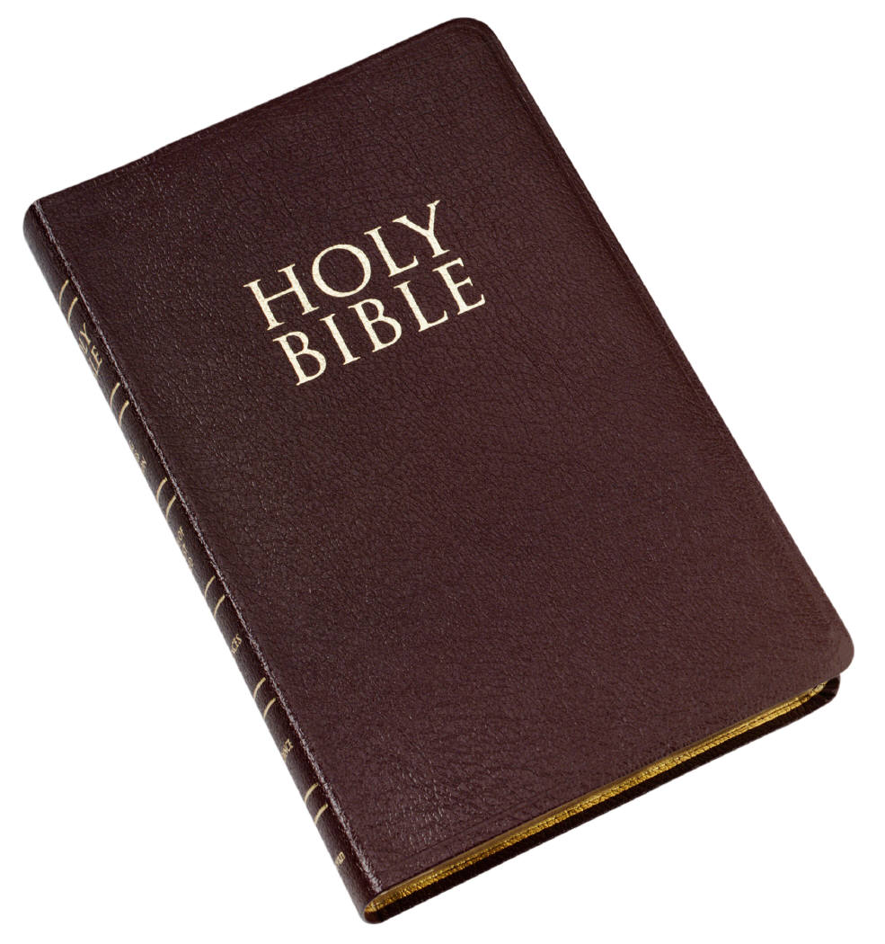
The Bible
Sacred literature in Christianity
Made up of the Old Testament (same as Judaism) and the New Testament (starts with the birth of Jesus)

Slide 36
Organization of the Church
Priests conducted services, baptisms and marriages
Bishops headed the Church in each city
Over time the Bishop of Rome took the title of Pope
DOCTRINE OF THE TRINITY: central belief in the existence of three persons in one God – Father, Son and Holy Spirit
Notes:
Empire Cities: rome, constantinople, alexandria, antioch and jerusalem
In 325 AD, Council at Nicaea proclaimed the Doctrine of the Trinity

