Slide 1
The Muslim world
Unit Four

Slide 2
The Muslim world: Overview
“As Muslim empires expanded, they blended, advanced, and spread the accomplishments of diverse civilizations.”
Our study of the Muslim world will closely examine the prophet Muhammad and the rise of Islam, the path that Islam took as it spread throughout the Middle East, Northern Africa and Europe, and the golden age of Muslim Civilization that lasted from 750 to 1350. Finally, we will conclude our study of the Muslim world with a look at the Muslim world today. This unit will be broken down into the following three sections:
Rise of Islam
Islam Spreads
Golden Age of Muslim Civilization

Slide 3
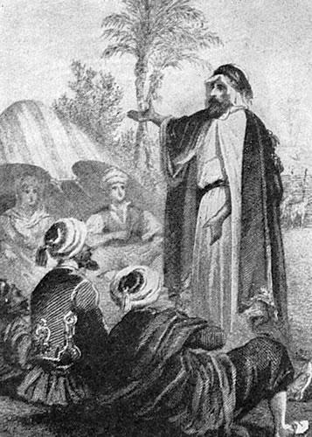
The muslim world: what is islam?
Around 600 AD, a new monotheistic religion began called Islam
The faith was founded by the prophet Muhammad
His followers, called Muslims, spread Islam throughout the Middle East, Africa, Asia, & Europe

Slide 4
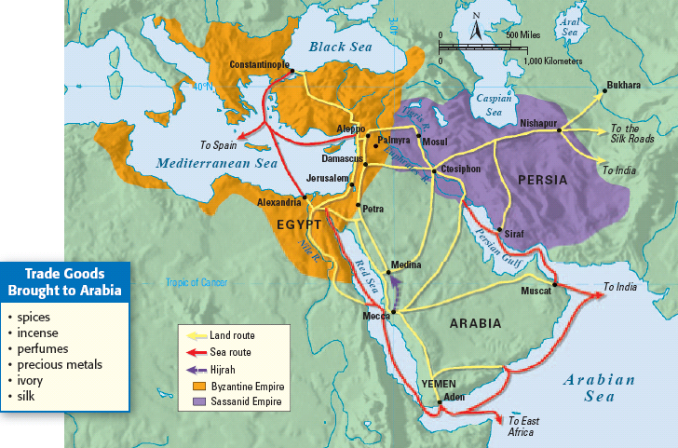
THE MUSLIM WORLD: BEFORE MUHAMMAD

Slide 5
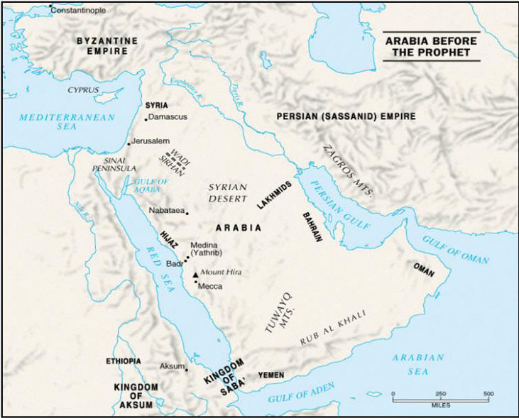
THE MUSLIM WORLD: ARABIA
The Arabian Peninsula is a desert region with little fertile soil or farming
Most Arabs lived in desert tribes which were centered around families & were ruled by clans
Arabia was not united under a single gov’t, but Arabs did have a common language (Arabic)
Most Arabs were polytheistic

Slide 6
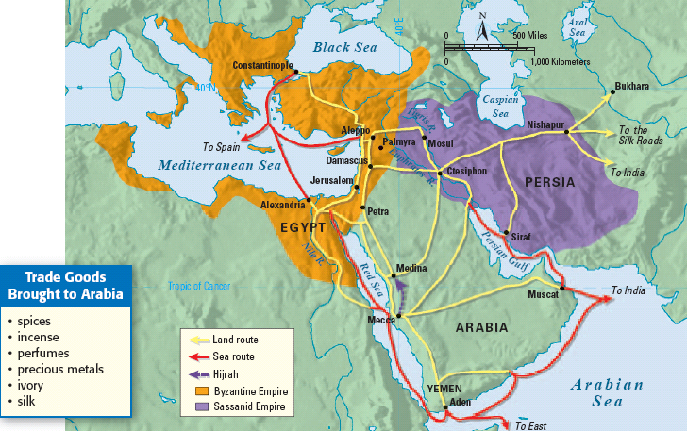
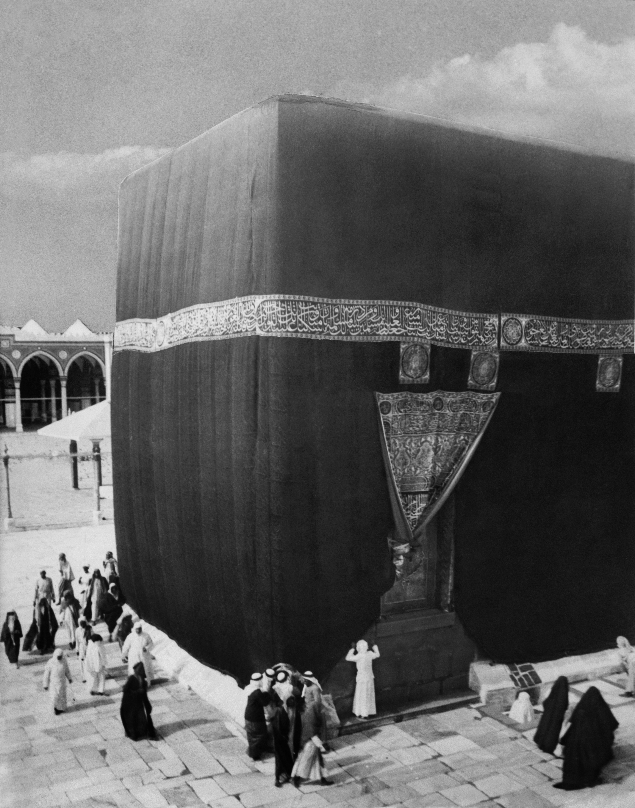
THE MUSLIM WORLD: ARABIA
One of the wealthiest trade cities in Arabia was Mecca
Mecca was also a religious city; Arabs made pilgrimages to Mecca to visit the Ka’aba
The Ka’aba was a cube that held statues of hundreds of gods
Notes:
Arabia was the intersection of 3 continents (Africa, Asia, & Europe) so it was an important region for trade & had lots of cultural diffusion

Slide 7
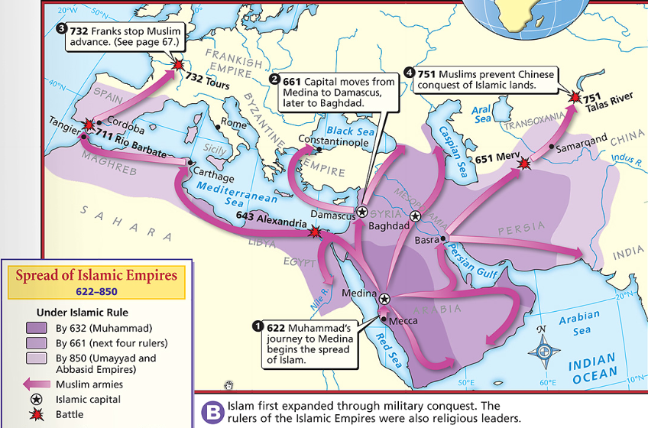
THE MUSLIM WORLD: GEOGRAPHY
The Islamic Empire connected diverse people through religion & trade
Muslim scholars focused on learning & developed numerous cultural achievements that are still used today

Slide 8
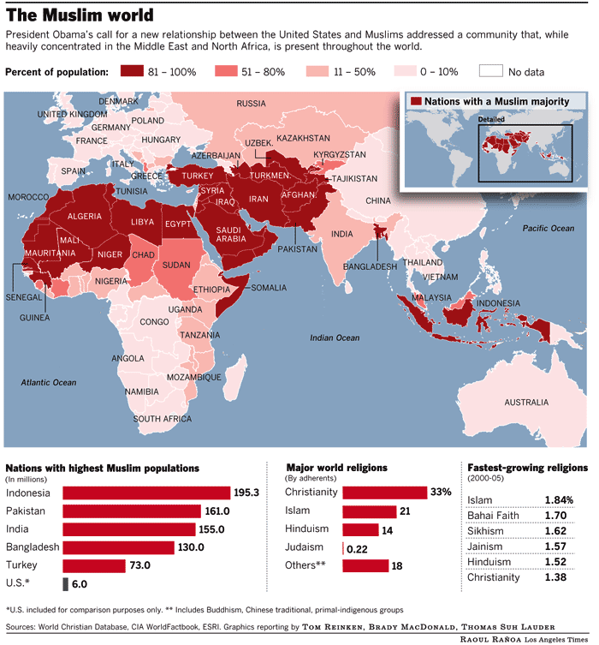
The muslim world: geography TODAY
Today, the Muslim community has spread throughout the world, with a strong majority settled throughout the Middle East and North Africa, parts of South East Asia.

Slide 9
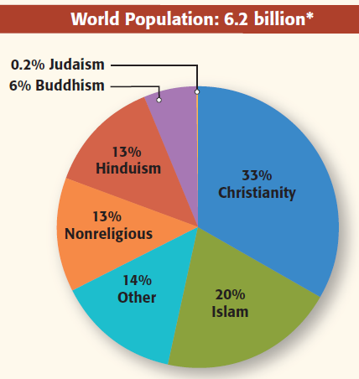
the muslim world: STATISTICS
Today, Islam is the world’s fastest growing religion with more than 1 billion followers throughout the world

Slide 10
Rise of islam
Section One

Slide 11
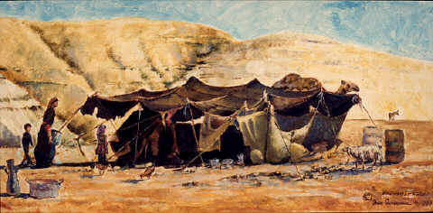
Life in the arabian peninsula
Before Islam came to the Arabian Peninsula, many clans occupied the region
BEDOUINS: nomadic herders
Bedouins adapted to desert conditions
Bedouins traded with other Arab settlers and helped support the Arab economy
Notes:
Bedouins have a strong tradition of hospitality and generosity

Slide 12
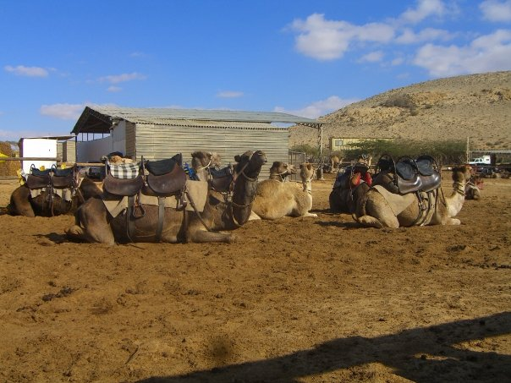
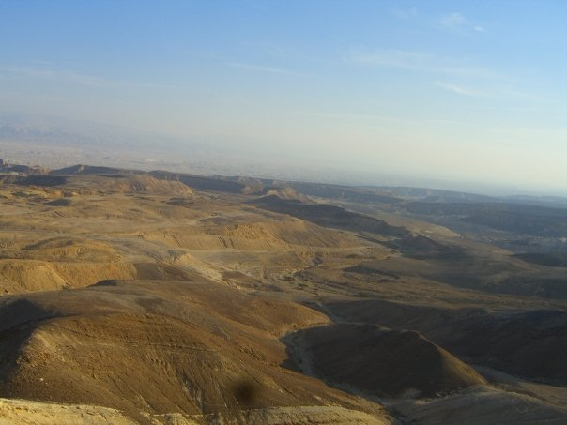
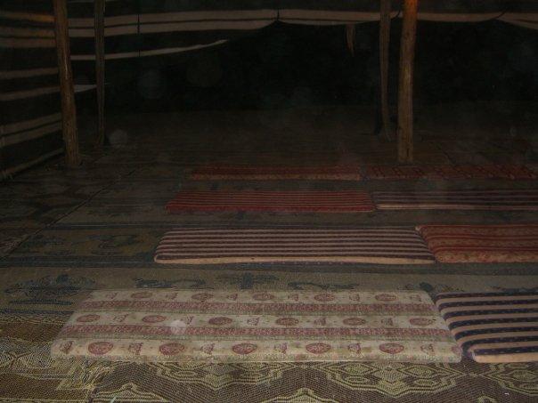
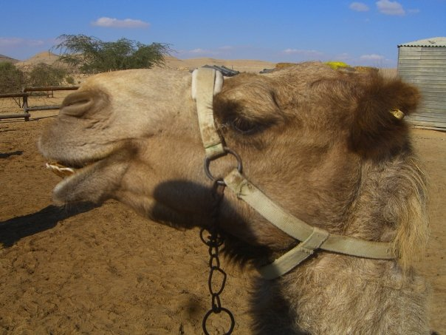
Bedouins in israel

Slide 13
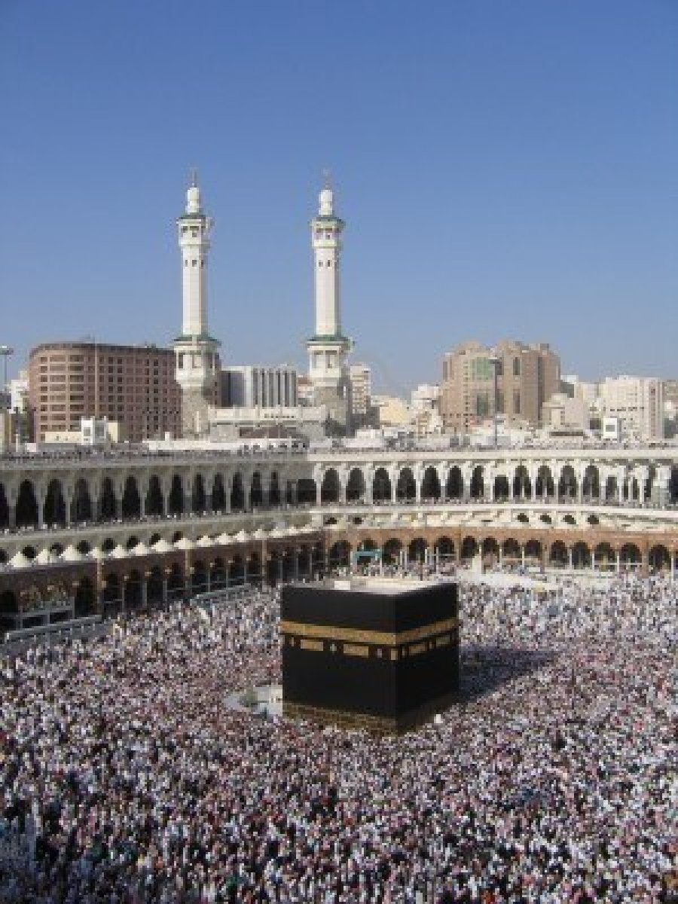
Mecca and ka’aba
Mecca was a bustling market town at the cross of 2 main caravan routes
Mecca was known for silks and spices
Also known as a thriving pilgrimage center
Arabs often prayed at Ka’aba, an ancient shrine in Mecca

Slide 14
Who was muhammad?
Muhammad was born in Mecca in 570 into a poor clan, orphaned at a young age, and raised by his uncle
Muhammad became an honest and successful merchant
At 25, he married a wealthy widow, Khadija, & started a family

Slide 15
Muhammad and islam
In 610, Muhammad heard the voice of the angel Gabriel, who told him that he was a prophet sent to Earth by God
Khadija encouraged him to accept the call to God
Muhammad began preaching a new faith called Islam
ISLAM: “surrender to God”
Notes:
After much soul-searching, Muhammad came to believe that the Lord who spoke to him through Gabriel was Allah. Muhammad became convinced that he was the last of the prophets. He began to teach that Allah was the one and only God and that all other gods must be abandoned. People who agreed to this basic principle of Islam were called Muslims. In Arabic, Islam (ihs•LAHM) means “submission to the will of Allah.” Muslim (MOOZ•lim) means “one who has submitted.” Muhammad’s wife, Khadijah, and several close friends and relatives were his first followers.

Slide 16
Muhammad and islam
At first, Muhammad angered many people by preaching his new religion. In 622, he left Mecca with his followers to the city of Yathrib, a journey that is known as the HIJRA.
Hijra was the turning point for Islam
Yathrib is now known as Medina, or “City of the Prophet”
622 is the 1st year of the Muslim calendar
In 630, Muhammad returned to Mecca
Muhammad died in 632, sending his followers into grief
Abu Bakr was elected to be the first caliph
CALIPH: successor to Muhammad
Notes:
In 630, Muhammad returned to Mecca and destroyed the idols in Ka’aba
– Muhammad’s reputation grew and many Arabs converted

Slide 17
The message of islam
Islam is based on strict monotheism
MONOTHEISM: belief in only one God
Islam believes in one all powerful and compassionate God, known as Allah
All Muslims accept 5 basic duties, known as the 5 Pillars of Islam: 1. Declaration of Faith, 2. Daily Prayer, 3. Giving Charity to the Poor, 4. Fasting from Sunrise to Sunset during Ramadan, and 5. Pilgrimage to Mecca.
Notes:
Qur’an teaches about God AND provides a guide to life
Converts typically learn Arabic to read the Qur’an in its original form

Slide 18
FIRST PILLAR: SHAHADAH
A creed that declares the belief in the oneness of God and acceptance of Muhammad
“There is no God, but God, and Muhammad is the messenger of God.”

Slide 19
SECOND PILLAR: SALAH
Declares the importance of daily prayer and is the practice of formal worship in Islam
Muslims face the holy city of Mecca to pray
Muslims may pray anywhere, but often do so in Mosques

Slide 20
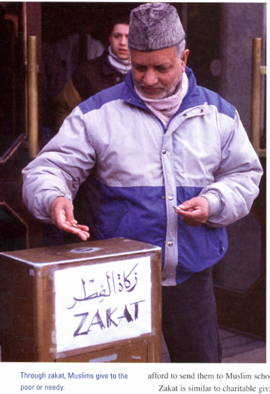
THIRD PILLAR: ZAKAH
The practice of charitable giving
Considered a personal responsibility for Muslims to ease the economic hardship for others and to eliminate inequality

Slide 21
FOURTH PILLAR: SAWM (OR SAYIM)
To abstain from eating and drinking during daylight hours
The observance of Sawm during the holy month of Ramadan is the fourth pillar of Islam
RAMADAN: ninth month of the Islamic calendar; observed as a month of fasting

Slide 22
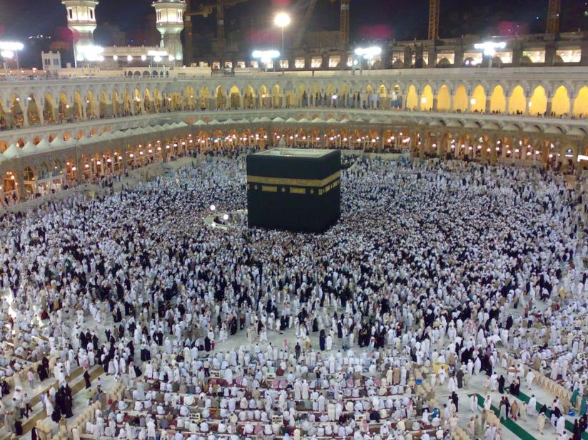
FIFTH PILLAR: HAJJ
The pilgrimage that every Muslim is expected to make to Mecca, and to the Ka’aba, at least once in his or her lifetime

Slide 23
The message of islam: the qur’an
QUR’AN (or Koran): sacred text of Islam
Contains the sacred word of God as revealed to Muhammad & is the final authority on all matters
Islam teaches responsibility for all actions, and believes in a hell and a paradise

Slide 24
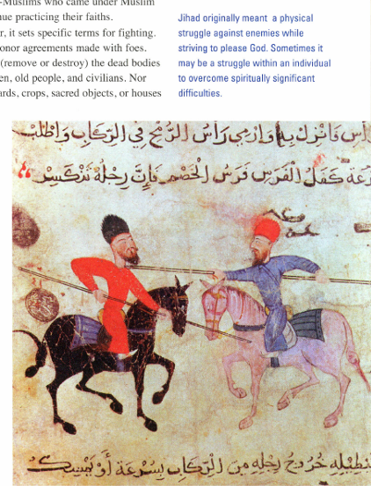
Message of islam: JIHAD
JIHAD: effort in God’s service
Often wrongly translated as “holy war” but it includes acts of charity, the inner struggle to achieve spiritual peace or any battle in defense of Islam

Slide 25
MESSAGE OF ISLAM: Sharia
SHARIA: Islamic system of law
Does not separate religious matters from criminal or civil ones
Through Sharia, Islam became both a religion and a way of life

Slide 26
Message of islam: people of the book
PEOPLE OF THE BOOK: Jews and Christians, as regarded by Muslims
Muslims believe that only Islam is God’s final and complete revelation
People of the Book had religious freedom in early Muslim society
Notes:
Muslims consider jews and christians to be people of the book

Slide 27
Women in early muslim society
Islam affirmed spiritual equality of women and men
As Islam spread, non-Arab attitudes were absorbed by Arabs
Arabs adopted the practice of veiling women and secluding them in the home
Women’s quarters were called harem, from the word haram
HARAM: forbidden
Notes:
Qur’an protected daughters and widows
Had to consent freely to marriage and could divorce
Muslim women had a right to an education

Slide 28
Islam spreads
Section Two

Slide 29
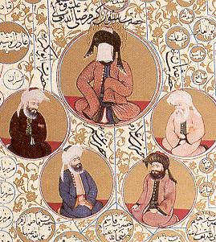
Islam After Muhammad
In 632, the Muslim community elected a new leader called a caliph
The first 4 caliphs all knew Muhammad & promised to stay true to the Qur'an & Muhammad’s message
Muhammad
& the Rightly Guided Caliphs

Slide 30
The Rightly Guided Caliphs
The first caliph was Muhammad’s friend & father-in-law, Abu Bakr
Under the rightly guided caliphs, armies had many victories
Expansion slowed 100 years later when in 732, the Arab push into Europe ended
Muslim and Christian forces fought in Spain for centuries
Notes:
Arab push ended at the Battle of Tours in France

Slide 31
Success of muslim conquests
Why did the Muslim Conquest have such success?
Weakness of the Byzantine and Persian Empires
Arabs were seen as liberators from harsh rule
Bold and efficient fighting methods were used
Common faith Muhammad had given his people
Muslim leaders imposed a tax on non-Muslims, but allowed them to continue to practice their own faith and follow their own religious laws. Non-Muslims played key roles in developing the Muslim civilization. Often, non-Muslims did convert to Islam.
Notes:
Long time rivals had fought to exhaustion
Persians and byzantine rulers were very harsh
Camel and horse cavalry with massive experience
Key reason!!!!!

Slide 32
Muslim presence in europe
Major areas of Muslim influence in Europe from 650 to 750 were in Spain and Sicily
Arabs overran Spain at the beginning of the 700s and Christians slowly fought back and reclaimed the peninsula, pushing the Muslims, who they called MOORS, to Southern Spain.
How long did the Moors stay in Southern Spain?
Until 1492.
For centuries, Spain was a cultural center of the Muslim world
Notes:
Arabs seized control of Sicily in the early middle ages, but Europeans soon regained the lost land – Sicily remained strongly Arabic in culture

Slide 33
Movements within islam
SUNNI MUSLIMS
SHI’ITE MUSLIMS
Believe the caliph should be chosen by leaders of the Muslim community
Agree Caliph should be a pious Muslim
Believe the caliph should be seen as a leader, not a religious authority
Believe the only true successors of the caliph are descendants of Muhammad’s daughter and son-in-law (Fatima & Ali)
Believes descendants are divinely inspired
A 3rd movement, the Sufi Muslims, has emerged.
Sufis are Muslim mystics who sought communication with God through meditation, fasting & other rituals.
Notes:
After Muhammad’s death, a division arose, and split into two main factions – sunni and shiite muslims.
Muhammad’s son-in-law Ali was the 4th caliph, but he was assassinated in 661 and his son was also later killed.
This division has survived over 1300 years and today, approx. 90% of Muslims are Sunni.

Slide 34
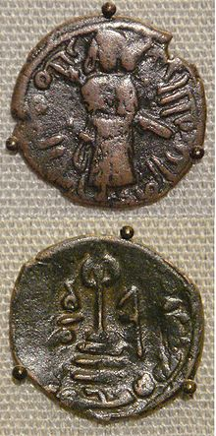
Arab empire: 661 – 750
The Umayyad Family was the first to set up dynasty rule in the Arab Empire, which lasted from 661 to 750 AD. The Umayyad’s faced 4 main problems:
Trouble adapting from desert life to ruling areas
Economic tensions increased
Resistance from Shiite Muslims
Unrest among non-Arab converts to Islam
In 750, the Abbassids captured Damascus and established the Abbassid Dynasty, which lasted until 1258.
Notes:
Umayyads defeated Ali and killed his son – Shiite Muslims were very upset by this
When the Abbassids took over, Abu al-Abbas invited all of the members of the defeated Umayyad family to a banquet and murdered them all.
Image: Coin of the Umayyad Caliphate, based on a Sassanian prototype, copper falus, Aleppo,Syria, circa 695 CE.

Slide 35
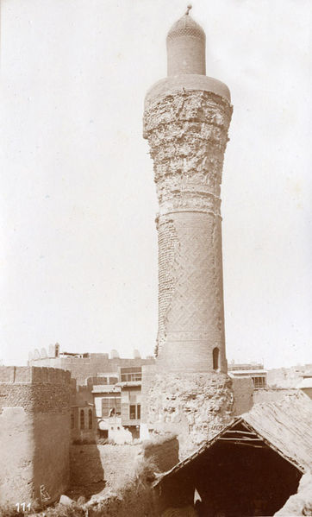
Abbassid dynasty
Abbassid Dynasty helped make Islam a universal religion
Known as the “Islamic Golden Age”
Capital moved to Baghdad and called the “City of Peace”
Baghdad was filled with domes and minarets
MINARETS: slender towers on mosques
From 786-809, the caliph, Harun al-Rashid, ruled the large empire
Notes:
Harun is seen as a model ruler and symbol of wealth & splendor

Slide 36
Decline of the caliphate
In 850, Abbassid control over the empire ended as other dynasties set up rule over separate Muslim states. Civil wars erupted, caliph power faded, and Shiite rulers took over parts of the empire. Between 900 and 1400, invasions by 3 groups added to the chaos:
Seljuks: Turks who migrated to the Middle East in the 900s and by 1055 controlled Baghdad with the Abbassid caliph as a figurehead
Crusaders: in 1099 Christian crusaders captured Jerusalem and for 200 years rule passed back and forth
Mongols: in 1216, Genghis Khan led the Mongols across Persia & Mesopotamia and in 1258, the Mongols killed the last Abbassid caliph, officially ending the Abbassid Dynasty
By the end of the 1200s, the Arab Empire had fragmented and fallen. The empire crumbled, but Islam continued.
Notes:
Crusades: Muslim general Saladin ousted Christians in 1187 but after his death they regained it and held it til 1244
Mongols: later adopted Islam

Slide 37
Golden age of muslim civilization
Section Three

Slide 38
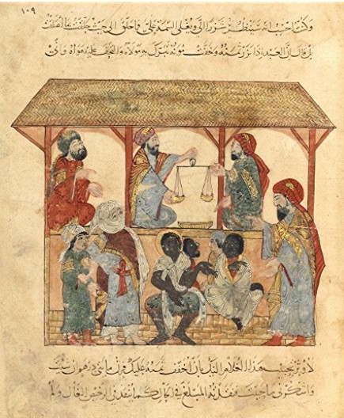
slavery in the muslim world
Slavery was common in cities
Slaves were brought from conquered lands but Muslims were not enslaved
Most slaves worked as household servants
Islamic law encouraged freeing of slaves and many slaves bought their freedom, often with charitable donations or state funds
Notes:
If non-Muslim slaves converted, did not automatically become free, but their children did
Image: 13th century slave trade market
- Not all house slaves, some were artisans and some were slave-soldiers

Slide 39
Merchants in the muslim world
Merchants were honored in the Muslim world
From 750 to 1350, merchants built a vast trading network
Trade spread products and technology
Muslims set up partnerships, bought and sold on credit and formed banks to change currency
Handicraft manufacturing was led by guilds
Notes:
Merchants were honored partly because Muhammad was a merchant
Goods made by guilds incl: steel swords, leather goods, cotton textiles, carpets, fine glassware, furniture and tapestry.

Slide 40
Agriculture in the muslim world
Agriculture flourished outside of cities
Farmers cultivated sugar cane, cotton and dyes
Arid regions were divided into 2 types of land: the desert and the sown
Abbassids organized massive irrigation projects and drained swamplands
Notes:
Farmers also cultivated more typical garden things – fruits, vegetables and flowers.
Deserts continued to support independent nomads who lived by herding – shared economic ties with farmers.

Slide 41
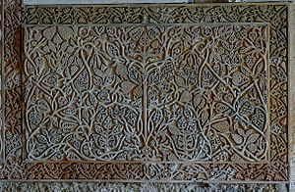
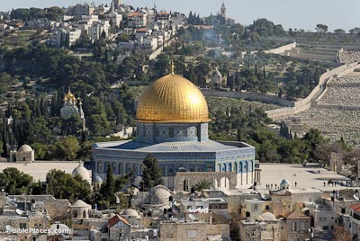
Muslim art
Religion shaped the art of the Islamic world
Artists were forbidden to portray God or human figures in religious art
ARABESQUE: intricate design composed of curved lines that suggest floral shapes
Artists were highly skilled in caligraphy
Architects adapted domes and arches for new uses
Notes:
Arabesque appeared in rugs, textiles and glassware
Dome of the Rock located in the old city in Jerusalem – houses the Foundation Stone which has strong significance for Muslims (possible site where Gabriel spoke to Muhammad), Christians and Jews (possible site where Abraham was going to sacrifice Isaac)

Slide 42
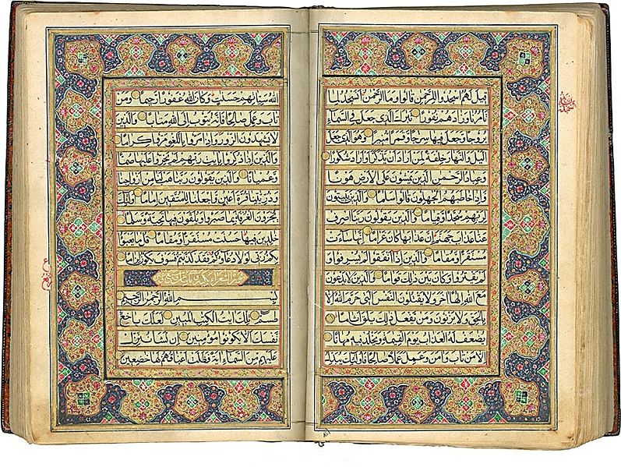
Muslim literature
Traditionally, Muslims valued oral poetry, but later poets developed formal rules for writing poetry
Two best known poets are Firdawsi and Omar Khayyam
Storytelling is also a large part of Muslim literature
Best known story is The Thousand and One Tales

Slide 43
The world of learning
Baghdad was Muslim center of learning
Ibn Rushd, the famous philosopher, put all knowledge to the test of reason
Greatest Muslim mathematician was al-Khwarizmi (aka Aricenna) whose work pioneered study of algebra
Muslim astronomers paved the way for later explorers
Notes:
Also translated Hindu and Buddhist texts
Known as aricenna in europe
Paved the way for christopher columbus

Slide 44
Masters of medicine
Muhammad al-Razi is the most respected doctor from the golden age
Remarkable advances in medicine and public health were made
CANON ON MEDICINE: huge encyclopedia on diagnosis and treatment, written by Ibn Sina
Europeans learned from the Arabs
Notes:
Published works from al-Razi and Sina became standard medical texts at European school
Advances in medicine and public health: the development of hospitals, set up of emergency rooms, surgery to treat for cataracts, and testing for doctors and pharmacists

