Slide 1
The Middle Ages
Unit VIII

Slide 2
Middle Ages Overview
Introduction & Dark Ages
Feudalism in Europe
Age of Chivalry
Power of the Church
Development of England
The Hundred Years’ War and the Plague

Slide 3
Introduction & Dark Ages
Section One

Slide 4
Medieval Times
Dark Ages
Middle Ages
410 AD to 1066 AD
AKA the early middle ages
Rise of barbarians
Between 400 and 700 AD, Monasteries became centers of education
Romanesque Architecture Style
1066 AD to 1453 AD
Marked by the Crusades, Feudalism and the Plague
Lasting Political Ideals – the Magna Carta and Parliament
Gothic Architecture Style

Slide 5
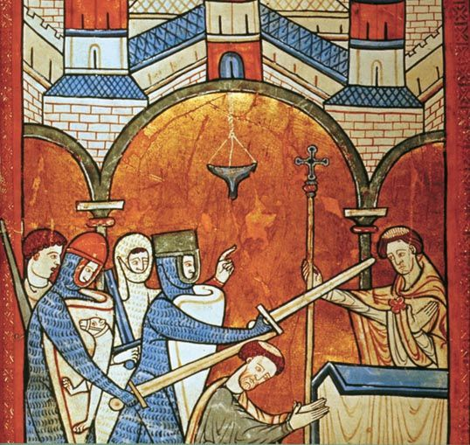
Expanding Influence of the Church
The Christian Church became an important political, economic, spiritual and cultural force in Europe.
Leading officials were Pope and Patriarch
Heresy was banned
Conversion by force
Great Schism occurs in 1054
Notes:
Christian Church has become an important political, economic, spiritual and cultural force in Europe
Leading officials of Church were the bishops of Rome (Pope) and Constantinople (Patriarch)
As influence grew, laws were passed to forced people to become Christians and banned heresy (holding beliefs that contradict the official religion)
Fines were given against heretics, then harsher penalties and even death
Eventually, conversion by force
Eventually in 11th Century, Church split into two independent branches Eastern Orthodox (Greek) based in Constantinople and Roman Catholic in Rome

Slide 6
European Empire Evolves
After the Roman Empire dissolved, small kingdoms developed across Europe
Franks controlled the largest and strongest kingdom in the former Roman province of Gaul
The Franks’ first Christian king was Clovis
By the time Clovis died, he had extended rule over what is now France

Slide 7
Carolingians
Rise of Charles Mantel began about 200 years after the death of Clovis
Mantel began church reforms
Pepin the Short continued reforms and established the Carolingian Dynasty
CAROLINGIAN DYNASTY: dynasty formed to protect the papacy & establish that the pope and bishops make kings
When Pepin died, left his two sons in power
After his brother’s death, Charlemagne quickly seized control of the entire kingdom
Notes:
Charles Mantel – aristocrat who dominated the Frankish kingdom in the 8th c.
Franks were a confederation of Germanic tribes first attested in the 3rd century AD as occupying land on the lower and middle rhine
The Rhine flows from the Southeastern Swiss Alps to the North Sea Coast in the Netherlands (12th longest river in Europe)

Slide 8
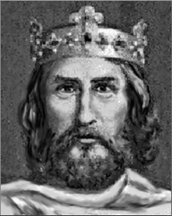
Charlemagne and The Holy Roman Empire
Named Holy Roman Emperor by Pope Leo III in 800 AD on Christmas Day
First ruler of the HRE
Imposed order throughout the Church and the state
Ordered standardization throughout the empire
Notes:
HRE would last over 700 years

Slide 9
Charlemagne as Emperor
Charlemagne being crowned by the pope showed that church and state were combined – Pope had religious and political power
After Charlemagne, feudalism became important
He was accorded sainthood in the 12th century
His reign was marked by revival of arts and education in Europe
The Carolingian Dynasty declined after his death in the early 800s

Slide 10
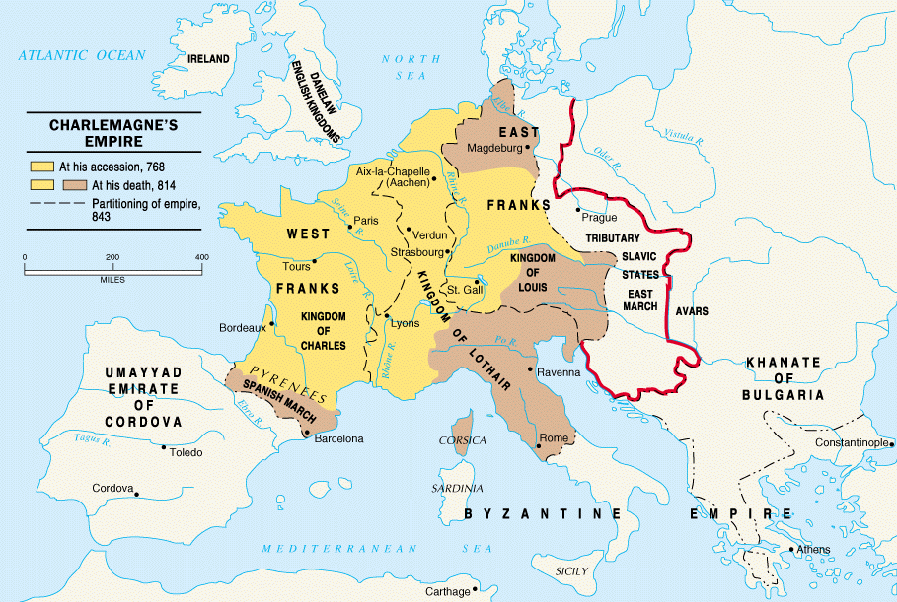
Charlemagne’s Empire

Slide 11
Feudalism in Europe
Section Two

Slide 12
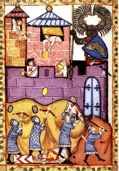
England in the Dark Ages
For centuries, invaders landed on English shores
Alfred the Great and his successors united England – called it “land of the Angles”
ANGLES: a tribe that had invaded England
In 1042, King Edward the Confessor took the throne
Edward died in January 1066 without an heir
A great struggle for the throne began and led to one last invasion

Slide 13
Norman Conquest
The invader was William the Conqueror, from Normandy
NORMANDY: region in France
As King Edward’s cousin, William claimed the English crown and invaded England with his Norman army
William’s rival was Harold Godwinson, the Anglo-Saxon claiming the throne
In October 1066, the Normans and Saxons fought the battle that changed the course of English history – the Battle of Hastings
Harold was killed by an arrow in his eye and the Normans won a decisive victory
After his victory, William declared all land his personal property and laid the foundation for centralized government

Slide 14
Invasions in Western Europe
Between 800 and 1000, the Carolingian Dynasty was destroyed by invaders
From the north were the most dreaded attackers of all – the vikings
Vikings set sail from Scandinavia
Also known as Northmen or Norsemen
The Vikings worshipped warlike gods and took pride in nicknames

Slide 15
Viking Raids
Raids were carried out at a high speed
Warriors with helmets, swords and heavy shields would strike quickly in towns and then leave as fast as they could
Viking warships were large – some holding over 300 warriors
The prow of each ship swept upwards, often ending with the carved head of a sea monster
The ships allowed the vikings to navigate the fjords, and loot inland villages and monasteries
FJORD: a long, narrow, deep inlet of the sea

Slide 16
Vikings as Traders
Vikings were also traders, farmers and explorers
Vikings ventured far beyond western Europe, as far as Russia and North America
One explorer, Leif Ericson, reached North America long before Columbus
Around 1000, fear of the Vikings began to fade in Europe
Vikings gradually accepted Christianity, and stopped raiding monasteries
Also, warming trends in Europe’s climate allowed for better farming in Scandinavia, prompting fewer men to adopt the sea life of Viking warriors

Slide 17
Feudalism Structures Society
Around 900 AD, feudalism emerged in Europe
Feudal system based on rights and obligations
In exchange for military protection, a lord granted land to a vassal
LORD: landowner
FIEF: land given by a lord to a vassal
VASSAL: person receiving a fief

Slide 18
European Feudal Pyramid

Slide 19
Well-Defined Social Classes
Status determined prestige and power
Social class was inherited
Vast majority of people were peasants
Most peasants were serfs
SERFS: people who could not lawfully leave the place where they were born
Serfs were not slaves – lords could not sell or buy them

Slide 20
Manorialism
MANOR: lord’s estate
Manor system was based on economic arrangement
Vassal provided serfs with housing, farmland and protection
Serfs tended the land and maintained the estate
Peasant women shared in farm work
All peasants – serf or not – owed a lord certain duties

Slide 21
Self-Contained World
Lords kept some land for their own use but the rest was farmed by peasants and serfs
The Lord controlled everything that happened on his land
Peasants rarely traveled from their own manor
15 to 30 families lived in the village on a manor
Fields, pastures and woodlands surrounded the village
Manor was largely self-sufficient

Slide 22
Harshness of Manor Life
Peasants paid high taxes to the lord to live
Also paid taxes to the village priest
TITHE: church tax
Serfs lived in crowded cottages and had a simple diet
Life for serfs was work, and more work
Average life expectancy was 35 years
Serfs accepted their life as part of the Church’s teachings

Slide 23
Age of Chivalry
Section Three

Slide 24
Warriors on Horseback
Soldiers mounted on horseback were valuable in combat
Used leather saddles and stirrups to stabilize riding
Feudal lords raised private armies of knights to defend their territories
Knights received fiefs
Wealth from fiefs allowed knights to pay for weapons and armor

Slide 25
Code of Chivalry
CHIVALRY: code of the knights; a complex set of ideals
The ideal knight was loyal, brave and courteous
Sons of nobles began training for knighthood at an early age
Young knights gained experience in fighting local wars or at tournaments
TOURNAMENT: chivalrous competition or mock battle

Slide 26
Literature of Chivalry
Themes of medieval literature did not show the brutality of knighthood and feudal warfare
Instead, it glorified knighthood and chivalry
Epic poems recounting a hero’s deeds and adventures were popular
TROUBADOURS: traveling poet-musicians at the castles and courts of Europe

Slide 27
Women’s Role in Feudal Society
Feudal society accepted that women were inferior to men
Noblewomen had some power, but generally their lives were limited
Peasant women performed endless labor at home and in the fields
Females in peasant families were poor and powerless
Female economic contribution was key for survival

Slide 28
Power of the Church
Section Four

Slide 29
Setting the Stage
Amid the weak central governments in feudal Europe, the Church emerged as a powerful institution. It shaped the lives of people from all social classes. As the Church expanded its political role, strong rulers began to question the pope’s authority. Dramatic power struggles unfolded in the Holy Roman Empire, the scene of mounting tensions between popes and emperors.

Slide 30
Far-Reaching Authority
The Church and the monarchs in Europe competed for power
The Church had its own power structure that was based on status
The Church acted as a place of stability during a turbulent time
The authority of the Church was both religious AND political

Slide 31
Age of Faith
Influenced by the religious devotion and reverence for God shown by new monasteries, the pope began to reform the Church.
Reformers were distressed by 3 main issues: 1. Priests Marrying; 2. Simony; and, 3. Bishop Appointment
SIMONY: practice of selling Church positions
In the early 1200s, friars traveled to spread Church ideas
Francis of Assisi founded the Franciscan order of friars

Slide 32
Cathedrals – Cities of God
Romanesque Style
Gothic Style
Built between 800 and 1000
Round arches and thick walls and pillars
Tiny windows
Came to be in the 1100s
Were built with pointed roofs, as if reaching toward heaven
Stained glass
Meant to inspire

Slide 33
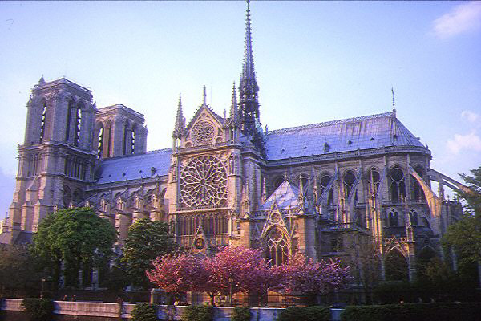
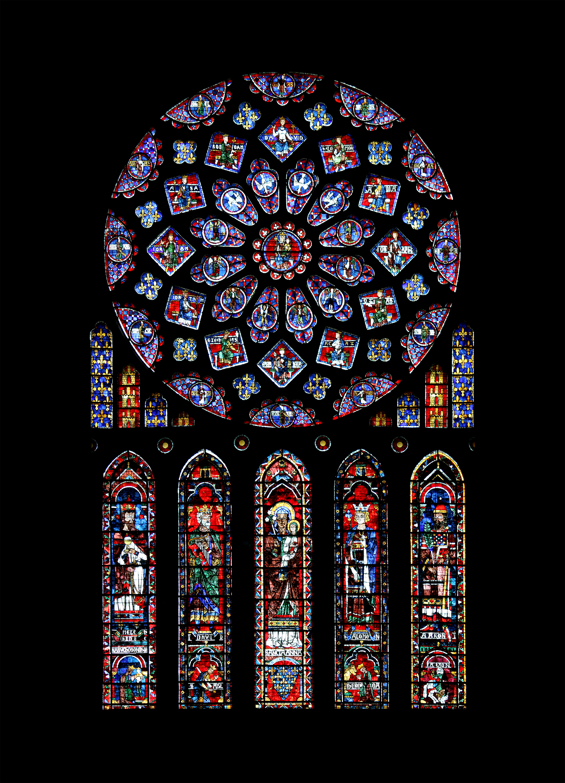
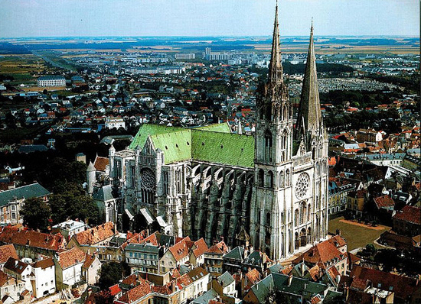

Slide 34
The Crusades
Age of Faith inspired wars of conquest
In 1095, the Byzantine Emperor contacted Pope Urban II about a military threat against Constantinople and Muslim control of Jerusalem
Then, Pope Urban II called for a crusade against the Muslim Turks
CRUSADE: holy war
Notes:
Crusades had economic, social and political goals

Slide 35
The Crusaders
Tens of thousands of peasants, nobles and clergy responded to Pope Urban II’s call for war
In the spring and summer of 1096, armies of Crusaders departed from Western Europe for Constantinople

Slide 36
First and Second Crusades
Between 1096 and 1099, Crusader armies made their way to Jerusalem
First Crusade had no strategy or leadership
On July 17, 1099, Crusaders captured Jerusalem after a long and costly seige
A city to the north, Edessa, fell to Muslims in 1144
Second Crusade was organized to recapture Edessa
Lost Edessa and Jerusalem to Saladin
Notes:
Some historians estimate loss of 100,000

Slide 38
Perspectives of the Crusaders
Christian Perspective
Muslim Perspective
Christians believed they were fighting in the name of Jesus to take back to the place of his birth from the infidels
INFIDEL: a person who follows a religion other than one’s own
Muslims believed they were defending land that was theirs
From their perspective, Christians were the invaders

Slide 39
Overview of the Other Crusades
All together there were 9 major crusades
The religious spirit of the first crusades faded
A Children’s Crusade took place in 1212, when thousands of children set out to conquer Jerusalem
Children’s Crusade was not successful
Muslims in Spain (Moors) were driven out in the reconquista
RECONQUISTA: long term effort by Spanish to drive Muslims out of Spain

Slide 40
Effects of the Crusades
The effects of the Crusades on the people who fought them were widespread, and often devastating. These are the 6 major effects of the Crusades:
Thousands left their homes and traveled
Women had a chance to manage affairs at home
European merchants expanded trade routes
Failure of later crusades lessened power of the pope
Crusades weakened feudal nobility
For Muslims, intolerance and prejudice left behind a legacy of bitterness and hatred

Slide 41
Development of England
Section Five

Slide 42
England’s Evolving Government
King Henry II added to his land by marrying Eleanor of Aquitaine from France
Henry II ruled from 1154 to 1189
Henry strengthened royal courts of justice – introduced use of the jury
Rulings of England’s royal judges formed a body of law
COMMON LAW: the unified body of law formed by rulings of the royal judges

Slide 43
Magna Carta
Henry was succeeded by Richard the Lionhearted in 1189
Richard was later succeeded by his younger brother, John
King John ruled from 1199 to 1216
King John was not an effective ruler – and raised taxes to an extreme
On June 15, 1215, nobles forced John to sign the Magna Carta
MAGNA CARTA: document that guaranteed certain basic political and legal rights

Slide 44
The Model Parliament
King Edward I needed to raise money for a war
In 1295, he called four citizens (2 nobles and 2 knights) from each town to serve in parliament
PARLIAMENT: legislative group
Now known as the “Model Parliament” because it served as a model (example) for later kings
As time went on, Parliament – like the Magna Carta – provided a check on royal power

Slide 45
The Hundred Years’ War and the Plague
Section Six

Slide 46
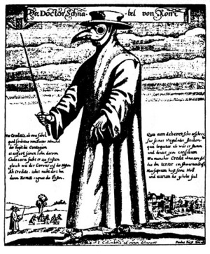
Start of the Bubonic Plague
During the 1300s, epidemic struck parts of Asia, North Africa and Europe
Approximately 1/3rd of the European population died
The plague ripped apart society
It began in Asia and traveled trade routes through fleas on rats, infecting much of the world

Slide 47
Impact and Effects of the Plague
Also known as the Black Death
Got its name because it produced purplish or black spots on the skin
Took about 4 years to reach every corner of Europe
Plague returned but never as severely as the first outbreak
Affected every area of life
Town population fell, trade declined, and the Church suffered

Slide 48
Hundred Years’ War
France and England battled for over a century
Launched by England’s King Edward III in an attempt to gain the French throne
War fought on and off from 1337 to 1453
French eventually pushed out the English
Brought change to the style of warfare
Longbow proved to be very successful in battle

Slide 49
Impact of Hundred Years’ War
Both the French and British experienced major changes:
Feelings of nationalism emerged;
Power and prestige of French monarch increased
English suffered period of internal turmoil (civil war) known as the War of the Roses
The end of the war is considered the end of the middle ages

