Slide 1
Early Americas
Mayan, Aztec and Inca

Slide 2
Mayan Empire
Section One

Slide 3
The Olmec Civilization
First urban civilization in Mesoamerica
Developed first writing system in the Americas
Traded with others from far away
Civilization ended around 400 BC

Slide 4
The Mayan Empire
Developed around 1000 BC
Grew to more than 40 cities of up to 50,000 people each
Spread throughout the Yucatan Peninsula
Traded goods to different areas of Mesoamerica

Slide 5
Mayan Cities
Built large pyramids, temples, and palaces
Canals built to control the flow of water through cities
Large plazas used for public events
Hillsides turned into flat terraces so crops could be grown close to cities
Battled against each other to gain power

Slide 6
Mayan Society
Divided into lower and upper class
Upper class included kings, priests, warriors, and merchants
Lower class included all others
Slaves held the lowest position in society

Slide 7
Mayan Religion
Worshipped many gods
Most important god was Itzamna
People believed they had to please the gods by offering human blood
Believed that Gods had attempted to create humans 3 times: 1st Mud, 2nd Wood, 3rd Maize

Slide 8
Mayan Achievements
Art and architectural achievements (Mayan Cities)
Built cities using metal tools
Built observatories to study the stars
Developed the calendar and number systems
Also developed a writing system similar to Egyptian hieroglyphics

Slide 9
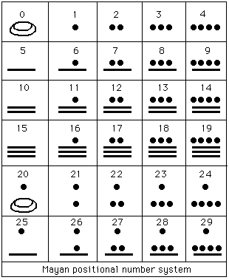
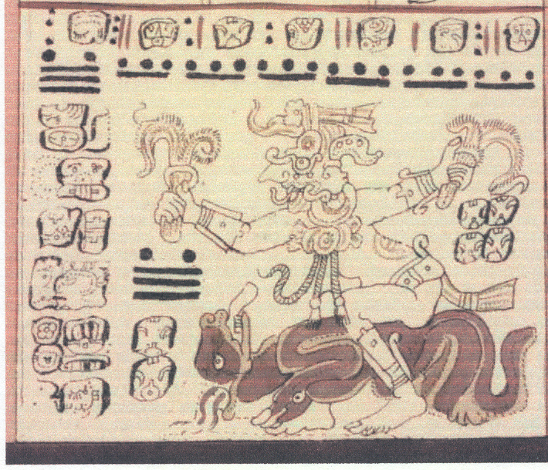
Mayan Math

Slide 10
End of the Mayan Empire
Began to collapse around 900 AD
Cause of the collapse is unknown
The three main theories of why the Mayan Empire declined are…
Warfare may have contributed
Kings made demands of people and they may have rebelled
A long period of dry weather may have made it hard to grow crops
A mix of events probably led to the decline

Slide 11
AZTEC Empire
Section Two

Slide 12
The Aztec Empire
Ruled a large empire in central Mesoamerica
Ruled from 1100s to 1500s
Controlled huge trade network
Considered themselves the people of the sun

Slide 13
Aztec Society
People divided into social classes
Kings and nobles the most important
Priests and warriors below kings
Merchants and artisans next
Farmers and slaves the lowest

Slide 14
Aztec Achievements
Built floating gardens
CHINAMPAS: floating gardens
Studied astronomy and created a calendar
Built bridges and canals

Slide 15
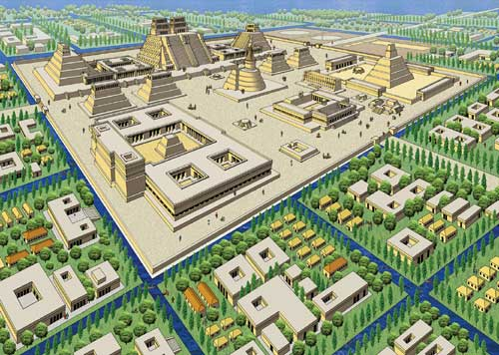
Tenochtitlan: The “Venice” of the Americas

Slide 16
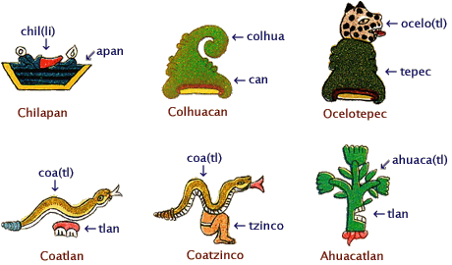
Aztec Writing
Aztec Math

Slide 17
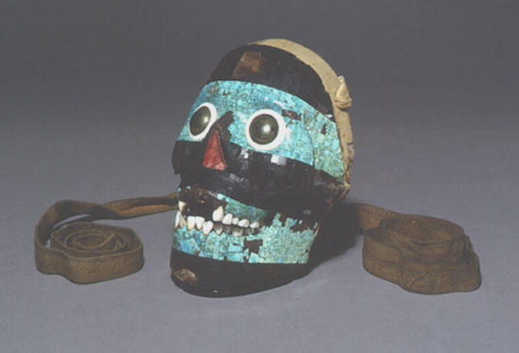
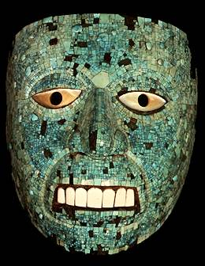
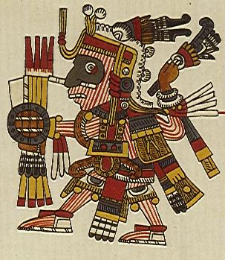
The Aztecs Were Fierce Warriors

Slide 18
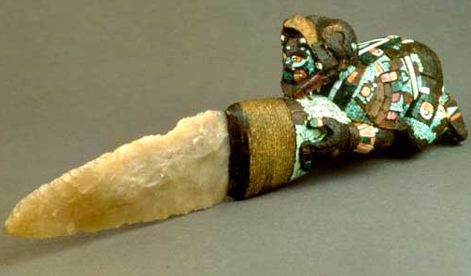
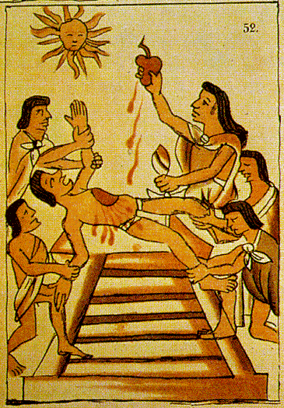
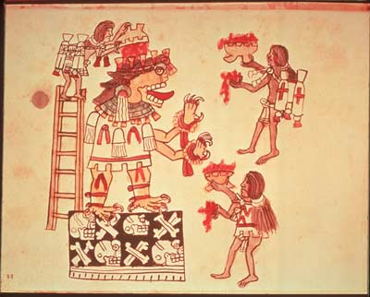
Aztecs Sacrifice Neighboring Tribes to the Sun God

Slide 19
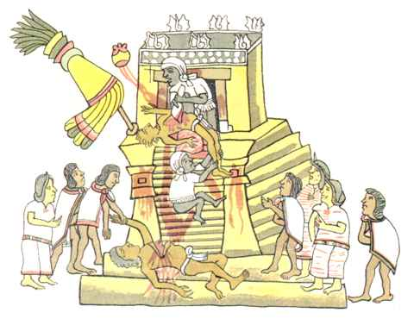
Heart Sacrifice on an Aztec Temple Pyramid

Slide 20
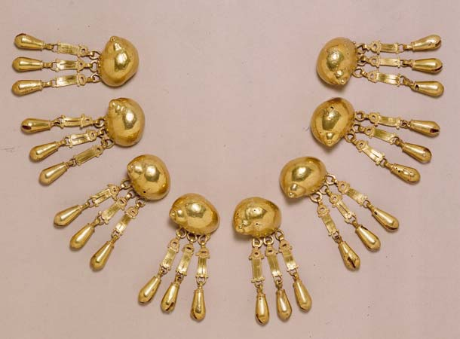
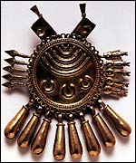
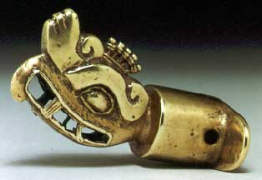
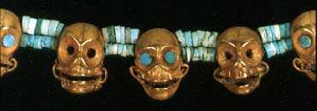
Aztec Gold

Slide 21
End of the Aztec Empire
Spanish explorer Hernan Cortes arrived in Mexico in 1519
Aztec emperor Montezuma II thought Cortes was a god but Cortes took him as a prisoner
The Aztecs became angry and drove the Spanish out
Cortez came back in 1521 and conquered the Aztecs

Slide 22
Inca Empire
Section Three

Slide 23
The Inca Empire
Began as a small tribe in the Andes Mountains in South America
By the 1500s it stretched from Ecuador to Chile and totaled 12 million people
Government was centralized and controlled many aspects of life
Called their empire the Four Quarters of the World

Slide 24
The Inca – “People of the Sun”
No writing system – but highly organized
No wheel – but built advanced network of roads, tunnels and bridges
Runners carried messages and food
Expert builders who knew how to construct earthquake resistant structures

Slide 25
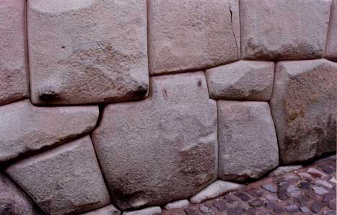
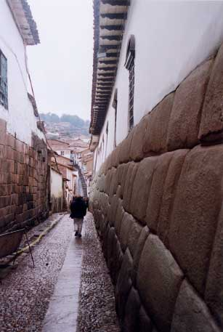
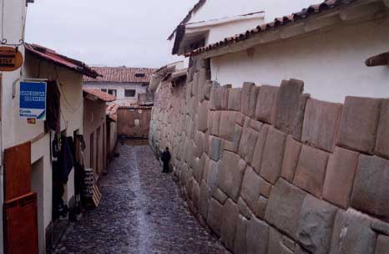
Cuzco: Ancient Capital of the Inca (11,000 ft. above sea level)

Slide 26
Cuzco – “The Bellybutton” of the Empire
Central Cuzco was given the shape of a crouching puma, a symbol of strength and power. Only royalty or the highest nobility were allowed to live in this area. At the puma’s head, the immense fortress of Sacsahuaman was built into the steep-sided hill that overlooked Cuzco.

Slide 27
Inca Society
Most Incans were farmers
Government officials gave people goods through the labor tax system

Slide 28
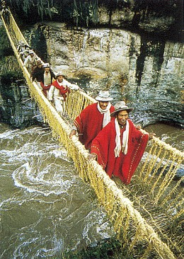
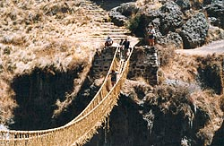
Inca Suspension Bridges

Slide 29
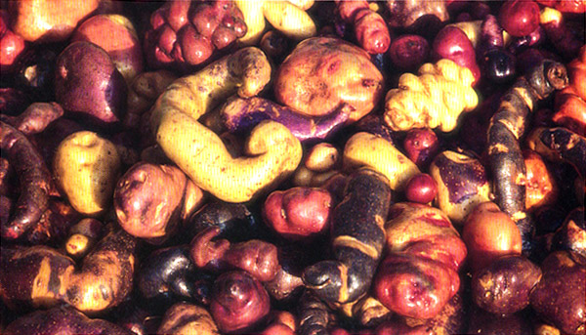
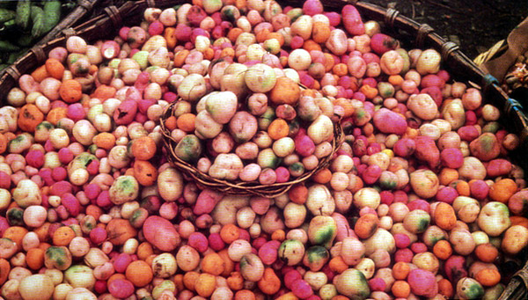
Over 100
Different
Types of
Potatoes
Cultivated
by the Incas

Slide 30
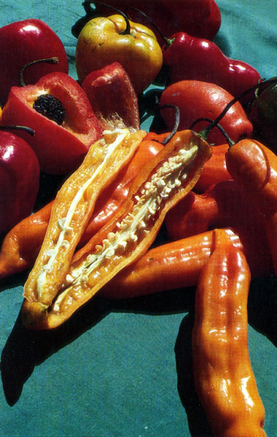
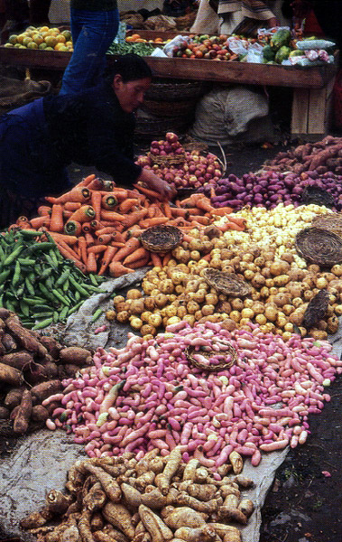
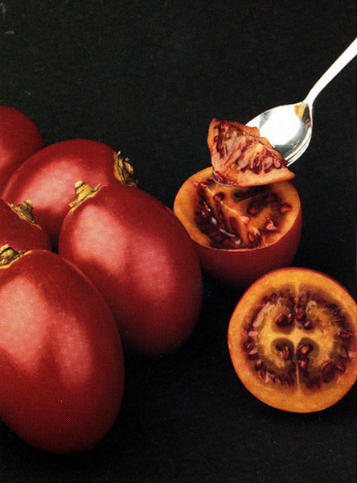
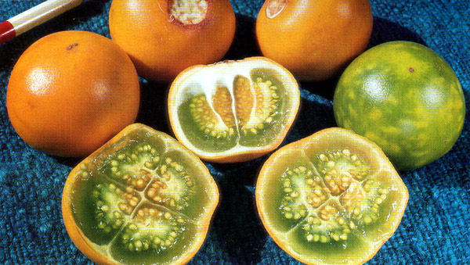
Produce From a Typical Inca Market

Slide 31
Machu Picchu
Machu Picchu means “old peak” and is situated on a mountain
It has giant walls, terraces and ramps, and it is in the middle of the tropical forest
It is still one of the greatest archaeological sites to this day

Slide 32
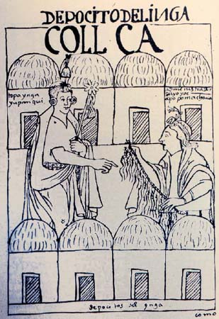
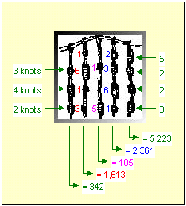
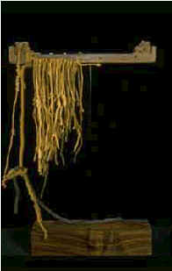
The Quipu: An Incan Database

Slide 33
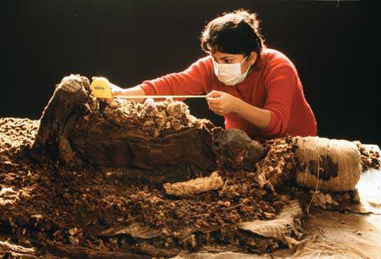
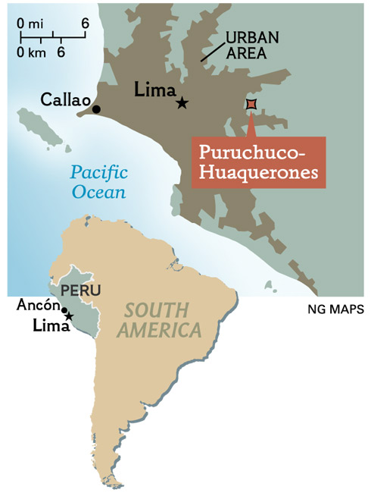
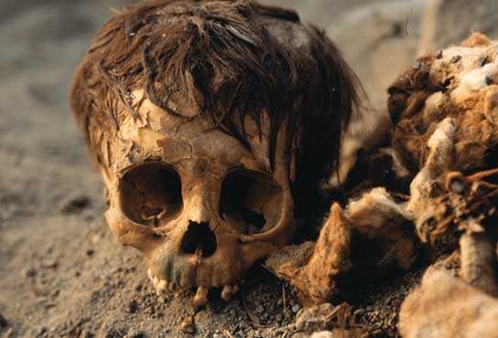
Incan Mummies

Slide 34
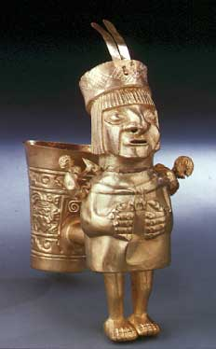
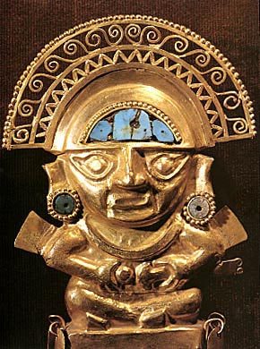
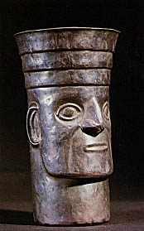
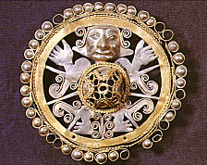
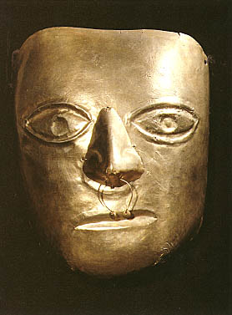
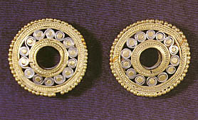
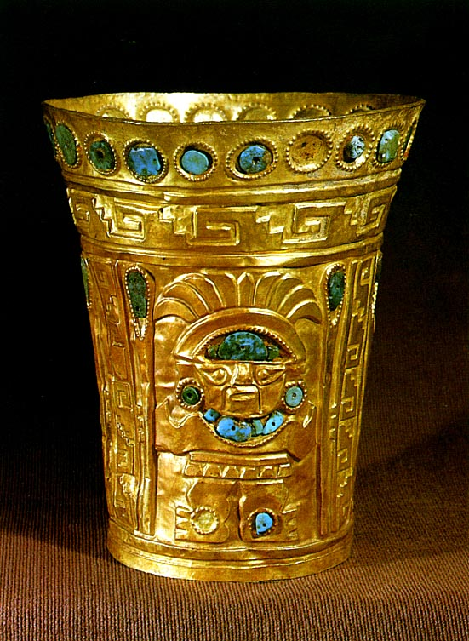
Inca Gold and Silver

Slide 35
End of the Inca Empire
Spaniards came to Peru in 1530, led by Francisco Pizarro
When the Incas would not convert to Christianity, the Spanish attacked
Spanish defeated the Incans in 1537 and took control of the area

Slide 36
Similarities in Falls of Inca and Aztec Empires
Both empires had internal problems before the Spanish arrived
The leaders of both empires were captured by the Spanish
The Spanish had an advantage with horses and with guns
Disease weakened and killed many native people

