Slide 1
China
Unit V

Slide 2
Our study of China will take us through 2000 years of Chinese history, as we explore different dynasties and the legacies that they left behind. We will study these in the following sections:
An Empire Unifies China
Two Great Dynasties in China
The Mongol Conquests
Empire of the Great Khan
China Rejects European Outreach

Slide 3
An Empire unifies china
Section One

Slide 4
Philosophy and Social Order
China’s ancient values of social order, harmony and respect for authority were put aside at the end of the Zhou Dynasty. To restore these values, Chinese scholars and philosophers developed different solutions.
CONFUCIUS: China’s most influential scholar, born in 551 BC
Confucius stressed the importance of respect for parents and elders

Slide 5
Confucius’ 5 Basic Relationships
Believed society should be organized into 5 basic relationships regulated by code of conduct
Ruler and Subject
Father and Son
Husband and Wife
Older Brother and Younger Brother
Friend and Friend

Slide 6
Confucius’ Writing
ANALECTS: book from Confucius’ students who collected his words
Laid the groundwork for bureaucracy
BUREAUCRACY: trained civil service, or those who run the government

Slide 7
Laozi and Daoism
LAOZI: philosopher who only believed that natural order was important
Said that a universal force called the Dao guides all things
DAO: the Way
Philosophy of Laozi became known as Daoism
Many of Daoism’s followers were led to pursue scientific studies

Slide 8
Other Chinese Philosophies
LEGALISTS: practical political thinkers
Believed efficient and powerful government was key to order
Founders of Legalism were Hanfeizi and Li Si
I CHING: book of oracles that answered ethical problems
Developed concept of yin and yang
YIN AND YANG: two powers together representing the natural rhythms of life

Slide 9
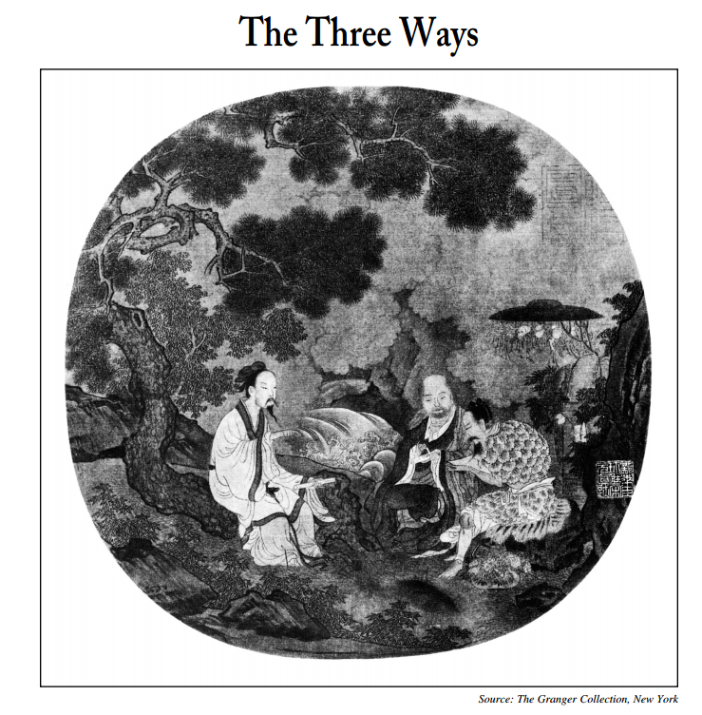

Slide 10
Qin Dynasty
Emerged in the 3rd century BC
In 221, Qin ruler took name Shi Huangdi
SHI HUANGDI: first emperor
Victories doubled China’s size
To destroy power of rival warlords, he commanded noble families to live in the capital city. He seized their land and created districts controlled by Qin officials.

Slide 11
Program of Centralization
Built a highway network of over 4,000 miles
Forced peasants to work
Instituted irrigation projects to increase farm production
Trade pushed merchants into prominence

Slide 12
Great Wall of China
Previous rulers had built small walls
Shi Huangdi worked to close the gaps and unify the wall
Rose on the backs of hundreds of thousands of peasants
Thousands died working on the wall

Slide 13
Two great dynasties in china
Section Two

Slide 14
Setting the Stage
By 202 BC, the Qin Dynasty gave way to the Han Dynasty. After almost 400 years, the Han Dynasty collapsed in 220 AD, and nomadic peoples from the northern steppe and Tibet conquered much of northern China. For 350 years, no emperor was strong enough to hold China together. More than 30 local dynasties rose and fell. By 589, an emperor named Sui Wendi had united northern and southern China once again. He restored a strong central government. Throughout the next two dynastic periods, the Tang and the Song, China experienced a golden age. It became the richest, most powerful, and most advanced country in the world.

Slide 15
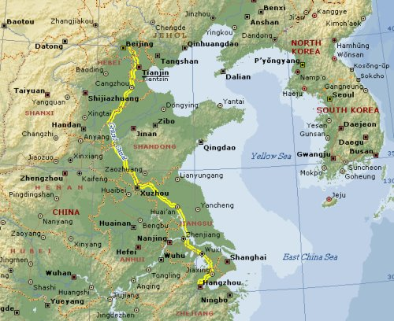
The Sui and The Grand Canal
Sui Dynasty’s greatest success was the Grand Canal
GRAND CANAL: waterway that connected the Yellow and Yangtze Rivers
Took 5 years to dig the 1,000 miles waterway

Slide 16
Tang Dynasty
Ruled for nearly 300 years
TANG TAIZONG: greatest Tang emperor
Empire expanded and lost lands reclaimed
Wu Zhao held power starting in 660 and later officially became emperor
EMPRESS WU: only woman ever to rule in China
Tang China prospered until end in 907

Slide 17
Song Dynasty Restores China
Song Dynasty began in 960
Like the Tang, lasted for about 300 years
Dynasty had military problems, but saw economic growth
By 1279, the Song Dynasty had ended

Slide 18
Era of Prosperity and Innovation
Intense growth under Tang and Song
China’s population nearly doubled
Under the Song, became most populated and advanced country in the world
Most important inventions were movable type and gunpowder
Other inventions included porcelain, mechanical clock, paper money and compass

Slide 19
Agriculture
Rapid growth resulted from advances in farming
Improved cultivation of rice

Slide 20
Trade & Foreign Contacts
Foreign trade flourished
Tang guarded the Silk Road, but later lost control
During Song rule, China developed into the greatest sea power in the world
Through trade and travel, Chinese culture spread through East Asia

Slide 21
Golden Age of Art
Tang and Song encouraged age of artistic brilliance
Tang produced great poetry, while the Song Dynasty saw new heights of beauty in painting

Slide 22
Changes in Chinese Society
A new class emerged during Tang and Song called the gentry
GENTRY: well to do, powerful upper class
Gentry got status through education and civil service positions
An urban middle class also existed
Below upper and middle classes was a working class
Peasants were at the bottom of the hierarchy

Slide 23
Women in Chinese Society
Status of women declined rapidly in Tang and Song Dynasties
Custom of foot-binding began during this time and lasted until the 20th century
FOOT-BINDING: custom of tightly binding a young girl’s feet with cloth
This eventually broke the arch and curled toes under – creating the “lily foot”
Women with bound feet were crippled for life

Slide 24
Mongol conquests
Section Three

Slide 25
Setting the Stage
While the Chinese grew prosperous during the Song Dynasty, a great people far to the north were also gaining strength. The Mongols of the Asian steppe lived their lives on the move. They prided themselves on their skill on horseback, their discipline, their ruthlessness, and their courage in battle. They also wanted the wealth and glory that would come with conquering mighty empires. Conflict between these nomadic people and settled people across Eurasia was about to explode into violence. The Mongol conquests would forever transform Asia and Europe.

Slide 26
Geography of the Steppe
STEPPE: large area of flat unforested grassland in southeastern Europe or Siberia
Western steppe spans from Central Asia to eastern Europe
Eastern steppe was the home to the Mongols
PASTORALISTS: herders of domesticated animals

Slide 28
Steppe Nomads
Nomads did not wander, but followed patterns
Traveled in clans
Nomads often came out of the steppe to invade towns
Chinese built the Great Wall to keep them out

Slide 29
Ghenghis Khan Unites the Mongols
Around 1200, a clan leader named Temujin sought unification
Defeated rivals one by one
In 1206 accepted the title “Genghis Khan”
GENGHIS KHAN: universal ruler of the Mongol clans
By 1221, central Asia was under Mongol control

Slide 30
Genghis the Conqueror
Four characteristics contributed to Ghengis Khan’s success:
Brilliant Organizer
Gifted Strategist
Adopted New Weapons and Technologies
Used cruelty as a weapon

Slide 31
Mongol Empire
Genghis Khan died in 1227
Son Ogadai became the Great Khan
By 1260, Empire divided into 4 large khanates
From 1200s to 1300s, Mongols imposed law and stability across Eurasia

Slide 32
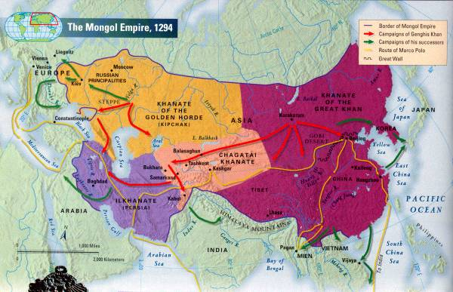

Slide 33
Empire of the great khan
Section Four

Slide 34
Setting the Stage
Kublai Khan, the grandson of Genghis Khan, assumed the title Great Khan in 1260. In theory, the Great Khan ruled the entire Mongol Empire. In reality, the empire had split into four khanates. Other descendants of Genghis ruled Central Asia, Persia and Russia as semi-independent states. The Great Khan focused on extending the power and range of his own khanate which included modern-day Mongolia, Korea, Tibet and northern China. To begin, Kublai had to fulfill the goal of his grandfather to conquer all of China.

Slide 35
Beginning a New Dynasty
Armies of Kublai Khan overcame Chinese soldiers in 1279
Kublai Khan founded the Yuan Dynasty
Lasted until 1368
Tried to conquer Japan but never succeeded

Slide 36
Importance of Yuan Era
The Yuan era was an important period in Chinese history for several reasons:
United China for the 1st time in 300 years
Control opened China to great foreign contacts and trade
Tolerated Chinese culture and left system of gov’t intact

Slide 37
Mongol Rule in China
Mongol rulers had little in common with Chinese subjects
Mongols kept separate identity
Favored foreigners over the Chinese
Encouraged foreign trade over the Silk Road

Slide 38
Marco Polo at Court
MARCO POLO: young Venetian trader who traveled by caravan on the Silk Roads
Served the Great Khan for 17 years
His stories gathered into a book called The Travels of Marco Polo

Slide 39
End of Mongol Rule
In 1368, Chinese rebels overthrew the Mongols
Rebel leader founded the Ming Dynasty
Most Mongols returned to homelands
The rise and fall of Mongols rule affected civilization from eastern Europe to China. By the end of the Yuan Dynasty, almost the entire Mongol Empire had disintegrated. Only the Golden Horde continued to rule in Russia, and would do so until Ivan III asserted Russia’s independence in 1480.

Slide 40
China Rejects European Outreach
Section Five

Slide 41
The Ming Dynasty
Hongwu was the first ruler of the Ming Dynasty (1368-1644)
Instituted reforms to restore agriculture
Worked to also restore China’s power and prosperity
Promoted Confucian moral standards

Slide 42
Chinese Exploration
Yonglo took over after Hongwu died
Launched voyages of exploration
ZHENG HE: Muslim admiral and leader of exploration
Showed Chinese superiority everywhere he went
Only 7 voyages took place, ending in 1433

Slide 43
Ming Relations with Foreigners
China withdrew into isolation
China kept from becoming industrialized for 2 main reasons:
Idea of commerce did not go with Confucian beliefs
Chinese economic policies favored agriculture
Christian missionaries came with foreign traders

Slide 44
Life in Ming China
Most Chinese families were farmers
Families favored sons over daughters
Pottery from this time period known as Ming Art
As population grew, the culture of early modern China grew with it

