Slide 1
African Civilizations
Unit Five

Slide 2
Kush and Axum Empires
Section One

Slide 3
Kushites Conquer the Nile
For centuries, Egypt dominated Nubia and the Nubian kingdom of Kush, which lasted for about a thousand years between 2000 and 1000 BC. During this time, Egyptian armies raided and even occupied Kush for a brief period. But as Egypt fell into decline, Kush began to emerge as a regional power.
Nubia lay south of Egypt on the first cataract of the Nile – where the river divided into the Blue Nile and the White Nile. The Nile served as a trade corridor for those in the area and Kush served as a trade corridor, linking Egypt and the Mediterranean to the interior of Africa and to the Red Sea.

Slide 4
Interaction of Egypt and Kush
Kush’s capital, Napata, became center for spread of Egyptian culture
With Egypt’s decline, Kush regained independence
In 751 BC, Kushite king named Piankhi united the entire northern Nile Valley

Slide 5
Kushite Golden Age
In 671 BC, after fighting with neighbors to the east, the Kushites were forced to retreat south along the Nile. There, the Kushites experienced a golden age, despite their loss of Egypt.
Kushites moved south to Meroe
Kush used natural resources to thrive
Meroe became a major center for manufacture of iron weapons and tools
After 4 centuries of prosperity, Meroe began to decline
Axum began to dominate North African trade and defeated the Kush around 350 AD

Slide 6
Kingdom of Axum
Originally located south of Kush – in the Horn of Africa
Location and expansion made it key for caravan routes
Kingdom reached its height between 325 and 360 AD, when Ezana ruled
Axum lasted for 800 years
Finally declined under Muslim invaders when Axum moved its location and became geographically isolated

Slide 7
West African Civilizations
Section Two

Slide 8
Kingdom of Ghana
GHANA: war chief
By the 700s, the kingdom of Ghana had been established
Rulers grew rich by taxing goods
Two most important trade items were gold and salt
Merchants traded goods in cities
Royal guards provided protection

Slide 9
Empire of Ghana
By 800, Ghana had become an empire
Ghana’s ruler acted as a religious leader, chief judge and military commander
Islam spread through North Africa by conquest, and south of the Sahara through trade
Ghana’s rulers eventually converted to Islam
In 1076, Berbers had taken over Ghana
BERBER: member of a Muslim group in North Africa
Ghana never regained its power

Slide 10
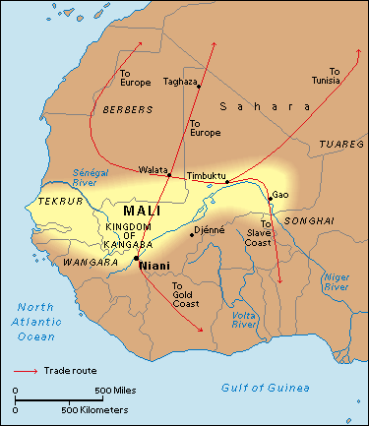
Empire of Mali
By 1235, the kingdom of Mali had emerged
Mali’s wealth was built on gold
SUNDIATA: Mali’s first great leader who came to power by crushing a cruel, unpopular ruler
Peace and prosperity existed during Sundiata’s rule

Slide 11
Mansa Musa
Ruled from 1312 to 1332
Muslim ruler of Mali
Sundiata’s grandnephew
Doubled the size of the Empire
Went on a hajj from 1324-25
Ordered new mosques built in Timbuktu
Timbuktu became one of the most important cities of the empire

Slide 12
Ibn Battuta
In 1352, Ibn Battuta visited the Empire of Mali
Traveled for 27 years, visiting most of the countries in the Islamic world
Visited Timbuktu and other cities of Mali

Slide 13
Empire of Songhai
Mali declined by the 1400s
Songhai Empire was established with Gao as the capital
Two extraordinary rulers were Sunni Ali and Askia Muhammad
Despite wealth and learning, Songhai lacked modern weapons
Empire collapsed by 1600, ending the 1,000 year period of rule by powerful kingdoms and empires in West Africa

