Slide 1
United States Since 1945
Unit One

Slide 2
1950s: Truman & Eisenhower
Section One

Slide 3
Setting the Stage
The detonation of the atomic bomb and the end of World War II led to disagreements in global policy, and a shift in American attitudes toward the Soviet Union. Shortly before the end of the war, US President Franklin Delano Roosevelt died from a stroke, and his vice president, Harry S. Truman, became president during that difficult time and oversaw the end of World War II and the start of the Cold War.
Truman was active in foreign policy in his first 5 years in office. He made the decision to drop the atomic bombs on Hiroshima and Nagasaki and he helped to found the United Nations. Truman was strongly anti-communist and suspicious of Stalin in the Soviet Union and his implementation of the Truman Doctrine and Marshall Plan, as well as his decision to enter into the Korean War, were examples of his willingness to help support anti-communist efforts.

Slide 4
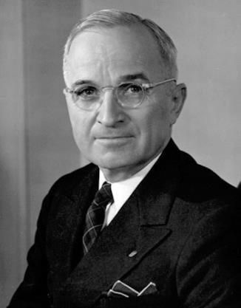
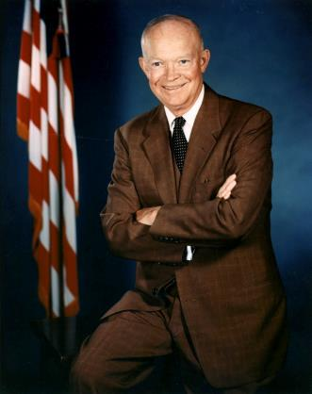
1950s: Truman and Eisenhower
Harry S. Truman
1945-1953
Dwight D. Eisenhower
1953-1961

Slide 5
Truman’s Foreign Policy
Truman took office in April 1945, just before Germany surrendered in World War II
In August 1945, Truman made the decision to drop two atomic bombs – on Hiroshima and Nagasaki
As World War II ended, the Cold War began, and the majority of Truman’s foreign policy centered around fighting communism
TRUMAN DOCTRINE: promise by Truman to help any country resisting Communism
MARSHALL PLAN: European assistance program to help rebuild
In 1950, Truman sent US troops into Korea to fight the Korean War in order to stop communism from spreading further

Slide 6
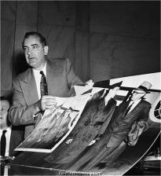
McCarthyism
In 1950, Joseph McCarthy, a senator from Wisconsin, started to play on American’s anxieties about communism
McCarthy used his power to in the Senate to investigate those whom he claimed to suspect of being communists, and his tactic of damaging reputations with vague and unfounded charges became known as McCarthyism
After 4 years, his popular support started to fade as his tactics of bullying became clearer to the American people
In late 1954, the Senate passed a vote of censure, formal disapproval, against him

Slide 7
Truman’s Domestic Policy
Truman was a democrat who faced significant opposition from a conservative Congress
Domestically, Truman worked to continue FDR’s New Deal Policies
FAIR DEAL: program set forth by Truman to provide every American a fair deal from the government
Under the Fair Deal, Congress raised the legal minimum wage to $0.75/hour, expanded Social Security and passed the National Housing Act of 1949, which provided for the construction of more than 800,000 units of low-income housing

Slide 8
Eisenhower’s Foreign Policy
By the end of 1952, many Americans were ready for a change in leadership
Dwight D. Eisenhower, the general who had organized the D-Day Invasion, became President in 1953
Eisenhower ended the Korean War
He formed a “New Look” defense policy to avoid spending too much money on costly wars in which he stockpiled nuclear weapons
He used hidden operations conducted by the CIA to fight communism in developing nations – including Iran and Guatemala
Under his leadership, Congress created NASA to coordinate research in rocket science and space exploration
NASA: National Aeronautics and Space Administration

Slide 9
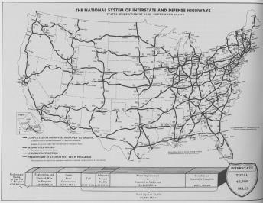
“I Like Ike!”
Eisenhower was known to be a political moderate – neither too liberal nor too conservative
DYNAMIC CONSERVATISM: balancing economic conservatism with some more liberal activism
He viewed business growth as vital to the nation and ended government price and rent controls
In some areas he took an activist role – and he passed the Federal Highway Act, the largest public works program in American history
The act appropriated $25 billion for a 10 year effort to construct more than 40,000 miles of interstate highways
Although the 1950s saw tremendous expansion of the middle class, at least 20% of Americans lived below the poverty line and was most apparent in urban centers

Slide 10
Home Life in the 1950s
The postwar economic boom brought great changes to society, including the ways many Americans worked and lived
Suburbs became increasingly popular – accounting for almost 85% of new home construction
Families started to grow larger and more married women entered the workforce
The American birthrate skyrocketed after World War II
BABY BOOM: from 1945 to 1961, more than 65 million children were born in the US

Slide 11
Culture & Technology in the 1950s
Medical breakthroughs of the 1950s included development of antibiotics and other new medicines
In the early 1950s, Jonas Salk developed an injectable polio vaccine and in 1958, Albert Sabin developed an oral vaccine
Both vaccines led the threat of polio to almost completely disappear
During the carefree and prosperous decade of the 1950s, Americans turned to television, new music and new movies to entertain themselves
By the end of the 50s, over 81% of families has a television
Americans of all ages embraced the new mass media, but some youth rebelled against the “conformist ideals” pushed by adult society
Young people found an outlet for their feelings of restlessness in music (rock ’n’ roll) and literature (the Beat movement)

Slide 12
1960s: Kennedy & Johnson
Section Two

Slide 13
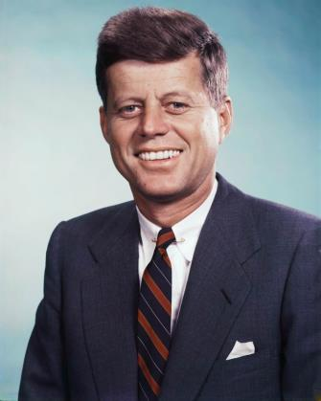
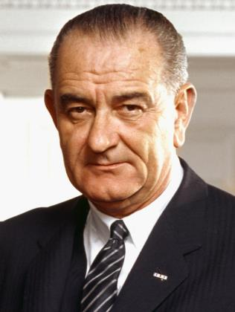
1960s: Kennedy and Johnson
John F. Kennedy
1961-1963
Lyndon B. Johnson
1963-1969

Slide 14
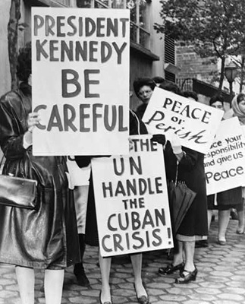
Kennedy’s Foreign Policy
President John F. Kennedy (JFK) captivated Americans like no one before him
Kennedy was the youngest elected president and he was Catholic
Under JFK, the nation’s dangerous rivalry with the USSR continued to intensify
Kennedy attempted to reduce the threat of nuclear war and to stop the spread of communism
JFK presided over the Bay of Pigs crisis, the rising of the Berlin Wall, and the Cuban Missile Crisis

Slide 15
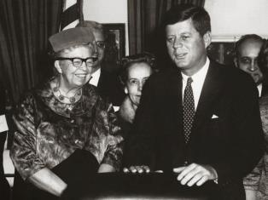
Kennedy’s Domestic Policy
Set out to implement a legislative agenda known as the New Frontier that was largely defeated by Congress who thought it was too big and too costly
He was able to improve the economy through deficit spending that increased jobs and economic growth
JFK created the Presidential Commission on the Status of Women and signed the Equal Pay Act of 1963

Slide 16
Major Decisions of the Warren Court, 1954-1967
Civil Rights
Brown v. Board of Education (1954) | Segregation in public schools unconstitutional
Baker v. Carr (1962) | Established that federal courts can hear lawsuits seeking to force state authorities to redraw electoral districts
Reynolds v. Sims (1964) | State legislative districts should be equal in population
Heart of Atlanta Motel v. US (1964) | Desegregation of public accommodations established in the Civil Rights Act of 1964 is legal
Loving v. Virginia (1967) | States may not ban interracial marriage
Due Process
Mapp v. Ohio (1961) | Unlawfully seized evidence is inadmissible at trial
Gideon v. Wainwright (1963) | Suspects are entitled to court-appointed attorney if unable to afford one on their own
Escobedo v. Illinois (1964) | Accused has the right to an attorney during questioning
Miranda v. Arizona (1967) | Police must inform subjects of their rights during the arrest process
Freedom of Religion and Freedom of Speech
Engel v. Vitale (1962) | State-mandated prayer in schools banned
Abington Sch. Dstrct. v. Schempp (1963) | State-mandated Bible readings in school banned
NY Times v. Sullivan (1964) | Celebrities may sue the media for libel only in certain circumstances

Slide 17
Assassination of JFK
On November 22, 1963, JFK and his wife Jacqueline Kennedy traveled to Texas for a series of political appearances
As the presidential motorcade rode slowly through the crowded streets of Dallas, gunfire rang out
Someone shot JFK twice – once in the throat and once in the head
Lee Harvey Oswald was arrested for the crime, but was killed by Jack Ruby two days later
A report was commissioned by Chief Justice Earl Warren, known as the Warren Commission, to investigate what had happened, but the report left many questions unanswered and theories about a conspiracy to kill JFK have persisted

Slide 18
Johnson’s Foreign Policy
Lyndon Baines Johnson’s presidency was dominated by the Vietnam War
Initially Johnson exercised caution and restraint regarding the conflict in Vietnam
On August 2, 1964, LBJ announced that North Vietnamese torpedo boats had fired on two US destroyers
LBJ did not reveal that those ships had been helping the South Vietnamese
Johnson asked Congress to authorize use of force to defend American forces
GULF OF TONKIN RESOLUTION: authorized the president to take all necessary measures to repel any armed attack against the forces of the US and to prevent further aggression in Vietnam
US involvement in the war lasted for over 8 years and led to the deaths of approximately 58,000 Americans

Slide 19
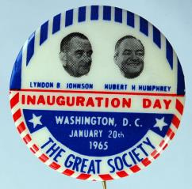
Johnson’s Domestic Policy
LBJ was a man of impressive stature who spoke directly and convincingly
By the end of 1964, he won passage of a tax cut, a major civil rights bill and a significant anti-poverty program
After wining the 1964 election, he began working with Congress to create a “Great Society”

Slide 20
The Great Society
GREAT SOCIETY: Johnson’s vision of the more perfect and equitable society the US could and should become
The Great Society focused on health and welfare, education, the war on poverty and consumer and environmental protection
Medicare and Medicaid were among the most significant programs of the Great Society
MEDICARE: established a comprehensive health insurance program for all elderly people; financed through Social Security
MEDICAID: provided health and medical assistance to low-income families; funded by federal and state governments
Project Head Start funded preschool programs and the Office of Economic Opportunity oversaw programs to improve life in inner cities
The Great Society programs touched nearly every aspect of American life and improved thousands if not millions of lives

Slide 21
Civil Rights Movement
Section Three

Slide 22
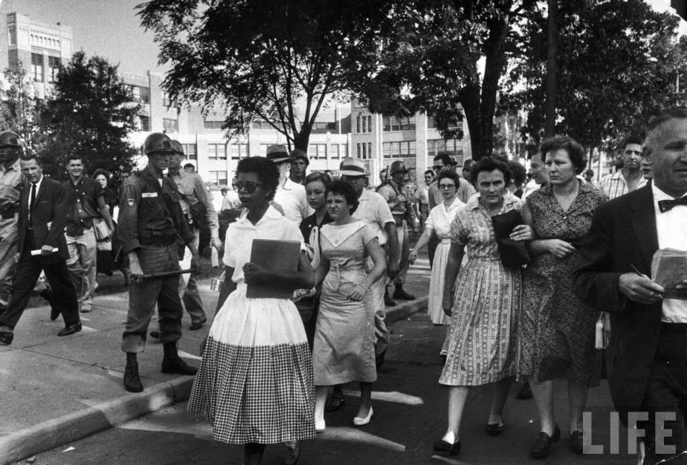
Elizabeth Eckford, Little Rock High School, Little Rock, AR, 1957

Slide 23
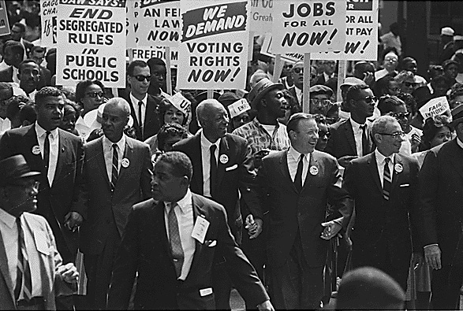
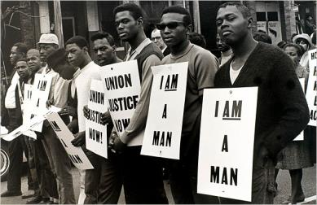
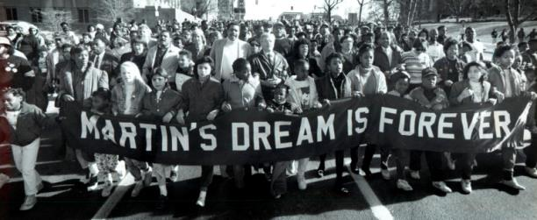
The Civil Rights Movement

Slide 24
Setting the Stage
After World War II, African Americans and other supporters of civil rights challenged segregation in the United States
Struggle against segregation and inequality was not easy
In 1896, in Plessy v. Ferguson, the Supreme Court declared segregation to be constitutional under the “separate-but-equal” doctrine
Areas without laws requiring segregation often had de facto segregation – segregation by custom and traditions

Slide 25
Key Groups in the Movement
Founded in 1909, the NAACP supported court cases intended to overturn segregations
NAACP: National Association for the Advancement of Colored People
Over the years, the NAACP achieved some key victories including keeping juries from excluding African Americans and making it illegal for state law schools to deny admission to qualified African American applicants
Founded in 1942, CORE worked to help desegregate public facilities
CORE: Congress of Racial Equality
Over the years, CORE used sit-ins to successfully integrate any public facilities including restaurants and theaters in Chicago, Detroit, Denver and Syracuse

Slide 26
Key Civil Rights Movement Vocab
FREEDOM RIDERS: name given to group of people who traveled to the South in 1961 to protest South’s refusal to integrate bus terminals
FILIBUSTER: attempt to kill a bill by having a group of senators take turns speaking continuously so that the vote cannot take place
CLOTURE: motion that ends debate and calls for an immediate vote, possible in the US Senate by a vote of 60/100
POLL TAX: tax paid in order to vote in an election
PREJUDICE: preconceived judgment or opinion, usually based on limited information
RACISM: system of advantage based on race
BLACK POWER: mobilization of the political and economic power of African Americans, especially to compel respect for their rights and improve their condition

Slide 27
1970s: Nixon, Ford & Carter
Section Four

Slide 28
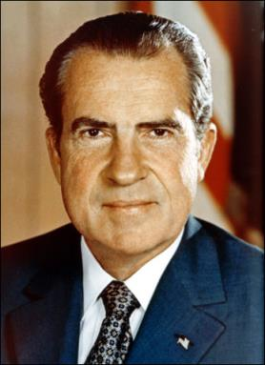
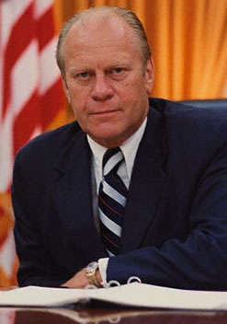
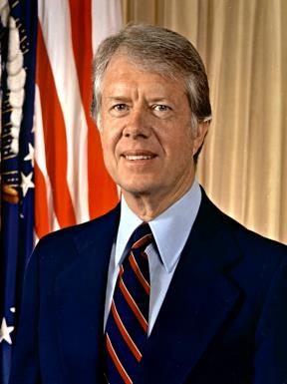
1970s: Nixon, Ford and Carter
Richard M. Nixon
1969-1974
Gerald R. Ford
1974-1977
James E. Carter
1977-1981

Slide 29
Nixon Administration
Foreign Policy
Domestic Policy
Richard Nixon sought to ease Cold War tensions abroad
HENRY KISSINGER: Nixon’s (and later Ford’s) National Security Advisor and Secretary of State who helped to shape US foreign policy
Established détente, the relaxation of tensions, between the US and USSR
Visited China in 1972
Ended the draft and US military involvement in Vietnam
Nixon sought to restore law and order and traditional values at home
NEW FEDERALISM: dismantling of federal programs with more control given to state and local governments
Oversaw a number of successes in the women’s rights movement, including Title IX (no discrimination in education) and Roe v. Wade (abortion is constitutionally protected)
Created the Environmental Protection Agency (EPA)

Slide 30
Watergate Scandal
WATERGATE SCANDAL: attempt by the Nixon administration to cover up its involvement in illegal actions during Nixon’s re-election campaign in 1972
Seeking to gain an edge in the 1972 election, Nixon’s team used a number of tactics, including spying and spreading rumors and false reports, AND stealing information
On June 17, 1972, 5 Nixon supporters broke into the Democratic National Committee (DNC) Headquarters to steal information
Nixon and White House denied involvement
Senate investigated the activities and special counsel to the President, John Dean, revealed that Nixon had played an active role
In July 1974, the Supreme Court ordered Nixon to release unedited tapings of White House conversations
On August 9, 1974, Nixon resigned before he could be officially impeached by the House of Representatives

Slide 31
Watergate Scandal

Slide 32
Ford Administration
Foreign Policy
Domestic Policy
Gerald Ford continued Nixon’s general foreign policy
Ford kept Kissinger on as Secretary of State and continued to pursue détente
Signed the Helsinki Accords to recognize borders of Eastern Europe established at end of World War II
Encountered problems in Southeast Asia when in May 1976, Cambodia seized an American cargo ship that Ford sent US marines to retrieve
Ford pardoned Nixon in September 1974, causing his approval ratings to plummet from 71% to 50%
In order to fight the worst recession since the Great Depression, Ford created a plan known as WIN
WIN: Whip Inflation Now; plan urging Americans to cut back on oil and gas consumption
Continued to work to limit federal authority

Slide 33
Carter Administration
Foreign Policy
Domestic Policy
Jimmy Carter’s foreign policy was clearly defined
Moved control of the Panama Canal to the Panamanians through 2 Panama Canal treaties
Détente collapsed under Carter as he strongly condemned the USSR for violation of human rights
In 1978, Carter helped to broker a historic Middle East peace treaty, the Camp David Accords
Unfortunately, just months after the CDA, Carter encountered a major crisis in Iran – the Iran Hostage Crisis
Carter devoted most of his domestic agenda to trying to fix the economy
He tried a number of different strategies, but ultimately none of his efforts succeeded
Carter created the Department of Energy as part of a national energy program to conserve oil and to promote the use of coal and renewable energy sources
Also created the Department of Education

Slide 34
Life in the 1970s
In the midst of widespread cynicism about their leaders and concerns about the economy, Americans sought fulfillment and escape
Women began entering the workforce in record numbers
Family life changed as the birthrate fell to an all-time low in 1976 and the divorce rate grew
TV reflected changes in society through shows like The Mary Tyler Moore Show, All in the Family and The Jeffersons
Disco music became the most popular and disco mania reached its peak in the late 1970s

Slide 35
1980s: Reagan
Section Five

Slide 36
The New Conservatism
Today, people who identify as liberal generally believe that the government should regulate the economy to protect people from power of large corporations and should play a large role in helping disadvantaged Americans, but feel that the government should not regular social behavior
Unlike liberals, conservatives today generally distrust the power of government – especially the federal government – and believes that government should not regulate the economy and generally oppose government programs that transfer wealth from the rich to those who have less, and many conservatives today believe that religious faith is vitally important in sustaining society
Conservatives gained support during the 1960s and 1970s, especially in suburban areas and in the South
By the end of the 1970s, the new conservative coalition of voters had begun to come together and for some, new conservatism’s most prominent spokesperson, Ronald Reagan, offered hope to a nation in distress

Slide 37
Reagan Administration, 1981-1989
Presidency of Ronald Reagan brought a new conservative attitude to government
Reagan was an actor and was Governor of California from 1966 to 1975
He defeated Carter in the 1980 presidential election to become the 40th President of the United States
Today, Reagan remains an icon among Republicans, tends to rank favorably in public opinion of US Presidents and his tenure constituted a realignment toward conservative policies

Slide 38
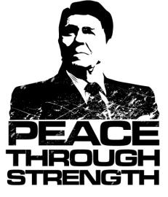
Reagan’s Foreign Policy
His presidency began with the release of the hostages from the Iran Hostage Crisis in January 1981
Proposed the Strategic Defense Initiative (SDI) that was nicknamed Star Wars and called for the development of weapons that could intercept and destroy incoming missiles
Signed the Intermediate-Range Nuclear Forces (INF) Treaty that marked the beginning of the end of the Cold War
REAGAN DOCTRINE: policy that the US should support guerrilla groups who were fighting to overthrow Communist or pro-Soviet governments
Reagan sent $570 million to Afghan rebels fighting the Soviet Union and presided over the Iran-Contra Scandal

Slide 39
Iran-Contra Affair
Political scandal in the US that occurred during Reagan’s 2nd term
Senior officials secretly organized the sale of weapons to Iran (which was the subject of an arms embargo at the time)
The goal was for Iran to release hostages and to fund the Contras in Nicaragua
The plan was that Israel would ship weapons to Iran, then the US would resupply Israel and receive the Israeli payment
Iran would then work to release US hostages and a portion of the proceeds from the sale would be diverted to fund the Contras
Information was revealed to the public in 1986 & Reagan took responsibility for it in 1987
Later, Reagan was found to have approved the sale of arms to Iran, but to not have known the full extent of the program

Slide 40
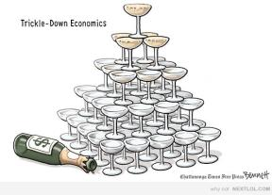
Reagan’s Domestic Policy
First domestic priority was the economy and he addressed it through an approach nicknamed “Reaganomics”
REAGANOMICS: trickle-down economics; interest rates were kept high while massive tax cuts were made
Cutting taxes led to cuts to many social programs, specifically Welfare – including the food stamp and school lunch programs
His economic policies worked in the short term, but the majority of benefits went to the richest members of society and overall created an obstacle to long-term growth
Also, he fostered the largest peacetime military buildup in US history and escalated the war on drugs

Slide 41
Life in the 1980s
Characterized by wealth and renewed activism
YUPPIES: young, urban professionals who were young, ambitious, hardworking and rewarded themselves with luxury lifestyles
Technology began to transform news and entertainment and by the end of the 1980s, many homes had VCRs
Many social problems plagued the nation in the 1980s
Drug use spread from cities to small towns and rural areas, abuse of alcohol became a serious concern and there was a widespread AIDS epidemic
Reagan presided over a new era in space exploration as NASA focused on space shuttles and space stations and Sally Ride became the first American woman in space
Americans mourned the worst disaster in the country’s history of space exploration when the Challenger blew up in January 1986

Slide 42
1990s: Bush and Clinton
Section Six

Slide 43
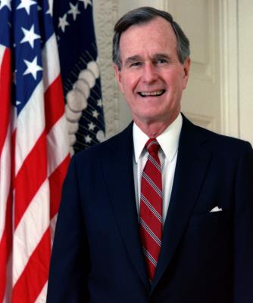
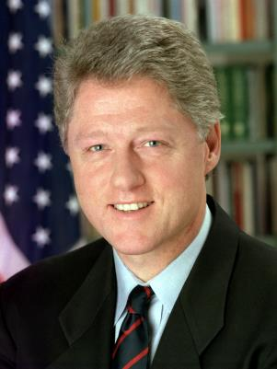
1990s: Bush and Clinton
George H. W. Bush
1989-1993
William J. Clinton
1993-2001

Slide 44
Bush Administration
Foreign Policy
Domestic Policy
George H. W. Bush presided over the end of the Cold War and the development of a “new world order”
Reduced diplomatic contacts with China after the Tiananmen Square Massacre
Invaded Panama in 1989 to seize the dictator, General Manuel Noriega, and to help the Panamanians hold elections and organize a new government
Led US troops into Iraq in 1991 under Operation Desert Storm to force Iraq to leave Kuwait
Bush inherited a growing deficit and slowing economy as a result of Reagan’s policies and the end of the Cold War
Tried to improve the economy with a self-titled tax break for the rich, but when it failed in Congress, he went back on his “no new taxes” campaign pledge and raised taxes
Signed the Americans with Disabilities Act in 1990
Named Clarence Thomas to the Supreme Court

Slide 45
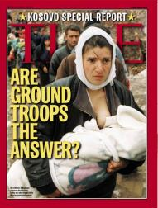
Clinton’s Foreign Policy
Clinton worked with the UN to impose a trade embargo on Haiti in order to help restore democracy
The trade embargo created a severe economic crisis in Haiti and Clinton ordered an invasion but before the troops arrived, former president Jimmy Carter convinced Haiti’s military leaders to restore democracy
In 1996, Clinton worked with NATO to stop Serbians from committing ethnic cleansing in Bosnia and then in 1998-1999, Clinton engaged again with NATO to aid Kosovo against bombing by Serbian forces
Oversaw Middle East peace talks in 1993 between Israeli Prime Minister Yitzhak Rabin and PLO leader Yasir Arafat called the Declaration of Principles

Slide 46
Clinton’s Domestic Policy
Clinton put forth an ambitious program to focus on 5 major areas: economy, family, education, crime and health care
To better the economy, Clinton worked to lower interest rates in order to reduce the federal deficit and to do this without cutting entitlement programs, Clinton raised taxes on middle- and upper-income Americans
Clinton’s economic plan worked to erase the deficit and better the economy
Bill Clinton, with the help of his wife, Hillary Clinton, worked to create a plan for universal health care but it did not pass in Congress
Clinton was able to pass the Family Medical Leave Act and to create the Americorps program
Worked to pass the Brady Bill – gun control legislation that imposed a waiting period before people could buy handguns and required a background check

Slide 47
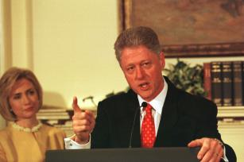
Impeachment
A scandal emerged involving Clinton and a white house intern, Monica Lewinsky
Some evidence suggested that Clinton had committed perjury about the relationship
PERJURY: lying under oath
The evidence was examined by a special investigator, Kenneth Starr, who concluded that Clinton had committed perjury
House of Representatives began impeachment hearings and in December 1998, they passed 2 articles of impeachment – for perjury and obstruction of justice
The case moved to the Senate for trial and both votes fell very short of the 2/3rds needed to remove the president from office

Slide 48
2000s – Today: Bush & Obama
Section Seven

Slide 49
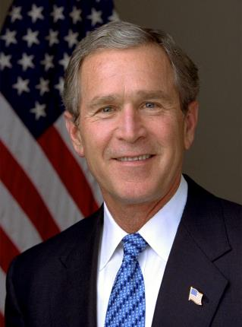
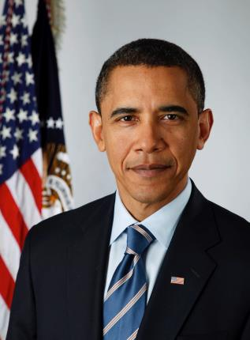
2000s – Today: Bush and Obama
George W. Bush
2001-2009
Barack H. Obama
2009-2017

Slide 50
Bush v. Gore
The 2000 presidential election was very close. Al Gore narrowly won the popular vote, but neither he nor George W. Bush won the over 270 electoral votes needed to win the election. The results in Florida were so close that ballots had to be recounted and thousands of ballots had to be thrown out because they were unclear when recounted by the vote counting machines. After counting, Bush was declared the winner by 537 votes, but Gore’s lawyers headed to court to argue that thousands of ballots were still uncounted. The Florida Supreme Court ordered all Florida counties to begin a hand recount of ballots rejected by the counting machines.
During this time, Bush had requested the US Supreme Court to intervene. As the hand recounting began, the US Supreme Court came to a decision on Bush v. Gore. On December 12, 2000, the court ruled that the hand recounts in Florida violated the equal protection clause of the constitution because different vote counters used different standards, the recount did not treat all voters equally and, further, the court ruled that there was not enough time left to recount the votes by hand within the deadline. This ruling left Bush the certified winner in Florida, and gave him the electoral votes that he needed to win the presidential election. And so, on January 20, 2001, George W. Bush became the 43rd president of the United States.

Slide 51
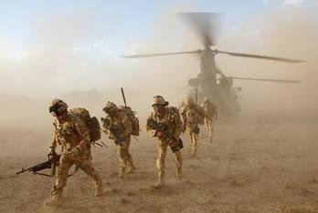
George W. Bush’s Foreign Policy
After suffering the worst terrorist attack in US history on September 11, 2001, the US launched a massive effort to end international terrorism
In October of 2001, the US bombed targets in Afghanistan as the War in Afghanistan began
In January of 2003, the US and Great Britain began building up their forces in the Middle East in preparation for war with Iraq and in April 2003, the War in Iraq began

Slide 52
George W. Bush’s Domestic Policy
Bush had begun working on reviewing the nation’s military programs when the attacks on September 11, 2001 changed everything and began a new war on terrorism
Bush signed an antiterrorism bill into law in October 2001 – the USA Patriot Act
Worked to pass a large $1.35 trillion tax cut to try to prevent a recession
Proposed major educational reforms and worked to pass legislation to require public schools to hold annual standardized tests
He signed into law a number of initiatives during his 8 years, including the No Child Left Behind Act, a Partial-Birth Abortion Ban, Medicare prescription drug benefits for seniors, and funding for AIDS relief
Bush was met with economic crisis at the end of 2007, when the United States entered its longest post-WW2 recession – known as the “Great Recession” – and Bush was faced with this, as well as the 2008 Financial Crisis – the largest depression since the 1930s

Slide 53
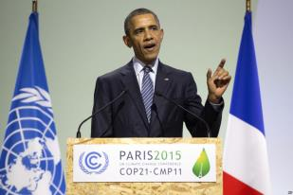
Barack Obama’s Foreign Policy
Obama ended US military involvement in the Iraq War and increased US troop presence in Afghanistan
Obama ordered the military operation that killed Osama bin Laden
US troops were sent to aid in Libya with those opposing Dictator Muammar Gaddafi, helping to move forward the Arab Spring revolutions in North Africa and the Middle East
In his second term, Obama promoted discussions that led to an agreement on global climate change
He worked to broker a nuclear deal with Iran and, for the first time in over 60 years, normalized US relations with Cuba

Slide 54
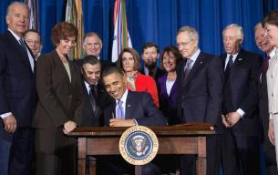
Barack Obama’s Domestic Policy
During his first two years in office, Obama signed economic stimulus legislation into law in response to the economic crisis including Wall Street reform and consumer protection
Obama is best known domestically for passing the Patient Protection and Affordable Care Act, often referred to as “Obamacare” – providing healthcare for all Americans
In 2010, he signed the Don’t Ask, Don’t Tell Repeal Act into law and under his tenure, the Supreme Court guaranteed the right to marriage for every American
In his second term, Obama pushed gun control reform after the tragic shooting at Sandy Hook Elementary School

Slide 55
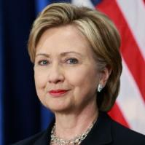
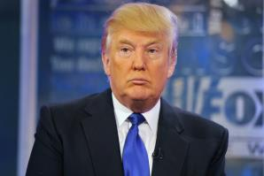
2016 and Beyond
As Barack Obama’s presidency comes to an end, candidates are hard at work campaigning to become the next president of the United States. The two major party candidates are Hillary Clinton (Democrat) and Donald Trump (Republican). There are candidates from other parties, the Libertarian and the Green Parties among others, that are also running for president. The election will take place on November 8, 2016 and the winner of the election will work to set US policy for decades to come, as past presidents have done before.

