Slide 1
Southeast Asia & Korea
Unit Six

Slide 2
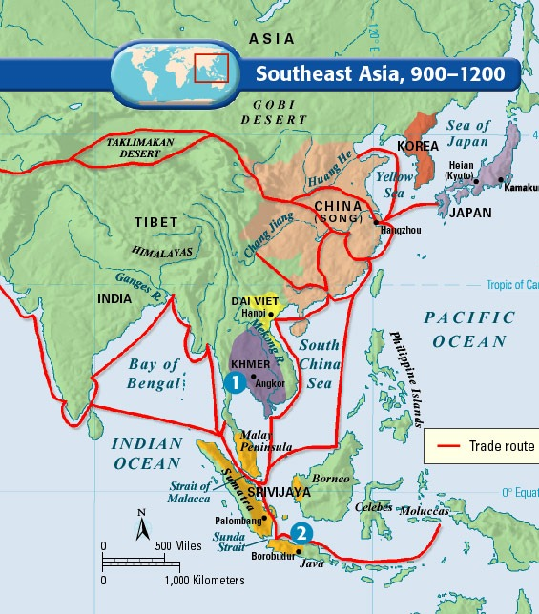

Slide 3
Khmer Empire
Main power on Southeast Asia mainland for centuries
Reached height around 1200 AD
Improved rice cultivation to remain wealthy
In capital of Angkor, rulers built city and temple complexes
ANGKOR WAT: city and temple complex; one of world’s greatest architectural achievements

Slide 4
Koryu Dynasty
To the northeast of India and the Khmer Empire was the Korean state. Korea is located on a peninsula that juts out from the Asian mainland toward Japan.
Around 935, a new king took power and established the Koryu Dynasty
Lasted from 935 to 1392
Modeled central government after China’s
Established a civil service system
Produced lasting achievements for Korea culture

Slide 5
Southeast Asia & Korea Extra Credit Opportunity
Since the end of World War II, Korea has been divided into two countries – communist North Korea and democratic South Korea. For years, many Koreans longed for their country to be reunited. Hopes for such a time rose in 2000 when the presidents of the two nations sat down to discuss reunification. In 2002, however, North Korea announced that it was developing nuclear weapons and would use them against South Korea if necessary. This greatly dimmed people’s hope for one Korea.
For extra credit, using the internet for research, write one page, in your own words, explaining what the situation between North and South Korea looks like today.

