Slide 1
Age of absolutism
Unit One

Slide 2
Age of Absolutism: Unit Overview
“I am the State.” – Louis XIV
The Age of Exploration brought new wealth and importance to the concept of the European state. These highly-centralized states desired to become as powerful as possible, while simultaneously making sure that other states did not gain power. The cyclical nature of this idea created a unique balance of power among the great powers in Europe that lasted for centuries. As we explore the Age of Absolutism, we will do so in 5 sections:
Spain’s Empire & European Absolutism
France’s Ultimate Monarch
Central European Monarchs Clash
Russian Czars Increase Power
Limits on the Monarchy

Slide 3
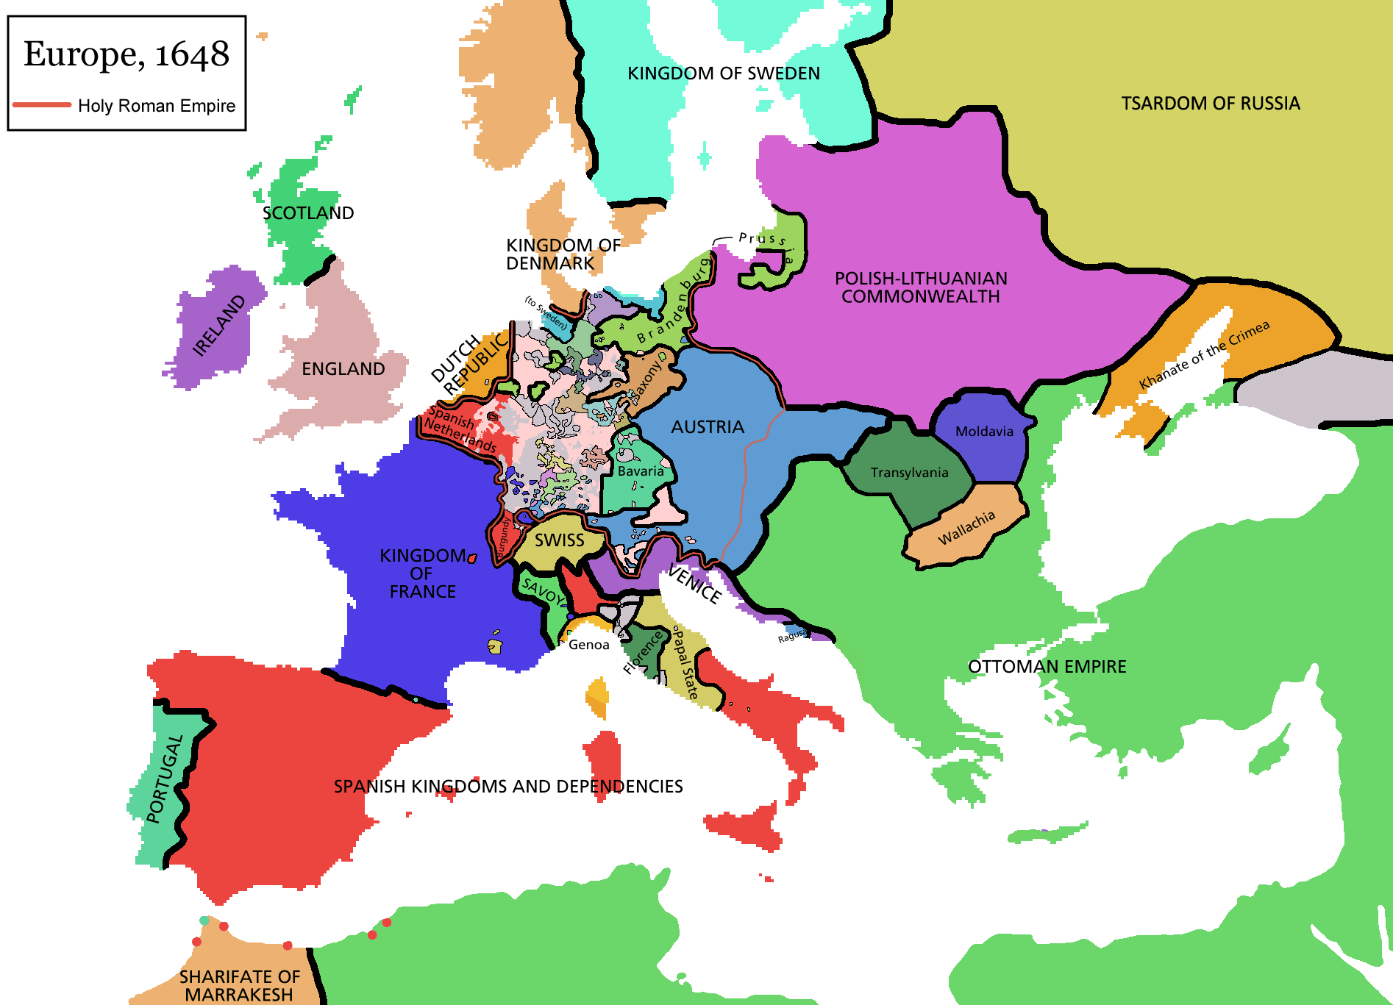
Age of Absolutism: Geography

Slide 4
Absolutism in Europe
Absolute Monarchs: kings or queens who believed that all power within their state’s boundaries rested in their hands
Divine Right: idea that God created the monarchy and the monarch was God’s representative on earth
As Europe emerged from the Middle Ages, monarchs grew increasingly powerful. The 17th century saw upheaval in Europe and monarchs responded to crises by increasing their own power. Their goal was to free themselves from the limits imposed by nobility and other governing bodies.

Slide 5
Spain’s Absolute Empire
Section One

Slide 6
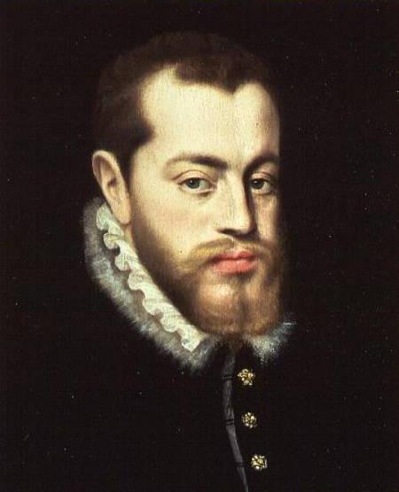
Spain’s Powerful Empire
In 1556, Phillip II inherited Spain and its territories
In 1580, Phillip II seized the Portugese kingdom, giving him a global empire
Phillip II believed it was his duty to defend Catholicism and launched the Spanish Armada against England in 1588 – seriously weakening Spain
Notes:
Charles V divides empire and gives his son Spain
Spain’s territories incl: Spanish Netherlands and American colonies
Phillip’s uncle had been king of portugal and he was left as heir – portugal empire incl land in Africa, India and East Indies

Slide 7
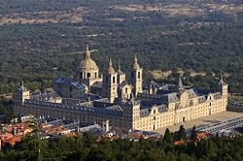
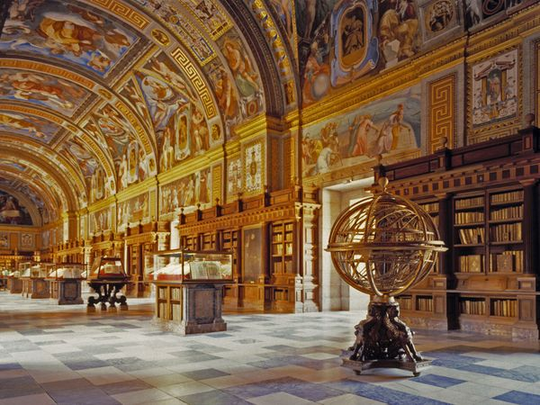
El Escorial
Notes:
Phillip II’s massive palace that was supported by Spain’s vast wealth

Slide 8
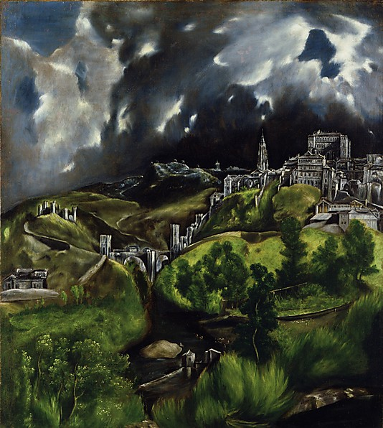
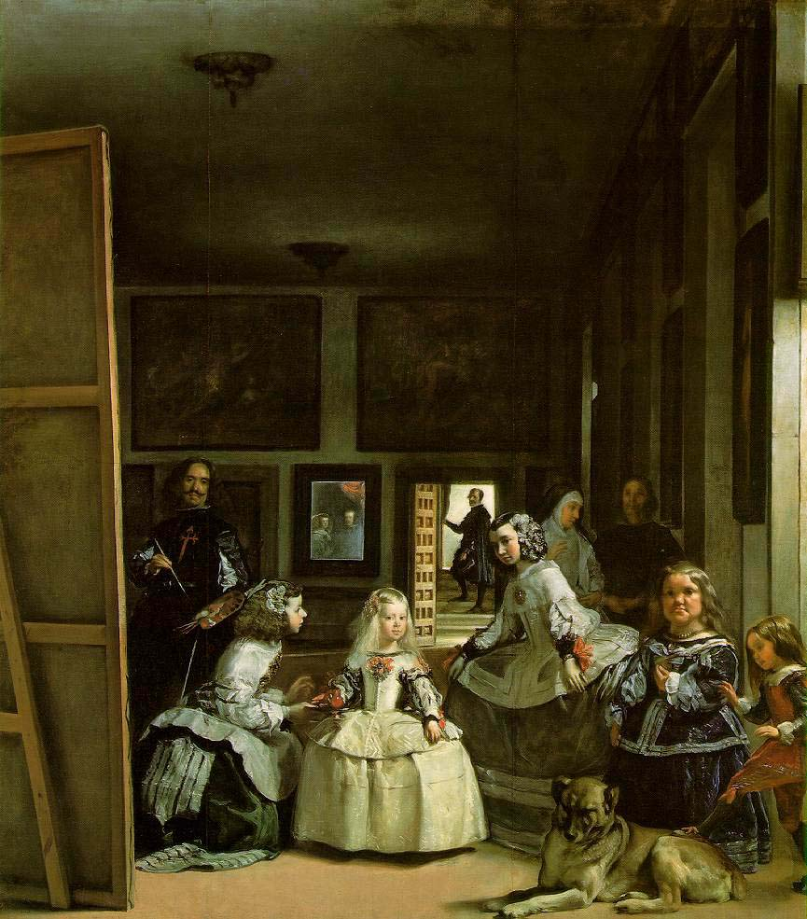
Spain’s Golden Age in the Arts
El Greco
Diego velazquez
Notes:
Both used art to show faith and pride in spain
View of Toledo
Las Meninas – The Maids of Spain

Slide 9
Problems Weaken the Empire
Three Main Problems:
Inflation, Enemies Made Rich and Dutch Revolt
Inflation : caused by population growth and a drop in the value of the silver coin
Enemies Made Rich: caused by expensive Spanish goods that caused Spaniards to buy goods from other countries

Slide 10
Problems Weaken the Empire
Dutch Revolt
  Dutch had little in common with the Spanish
  Dutch were Protestant and had a strong economy
  In 1579 the 7 northern provinces of the Netherlands united and declared independence

Slide 11
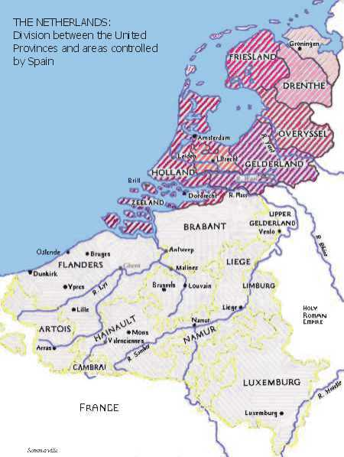
Independent Dutch Prosper
Exercised religious tolerance
Republic with elected governors
Stability led to economic growth
Became the “bankers of Europe”
Best art collection in Europe

Slide 12
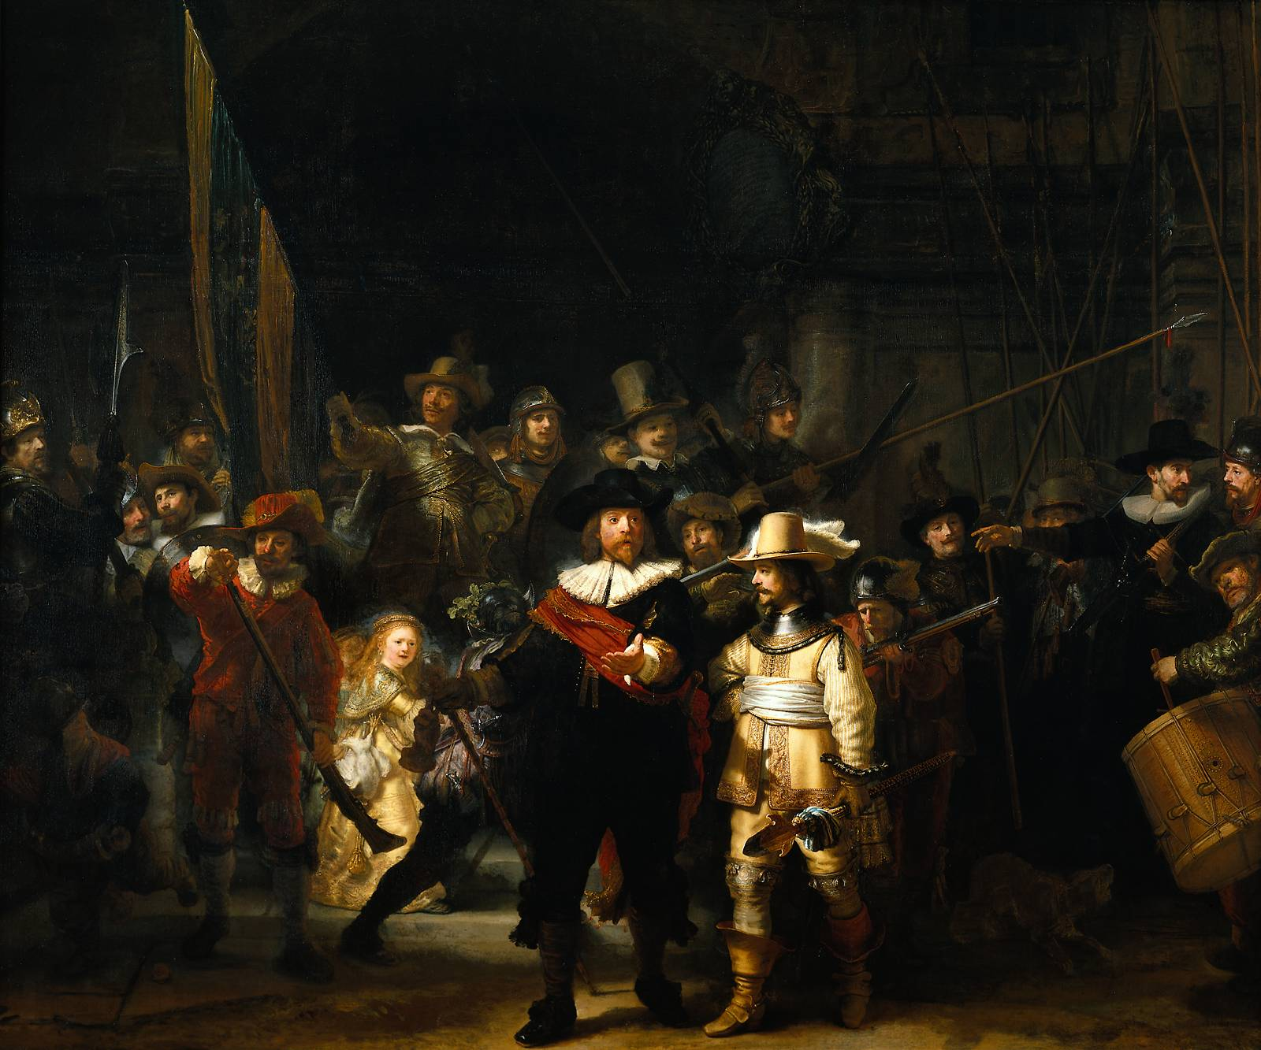
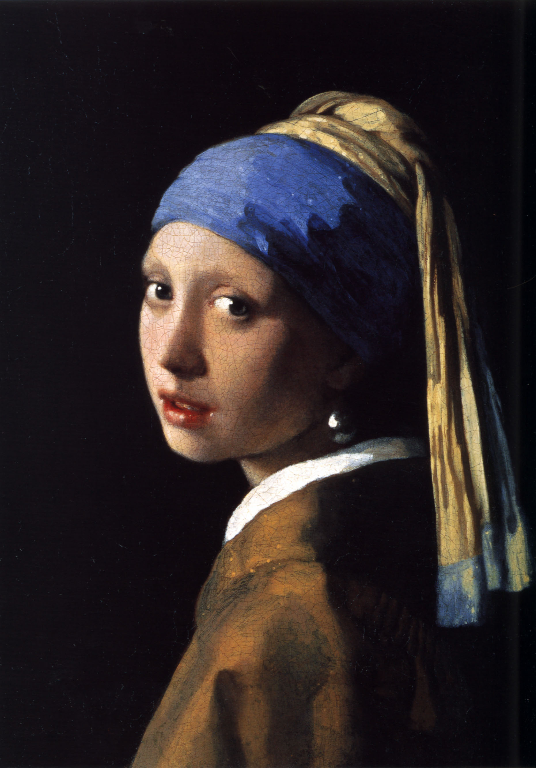
Dutch Artists
Rembrandt
johannes vermeer
Notes:
The Nightwatch – Rembrandt
Girl with the Pearl Earring - Vermeer

Slide 13
Differences between the Economies of Spanish and the Dutch
Spanish economy
Dutch economy
Source of Wealth: Gold Mines
Tax burden fell on Lower Classes – not allowing for a Middle Class
Very high taxes were needed to pay for monarch’s luxuries
Phillip II controlled the state of the economy with no limits
Source of Wealth: Trade
Strong middle class that included merchants
Taxes were not extreme
Merchants were largely in control of the state of the Dutch economy
Notes:
Merchant: person or company involved in wholesale trade

Slide 14
Illustrated Poster Activity
Work with a partner to create an illustrated poster contrasting the economy of Spain and the economy of the Dutch Netherlands around 1600.
Choose one of these areas to illustrate:
Sources of Wealth
Existence of Middle Class
Taxes
Who Controlled Finances

Slide 15
France’s Ultimate Monarch
Section Two

Slide 16
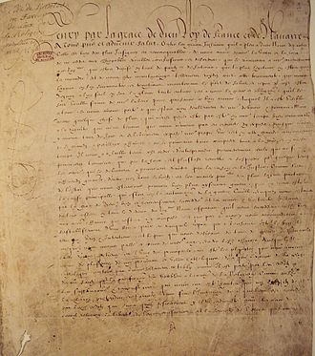
Religious Wars Create Crisis
In 1589, Henry IV became the 1st King of the Bourbon Dynasty
EDICT OF NANTES: established religious tolerance
Henry IV devoted his life to rebuilding France

Slide 17
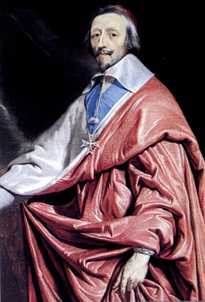
Cardinal Richelieu
Appointed in 1624 by Louis XIII
Became the effective ruler of France and took 2 major steps:
Moved against the Huguenots
Weakened the nobles’ power
Notes:
After Henry IV died, his son Louis XIII reigned – weak ruler and appointed strong minister Cardinal Richelieu

Slide 18
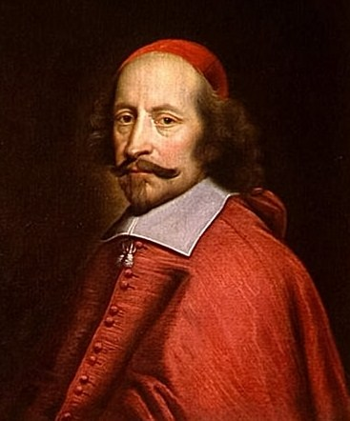
King Louis the XIV
The efforts of Henry the IV and Cardinal Richelieu paved the way for the most powerful ruler in French history, King Louis XIV.
Louis became King at age 5 in 1643
France was ruled by Cardinal Mazarin
People led riots against Mazarin because he raised taxes

Slide 19
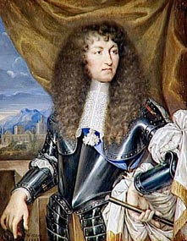
Louis XIV Takes Control
In 1661, Mazarin died and 23 year old Louis took over
Louis weakened noble power by keeping them out of his councils
INTENDANTS: agents to collect taxes and administer justice

Slide 20
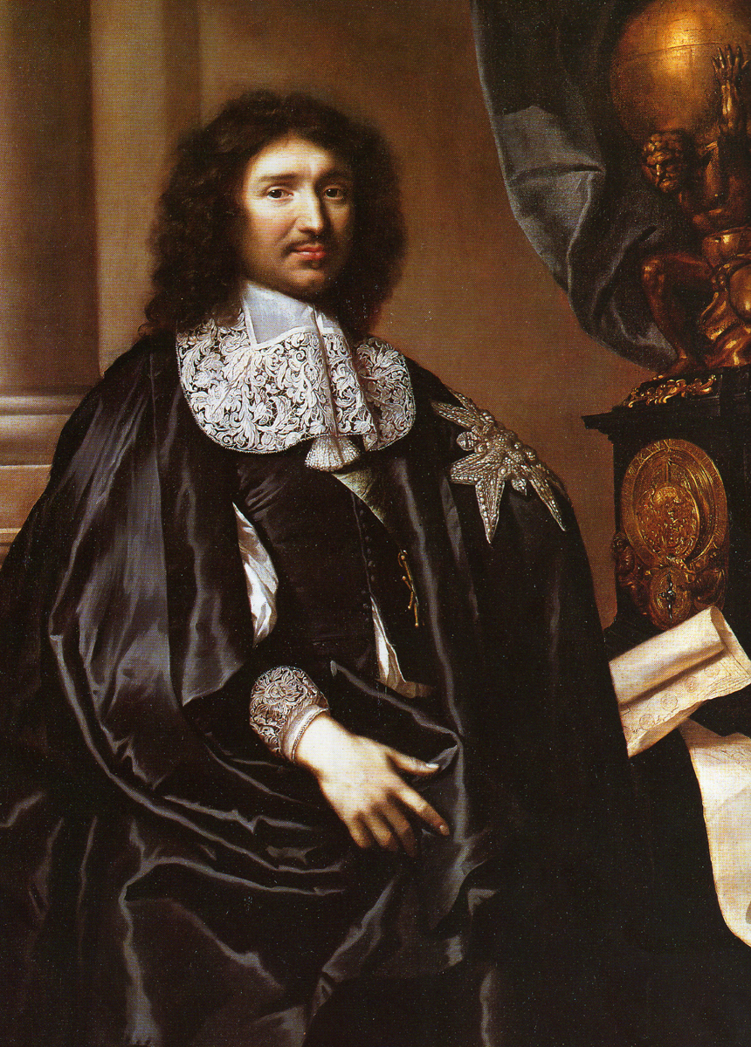
Jean Baptiste Colbert
Minister of Finance
Wanted France to be self-sufficient
MERCANTILISM: economic policy; belief in the benefit of profitable trading
Notes:
After Colbert’s death, Louis ended the Edict of Nantes and skilled Huguenot workers fled France

Slide 21
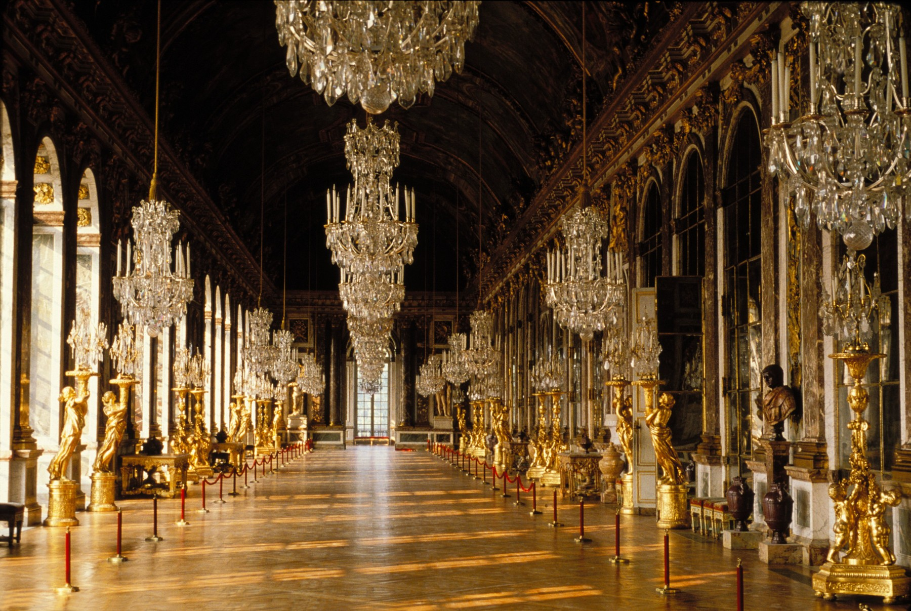
Life of Luxury
Spent a fortune to surround himself with luxury
Made opera and ballet more popular
Kept nobles at the palace – making them totally dependent on the King

Slide 22
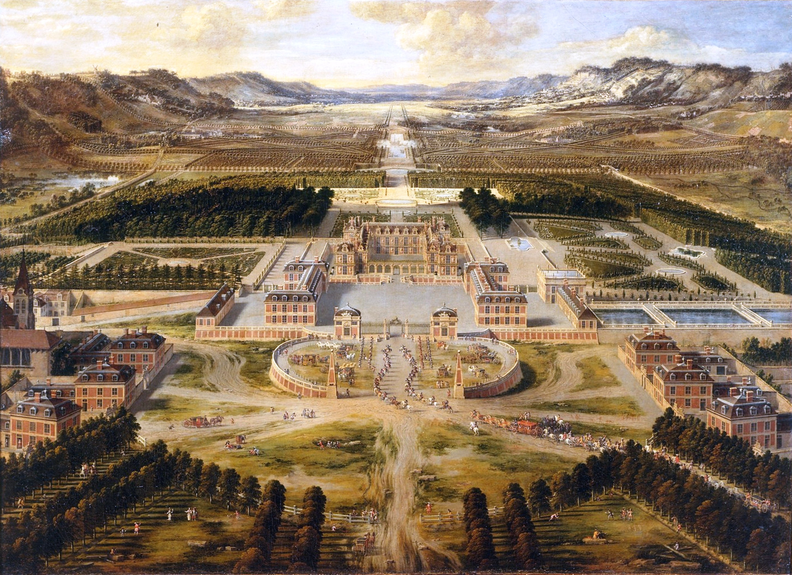
Palace at Versailles

Slide 23
Palace at Versailles: Statistics
Built by 36,000 laborers and 6,000 horses
Has approximately 2,000 rooms
Main building is 500 yards long
Each wing is 150 yards long
15,000 acres of garden, lawns and woods
1,400 fountains on the grounds
Notes:
Main building is FIVE FOOTBALL STADIUMS LONG

Slide 24
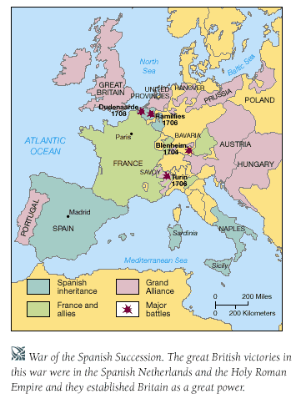
Louis XIV and the Military
Tried to expand France’s boundaries but failed
In 1700, most of Europe allied against France and Spain in the War for Spanish Succession (WSS)

Slide 25
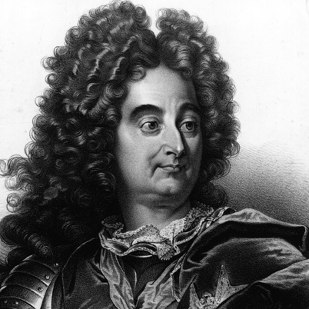
Louis XIV’s Legacy
Louis XIV died in 1715
Regretted ruining France through many wars
Left a mixed legacy – France was powerful but resentment from the people ultimately led to the French Revolution

Slide 26
Central European Monarchies
Section Three

Slide 27
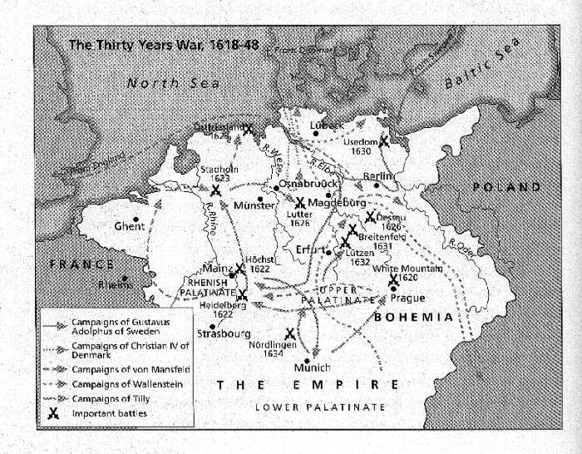
The Thirty Years War: Geography

Slide 28
The Thirty Years War: 1618-1648
Ferdinand II was head of the Hapsburg family and ruled the Czech kingdom of Bohemia
Protestants did not trust Ferdinand II
Protestants revolted, Ferdinand II sent an army to stop the revolt and started the war
THIRTY YEARS WAR: conflict over religion, territory and power among Europe’s ruling families from 1618 – 1648

Slide 29
Two Phases of the War
Hapsburg triumphs
Hapsburg defeats
First 12 years of the war, Catholics won and crushed the Protestant troops
Paid army of 125,000 men by allowing them plunder villages
In 1630, Protestants drove Hapsburg armies out of Northern Germany
France dominated the remaining years to keep the Hapsburgs from gaining more power

Slide 30
Peace of Westphalia
In 1648, the Peace of Westphalia ended the war and had 6 major consequences:
Weakened Spain & Austria
Strengthened France with more Territory
Made German princes independent from the Holy Roman Emperor
Ended religious wars in Europe
Introduced new method of peace negotiations
Marked the beginning of the modern state system

Slide 31
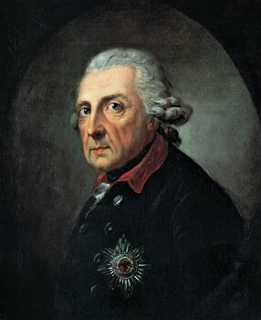
Central European Clashes
In 1711, Charles VI became the head of Austria
Austria’s largest enemy was Prussia
In 1740, Maria Theresa – Charles VI’s named heir - took power in Austria and Frederick the Great took power in Prussia

Slide 32
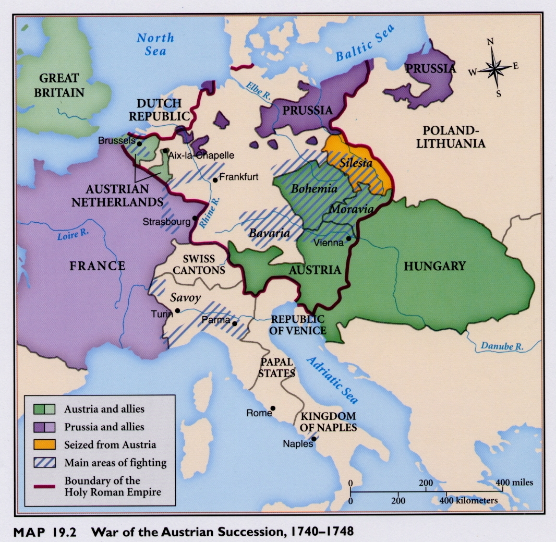
Austria vs. Prussia
Frederick the Great was beloved
Saw an opportunity to take over Austria and began the War of Austrian Succession
Maria Theresa allied with France and stopped Prussia

Slide 33
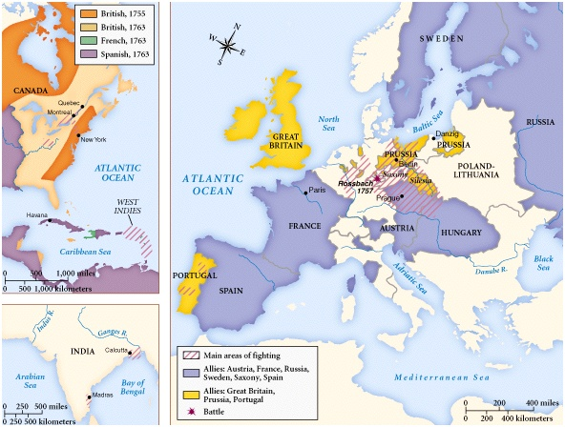
The Seven Years War: Europe
In 1756, Frederick the Great attacked Saxony – an ally of Austria
Soon every great European power was involved in conflict
Fought on 3 continents – in Europe, North America and in India
Notes:
- No one gained any territory except the British who gained territory in North America and in India
- In the colonies – not yet the United States – called the French and Indian War bc the British/colonists fought the French and the Indians who allied with them

Slide 34
Russian Czars Increase Power
Section Four

Slide 35
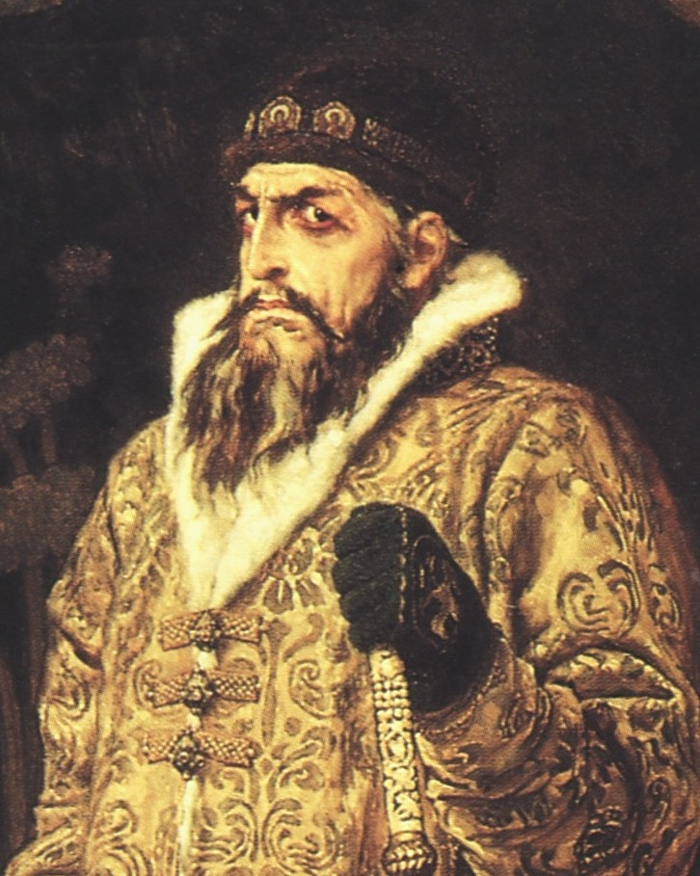
Ivan the Terrible
Ivan IV, aka Ivan the Terrible, came to power in 1533 when he was 3 years old
Young life spent caught in power struggles by the boyars
BOYARS: landowning nobles
At age 16, Ivan crowned himself czar

Slide 36
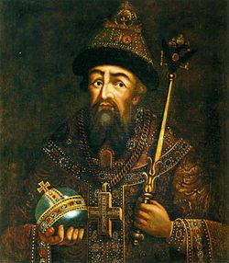
The Good: 1547 – 1560
Ivan married Anastasia Romanov
Ivan won military victories, added land to Russia, and gave Russia a code of laws

Slide 37
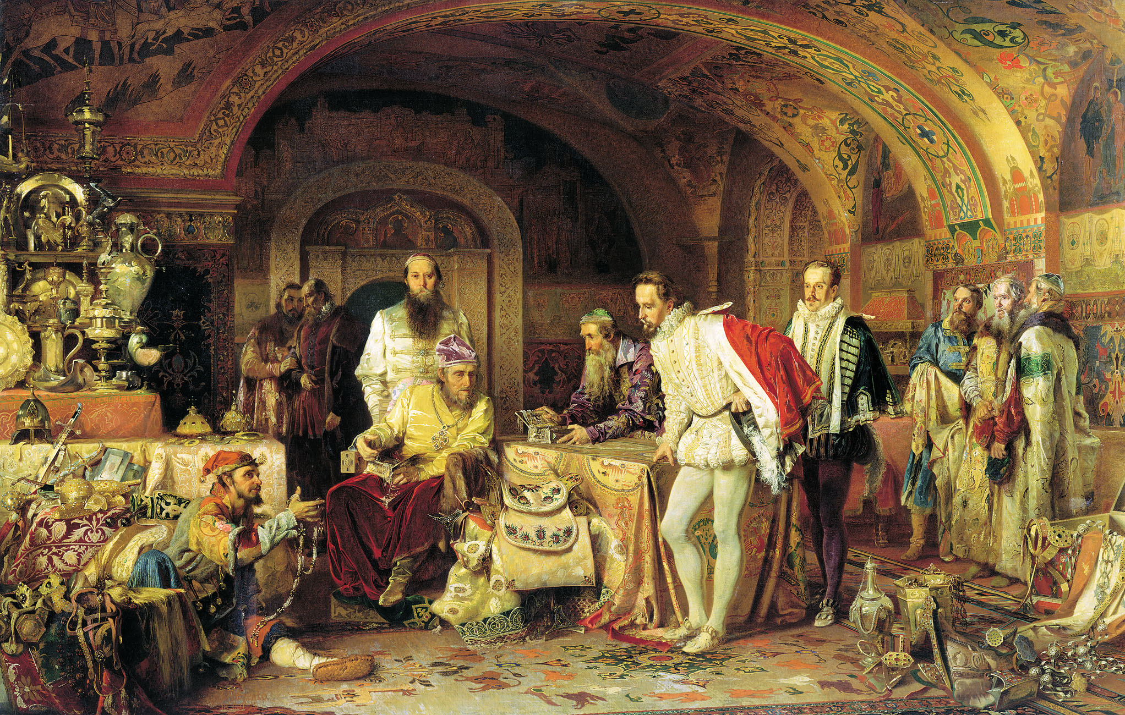
The Bad: 1560 – 1581
In 1560, Anastasia died and Ivan accused the boyars of poisoning her
Created the Secret police who hunted people considered to be traitors
Over 20 years, Ivan murdered thousands of Russian people

Slide 38
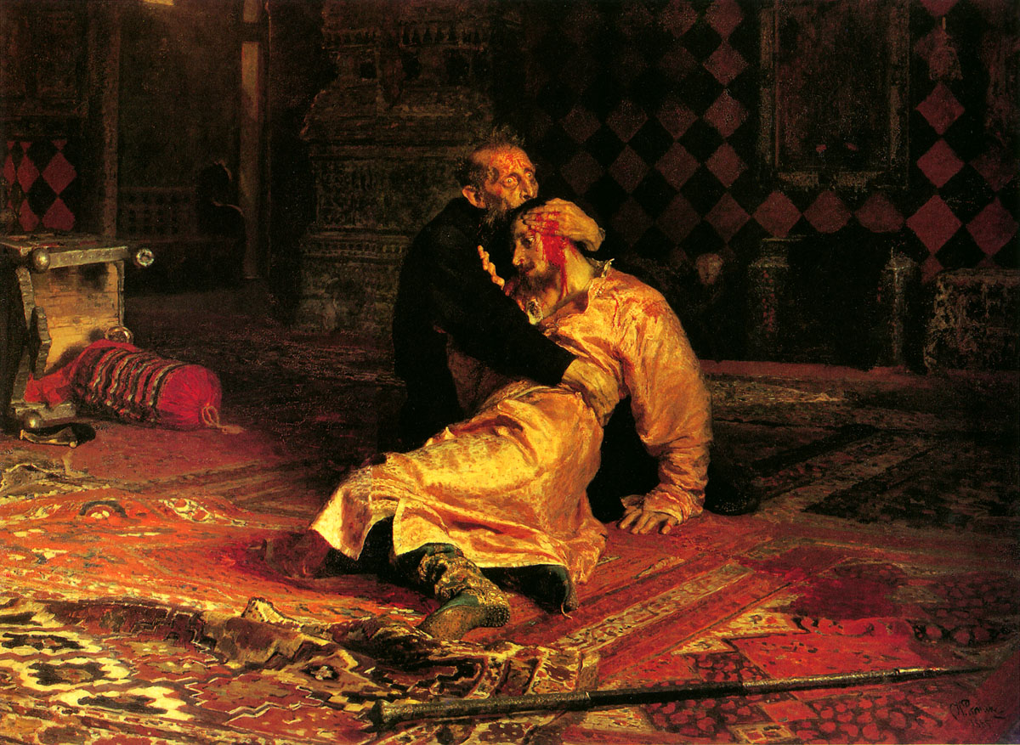
The Ugly: 1581 – 1584
In 1581, Ivan killed his oldest son and heir to the throne
Ivan died in 1584, leaving only his weak younger son, Fyodor I, to rule

Slide 39
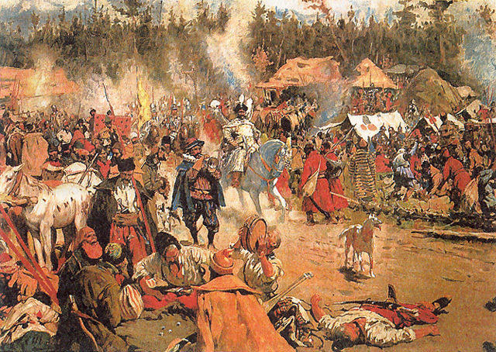
Time of Troubles
1598 to 1613
Period of confusion in the government
In 1613, representatives chose Michael Romanov – Anastasia’s grandnephew – as the next czar
Notes:
Fyodor I died in 1598

Slide 40
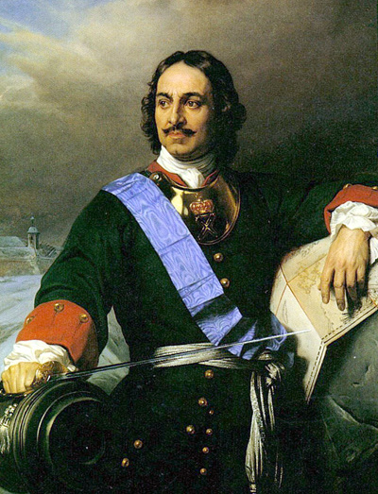
Peter the Great
Came to power in 1696
One of Russia’s greatest reformers
Had goal of westernization for Russia
WESTERNIZATION: using Western Europe as a model for change

Slide 41
Westernization in Russia
In order to westernize Russia, Peter put a number of new policies in place throughout the country:
Reduced power of boyars
Used European soldiers to train military
Introduced potatoes
Started 1st newspaper
Raised status of women
Introduced Western fashion
Increased education efforts

Slide 42
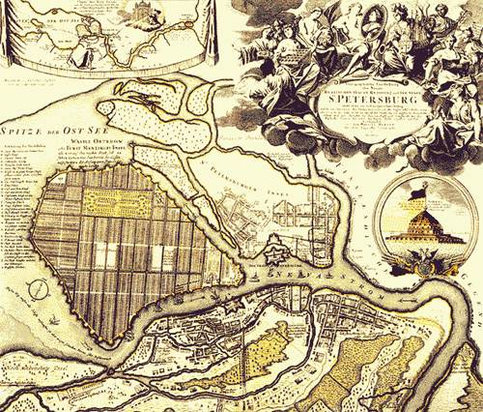
St. Petersburg
Moved capital from Moscow to St. Petersburg
Nobles were ordered to leave Moscow and move to new capital in 1713
Peter the Great died in 1725, leaving Russia as a major world power

Slide 43
Limits on Monarchy
Section Five

Slide 44
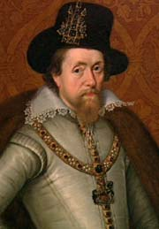
King James I
James Stuart, King of Scotland, also became King James I of England in 1603
Struggled with Parliament
James I died in 1625 and left power to his son Charles I

Slide 45
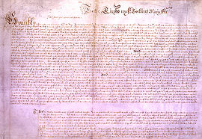
Petition of Right
Charles I struggled with Parliament and in 1628, was forced to sign the Petition of Right, in which the King agreed not to:
Imprison subjects without due cause
Levy taxes without Parliament’s approval
House soldiers in private homes
Impose martial law in peacetime

Slide 46
English Civil War
In 1637, Charles I tried to bring Scotland and England under one religion and Scotland rebelled. To stop Charles I from using unlimited money to fight with Scotland, Parliament passed laws to limit royal power. Charles I tried to arrest Parliament’s leaders, but did not succeed in those arrests. A mob came after Charles I, but he fled and raised an army in Northern England.

Slide 47
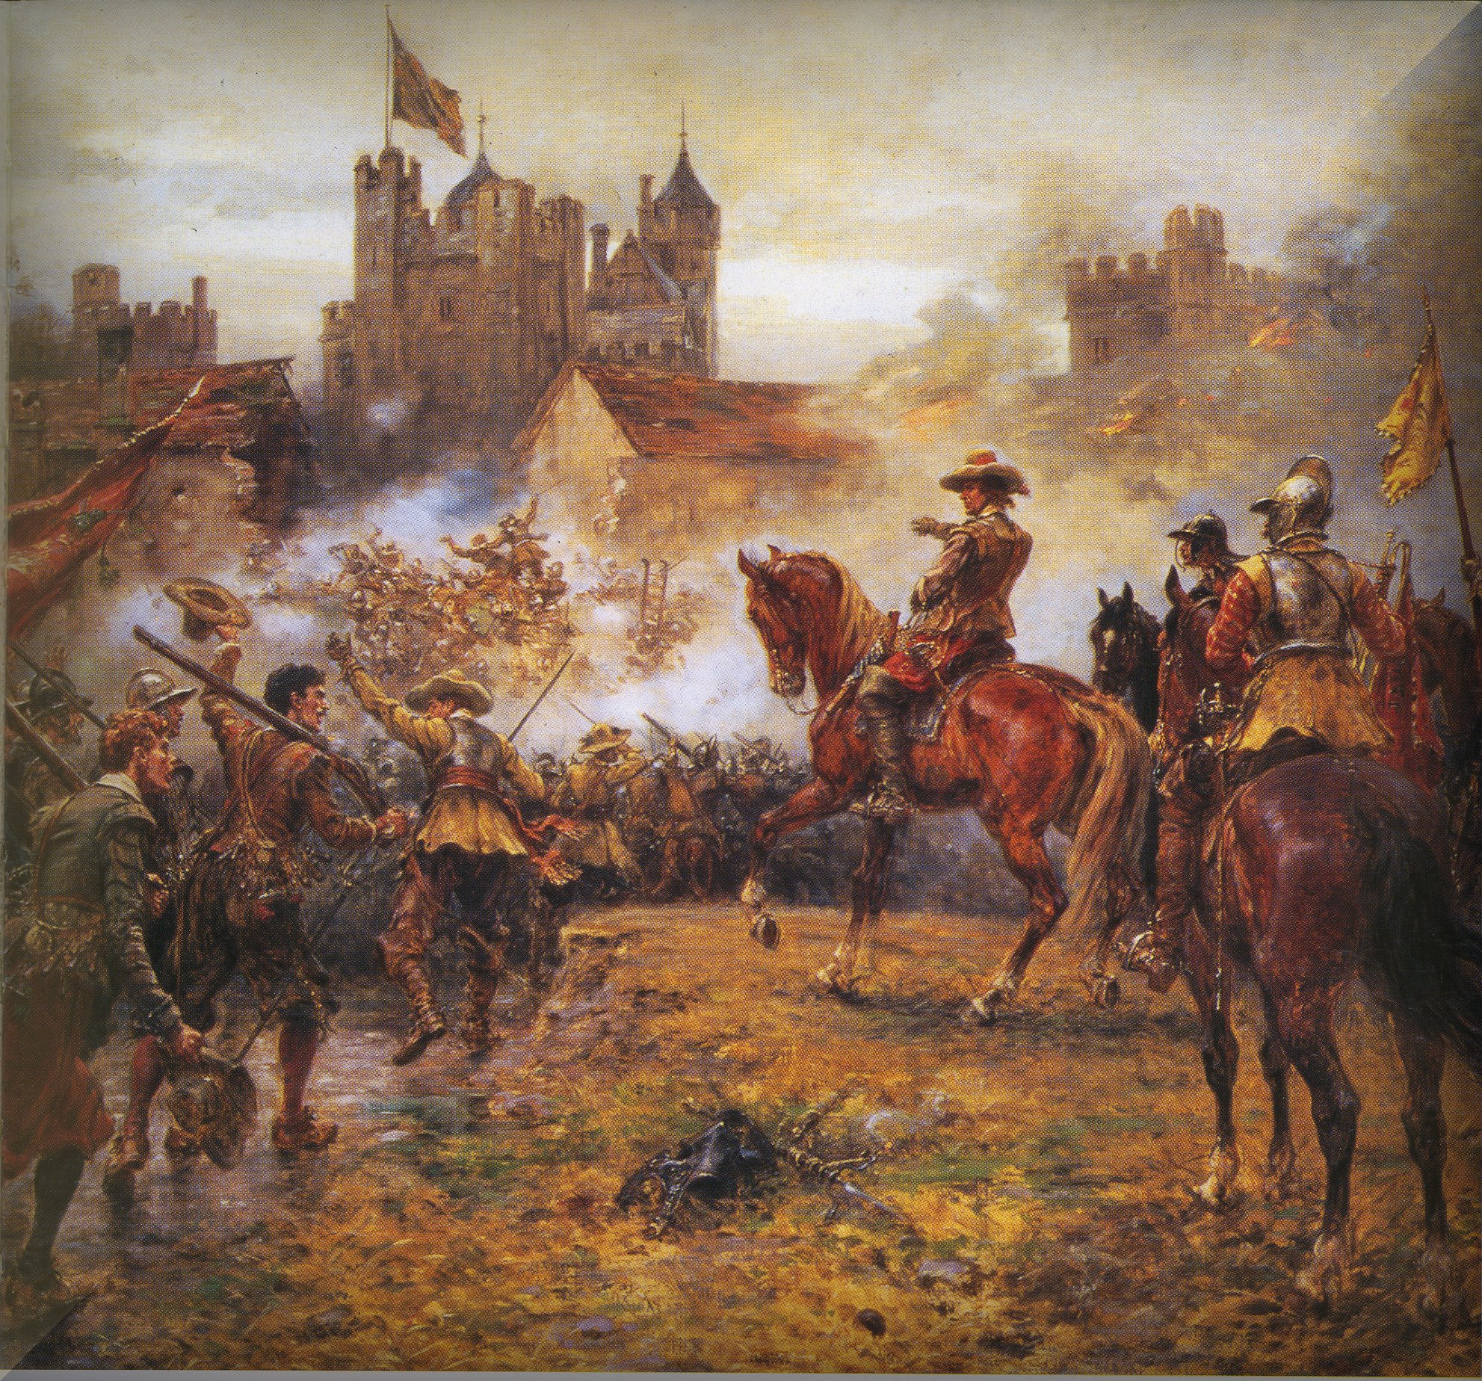
English Civil War: 1642 – 1649
ROYALISTS: supporters of Charles I
PURITANS: English protestants who wanted to regulate and simplify worship – supported Parliament
In 1646, Oliver Cromwell helped defeat the Royalists
Charles I was brought to trial, found guilty and sentenced to death
Notes:
Puritans: English protestants who wanted to regulate and simplify worship

Slide 48
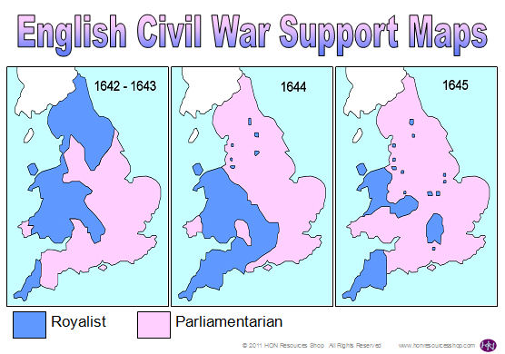
Map Analysis
What does this map show you about the English Civil War?
How did support change throughout the war?

Slide 49
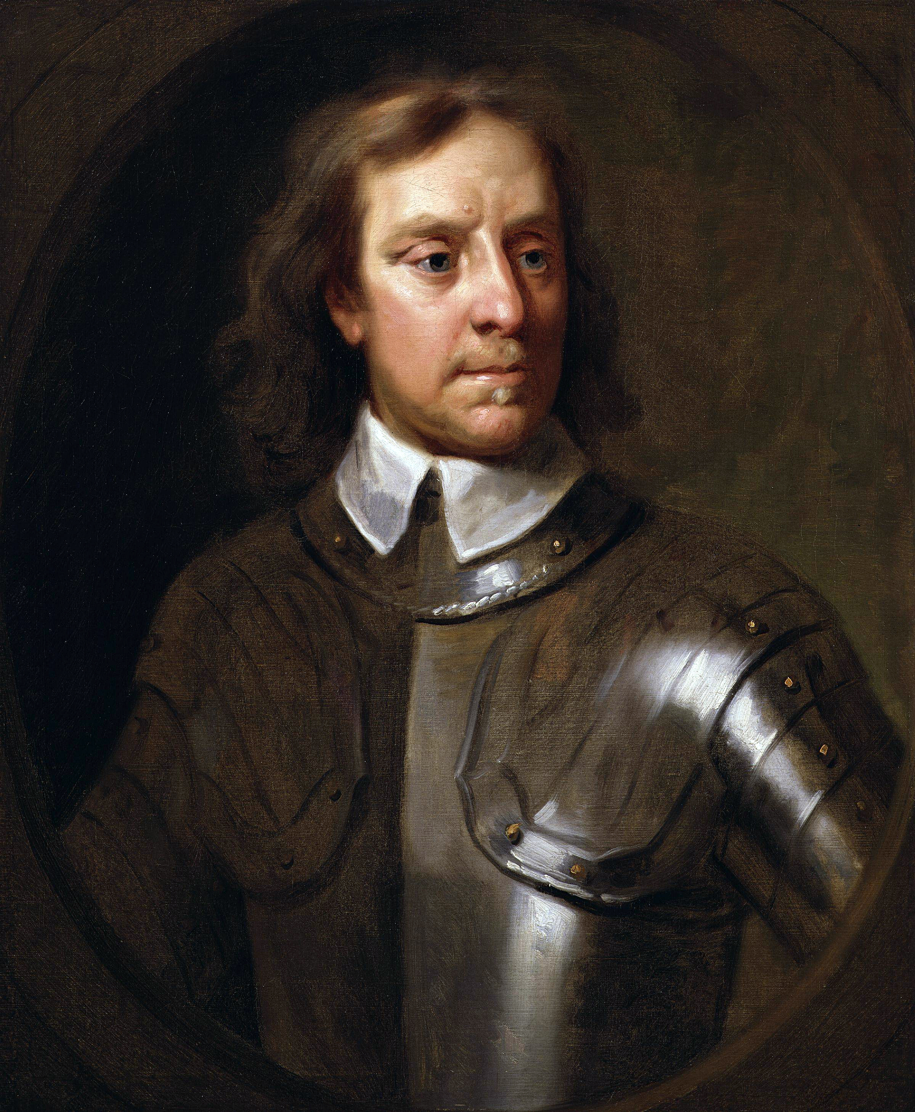
Oliver Cromwell
Took power in 1649
Abolished the monarchy and House of Lords
Religiously tolerant of everyone but Catholics
Ruled until death in 1658

Slide 50
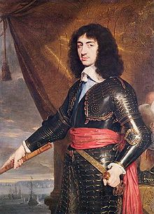
Restoration
Government collapsed and new Parliament was chosen
In 1659, asked Charles II to take the throne
Charles II restored the monarchy

Slide 51
Glorious Revolution
James II became King in 1685
James II put Catholics into government positions
In 1688, Parliament invited James’ daughter Mary and her husband William to overthrow James II for sake of Protestantism
William led an army and James II fled
Notes:
Charles died in 1685 and brother James was only heir

Slide 52
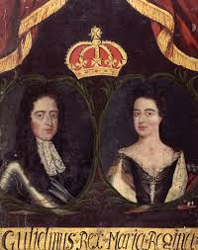
Political Changes
William and Mary are coronated in 1685
They see Parliament as their partner in governing
CONSTITUTIONAL MONARCHY: form of government where king or queen acts as head of state within limits set by a constitution

Slide 53
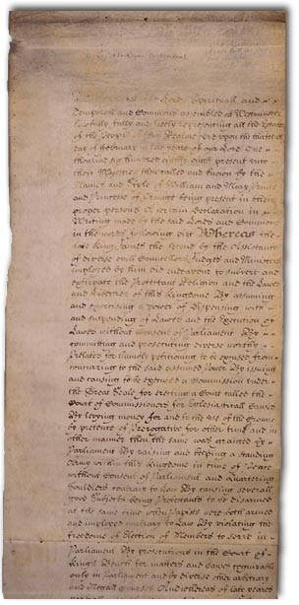
English Bill of Rights
Drafted by Parliament in 1689 listing a number of things that the monarch could not do:
Suspend Parliament’s laws
Levy taxes without Parliament approval
Interfere with Parliament’s freedom of speech
Penalize citizens who petition the King

Slide 54
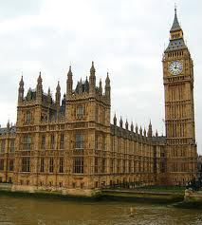
British Cabinet
In the 1700s, a cabinet was introduced to the system
CABINET: group of government ministers who act as a link between the monarch and Parliament
Prime Minister heads the cabinet
Notes:
Palace of Westminster houses the two houses of Parliament

