Slide 1
Middle East
Unit Five

Slide 2
Geography & Introduction
Section One

Slide 3
Geographic Location
Middle East is also known as Southwest Asia, because it is in the southwestern region of the Asian continent
Different resources may refer to this region by different names
Middle East = Southwest Asia

Slide 4
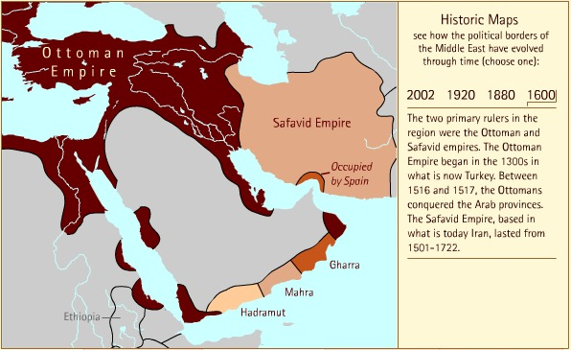
Middle East 1600

Slide 5
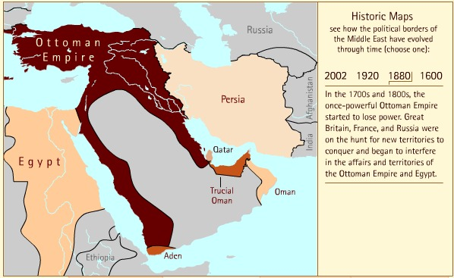
Middle East 1880

Slide 6
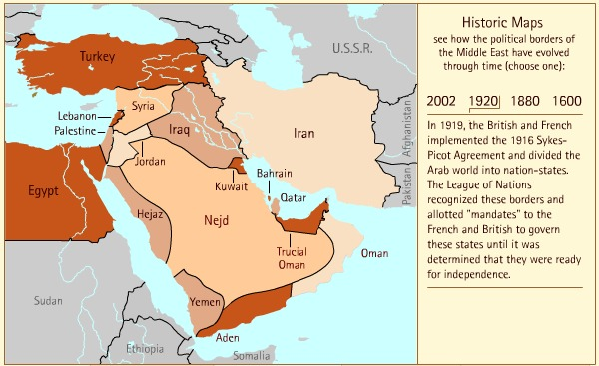
Middle East 1920

Slide 7
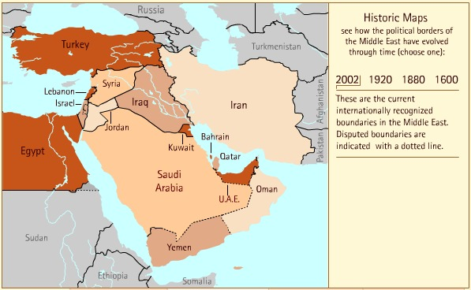
Middle East 2002

Slide 8
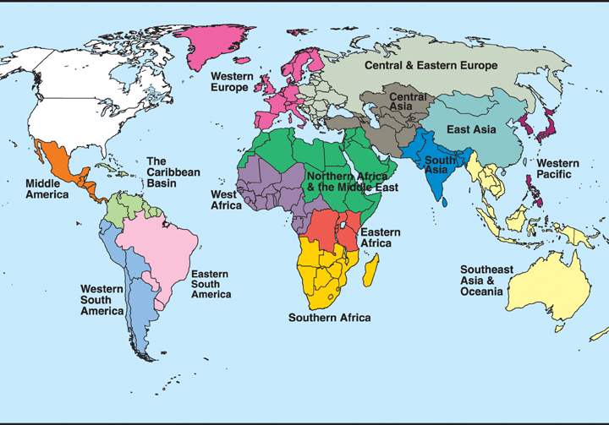

Slide 9
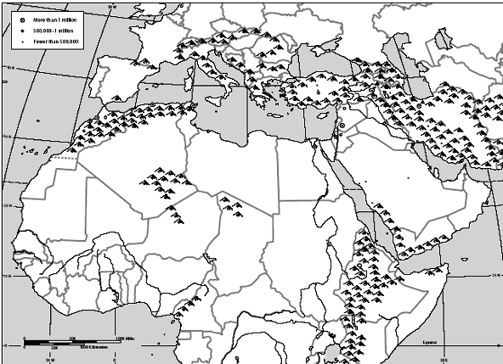
Bodies of Water
Black Sea
Caspian Sea
Dardanelles Strait→
Atlantic
Ocean
←Tigris
River
Mediterranean Sea
Euphrates
River→
Jordan River→
Suez Canal→
Strait of
←Hormuz
Persian Gulf
Nile River→
←Gulf of
Oman
Red Sea
Arabian
Sea
←Gulf of Aden
Indian
Ocean

Slide 10
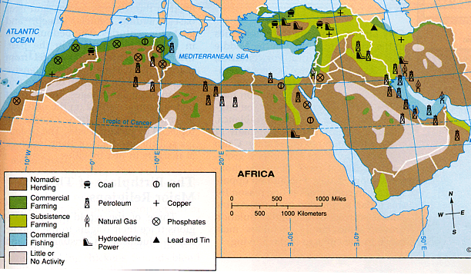
Natural Resources

Slide 11
Israel & Palestine
Section Two

Slide 12
Zionism
The spiritual and political renewal of the Jewish people in its ancestral homeland of Palestine
ZIONISM: a movement for (originally) the re-establishment and (now) the development and protection of a Jewish nation in what is now Israel
Freedom from Western anti-semitism
Theodore Herzl (1860-1904) was a famous leader of the Zionist movement and originally established Zionism as a political organization in 1897

Slide 13
Balfour Declaration
A promise from Britain to the Jews in 1917
Britain promised to establish a national home for the Jewish people and to use their best endeavors to facilitate the achievement of this goal
The Balfour Declaration also maintained that nothing would be done that would prejudice the rights of existing non-Jewish communities in Palestine

Slide 14
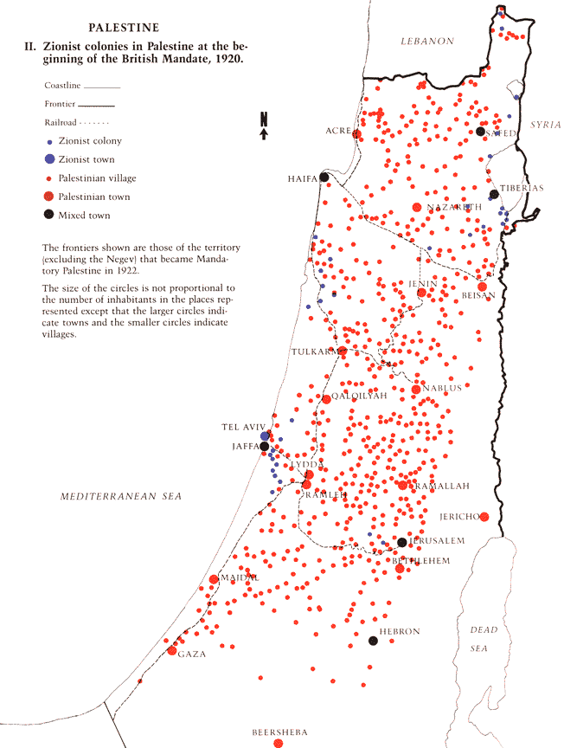
Jews & Arabs in Palestine
In 1920 there was 1 Jew to every 10 Arabs in Palestine
By 1947, the ratio was 1 Jew to every 2 Arabs
Arabs began to feel that they were losing control

Slide 15
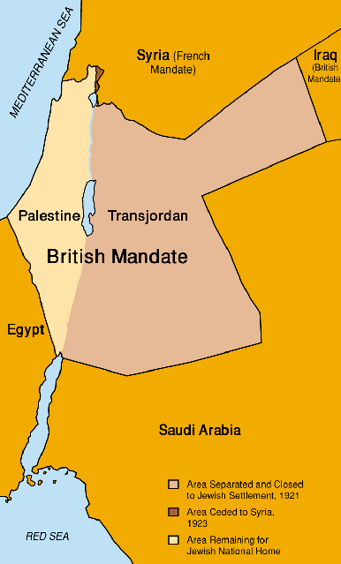
British Mandate
British Mandate in Palestine was created in July 1922
This was an area of land set aside for a national home for the Jewish people

Slide 16
British White Paper of 1939
Limited Jewish immigration to Palestine to 75,000 over next 5 years between 1939 and 1944
Ended Jewish land purchases
Promised independence for Palestine within 10 years
It was NOT British policy that Palestine would become Jewish state – but Hitler changed that
During WW2, 6 Million Jews were killed by the Nazis and this sparked a massive Jewish immigration to Palestine

Slide 17
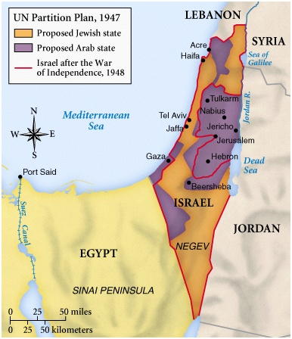
UN Partition Plan of 1947

Slide 18
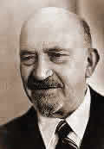
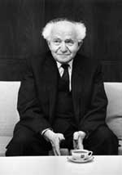
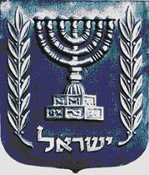
Israel Becomes a Nation: May 14, 1948
Chaim Weizmann,
1st President
David Ben-Gurion,
1st Prime Minister

Slide 19
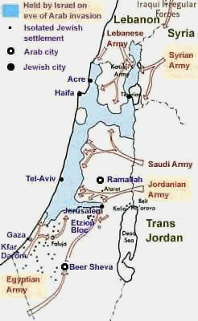
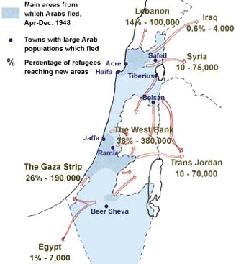
War Begins! May 15, 1948

Slide 20
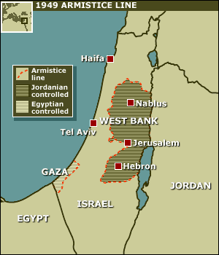
War Ends, 1949

Slide 21
Suez Conflict
Egypt nationalized the Suez Canal and in 1956, Britain and France worked with Israel to recapture it
UN insisted that French and British pull out of Suez
UN also demanded that Israel pull back to the 1949 Armistice line
Showed Britain was no longer a super power and led to decolonization
Laid the groundwork for the Six Day War

Slide 22
Leading to the Six Day War
During the 1960s, Syria repeatedly shelled border villages
In 1967, Israeli fighter aircraft began to fight back
Egypt ordered UN forces out of Gaza and Sinai and blocked Israel’s only outlet to the Red Sea
Israel saw this as grounds to go to war

Slide 23
Six Day War
Israel destroyed Egyptian, Syrian and Jordanian aircrafts
Following the air campaigns came a ground invasion of Sinai and the Gaza Strip, Jordan and then, Syria
This was a swift and stunning victory for Israel
Israel began to build new settlements in disputed territories
For nearly two years following this, Egyptians and Israelis waged a low-level war

Slide 24
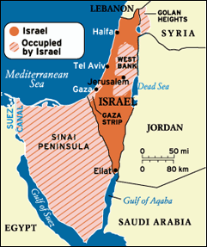
Map of Israel After Six Day War

Slide 25
Yom Kippur War
The Egyptian leader, Anwar Sadat, proposed a peace offer that was rejected by Israel
ANWAR SADAT: president of Egypt 1970-1981
This rejection convinced Sadat to start a war
Egypt and Syria chose Yom Kippur – the Jewish Day of Atonement – to launch a surprise attack on Israel
Soviet Union and US quickly got involved
War shattered Israel’s image of invincibility
Israel “won,” but became more dependant on the US for military, economic and diplomatic aid

Slide 26
Camp David Accords
In 1977, Egypt engaged Israel in peace efforts
US President Jimmy Carter brought Israel Prime Minister Menachem Begin and Egyptian President Anwar Sadat to Camp David for peace talks
MENACHEM BEGIN: prime minister of Israel 1977-1983
The Camp David Accords were signed on September 17 and restored Sinai to Egypt and allowed passage for Israelis through Suez Canal and Egypt recognized Israel as a country
First agreement between Israel and an Arab nation

Slide 27
Effects of the Camp David Accords
ISRAEL
Shows that the country is willing to trade land it has conquered for peace
PALESTINIAN
AND ARAB NATIONS
Egypt recognizes that Israel is a country and exists
Sadat assassinated in 1981 by Muslim extremists
Jordan signs peace agreement with Israel in 1994

Slide 28
First Intifada
INTIFADA: Palestinian uprising against Israeli occupation of the West Bank and Gaza Strip, beginning in 1987
Officially ended when the Oslo Accords were signed in 1993
Inspired a more intense push for a “two-state solution”
TWO-STATE SOLUTION: a solution to the Israeli-Palestinian conflict that calls for two separate states – a State of Palestine and a State of Israel
Led to Israel recognizing the PLO as legitimate

Slide 29
Peace Efforts Continued
During the 1990s, several advances towards peace were made
Oslo Accords in 1993
  Palestinian Leader Yasser Arafat and Israel Prime Minister Yitzhak Rabin met to begin working out a peace deal
  Israel and the Palestinian Liberation Organization (PLO) negotiated a Declaration of Principles
  PLO recognized Israel in 1988
Rabin was assassinated by a Jewish extremist in November of 1995

Slide 30
Palestinian Liberation Organization
PLO: Palestinian Liberation Organization; founded in 1964 with the purpose of liberating Palestine through armed struggle
After the Oslo Accords, negotiation and diplomacy became the official policy of the PLO
Yasser Arafat led the PLO from 1994 to 2004, but held positions high up within the PLO prior to acting as President
Currently led by Mahmoud Abbas

Slide 31
Second Intifada
By 2000, the peace process had faded
In 2000, Israeli Prime Minister Ariel Sharon visited Temple Mount in Jerusalem
ARIEL SHARON: prime minister of Israel 2001-2006
TEMPLE MOUNT: one of the most important religious sites in the Old City of Jerusalem and is considered to be the holiest site in Judaism and the 3rd holiest site in Islam
Palestinians took offense to Sharon’s visit and violence erupted
Buses, discos, hotels, fast food restaurants, etc. were blown up by Palestinian suicide bombers
Israel responded militarily and built walls around West Bank
Ended in 2005 when Abbas and Sharon agreed that Palestinians would stop violence against Israelis and Israel would cease military activity against Palestinians

Slide 32
The Gaza Strip
In 2005, Israel removed its settlements from the Gaza Strip and gave much control to Palestinian government – with exceptions of border, airspace and coastline
Gaza then fell under control of Hamas
HAMAS: Palestinian Islamic organization; designated as a terrorist group by the European Union, Canada, Israel, Egypt, Japan & the United States
Since 2007, Hamas has been launching rockets into Israel
In July 2014, issues came to a head again when for 50 days from July to August, Israelis were bombarded with rocket attacks and ground fighting killed over 2,000 people

Slide 33
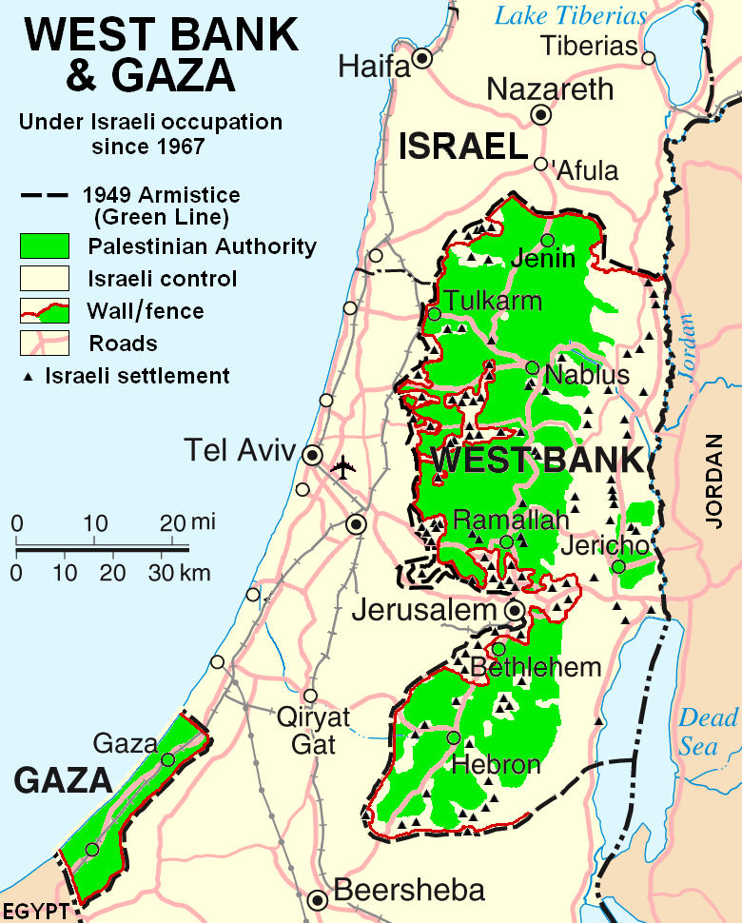
Map of West Bank & Gaza, Present Day

Slide 34
Currently in Israel
Palestinian wave of attacks on Israeli soldiers, police and civilians began earlier this year
In the past, Israel has been able to fight back with checkpoints and a missile defense system (Iron Dome)
With this new wave of attacks, many have been carried out by young Palestinian men, and most often a knife or other sharp object has been used – making it hard for Israel to stop the attacks
Fear has settled over Jerusalem, but still, the majority of people – both Israeli and Palestinian – want peace

Slide 35
Islam
Section Three

Slide 36
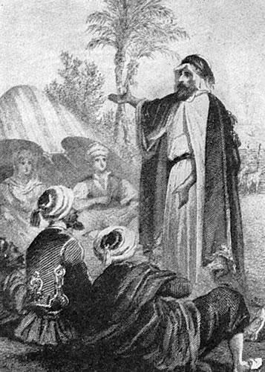
The Muslim World: What Is Islam?
Around 600 AD, a new monotheistic religion began called Islam
The faith was founded by the prophet Muhammad
His followers, called Muslims, spread Islam throughout the Middle East, Africa, Asia, & Europe

Slide 37
Muhammad and Islam
In 610, Muhammad heard the voice of the Angel Gabriel, who told him that he was a prophet sent to Earth by God
His wife, Khadija, encouraged him to accept the call to God
Muhammad began preaching a new faith called Islam
ISLAM: “submission to God”
Notes:
After much soul-searching, Muhammad came to believe that the Lord who spoke to him through Gabriel was Allah. Muhammad became convinced that he was the last of the prophets. He began to teach that Allah was the one and only God and that all other gods must be abandoned. People who agreed to this basic principle of Islam were called Muslims. In Arabic, Islam (ihs•LAHM) means “submission to the will of Allah.” Muslim (MOOZ•lim) means “one who has submitted.” Muhammad’s wife, Khadijah, and several close friends and relatives were his first followers.

Slide 38
Muhammad and Islam
At first, Muhammad angered many people by preaching his new religion. In 622, he left Mecca with his followers to the city of Medina, a journey that is known as the HIJRA.
Hijra was the turning point for Islam
Medina is known as the “City of the Prophet”
In 630, Muhammad returned to Mecca
Muhammad died in 632, sending his followers into grief
Abu Bakr was elected to be the first caliph
CALIPH: successor to Muhammad
Notes:
In 630, Muhammad returned to Mecca and destroyed the idols in Ka’aba
– Muhammad’s reputation grew and many Arabs converted

Slide 39
The Message of Islam
Islam is based on strict monotheism
MONOTHEISM: belief in only one God
Islam believes in one all powerful and compassionate God, known as Allah
Islam is a religion that teaches peace and compassion
All Muslims accept 5 basic duties, known as the 5 Pillars of Islam: 1. Shahadah: Declaration of Faith, 2. Salat: Daily Prayer, 3. Zakat: Giving Charity to the Poor, 4. Sawm: Fasting from Sunrise to Sunset during Ramadan, and 5. Hajj: Pilgrimage to Mecca.
Notes:
Qur’an teaches about God AND provides a guide to life
Converts typically learn Arabic to read the Qur’an in its original form

Slide 40
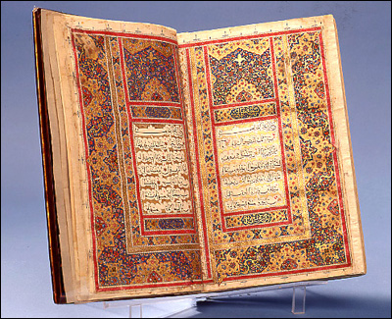
The Message of Islam: The Quran
QURAN (or Koran): sacred text of Islam
Contains the sacred word of God as revealed to Muhammad & is the final authority on all matters
Islam teaches responsibility for all actions, and believes in a hell and a paradise

Slide 41
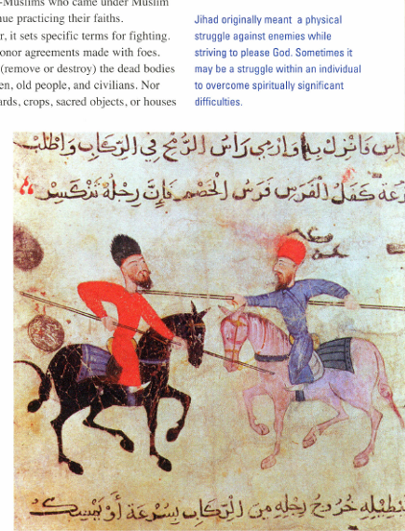
Message of Islam: JIHAD
JIHAD: effort in God’s service
Often wrongly translated as “holy war” but it includes acts of charity and the inner struggle to achieve spiritual peace

Slide 42
Movements Within Islam
SUNNI MUSLIMS
SHIA MUSLIMS
Believe the caliph should be chosen by leaders of the Muslim community
Agree Caliph should be a pious Muslim
Believe the caliph should be seen as a leader, not a religious authority
Believe the only true successors of the caliph are descendants of Muhammad’s daughter and son-in-law (Fatima & Ali)
Believes descendants are divinely inspired
A 3rd movement, the Sufi Muslims, has emerged.
Sufis are Muslim mystics who seek direct communication with God through meditation, fasting & other rituals.
Notes:
After Muhammad’s death, a division arose, and split into two main factions – sunni and shiite muslims.
Muhammad’s son-in-law Ali was the 4th caliph, but he was assassinated in 661 and his son was also later killed.
This division has survived over 1300 years and today, approx. 90% of Muslims are Sunni.

Slide 43
Saudi Arabia
Section Four

Slide 44
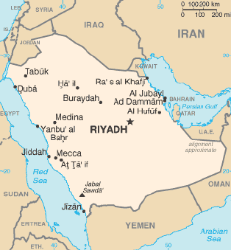
Geography of Saudi Arabia

Slide 45
Geography of Saudi Arabia
The 2nd largest state geographically in the Arab world after Algeria
Only nation with coasts on both the Red Sea and the Persian Gulf
Known as the “Land of the Two Holy Mosques” because the two holiest sites in Islam (Mecca and Medina) are there

Slide 46
Foundation of Saudi Arabia
Ottoman Empire had control of the Arabian Peninsula until World War I
In 1916, with British support, Hussein bin Ali, led a pan-Arab revolt against the Ottoman Empire to create a united Arab state
The area of modern-day Saudi Arabia had consisted of four distinct regions: Hejaz, Najd, parts of Eastern Arabia and Southern Arabia
In 1932, the Kingdom of Saudi Arabia was founded by Ibn Saud
He united the regions into a single state

Slide 47
Discovery of Oil
At first, Saudi Arabia was one of the poorest countries in the world
In 1938, vast reserves of oil were discovered along the coast of the Persian Gulf
A full scale development of the oil fields began in 1941
Oil provided Saudi Arabia with economic prosperity
Government became wasteful and extravagant
By 1950s, there were large governmental deficits and foreign borrowing was weighing heavily on the country
OPEC: Organization of the Petroleum Exporting Countries
OPEC was established in 1960 to “coordinate and unify the petroleum policies of its member countries and ensure the stabilization of oil markets, in order to secure an efficient, economic and regular supply of petroleum to consumers, a steady income to producers, and a fair return on capital for those investing in the petroleum industry”
Saudi Arabia is the de-facto leader of OPEC

Slide 48
Life Under Saud and Faisal
In 1953, Saud of Saudi Arabia became the king of Saudi Arabia
Held power until 1964 when his half brother took over
FAISAL OF SAUDI ARABIA: king of Saudi Arabia 1964-1975 who implemented a policy of modernization and reform
King Faisal was pro-Palestinian and led an oil boycott in 1973 against Western countries that had supported Israel in the Yom Kippur War
Oil prices surged in the US and Europe

Slide 49
1979
In 1979, two events occurred that had long-term effects on Saudi foreign and domestic policy
The Iranian-Islamic Revolution: it was feared that the country’s Shi’ite minority in the Eastern Province might rebel and there were several anti-government uprisings
Grand Mosque Seizure: Islamist extremists took over Al-Masjid al-Haram in Mecca (the holiest site in Islam) and in 10 days killed hundreds of militants, security forces and hostages
In response, the royal family enforced a much stricter observance of the traditional religious and social norms in the country

Slide 50
1980s
Saudi Arabia continued to strengthen ties with the US and increased the amount of British and American military weapons purchased
King Fahd became king in 1982, when his half-brother, King Faisal, died
FAHD BIN ABDULAZIZ AL SAUD: king of Saudi Arabia from 1982-2005
During King Fahd’s rule, he supported Iraq against Iran, supported the UN, and worked to develop a peace plan to resolve Arab differences

Slide 51
Saudi Arabia Under King Abdullah
Abdullah came to power in 2005 and introduced economic reforms
In 2009, he announced a series of governmental changes to modernize many government institutions
Since 2011, Saudi Arabia has been affected by some revolutionary protests
In 2011, Abdullah announced benefits for citizens, aimed towards housing and job security
Municipal elections planned for December 12, 2015 will allow women to vote and to be elected to government positions

Slide 52
Government in Saudi Arabia
Saudi Arabia is an absolute monarchy
The royal family in Saudi Arabia is the Al Saud family
The rule of Al Saud is opposed from 4 main places: Sunni Islamist activism, liberal critics, Shia minority and tribal opponents
The king follows Sharia (Islamic law) and the Quran
The Quran and the Sunnah (traditions of Muhammad) are declared to be the country’s constitution
No political parties or national elections are allowed
Saudi Arabia is the only country in the world that bans women from driving

Slide 53
Saudi Arabia and Islam
Almost all Saudi citizens are Muslim
Approximately 75-90% of those Muslims are Sunni Muslims (with the remaining 10-25% being Shia Muslims)
Official and dominant form of Sunni Islam in Saudi Arabia is known as Wahhabism
WAHHABISM: an ultraconservative and fundamentalist branch of Sunni Islam
The alliance between the founder of the Wahhabi movement, Muhammad ibn Abd al-Wahhab, and the al Saud family has lasted for almost 250 years
Today, the teachings of Wahhabism are state-sponsored and the official form of Sunni Islam in 21st century Saudi Arabia
Wahhabism has been accused of being the foundation for widespread terrorism and inspiring the ideology for ISIS

Slide 54
International Opinion
Saudi Arabia joined the UN in 1945 and plays a major role in the IMF (International Monetary Fund) and the WTO (World Trade Organization)
Much international debate over the culture within Saudi Arabia exists
After 9/11, relations with the US became strained
American politicians and media have accused the Saudi government of supporting terrorism and tolerating an extremist culture
Despite this, in the Arab and Muslim worlds, Saudi Arabia is considered to be pro-Western and pro-American and it is officially a long-term ally of the US, although relations have become less close in recent years

Slide 55
Iran
Section Five

Slide 56
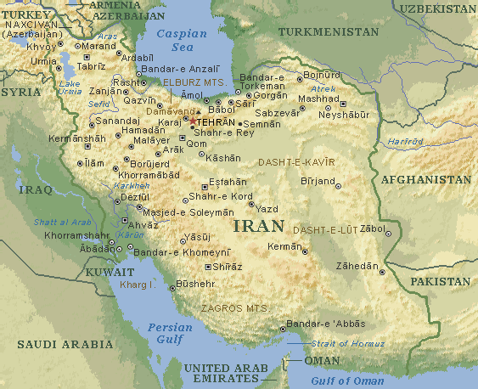
Geography of Iran

Slide 57
Iran in the 1950s
Dr. Mohammad Mossadegh became Prime Minister in 1951
He nationalized foreign oil companies and got rid of corrupt military officials
Mossadegh was overthrown in a coup aided by the American CIA in 1953
Shah of Iran increased his power

Slide 58
Shah Reza Pahlavi
SHAH REZA PAHLAVI: king of Iran from 1941 to 1979
Instituted western reforms and maintained close ties with the west
Majority of the people in Iran lived in poverty and he brutally suppressed his opponents
He and his wife, Farah, were part of the Iranian upper and intellectual classes – very pro-Western

Slide 59
White Revolution
The Shah set forth a reform program in 1963 that did 6 major things:
Land Reform – 90% of peasants became land owners
Initiated massive government financed industry projects
Granted women more political power – right to vote
Put government money into education to improve literacy
Introduced profit-sharing for industrial workers
Nationalized forests and pasture lands

Slide 60
Fall of the Shah
The Shah spent oil profits on American military hardware, leaving little money to reinvest back into Iranian economy
Religious leaders were angry about Westernization
Enormous amounts of corruption existed within the government
The Shah was mainly opposed by field workers, students, middle class businessmen, Iranian nationalists and Muslim clerics
The Shah left Iran on January 16, 1979 and was officially overthrown on February 11, 1979

Slide 61
Iranian Revolution
After the Shah left Iran, Khomeini – a political figure against the Shah - was invited back from exile by the Iranian government and returned to Tehran
TEHRAN: capital of Iran
Iran voted by national vote to become the Islamic Republic on April 1, 1979 and approved a new theocratic-republican constitution
Khomeini became Supreme Leader of the country in December 1979

Slide 62
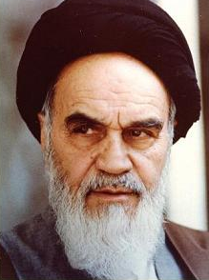
Ayatollah Khomeini (1902-1989)
Khomeni began to speak out against the Shah in the 1960s
Arrested and imprisoned several times
He was deported in 1978 and went to France before returning to Iran
Believed that women should be veiled to show their Islamic and moral values
Funded Hamas and supported Palestinian cause against Israel

Slide 63
Iran Hostage Crisis
Diplomatic crisis between Iran and the United States
52 American diplomats and citizens were held hostage for 444 days (November 4, 1979 to January 20, 1981) after a group of students supporting the revolution took over the US Embassy in Tehran
Iran was angry with the US for allowing the former Shah to receive medical treatment and saw it as support for the Shah’s actions
US saw the hostage crisis as a violation of international law
Failed rescue attempts caused further issues
The Iraq-Iran War began in September 1980 and led to Iran entering negotiations with the US to return hostages
Hostages formally released on January 20, 1981, minutes after Ronald Reagan was sworn into office as President

Slide 64
Iran-Iraq War (1980-1988)
IRAN-IRAQ WAR: armed conflict from 1980-1988 between Iran & Iraq that began when Iraq invaded Iran
Came after a long history of border disputes and was motivated by fears that the Iranian Revolution would inspire insurgency and unrest
Iraq hoped to take advantage of Iran’s revolutionary chaos and attacked without formal warning
Iraq made limited progress and by 1982, Iran regained all lost territory and for the next 6 years, Iran was on the offensive
War finally ended with Resolution 598, a UN brokered ceasefire accepted by both sides

Slide 65
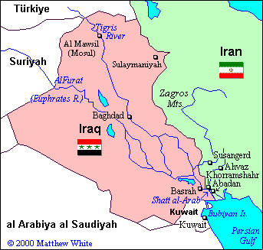
Map of the Iran-Iraq War

Slide 66
After the Death of Khomeini
Ayatollah Khomeini died in June 1989
The new Supreme Leader is Ayatollah Ali Khameini, who served as the President of Iran from 1981-1989
The Ayatollah represents fundamentalist Muslims but is considered to be very politically conservative
Khameini is considered the most powerful political authority in Iran
Khameini has said that he believes in the importance of nuclear technology for civilian purposes but has issued statements condemning nuclear weapons

Slide 67
Present Day Iran
Since 2005, Iran’s nuclear program has become a subject of issue among the international community
Many countries have expressed concern that Iran’s nuclear program could divert civilian nuclear technology into a weapons program
UN Security Council imposed sanctions against Iran
Hassan Rouhani was elected President of Iran on June 15, 2013
Rouhani signed the 2013 Geneva Agreement and this provided temporary lifting of some sanctions, but not all
This has improved Iran’s relations with other foreign countries

