Slide 1
How to Read a Textbook

Slide 2
Your textbook is written like...

Slide 3
...an essay!!!

Slide 4
Note-taking is like reverse essay writing
Step 1: Find the author’s thesis. Write it down.
Step 2: Read the rest of the section looking for supporting evidence.

Slide 5
Follow a PLAN
Browsing
Skim-and-Scan
Careful Reading
with Note-taking
4. Reminding

Slide 6
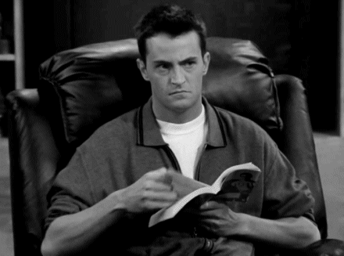
BROWSING
Look through the reading. Read the headings, sections, and sub-sections. Read and look at all of the maps, drawings, painting, graphs, and charts. Just “look around” at what you will be reading. (15-20 minutes)

Slide 7
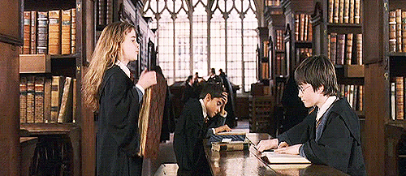
2. SKIM-and-SCAN
Read the opening remarks of the reading. Read the first paragraphs of each section. Find the thesis for the chapter & sections. (30-45 minutes)

Slide 8
3. CAREFUL READING with NOTE-TAKING
With pen in hand, carefully read the chapter from start to finish. Take outline notes with headings matching those in the chapter. Don’t rewrite the book. Take quick notes of things you will need to remember. You may also wish to start notecards. (2-4 hours)

Slide 9
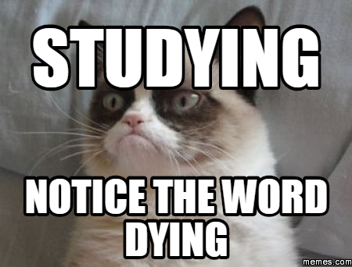
4. REMINDING
Let the notes remind you what is in the text, referring to the text only when you need to. Reread the introduction and conclusion to the chapter. This is a final check before the exam. (30-45 minutes)

Slide 10
Note-taking Tips

Slide 11
Do you read a sentence, write down a note, read a sentence, write down a note?

Slide 12
STOP writing down EVERYTHING! You will need to determine what parts are the main ideas and their supporting evidence.

Slide 13
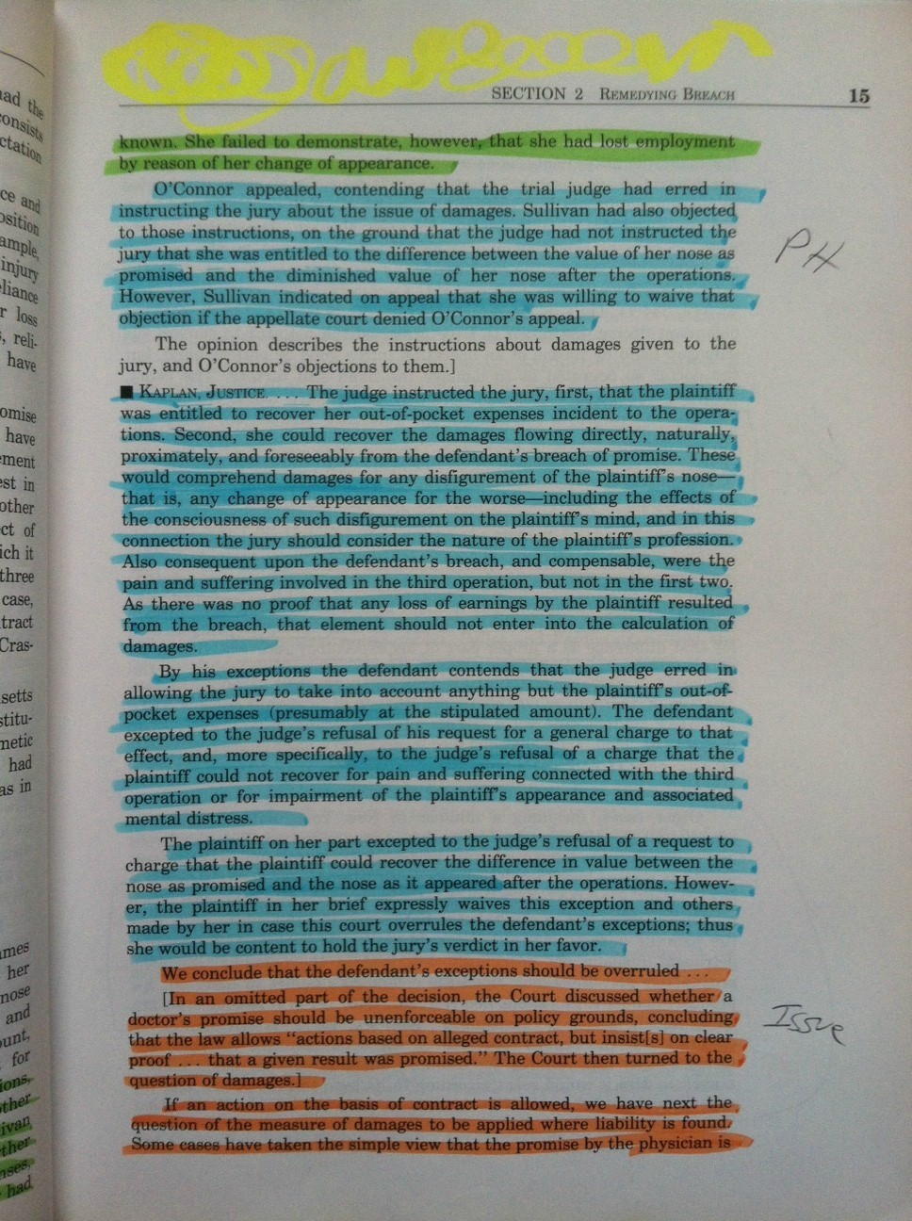
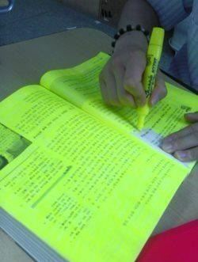

Slide 14
Eliminate Distractions!
CELL PHONE, internet, other people, music (unless instrumental)

Slide 15
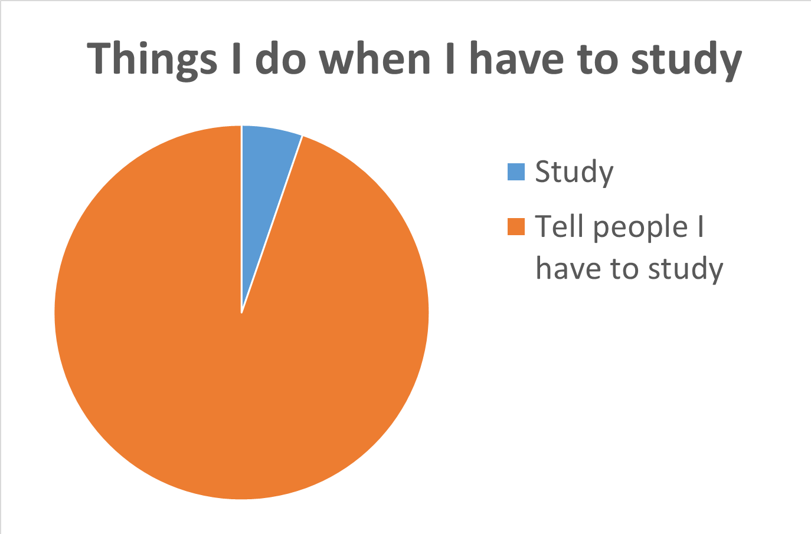

Slide 16
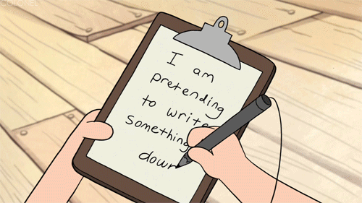
Note-taking Formats

Slide 17
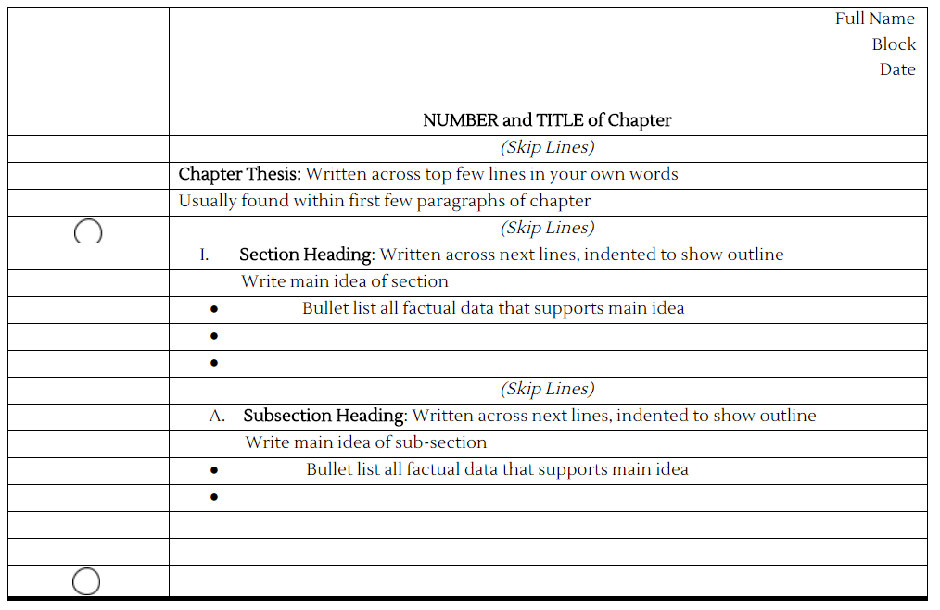
Outline Notes

Slide 18
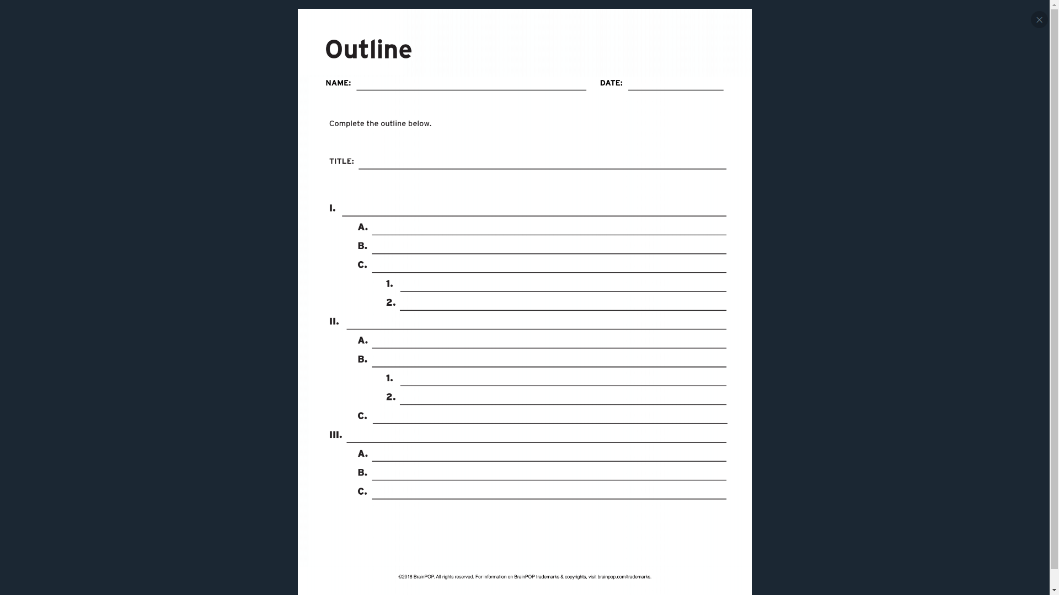
Outline Notes

Slide 19
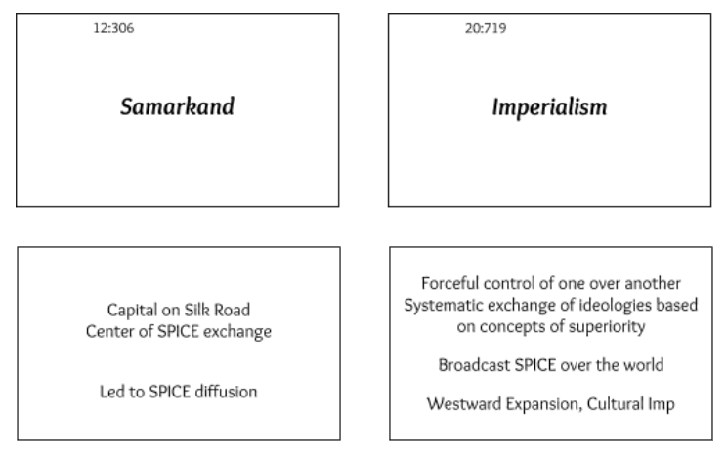
Notecards

Slide 20
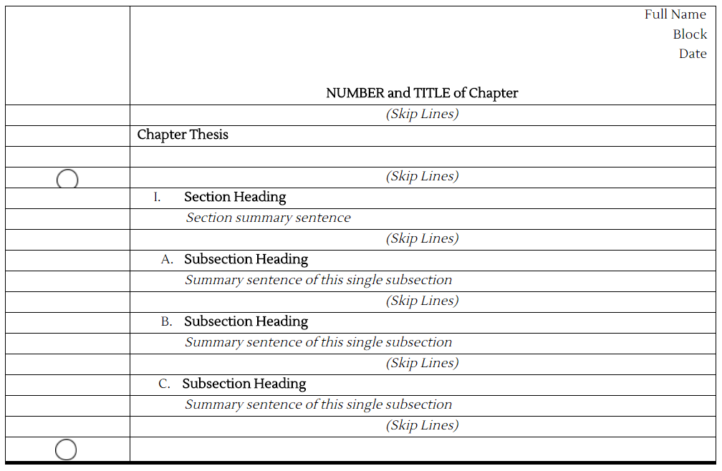
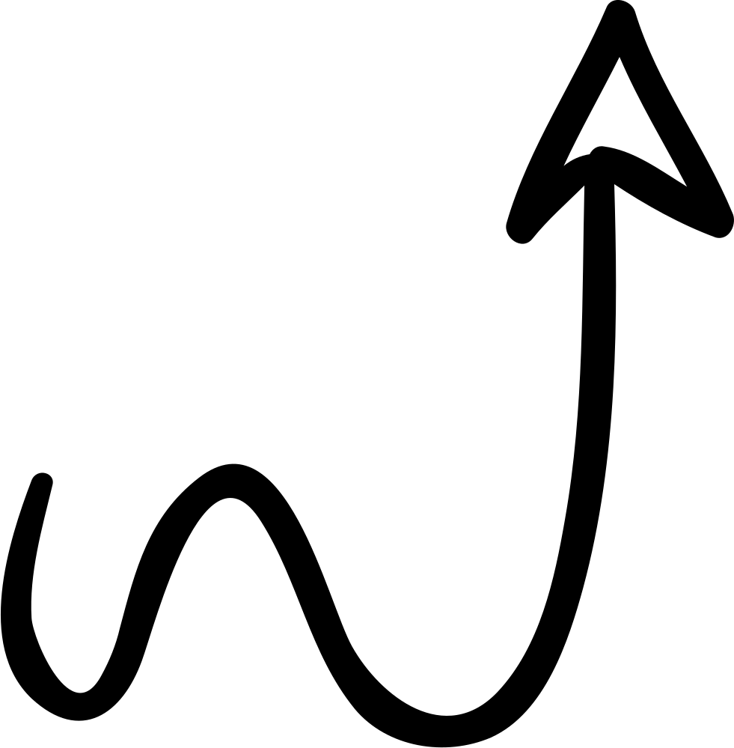
Using Subheadings
The synthesis of the section summaries should match the “thesis summary”.
The synthesis of these sub-section summaries should match the “section summary sentence”.

