Slide 1
vietnam
1945 to Present Day

Slide 2
Vietnam before 1945
In the early 1900s, France controlled much of the resource-rich Southeast Asia
French Indochina was made up of what are now Vietnam, Laos and Cambodia
Nationalist independence movements began to develop
A young Vietnamese nationalist, Ho Chi Minh, turned to the Communists for help in his struggle
During the 1930s, Ho’s Indochinese Communist Party led revolts and strikes against the French
Forced into exile, Ho returned to Vietnam in 1941, a year after Japan seized the country in WW2, and founded the Vietminh (Independence) League

Slide 3
When world war II ended…
Japanese forces were forced out of Vietnam after their defeat in 1945
Ho Chi Minh believed that independence would follow but France intended to regain its colony
Vietnamese Nationalists and Communists joined to fight the French armies
French held the major cities, but the Vietminh held widespread support in rural areas
In France, people began to doubt that their colony was worth the lives and money the struggle was costing
In 1954, the French surrendered to Ho

Slide 4
Vietnam and the cold war
The struggle for Vietnam quickly became a part of the Cold War
With the defeat of the French in Vietnam, the US saw a rising threat to the rest of Asia and described it in terms of the domino theory
DOMINO THEORY: the theory that the Southeast Asian nations were like a row of dominos and the fall of one to communism would lead to the fall of its neighbors

Slide 5
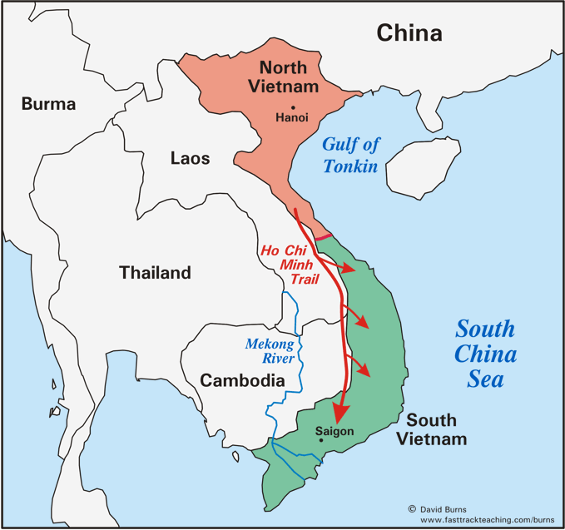
Vietnam – a divided country
After France’s defeat an international peace conference met to discuss the future of Indochina
Vietnam was divided at 17 degrees north latitude
North of that line, Ho Chi Minh’s Communist forces would govern
To the south, the US and France set up an anti-Communist government under the leadership of Ngo Dinh Diem
Notes:
HI Chi Minh Trail was a logistical system from North to South Vietnam to provide support

Slide 6
Rise of opposition
Diem ruled the south as a dictator and opposition to his government grew
Communist guerrillas called Vietcong began to gain strength in the south
Gradually the Vietcong won control of large areas
In 1963, a group of South Vietnamese generals had Diem assassinated, but the new leaders were no more popular
It appeared that a takeover by the Communist Vietcong, backed by North Vietnam, was inevitable

Slide 7
US Involvement
In 1964, Congress authorized LBJ to send US troops to Vietnam
US faced difficulty in unfamiliar terrain, unpopular South Vietnamese government that they were defending and growing support for the Vietcong
Unable to win a decisive ground victory, the US turned to air power and bombed millions of acres of forests and farmlands – only strengthening the peasants’ opposition to the South Vietnamese government
The war grew increasingly unpopular in the US and Nixon began to withdraw troops in 1969 beginning the plan of Vietnamization
VIETNAMIZATION: allowed US troops to gradually leave, while the South Vietnamese increased their combat role
The last troops left in 1973 and 2 years later the North Vietnamese army overran South Vietnam
More than 1.5 million Vietnamese, and 58,000 Americans, lost their lives

Slide 8
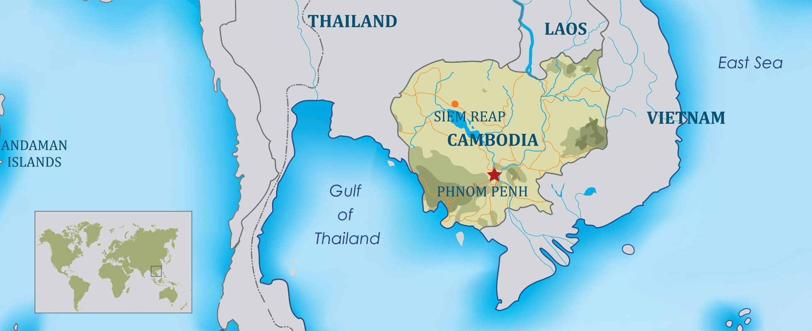
Postwar in southeast asia
The end of the Vietnam War did not bring an immediate halt to bloodshed and chaos in the region
Cambodia was under siege by Communist rebels and during the war it had suffered US bombing when it was used as a sanctuary by North Vietnamese and Vietcong troops

Slide 9
Cambodia in turmoil
In 1975, Communist rebels known as the Khmer Rouge set up a brutal Communist government under the leadership of Pol Pot
In a ruthless attempt to transform Cambodia into a Communist society, Pol Pot’s followers slaughtered 2 million people – almost ¼ of the nation’s population
Known as the Cambodian Genocide, people died from executions and torture, as well as famine and terrible diseases such as malaria
The Khmer Rouge forced relocation of the population from urban centers and used forced labor
Almost 20,000 mass graves, known as “Killing Fields” have been uncovered
The Vietnamese invaded in 1978 and overthrew the Khmer Rouge
Fighting continued and the Vietnamese withdrew in 1989
In 1993, under the supervision of the UN, Cambodia adopted a democratic constitution and began holding free elections

Slide 10
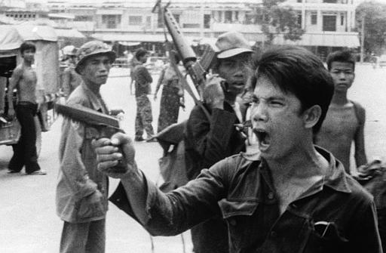
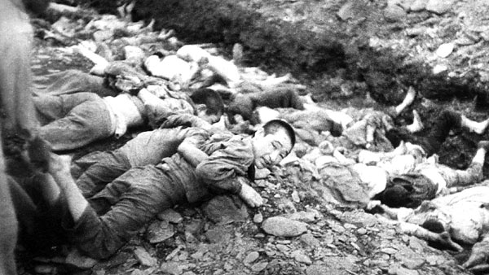
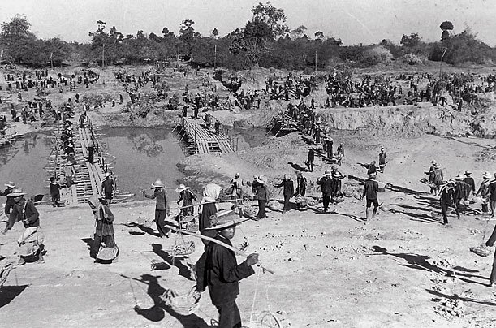
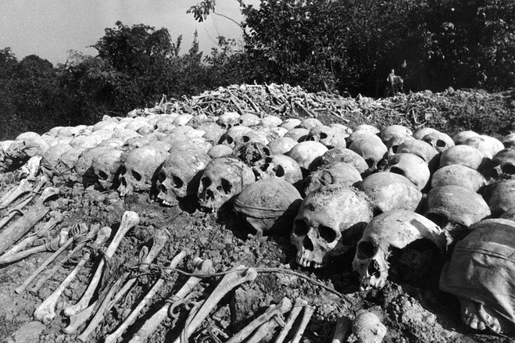
Cambodian genocide

Slide 11
Vietnam after war
After 1975, the victorious North Vietnam imposed tight controls over the South
Communist oppression caused 1.5 million people to flee Vietnam and most escaped in dangerously overcrowded ships
More than 200,000 “boat people” died at sea and survivors spent months in refugee camps, with approximately 70,000 eventually settled in the US or Canada
Communists still govern Vietnam, but the country welcomes foreign investment and the US normalized relations with Vietnam in 1995

Slide 12
Vietnam today
One of the world’s four remaining single-party socialist states officially supporting communism
The Prime Minister acts as head of government, and there is also a President who acts as a ceremonial head of state and a Commander-in-Chief of the military who acts as council
Since 2000, Vietnam’s economic growth rate has been among the highest in the world
In 2011, it had the highest Global Growth Generators Index among 11 major economies
Its successful reforms led to it joining the World Trade Organization in 2007
Despite successes, Vietnam remains under fire for its human rights violations – including restricting freedom of speech, press, assembly, association and religion
To date, Vietnam holds more than 160 political prisoners who have committed no real “crimes” and police routinely use torture and beatings

