Slide 1
The USSR
1945 to Present Day

Slide 2
When World War II Ended…
The USSR was a communist country led by a totalitarian dictator – Joseph Stalin
They occupied much of Eastern Europe because they took it from the Germans during World War 2
The USSR had lost over 22 million people and faced massive destruction
Stalin did not trust President Franklin Roosevelt or Prime Minister Winston Churchill

Slide 3
Goals after WWII
Goals of the US
Goals of the USSR
Prevent Communism from spreading
Encourage Democracy
Gain access to European markets
A Stable Europe
Reunite and Stabilize Germany
Spread Communism
Rebuild the Soviet economy
Control Eastern Europe
Protect its borders
Keep Germany divided and weak
Balance US influence in Western Europe

Slide 4
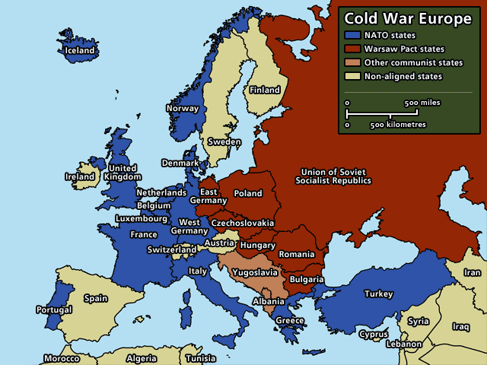
Cold War Europe

Slide 5
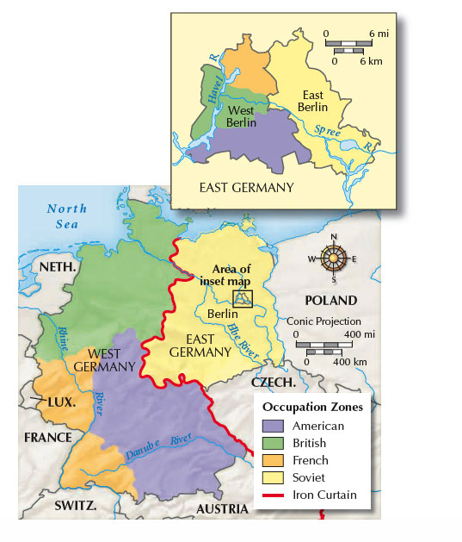
Germany During the Cold War

Slide 6
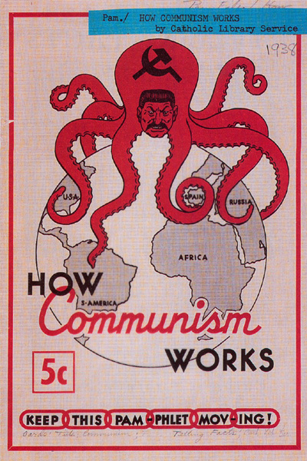
Containment
Truman’s policy of dealing with the USSR
CONTAINMENT: an attempt by the USA to block any more countries from becoming communist
WHAT COULD POSSIBLY GO WRONG?
Korean War
Vietnam War
Trouble with Iran
Dictators in South America
Nearly WWIII

Slide 7
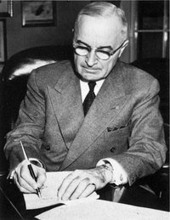
The Truman Doctrine
TRUMAN DOCTRINE: promise by President Truman to help any country that was trying to resist communism
Started with aid to Greece and Turkey
It made it clear to the USSR that Americans would resist Soviet expansion around the world
Stalin saw this is as an attempt to isolate the USSR

Slide 8
The Marshall Plan
European assistance program
Provided food, machinery, and other materials to rebuild Europe
Stalin rejected any aid for the USSR and the countries under his control
Stalin went so far as to forbid Eastern European countries to accept American aid and promised aid from the USSR in its place

Slide 9
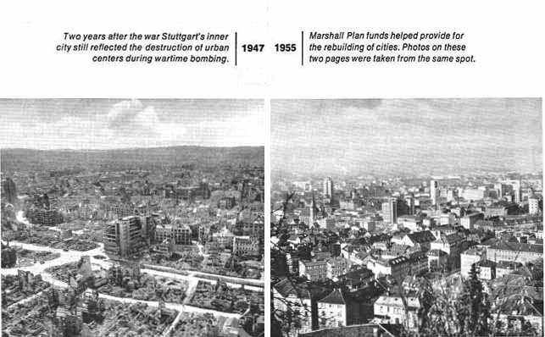
Stuttgart, Germany – 1947 & 1955

Slide 10
Berlin airlift
Germany became a divided nation with a democratic government in the west and a communist government in the east
Berlin, although in East Germany, was divided into east and west as well
In 1948, USSR tried to force the western allies out of Berlin by sealing off every railroad and highway into the western parts of the city
Western powers responded by carrying out an around-the-clock airlift
For over a year, cargo planes supplied West Berliners with food and fuel
Success forced USSR to end the blockade and deepened the hostilities

Slide 11
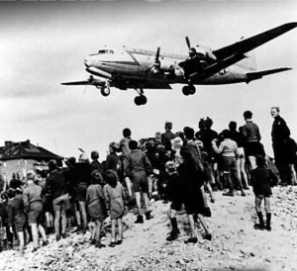
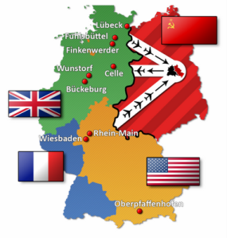
Berlin Airlift

Slide 12
NATO and the Warsaw Pact
NATO: North Atlantic Treaty Organization
An attack on one is an attack on all
Western Europe, the USA, and Canada
Formed in 1949
Members pledged to help one another if any one was attacked
The Warsaw Pact
USSR, E. Germany, Czechoslovakia, Poland, Hungary, Romania, Bulgaria, and Albania
Formed in 1955
A weapon used by the Soviets to keep its satellites in order

Slide 13
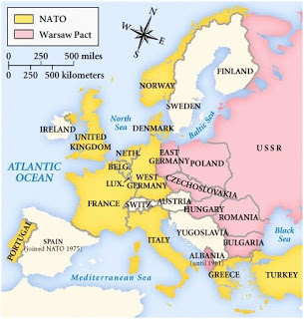
NATO/WARSAW PACT MAP

Slide 14
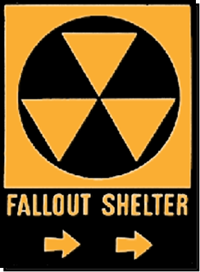
Nuclear War
1949 the USSR tested its first atomic bomb
President Truman ordered work on a thermonuclear weapon in 1950
By mid-1950s, both had intercontinental ballistic missiles (ICBMs) capable of sending bombs anywhere
Hydrogen or H-Bomb was more deadly than the atomic bomb
USA-1952
USSR-1953
DETERRENCE: policy held that huge arsenals of nuclear weapons on both sides prevented war
The Arms Race had begun!

Slide 15
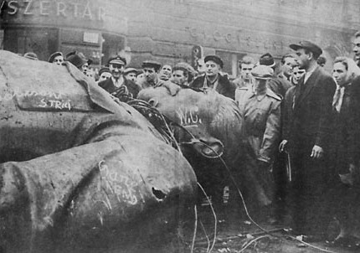
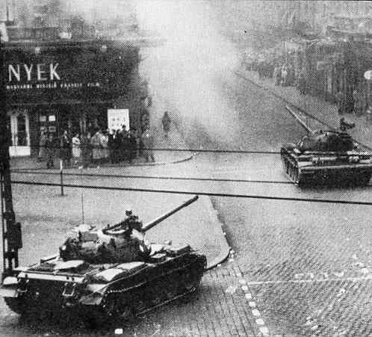
Rebellion in Hungary, 1956
Hungarian communists sought reforms
Imre Nagy, the Hungarian leader, declared Hungary a free nation on November 1, 1956
Nagy promised free elections
USSR attacked Budapest 3 days later and reestablished control over the country
Nagy was seized by the military and executed 2 years later

Slide 16
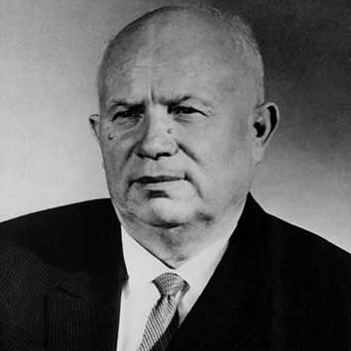
DeStalinization & The berlin wall
Joseph Stalin died in 1953
Nikita Khrushchev became the Soviet leader in 1955
Denounced Stalin’s killing of Soviet citizens
Gave Soviets and Satellites hope for change
In 1961, Khrushchev began to build a wall between East and West Berlin to stop flow of refugees
This wall became the Berlin Wall
Eventually the wall became a massive barrier and a striking symbol of the division between the two superpowers

Slide 17
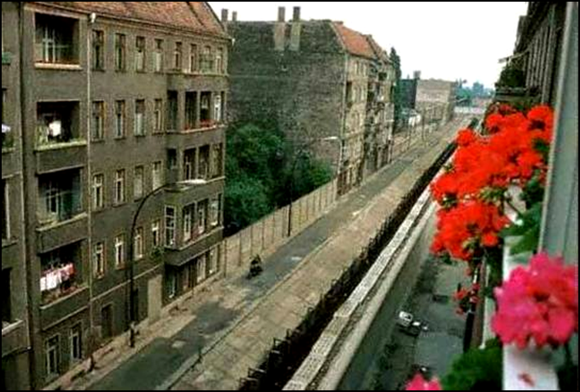
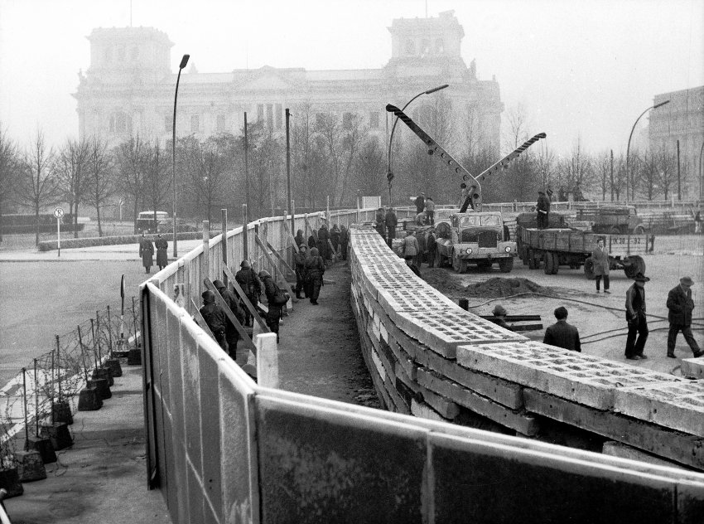
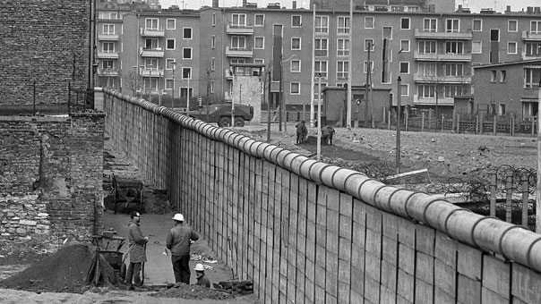
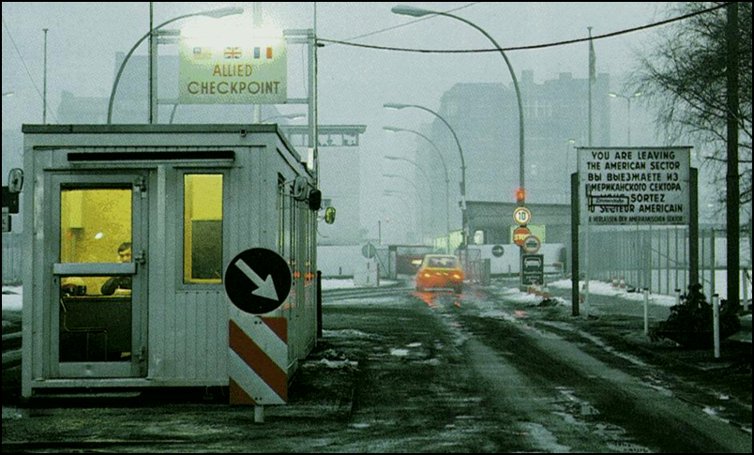
Berlin wall

Slide 18
Brinkmanship & the brezhnev doctrine
Rising tensions led the idea of deterrence lead to turn into the greater idea of brinkmanship
BRINKMANSHIP: willingness to go to the brink or edge, of war
Each side – both the US and the USSR – was willing to go to nuclear war if provoked
This commitment to brinkmanship lead to many near misses
In 1964, Leonid Brezhnev replaced Khrushchev as the leader in the USSR
Brezhnev set forth the Brezhnev Doctrine
BREZHNEV DOCTRINE: claim that the USSR had the right to prevent its satellites from rejecting communism

Slide 19
Détente
The commitment to brinkmanship broke down after the near catastrophe of the Cuban Missile Crisis
DÉTENTE: policy of lessening Cold War tension
Richard Nixon was US President when détente replaced brinkmanship
To show commitment to détente, Nixon visited China and the USSR
Talks with USSR led to the signing of the Strategic Arms Limitation Talks (SALT) I Treaty

Slide 20
The End of Détente
In late 70s, US President Jimmy Carter was concerned over treatment of protesters in the Soviet Union, but still met with Brezhnev in the USSR for second round of SALT
When the Soviets invaded Afghanistan in 1979, the second round of SALT talks fell apart
Ronald Reagan elected president of the US in 1980
Massive increase of military spending
Strategic Defense Initiative (SDI)
Tensions continued to increase throughout the 1980s

Slide 21
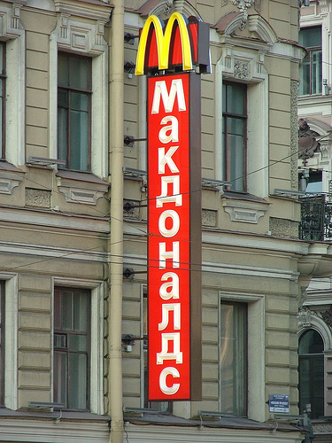
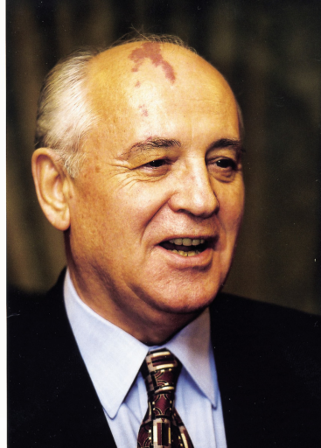
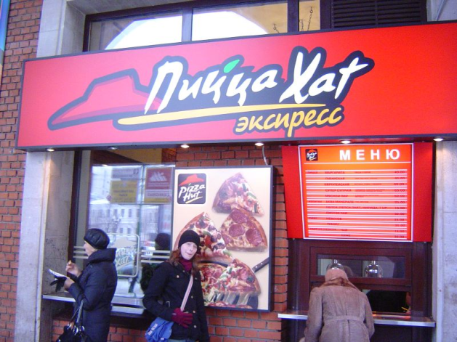
Mikhail Gorbachev Takes Power
MIKHAIL GORBACHEV: became General Secretary of the Communist Party in 1985
Youngest Soviet leader since Stalin
Unlike other Soviet rulers, he decided to pursue new ideas
Notes:
Yuri Andropov succeeded Brezhnev, died after 15 months, succeeded by Konstantin Chernenko, who died after 13 months, then Gorbachev took power

Slide 22
Glasnost & Perestroika
Soviet leaders before Gorbachev had created a totalitarian state which rewarded silence
Gorbachev knew economic and social reforms could not happen without new ideas and introduced glasnost in 1985
GLASNOST: practice of more open and consultative government and wider spread of information
Glasnost allowed consumers to complain about the lack of consumer goods and long lines
Big changes begin to occur: churches reopen, books taken off banned books list, and dissidents released from prison

Slide 23
Perestroika
Gorbachev blamed Central Planning and the Command Economy for the shortages
People could not increase pay by producing more—so they didn’t
In 1985, Gorbachev announced perestroika
PERESTROIKA: economic restructuring
Perestroika allowed managers to have more control over farms and factories and allowed people could open small private businesses

Slide 24
More Big Changes in government and foreign policy
Gorbachev did not want to end Communism, instead make it more efficient and productive
In 1987, Gorbachev announced democratization
DEMOCRATIZATION: a gradual opening of the political system
The election results surprised many—little known reformers won over party bosses
Gorbachev knew the USSR couldn’t beat the US in an expensive arms race
Instead, he focused on arms control and signed the Intermediate-Range Nuclear Forces (INF) Treaty which banned certain nuclear missiles

Slide 25
The Soviet Union Faces Turmoil
The Soviet Union was made up of 100 different nationalities—Russian is the largest
Nationalist groups in Ukraine, Georgia, and other places demanded self rule
Muslims in the south wanted religious freedom
Between the wars, Lithuania, Latvia and Estonia were independent nations, but the Soviet Union annexed them in 1940

Slide 26
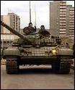
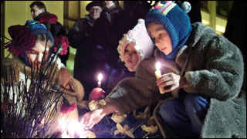
Lithuania
In March of 1990, Lithuania declared its independence
To force it back in the USSR, Gorbachev ordered an economic blockade—it did not work
In January of 1991, Soviet troops attacked unarmed citizens in Lithuania's capital
14 were killed and hundreds wounded

Slide 27
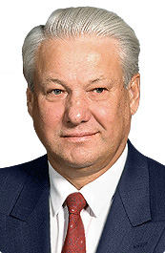
Boris yeltsin
With democratization, came major changes, and eventually the end to, the USSR
In March of 1991, the Russian people voted to change the current government into the Russian Federation
Boris Yeltsin was elected in 1991 to be the Russian Federation’s first directly elected president
Yeltsin and Gorbachev faced a common enemy in the old guard of Communist officials

Slide 28
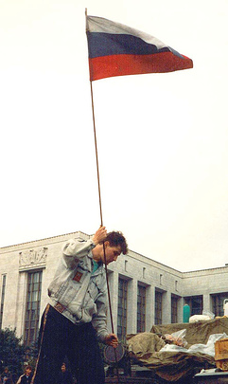
Opposition from the Old Timers
The hard line communists did not agree with reforms
August 18, 1991 they detained Gorbachev at his vacation home in the Black Sea
Protestors supporting democracy surrounded the Russian Parliament
On August 20, the hardliners ordered troops to attack the Parliament Building
THE ARMY REFUSED!
On August 21, the army withdrew from Moscow and Gorbachev returned

Slide 29
The End of the Soviet Union
The public turned against the Communist Party
Gorbachev resigned as general secretary of the Communist Party and the Soviet Parliament voted to end all party activities
Estonia and Latvia declared their independence, other republics followed
By December, all the republics had declared independence—Gorbachev pleaded for unity

Slide 30
The CIS
Yeltsin met with the leaders of the other republics to decide a new path
They agreed to form the Commonwealth of Independent States (CIS)
CIS: a loose federation of former Soviet territories
The Baltic Republics and Georgia did not join
On Christmas Day 1991, Gorbachev announced his resignation as president of the Soviet Union — a country that no longer existed

Slide 31
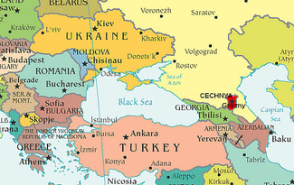
Chechnya
Mostly Muslim area in Southwestern Russia
Declared independence in 1991, but Yeltsin denied its right to leave Russia
In 1994, he ordered 40,000 troops into Chechnya
News of death and destruction sparked anger in Russia
Today, Chechnya is still under Russian rule and is still rebuilding from wars throughout the 1990s

Slide 32
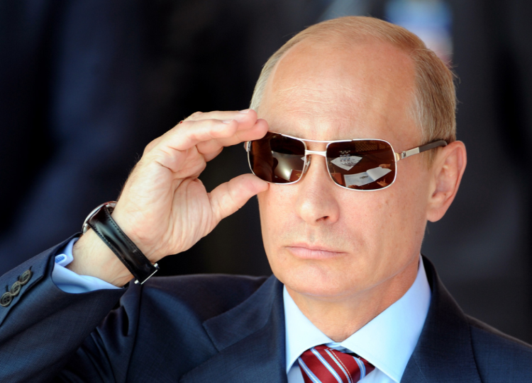
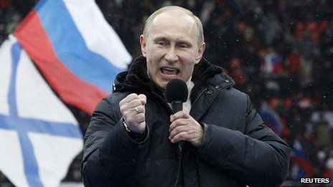
Russia under vladimir putin
VLADIMIR PUTIN: former KGB officer appointed prime minister by Boris Yeltsin and current president of Russia
When Yeltsin resigned in 1999, he appointed Putin acting president
Putin won presidential election in March 2000
Putin forcefully dealt with the rebellion in Chechnya, ending the Second Chechnyan War
Nation’s economic problems continued
Massive social problems—domestic abuse, homelessness, and alcoholism
Accused of a number of crimes, including abuse of power, civil rights violations and murder/in prisoning opponents

Slide 33
Russia today
In 2008, Dmitry Medvedev was elected president of Russia, and named Putin as Prime Minister
Medvedev and Putin ruled as a practically 2-headed government known as a government by tandem
Putin ran for a 3rd non-consecutive term in 2012 and is now serving a 6 year term as president again, in office until 2018
In February 2014, Putin annexed Crimea and caused unrest throughout Ukraine
Sanctions have been placed on Russia by countries around the world, including the US, the European Union and others, crippling the Russian economy

