Slide 1
Korea
1945 to Present Day

Slide 2
korea before 1945
Until the 20th century, Korea was an independent, although isolationist, country
Korea was not a powerful country but maintained a distinct economy focused on minerals in the north and agriculture in the south
When Japan began to build its empire, Korea was one of its first targets
Japan annexed Korea in 1910 and held it until the end of World War II

Slide 3
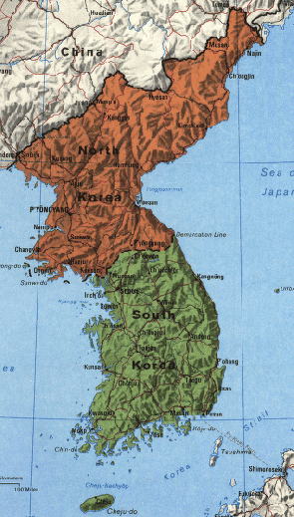
When world war II ended…
After World War II, the US and the USSR agreed to temporarily divide Korea along the 38th parallel of latitude
North Korea, ruled by Kim Il Sung, quickly became a Communist ally of the USSR
South Korea was led by a US backed authoritarian leader, Syngman Rhee

Slide 4
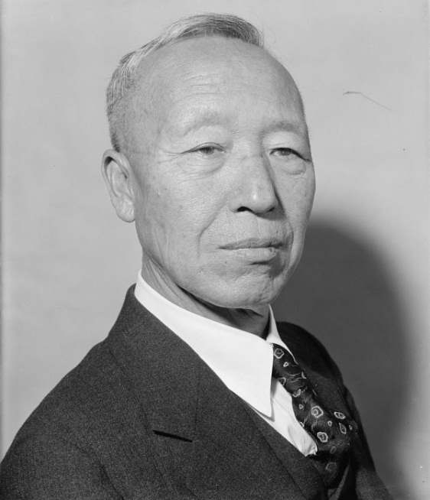
South Korea
Called the Republic of Korea
Although the government purported to be a democracy, it was really a dictatorship
President Syngman Rhee was anti-Communist and vowed to reunite Korea

Slide 5
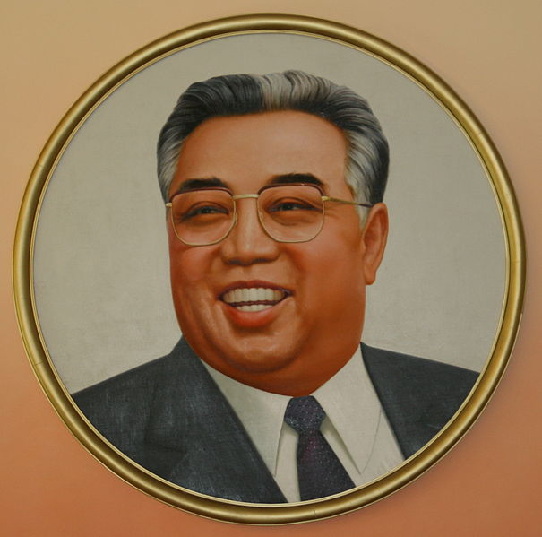
North korea
Called the Democratic People’s Republic of Korea
Dictator Kim Il Sung wanted to unify Korea under himself and socialism
He depended upon the USSR for support and did nothing without the approval of Stalin

Slide 6
The korean war
In early 1950, Kim Il Sung called for a “heroic struggle” to reunite Korea
North Korean troops attacked on June 25, 1950 with the authorization of Stalin and soon overran most of the south
The US helped organize a UN force to help South Korea because of the US policy of containment
UN forces were made up mostly of Americans and South Koreans and led by General Douglas MacArthur
MacArthur drove the invaders out of South Korea and pushed north to the Yalu River, along the border of China
MacArthur’s success scared China, who then sent Chinese troops to help the North Koreans, who again advanced southward
If China had not intervened, it is likely that Stalin would have abandoned North Korea

Slide 7
THREE LONG YEARS
The war quickly turned into a stalemate and finally on July 27, 1953, both sides signed an armistice (only after Stalin had died)
ARMISTICE: agreement signed by both sides in a war to stop fighting
The armistice has held for 50 years, but no peace treaty has ever been negotiated
More than a million North Korean and South Korean troops dug in on either side of the demilitarized zone (DMZ) – an area with no military forces – near the 38th parallel
Over 36,000 Americans died in combat, around 600,000 Chinese troops died and well over 2 million Koreans (both civilian and military) died
The only decisive outcome of the war was the precedent it set – that there could be a long and bloody conflict involving nations with nuclear weapons, and that those countries would choose not to use them

Slide 8
After the korean war
Two Koreas slowly rebuilt economies destroyed by the fighting and by years of Japanese occupation
Both remained centers of Cold War tensions
The US continued to send aid to South Korea, while the USSR continued to aid North Korea
North Korea is Communist and South Korea is a democracy
Today, the border is still at the 38th parallel and remains the most fortified border in the world

Slide 9
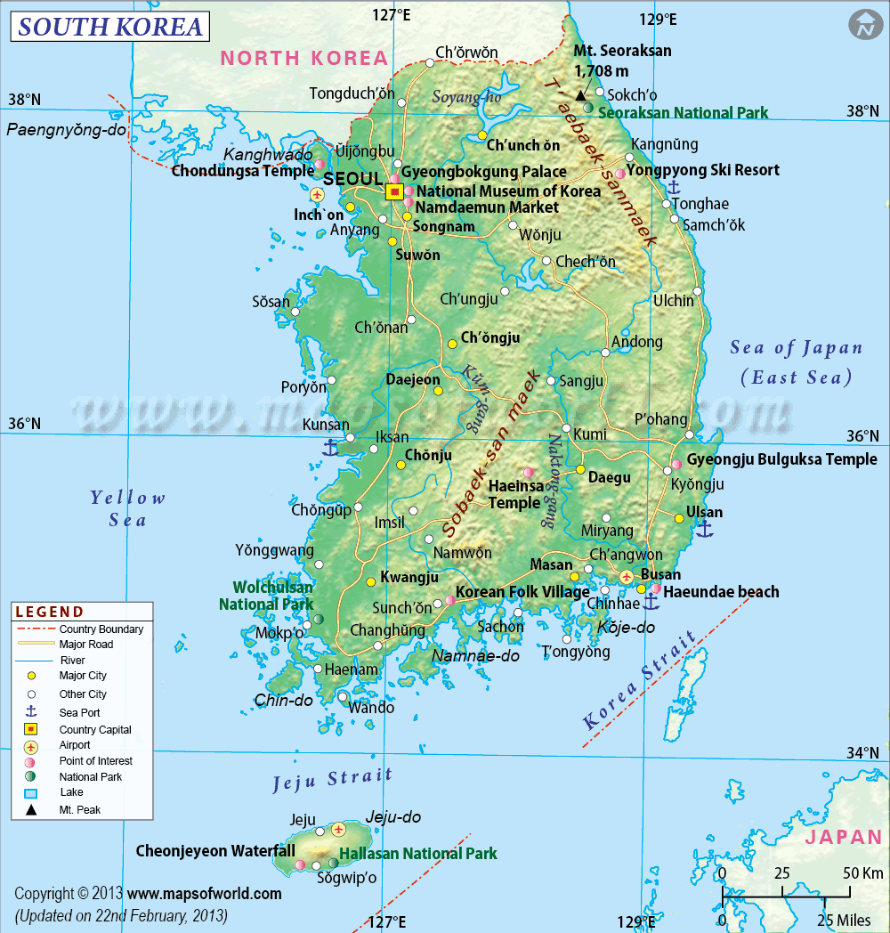
South korea after the war
By the mid-1960s, the South Korean economy had moved ahead
The government was a pro-American dictatorship until 1987, when it became a democracy
South Korea hosted the summer Olympics in 1988
South Korea has tried to open a relationship with North Korea, but they have not been successful

Slide 10
North Korea after the war
Under Kim Il Sung, state-owned industries and collective farms increased output, but growth slowed in the late 1960s
Kim’s emphasis on self-reliance kept North Korea very isolated
Even when the USSR and China began economic reforms, North Korea clung to hardline communism, although this has turned into juche – an ideology of national self-reliance
North Korea is anti-South Korean and anti-American
The dictatorship is hereditary – after Kim Il Sung (known as the Great Leader), his son Kim Jong Il (known as the Dear Leader) took over, and the current leader is Kim Jong-Un (known as the Great Successor)

Slide 11
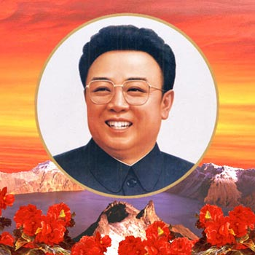
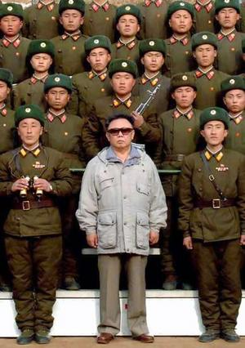
Kim jong-il
Took power when his father died in 1994
Changed the name of the position to “Supreme Leader of the DPRK”
Faced major problems
Failed government policies and terrible floods destroyed harvests and brought widespread hunger
In the late 1990s, North Korea suffered a famine that resulted in the deaths of thousands of citizens and food production still suffers today
He involved North Korea in state terrorism and strengthened the role of the military

Slide 12
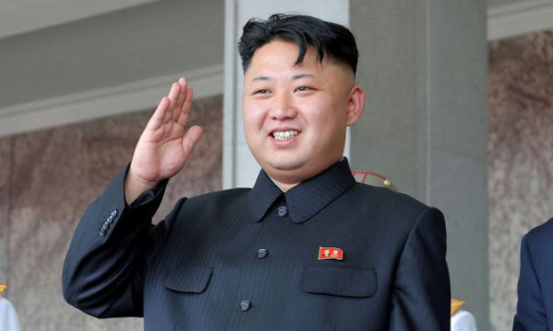
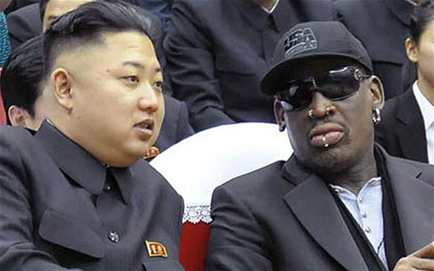
Kim jong-un
Became the Supreme Leader in December 2011
He is only 32 years old, and is the first North Korean leader born after the country’s founding, and the world’s youngest head of state
The cult of personality around the Kim dynasty, and Kim Jong-un, was stepped up when he took power
He has pushed forward with the nuclear weapons program, and made a number of threats against the US
In attempting to establish his own rule, he has demoted or killed anyone that worked with his father and replaced them with those loyal only to himself
Culturally, Kim Jong-Un has been shown to be interested in western pop culture and his wife has been photographed with luxury goods
After Dennis Rodman visited in February 2013, it was reported that Kim Jong-Un was socially awkward
Notes:
Georgia’s PM is 33 and the Emir of Qatar is 35
Youngest state leaders since 1945 (when taking office): King of Jordan (16), King of Bhutan (16), King of Iraq (18 after 14 year regency), and more to age 24

Slide 13
North korean nuclear weapons program
Declared in 2009 that it had developed a nuclear weapon
Most likely the country does own a number of more simplistic nuclear weapons and may also have chemical or biological weapons capability
Has conducted 3-5 nuclear weapon tests to date
In the 1990s, under intense pressure from the US, North Korea agreed to end its program in exchange for aid from the US
As tensions increased, this fell apart, but in February 2012, North Korea agreed to not test long-range missiles and to allow inspectors to moniter operations
In 2012, the US reaffirmed that it was prepared to improve relations and agreed to ship humanitarian food aid to North Korea
However, when North Korea conducted more tests later in 2012, the US decided not to proceed with aid

Slide 14
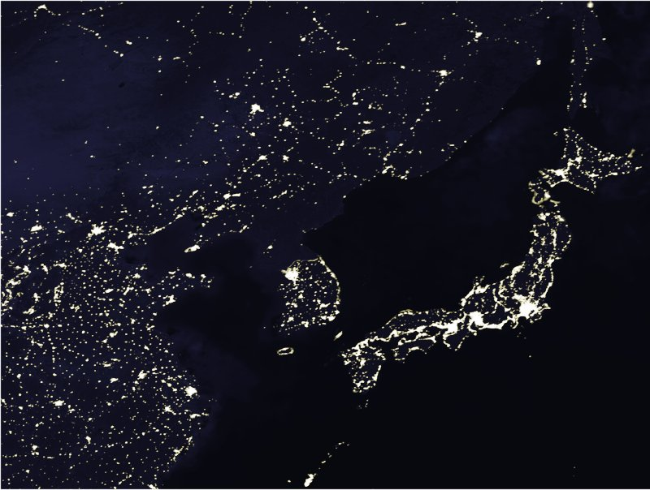
Satellite view of the 2 Koreas

Slide 15
North korea today
Despite differences between the two Koreas, most Koreans want to see their country reunited
Very little is still known about day-to-day operations within North Korea because of the state-run media and propaganda
The DPRK continues to describe itself as a self-reliant totalitarian state and holds elections, but internationally it is considered a totalitarian dictatorship

