Slide 1
China
1945 to Present Day

Slide 2
When world war II ended…
Japanese forces left China
China was devastated after the war ended and 15-20 million people had been killed – mostly citizens
Civil War broke out again – as it had consumed the country prior to the Japanese invasion
Fighting occurred between nationalists and communists

Slide 3
Civil war in china
Civil war was fought between Mao Zedong’s communist forces and Chiang Kai-Shek’s (Jiang Jieshi) nationalists
At first, nationalists had the advantage with numbers and support from the US but they did little to win popular support
Within 3 years, Mao’s forces swept to victory and set up the People’s Republic of China (PRC)
Jiang Jieshi and his supporters fled to the island of Taiwan and set up what they called the only legitimate Chinese government – the Republic of China (ROC)
The existence of 2 Chinas, and the conflicting international loyalties they inspired, intensified the Cold War

Slide 4
China and tibet
China took control of Tibet in 1951, and later tightened control despite promising autonomy to the Tibetans
When China’s control tightened in the late 1950s, the Dalai Lama fled to India
DALAI LAMA: spiritual head of Tibetan Buddhism and, until the establishment of Chinese Communist rule, the ruler of Tibet
India welcomed many Tibetan refugees after a failed revolt in Tibet in 1959
Resentment between India and China grew as a result
Today, China governs western and central Tibet as the Tibet Autonomous Region, although most of the eastern areas are ruled autonomously now
AUTONOMOUS: having self-government, at least to a significant degree
Huge tensions still exist regarding the status of Tibet and many dissident groups are active in exile

Slide 5
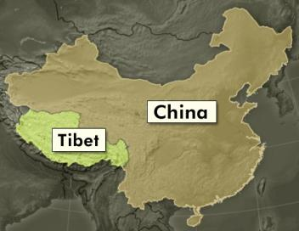
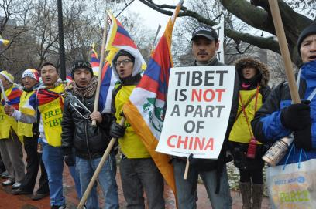
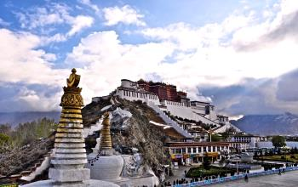
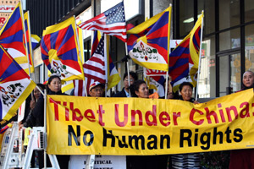
China and tibet

Slide 6
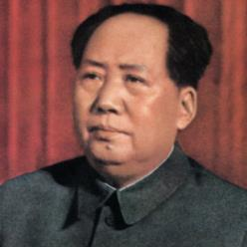
Communism in china
Leader of the party was Mao Zedong
Like the Soviets, the Chinese Communists set up two parallel organizations – the Communist party and the national government
Mao headed both until 1959
Mao seized 70% of the land holdings in China in 1950, killing over a million landlords who resisted, and then divided the land among the peasants
Peasants were later forced to join collective farms
But Mao’s changes did not just reshape the economy, they also transformed industry and business and by 1957, China’s output of coal, cement, steel and electricity had increased dramatically

Slide 7
“The great leap forward”
Proclaimed by Mao in 1958 to expand on the success of his previous Five-Year Plan
The plan called for communes, of which the average one sprawled over 15,000 acres and supported over 25,000 people
COMMUNES: larger collective farms
Peasants worked the land together, ate together, slept together and raised children together
They owned nothing and had no incentive to work hard
The Great Leap Forward was a giant step backward for China
Poor planning and home industries stalled growth
In 1961, the program was stopped after crop failures caused a famine that killed between 20 and 40 million people

Slide 8
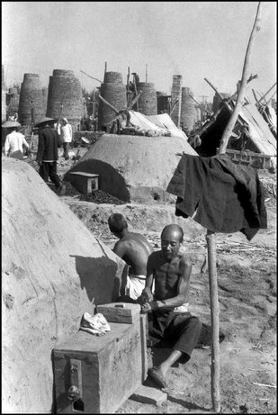
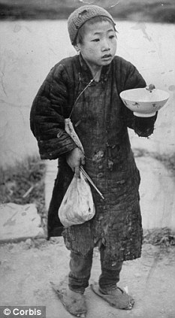
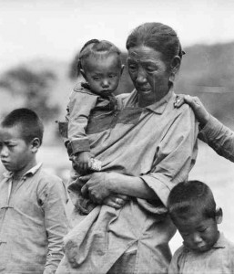
The great leap forward

Slide 9
New policies and mao’s response
By the late 1950s, China was facing external problems as well
Connection to the USSR faded as each sought to lead the worldwide Communist movement and they faced numerous territorial border disputes
Mao reduced his role in government after the failure of the Great Leap Forward and the split with the USSR
Leaders then began to move away from Mao’s strict socialist ideas

Slide 10
Cultural revolution
Mao thought that China was weakening and in 1966, he urged China’s young people to “learn revolution by making revolution”
Millions of high school and college students left their classrooms and formed militia units called Red Guards
The Red Guards led a major uprising known as the Cultural Revolution
The goal of the Cultural Revolution was to establish a society of peasants and workers in which all were equal
Thousands were executed or imprisoned by the Red Guard and chaos began to threaten production
By 1968, even Mao admitted that the Cultural Revolution had to stop
Zhou Enlai, the Chinese Communist Party founder and premier since 1949, began to restore order

Slide 11
China and the west
Throughout the 1960s, China isolated themselves and played almost no role in world affairs
After the Cultural Revolution, Zhou began to send signals that he was willing to form ties to the west
A visit by an American table-tennis team to tour China in 1971 opened a new era in Chinese-American relations
After visits to China by Nixon, and meets with Zhou and Mao, the 3 leaders began cultural exchanges and some trade
In 1979, the US and China established diplomatic relations

Slide 12
One-child policy
Mao Zedong had believed that population growth empowered the country and so he encouraged couples to have as many children as possible
The population grew from under 600 million in 1949 to over 900 million in 1976
A family planning policy for population control was introduced in 1978 and enacted on September 18, 1980 to alleviate social, economic and environmental problems
The term “one-child” is not completely accurate, as the policy allowed many exceptions and ethnic minorities were exempt
Policy was enforced through fines on a local level
Over the past 25 years, the policy has been relaxed in a variety of ways, but is still technically in existence
While the policy is supported by the majority within China, it is very controversial outside of the country

Slide 13
Economic reform in china
Both Mao and Jhou died in 1976
In 1980, Deng Xiaoping emerged as the most powerful leader in China
Although a lifelong Communist, Xiaoping supported moderate economic policies and was willing to use capitalist ideas to help China’s economy
Xiaoping embraced a set of goals known as the Four Modernizations
FOUR MODERNIZATIONS: goals that called for progress in agriculture, industry, defense, science and technology
Xiaoping put forth an ambitious program for economic reform and his policies produced striking changes in Chinese life

Slide 14
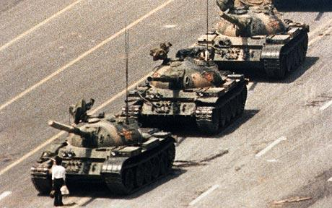
Beijing, 1989

Slide 15
Tiananmen square massacre
In April of 1989, more than 100,000 students occupied Tiananmen Square in Beijing to protest political leadership and quickly won widespread popular support
Instead of considering reform, Xiaoping declared martial law and ordered 100,000 troops to surround Beijing
Many students left, but around 5,000 remained and defiantly built a 33-foot statue they named the “Goddess of Democracy”
On June 4, 1989, the standoff came to an end when thousands of heavily armed soldiers stormed Tiananmen Square
Tanks smashed through barricades and crushed the “Goddess of Democracy” and soldiers sprayed gunfire into the crowds
The assault killed hundred and wounded thousands, marking the beginning of a massive government campaign to stomp out progress

Slide 16
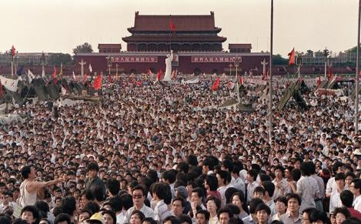
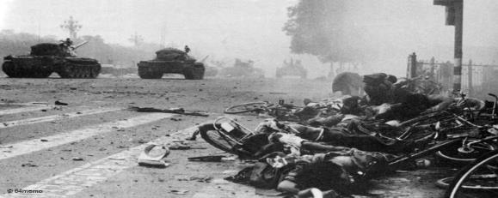
Tiananmen square massacre

Slide 17
China after deng xiaoping
Xiaoping died in February 1997 and Communist Party General Secretary Jiang Zemin assumed the presidency
Intelligent leader, but with no military experience, Zemin faced a number of challenges in office, including human rights issues and the lack of democracy in China
He stepped down as president in 2003 and was replaced by Hu Jintao
Zemin retained power behind the scenes and remained the political leader of the military

Slide 18
Hong kong
Another major issue for China was the status of Hong Kong
Hong Kong was a thriving business center and British colony on southeastern coast of China
On July 1, 1997, Great Britain gave Hong Kong over to China, ending 155 years of colonial rule
Hong Kong became China’s first Special Administrative Region (SAR)
As part of this transfer, China promised to respect Hong Kong’s economic system and political liberties (“One Country, Two Systems”)
“ONE COUNTRY, TWO SYSTEMS”: constitutional principle that suggests that there would be only 1 China, but distinct regions could retain their own capitalist economic and political systems, while the rest of China used the socialist system
This agreement grants Hong Kong autonomy for 50 years after reunification, but no one knows what will happen for Hong Kong in 2047

Slide 19
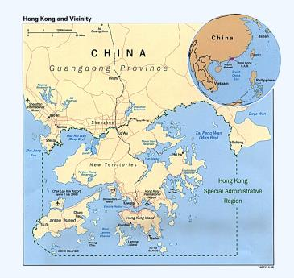
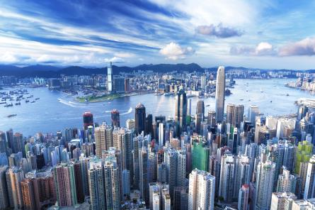
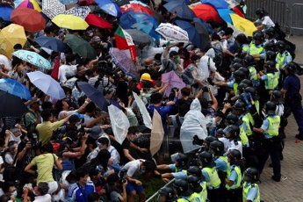
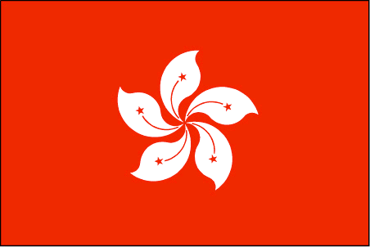
HONG KONG

Slide 20
CHINA TODAY
China shows us that while liberal reforms may occur in one area, that does not mean they will lead to all areas
Since 2000, there has been a dramatic reduction in poverty
As of December 2014, China has the world’s largest economy (surpassing the US for the first time) and is the world’s largest exporter and 3rd largest importer of goods (after the US and the EU)
China’s current president is Xi Jinping, in office since 2013
China is a recognized nuclear weapons state, and has the world’s largest standing army, with the 2nd largest defense budget

