Slide 1
From Rome to Byzantium: Early Europe
Unit Seven

Slide 2
Overview of the Roman and Byzantine Empires
Our study of the Roman and Byzantine Empires will start with the examination of the rise of the Roman Empire, the society and culture at the height of the empire, and finally, by exploring the decline of Roman power and analyzing the fall of the Roman Empire.
We will then move into our study of the Byzantine Empire, as the growth of Constantinople and the development of the eastern provinces allowed the Byzantine Empire to grow into one of the most powerful empires ever to exist.
Rise of the Roman Empire
Roman Society and Culture
Fall of the Roman Empire
Rise of the Byzantine Empire
Byzantine Achievements
Rise of Russia

Slide 3
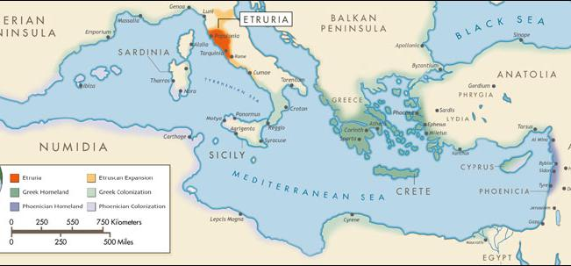
Impact of Geography on Rome: Identify a geographic feature & propose how it might have impacted the overall culture of Rome and the Roman Empire.
Notes:
an ancient country in central Italy; assimilated by the Romans by about 200

Slide 4
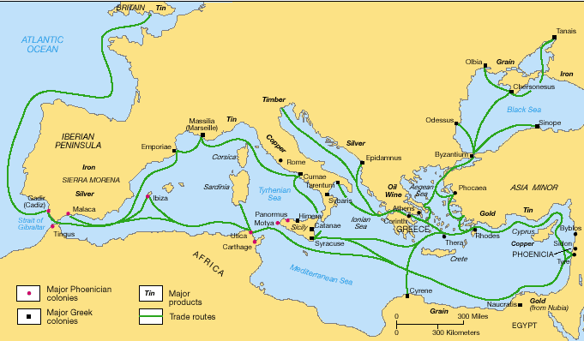
The Geography of Rome
Rome was located on the Italian peninsula along the Mediterranean Sea
The Romans were influenced by the Greeks & neighboring Etruscans

Slide 5
Rise of the Roman Empire
Section One
Notes:
What do you think this is? What might it remind you of?

Slide 6
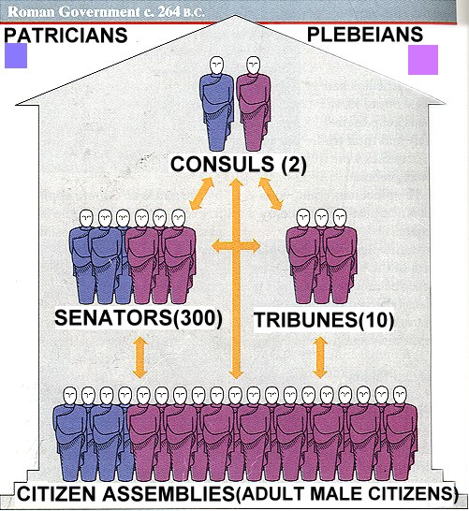
Discussion:
Based upon this image, what government system does the Roman government resemble? Why?

Slide 7
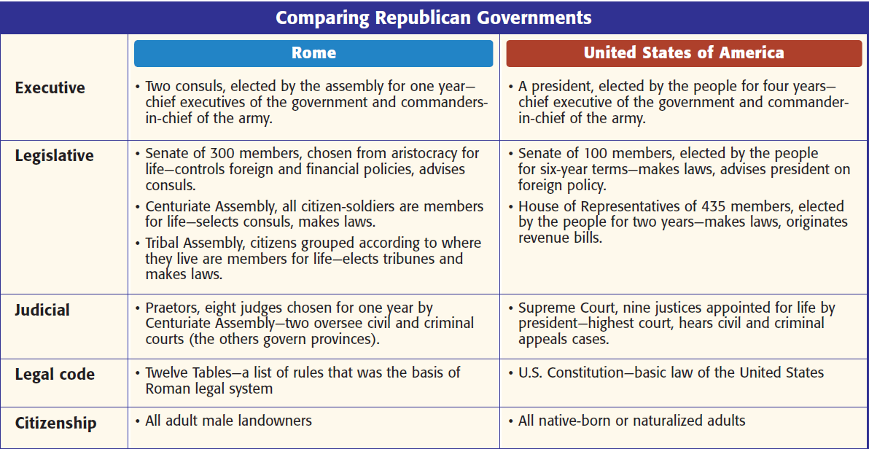

Slide 8
Roman Government
Rome was originally ruled by kings
In 509 BCE Romans created a republic
REPUBLIC: government in which citizens have the power to elect their leaders

Slide 9
Governing Bodies in Rome
Senate: most important & powerful with 300 members
Popular Assemblies: citizen groups who voted on law and elected officials
Magistrates: public officials who governed in the name of Rome
The Senate also controlled public funds and made foreign policy decisions. They could propose a dictator during a time of emergency in the Republic.

Slide 10
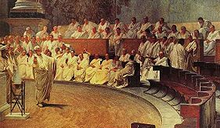
An important feature of the republic was the Senate, whose 300 members were elected by citizens to make laws & taxes.

Slide 11
Roman Consuls
Two Consuls were elected for one-year terms and served as chief executives
Had veto power over each other
VETO: refuse to approve
Governed with advice of Senate

Slide 12
Roman Officials
Two main types of Roman officials
PRAETORS: officials who helped the consuls command armies and oversee the legal system
CENSORS: elected officials who registered citizens according to wealth

Slide 13
The Conflict of the Orders
Roman society was divided into 2 social classes
PATRICIANS: powerful aristocratic class organized into clans
PLEBEIANS: all other citizens
Plebeians were discriminated against but gradually increased their own power

Slide 14
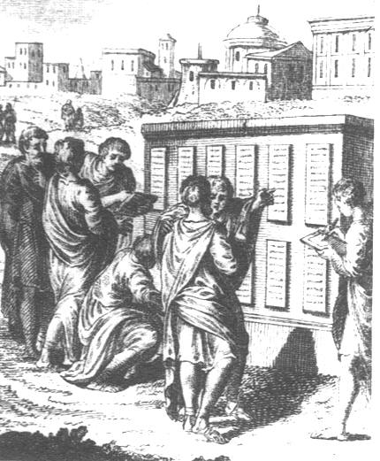
Twelve Tables
In 450 BCE, Romans engraved laws on tablets known as the Twelve Tables
Placed in the Forum
By 300 BCE, distinction between classes became less important

Slide 15
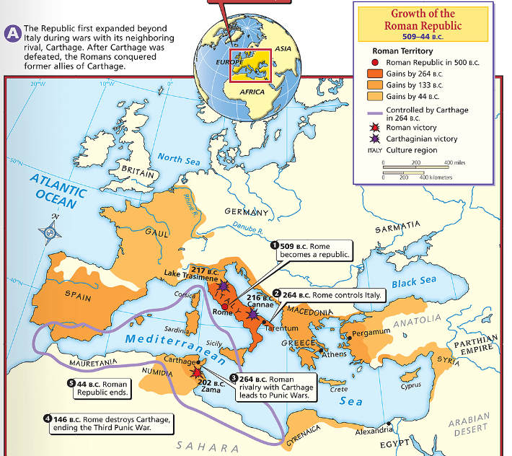
By the 3rd century B.C.E., the Romans conquered the Italian peninsula & began to exert power in the Mediterranean world
But, the growth of Rome threatened Carthage, the superpower of the Mediterranean world

Slide 16
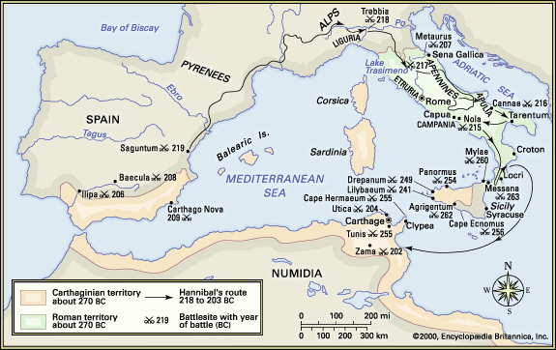
In a series of battles known as the Punic Wars, Rome defeated Carthage & began the dominant power in the Mediterranean

Slide 17
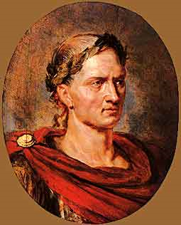
After the Punic Wars, Rome conquered new territories & gained great wealth
One of the generals who led Rome’s expansion was a politician named Julius Caesar

Slide 18
First Triumverate
By 133 BCE, the Republic was facing problems
Julius Caesar gained widespread popularity
Caesar joined with Gaius Pompey and Licinius Crassus to form the First Triumverate in 60 BCE

Slide 19
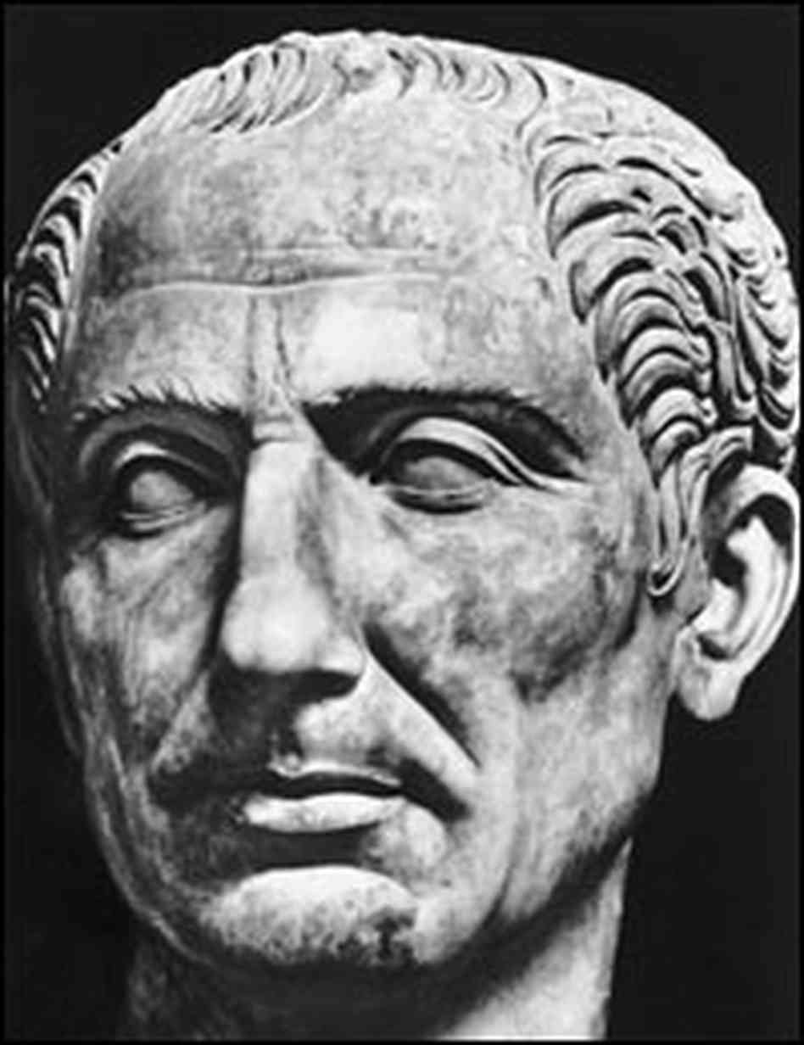
Julius Caesar
Became Consul in 59 BCE
Spent 10 years bringing Gaul under Roman rule
In 49 BCE, Caesar marched on Rome
Gaius Pompey and his followers fled to Greece
Caesar traveled to Egypt and put Cleopatra on the throne
In 46 BCE, Caesar returned to Rome & in 44 BCE, Senate named him Dictator for life

Slide 20
“Et tu, Brute?”
Initiated reforms
Some envied his new status
On March 15, 44 BCE, he was stabbed to death
Notes:
Stabbing was conspired by Gaius Cassius Longinus and Marcus Brutus
Stabbed by 23 different senators

Slide 21
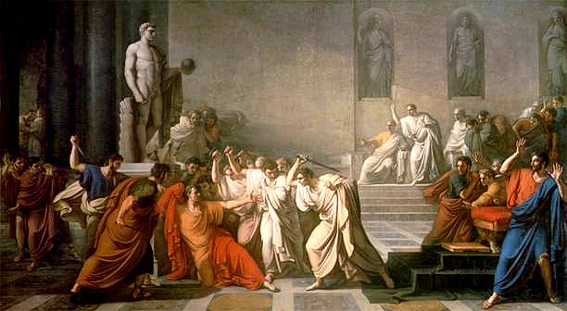

Slide 22
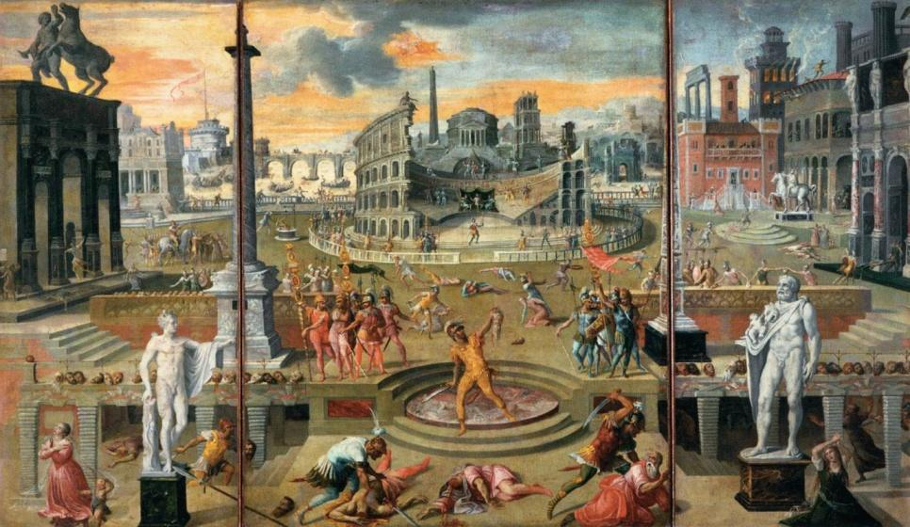
The assassination led to another civil war led by Caesar’s grand-nephew Octavian & his best general, Marc Antony.

Slide 23
Second Triumvirate
In 43 BCE, Octavian, Marc Antony, and Lepidus formed the Second Triumvirate. Within 10 years, Lepidus had been pushed out of the Triumvirate and sent into exile. Octavian and Antony divided the Roman world – Octavian took the west and Antony took the east. Antony went to Egypt and joined with Cleopatra.

Slide 24
The Revered One
Octavian declared war on Antony & Cleopatra
In 31 BCE, Octavian defeated their fleet & captured Alexandria
In 27 BCE, Senate titled him Augustus, meaning “the revered one”
First Roman Emperor
Roman state became the Roman Empire

Slide 25
The Julio-Claudians
Augustus died in 14 CE
For next 54 years, Caesar’s relatives ruled the empire
Nero was the last Julio-Claudian emperor, from 54 to 68 CE

Slide 26
The Good Emperors
After Nero’s death, a number of different emperors ruled Rome
Series of 5 emperors, known as the Good Emperors ruled for over 100 years, until 196 CE

Slide 27
Roman Society & Culture
Section Two

Slide 28
Government & The Provinces
The period of time from Augustus’ reign to the death of Aurelius, 27 BCE through 180 CE, is known as the Pax Romana, or “Roman Peace.”
Roman government provided unifying force
Provinces were governed honorably
Romans constructed many new cities
AQUADUCTS: bridge-like structures that carried water from the mountains

Slide 29
Roman Law
Unifying factor
Twelve Tables were changed to address needs of the huge empire
Development of the belief that certain basic legal principles apply to all humans

Slide 30
Roman Army
Augustus restored the Roman Army
PRAETORIAN GUARD: small, elite force kept in Rome to protect the Emperor
Notes:
Brush like plume was a crest indicating ranking

Slide 31
Trade & Transportation
Agriculture was the primary occupation
Olive and wine products were exported
COLONUS: tenant farmer who replaced slaves on large estates
Opportunities for commerce
Trade with Asia and India increased
50,000 miles of highway was built to link cities to Rome
Notes:
Manufacturing also increased
“all roads lead to Rome”

Slide 32
Living Conditions
Patricians
Plebeians
Luxurious living
City and Country homes
Lots of time for leisure
Majority
Ate 3 simple meals each day
Most were artisans and farmers

Slide 33
Amusements
Theater – comedy and satire
Chariot racing at Circus Maximus
Events at the Colosseum, including gladiator combat

Slide 34
Science, Engineering & Architecture
Applied scientific knowledge from the Greeks. They planned cities, built water and sewage systems and improved farming. The biggest contribution was from Roman architects with their use of concrete in constructing large buildings

Slide 35
Education
Boys and girls entered school at age 7 to study basic subjects
After age 13, only boys continued with school
Notes:
Children were trained to be loyal and obedient
Basic subjects: reading, writing, arithmetic and music
Upper class women received more formal education

Slide 36
Literature & Language
Development of art and literature was encouraged
Great poets included Virgil and Ovid
Today, we use the Roman or Latin alphabet of 23 letters plus J, U, and W
Notes:
Romans adapted their alphabet from the Etruscans who had adapted it from the Greeks

Slide 37
Fall of the Roman Empire
Section Three

Slide 38
Jews & the Roman Empire
After Rome conquered Judea, Judaism spread through the Roman Empire
Jews moved around and started new Jewish communities
Jews were allowed to practice Judaism openly
But later, some new laws were put in place to keep the Jews from practicing their religion their way

Slide 39
Jews & the Roman Empire
Upset over the new laws, the Jewish people rebelled twice
The Romans crushed the 1st rebellion
The Romans took over Judea, destroyed the Jews’ temple, and stole religious items
Around 135 CE, there was a 2nd rebellion
This rebellion was also crushed, and the Jews were kicked out of Judea

Slide 40
Rome’s Economy Declines
The Roman Empire began to decline at the end of the reign of the last of the Good Emperors, Marcus Aurelius. The rulers that followed were brutal and incompetent.
Frequent wars disrupted trade
Massive food shortages occurred, disease spread and population declined

Slide 41
Military Upheaval
Economic crisis was worsened by military trouble
Government recruited mercenary soldiers
MERCENARY: foreign soldier who will fight for pay
Mercenaries have no loyalty
Notes:
Public Coffers are tax dollars

Slide 42
Diocletian’s Reforms
Diocletian became Emperor in 284 CE
Restored order and increased the empire’s strength
Divided the Empire and ruled the Eastern half
Retired in 305 CE and civil war broke out immediately
Notes:
General Maximian was given the western half

Slide 43
The New Capital
Constantine reunited the empire
In 330 CE, he moved the capital to Byzantium
Renamed the capital Constantinople
After Constantine died in 337 CE, the empire was again divided
Notes:
Byzantium is present day Turkey
Moving the capital caused the center of power to shift from Rome

Slide 44
Invaders Overrun the Empire
From 376 to 476, huge numbers of Germans came into the territory
In 410, Rome was under siege
In 455, vandals again sacked Rome and left it in chaos

Slide 45
Sack of Rome, 455 CE
Notes:
Painting by Karl Briullov in the Tretyakov Gallery in Moscow

Slide 46
The Last Emperor
Romulus Augustulus was the last Emperor
Romulus was exiled in 476
Eastern half of the Empire flourished and became the Byzantine Empire which lasted until 1453

Slide 47
Roman Empire, 626 CE

Slide 48
Rise of the Byzantine Empire
Section Four

Slide 49
Rise of the Byzantine Empire
Because of the difficulties of communication between the eastern and troubled western parts of the empire, they were officially divided in two in 395. Despite this separation, Constantine’s successors in the East continued to see themselves as Roman emperors. In 527, a high-ranking Byzantine nobleman named Justinian succeeded his uncle to the throne of the eastern empire.

Slide 50
Justinian: A New Caesar
Became emperor in 527
In 533, he sent Belarius to recover North Africa from the vandals
By 549, Justinian’s armies won almost all of Italy and parts of Spain - coming to rule almost all the territory Rome had ever ruled
Described as a serious and even-tempered ruler who worked from dawn to midnight by the famous historian, Procopius

Slide 51
Justinian Code
To regulate a complex society, Justinian set up a panel of 10 legal experts. Between 528 and 533, they combed through 400 years of Roman law and legal opinions. Some of those laws had become outdated. Some repeated or contradicted other laws. The panel’s task was to create a single, uniform code.
The result was a body of civil law known as the Justinian Code.

Slide 52
Justinian Code
After it was completed, the code consisted of 4 works:
The Code: nearly 5,000 Roman laws that the experts considered useful for the Byzantine Empire
The Digest: opinions of Rome’s greatest legal thinkers about the laws (was made up of 50 volumes)
The Institutes: a textbook that told law students how to use the laws
The Novellae (New Laws): presented legislation passed after 534

Slide 53
Legacy of the Code
The Code decided legal questions that regulated whole areas of Byzantine life
Justinian died in 565, and his code served the Byzantine Empire for 900 years

Slide 54
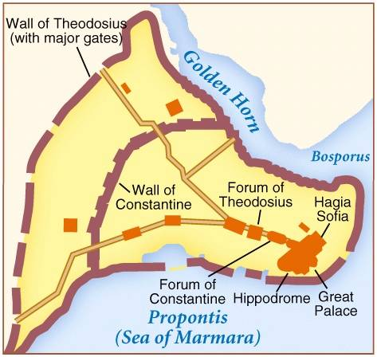
Creating the Capital
Justinian launched an ambitious public building program
Rebuilt crumbling city walls around Constantinople
Church building was Justinian’s greatest passion

Slide 55
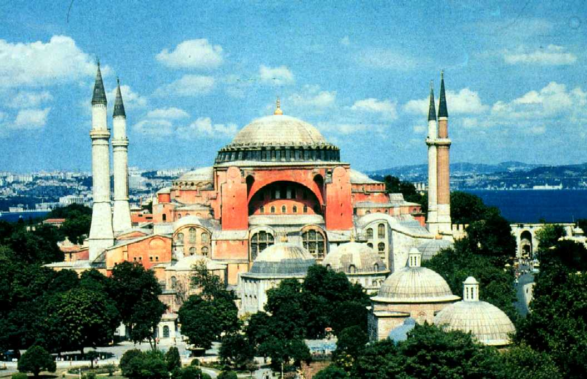
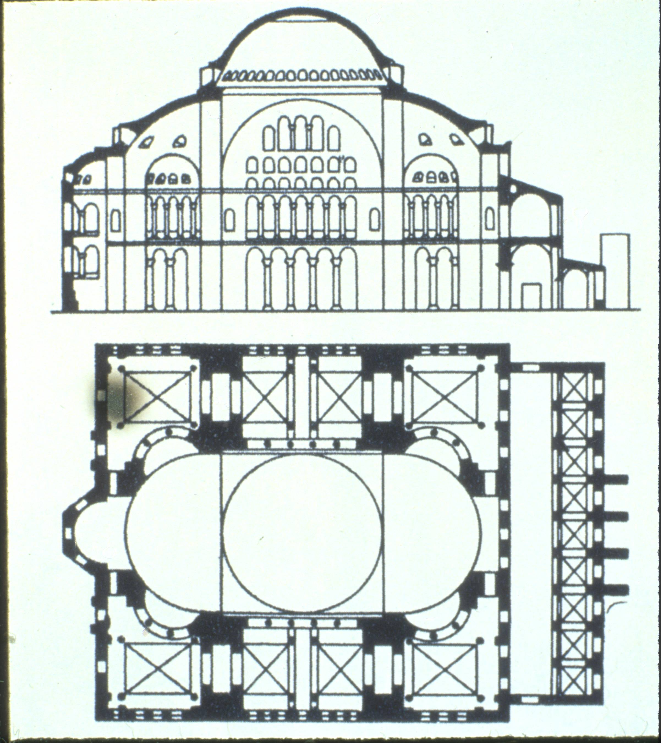
Hagia Sophia
532-537 AD
Crowning glory of Justinian’s reign
Combination of central plan and early Christian basilica architectural styles
Notes:
Hagia Sophia—eastern parallel to San Vitale, but on a much grander scale
Built in 532-37 AD
Combines the longitudinal axis of the Early Christian basilica with the central plan church under a large dome
Justinian had it built in Constantinople, present-day Istanbul
Recruited two scholars from Asia Minor to help him design the church—Anthemius of Tralles aned isidorus of Miletus.
The church of Hagia Sophia is believed to have been founded by Constantine the Great. The initial building was erected over the ruins of an ancient temple of Apollo, a common practice.

Slide 56
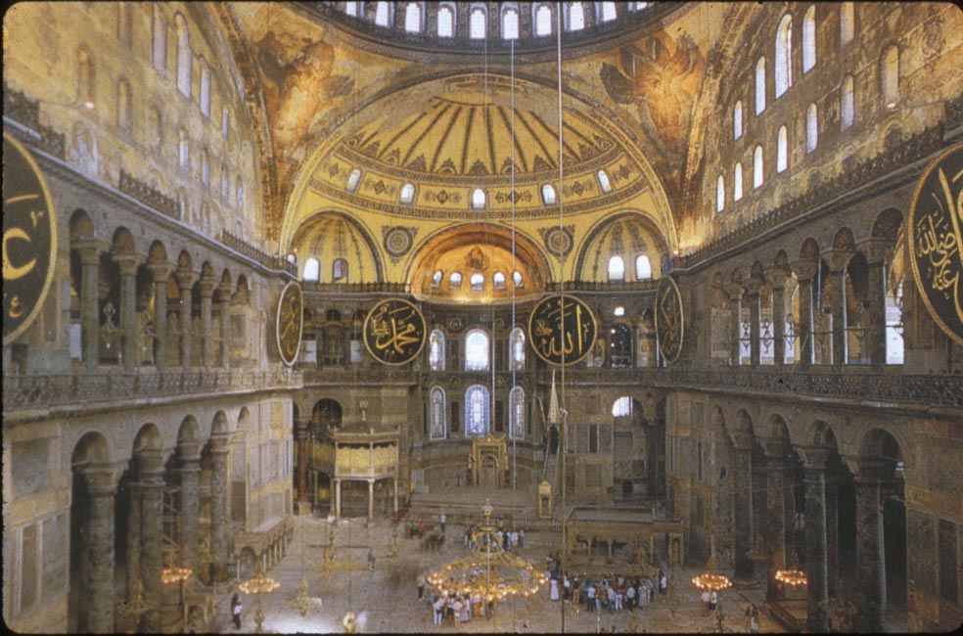
Interior, Hagia Sophia
Notes:
Most mosaics covered over when taken over by Turks and turned into a mosque

Slide 57
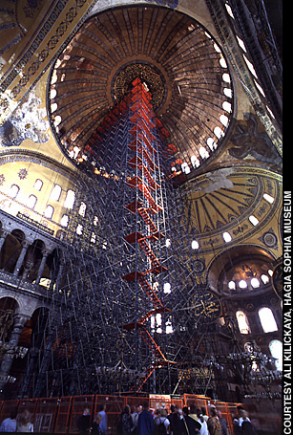
Restoring Hagia Sophia
Notes:
Most mosaics in Hagia Sophia did not survive. They were covered over when Constantinople was overthrown by the Turks in 1453.
They are in the process of being restored.

Slide 58
Hippodrome
Large arena that held 60,000 spectators
Offered wild chariot races and circus acts

Slide 59
Education Preservation
Byzantine families valued education and sent their children to monastic or public schools or hired private tutors. Basic courses focused on Greek and Latin grammar, philosophy and rhetoric. The classics of Greek and Roman literature served as textbooks. Students memorized Homer. They learned geometry from Euclid, history from Herodotus and medicine from Galen. The modern world owes Byzantine scholars a huge debt for preserving many of the great works of Greece and Rome.

Slide 60
The Church Divides
Distance and lack of contact between the new Byzantine Empire and the Western church in Rome slowly caused the doctrines and rituals of Western and Eastern Christianity to diverge. The Church would eventually split into the Eastern Orthodox and Roman Catholic churches.

Slide 61
Iconoclastic Controversy
In 730 Emperor Leo III banned the use of icons
ICONS: religious images used by eastern Christians to aid their devotions
Leo III believed that icons equaled idol worship
Army supported Leo III and iconoclasts broke into churches to destroy images
ICONOCLASTS: icon-breakers
Notes:
sculpture
Sculpture became less important than in classical times.
One of the ten commandments forbid making “graven images” which seems to have been applies mostly to sculpture as a kind of idol.
Sculpture is mostly small—sarcophagi, reliquaries, altars, marble screens—items to be used in the church.
Painting
The development of Byzantine painting and sculpture was interrupted by the Iconoclastic Controversy which began with an imperial edict of 726 prohibiting religious images. This went on for more than 100 years.
Emperor Leo III (reigned 717–741) ruled after Justinian and ordered the edict. It was a strict interpretation of the Ten Commandants.
Images were not only prohibited, they were destroyed.
"What Scripture is to the educated, images are to the ignorant, who see through them what they must accept. They read in images what they cannot read in books."
Pope Gregory the Great, sixth century.
The first Iconoclastic period came to an end when Leo IV (Leo III’s son) died and his widow, Empress Irene came into power. An iconophile, she initiated the Second Council of Nicaea in 787, where the veneration of icons was affirmed, although the worship of icons was expressly forbidden. Among the reasons were the doctrine of the Incarnation: because God the Son (Jesus Christ) took on flesh, having a physical appearance, it is now possible to use physical matter to depict God the Son, and to depict the saints. Icon veneration lasted through the reign of Empress Irene's successor, Nicephorus I (reigned 802-811), and the two brief reigns after his.
Emperor Leo V (reigned 813–820) instituted a second period of Iconoclasm in 813, which seems to have been less rigorously enforced, since there were fewer martyrdoms and public destructions of icons. Leo was succeeded by Michael II, who was succeeded by his son, Theophilus. Theophilus died leaving his wife Theodora regent for his minor heir, Michael III. Like Irene 50 years before her, Theodora mobilized the iconodules and proclaimed the restoration of icons in 843. Since that time the first Sunday of Lent is celebrated in the churches of the Orthodox tradition as the feast of the "Triumph of Orthodoxy".
since God had assumed material form in the person of Jesus Christ, he also could be represented in pictures.

Slide 62
Iconoclastic Controversy
People rioted and clergy rebelled
CLERGY: church officials
Pope became involved and supported use of icons

Slide 63
The Great Schism
Differences between the Eastern and Western churches, however, continued to grow. In 1054, matters came to a head when the pope and Byzantine patriarch excommunicated each other in a dispute over religious doctrine. After this schism, Christianity was permanently divided between the Roman Catholic Church in the West and the Orthodox Church in the East.
EXCOMMUNICATION: being banned from the church
SCHISM: split

Slide 64
Byzantine Missionaries
As West and East grew apart, the two traditions of Christianity competed for souls. Missionaries from the Orthodox Church, for example, took their form of Christianity north to the Slavs. Two of the most successful eastern missionaries, Saint Methodius and Saint Cyril, worked among the Slavs in the 9th century. Cyril and Methodius invented an alphabet for the Slavic languages. With an alphabet, Slavs would be able to read the Bible in their own tongues. Many Slavic languages, including Russian, are now written in what is called the Cyrillic Alphabet.
The Orthodox missionaries opened up highways for Byzantine influence in Slavic lands. As these missionaries were carrying out their work among the Slavs, a new Slavic nation was forming.

Slide 65
Byzantine Achievements
Section Five

Slide 66
Byzantine Art Characteristics
Flattened, symbolic, (heavenly) space (gold backgrounds common)
Shapes and figures show continuing trend toward shallow space
Details are described by line, not light and shade
Elongated proportions
Dematerialized bodies with strong emphasis on the eyes

Slide 67
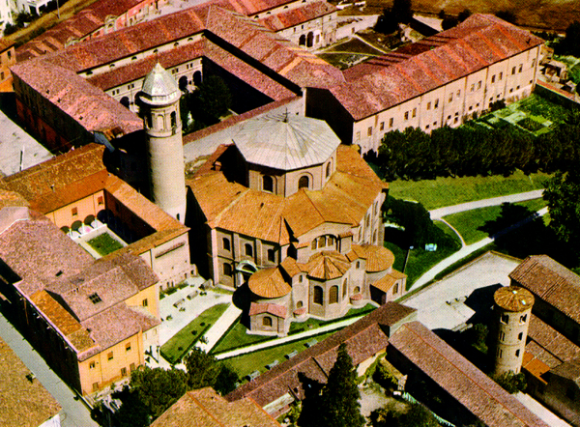
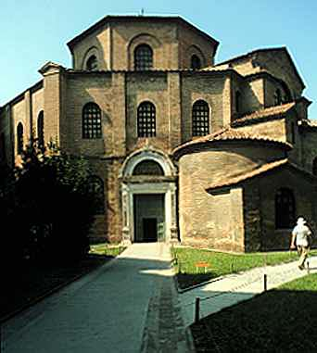
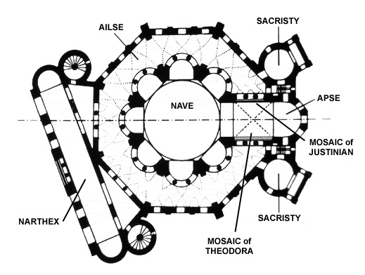
Early Christian Churches
San Vitale, Ravenna, c. 526-547
Notes:
One of his first building projects in the West was San Vitale in Ravenna, 526-547 AD.
Showed his authority in Italy.
Example of the central plan church.
Even though it is very different from the basilica plan, it has many of the same sections including a nave, narthex, side aisles and apse.
Instead of looking down the long nave, the viewer looks up into the dome.
There were circular building from ancient Rome, especially tombs and baths. Also Greek round buildings like the Pantheon.
Circle was symbolic of eternity, not beginning and no end.
Justinian and the Eastern Empire favored round or octagonal churches over long basilica plans.
An example of a round building is a baptistery, where people would be baptized. Changed the meaning of the bath building from secular to religious.
Dome of San vitale
Early example of Byzantine dome
Represents the dome of heaven, symbolic
Used a system of squinches to support the weight of the dome.
Dome is set on an octagonal drum.
Women’s gallery, called the matroneum, is elevated above the main arcade. Women were strictly segregated in Byzantine rites.

Slide 68
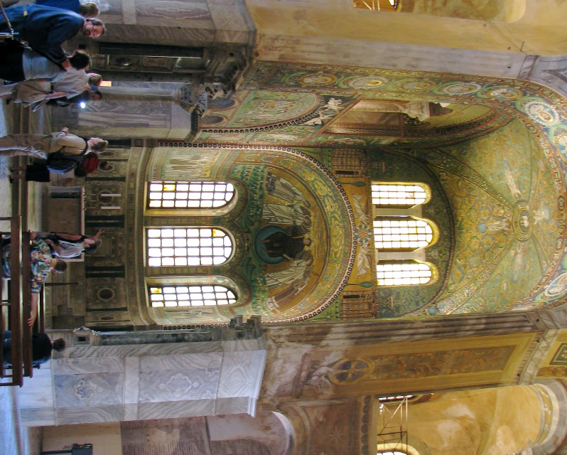
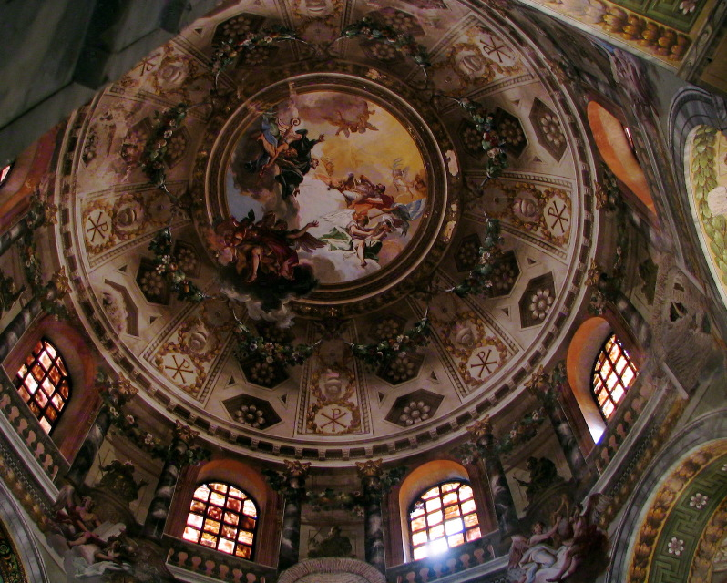
Interior of San Vitale

Slide 69
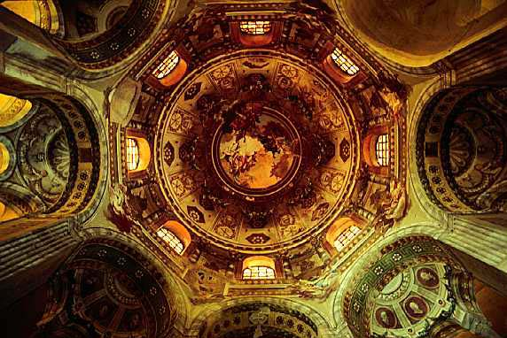
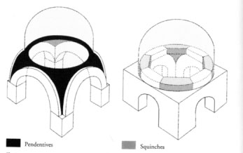
Squinches

Slide 70
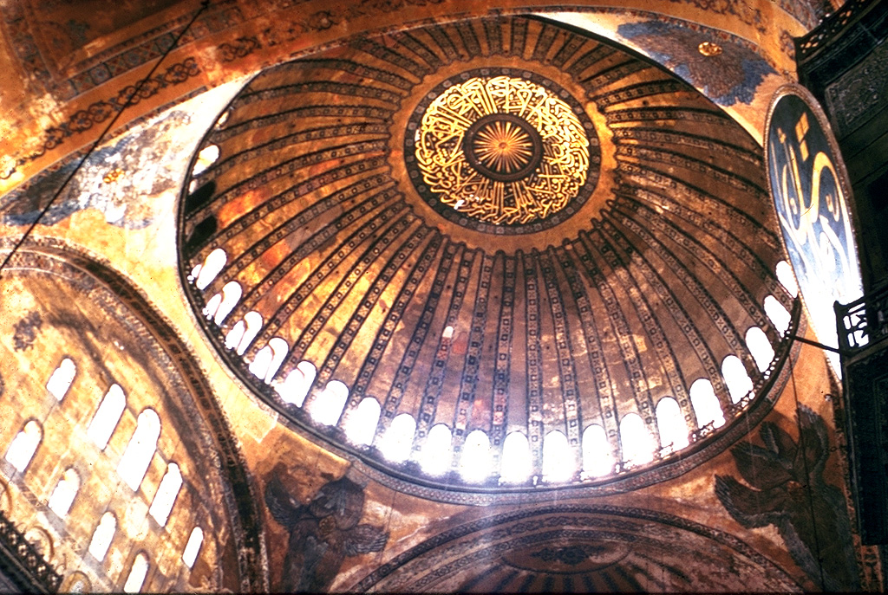
Pendentives
Notes:
Used a system of pendentives to elevate main dome.
Pendentive—A spherical triangle which acts as a transition between a circular dome and a square base on which the dome is set
Pendentives are created by spherical triangles that connect arches coming from corner piers and unite at the apex of the arches to form a circular base upon which the dome rest.
The architects achieved a space that spanned 100 feet wide and 200 feet in length.
Dome seems to float above.

Slide 71
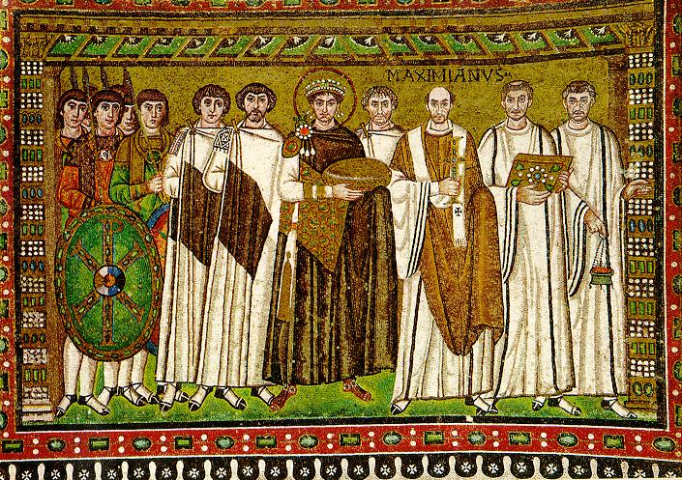
Byzantine Mosaics
Emperor Justinian and Courtiers, c. 547, San Vitale, Ravenna
Notes:
Back to San Vitale in Ravenna.
Mosaics depict the emperor Justinian and his wife Empress Theodora.
Portrayed as if making a procession through the church.
Surrounded by clergymen. Only Archbishop Maximian is identified by name above his head. Holds a crucifix as sign of power.
Justinian holds a golden plate which was used to hold the communion bread at the alter.
Justinian is in the center, place of importance.
Important ruler, brought peace, codified Roman law, presided over religious councils, unified the church and the state.

Slide 72
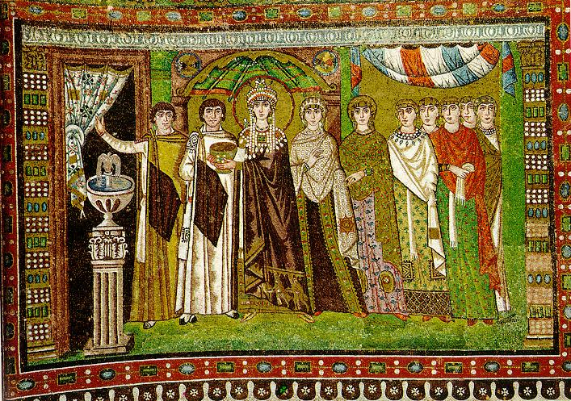
Byzantine Mosaics
Empress Theodora and Retinue, c. 547, San Vitale, Ravenna
Notes:
Empress Theodora wears purple, symbol of royalty.
Makes an offer to Christ. Holds the golden chalice that contains the wine. Three wise men are on hem of her robe, echoing the offertory theme.
Both wear haloes, a carryover from the belief that the emperor had divine power.

Slide 73
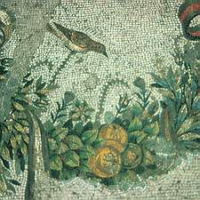
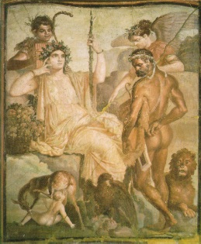
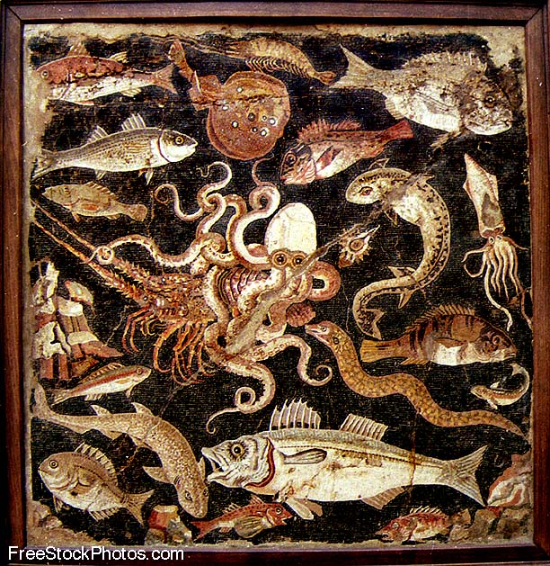
Earlier Greek Mosaics and Painting vs. Byzantine Mosaics

Slide 74
Byzantine Icons
During the 9th century, religions icons became an important part of the Eastern Orthodox Church
Become very symbolic
Icons used as objects of devotion
Icons become more and more abstract and stylized

Slide 75
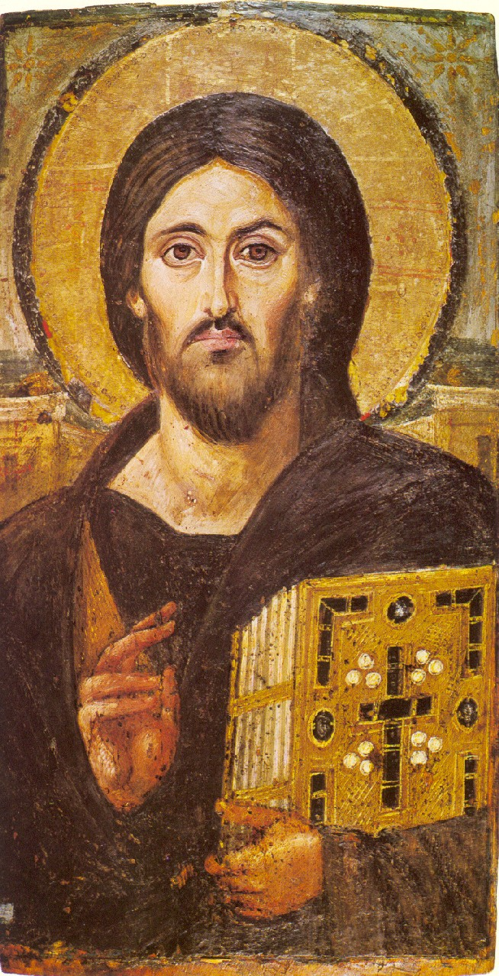
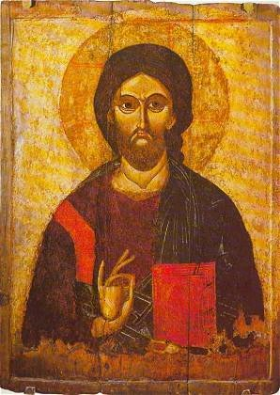
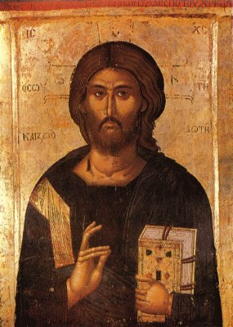
Byzantine Icons
6th century
13th century
14th century
Notes:
Christ Pantokrator

Slide 76
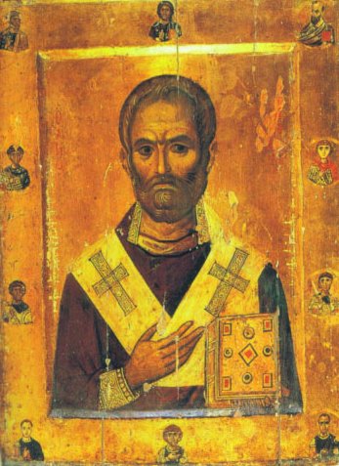
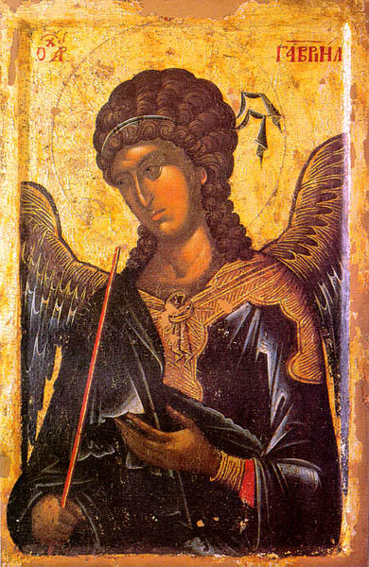
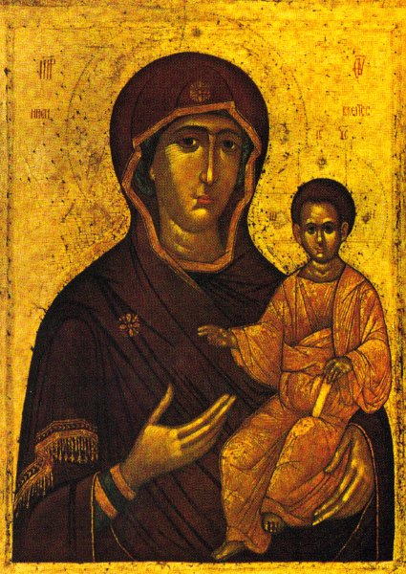
Icons of Mary, Saints, and Angels
10th century
14th century
14th century
Notes:
St Nicholas
Gabriel
Virgin Mary and Christ Child

Slide 77
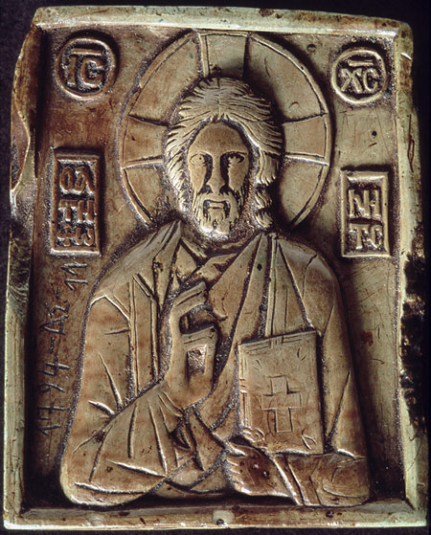
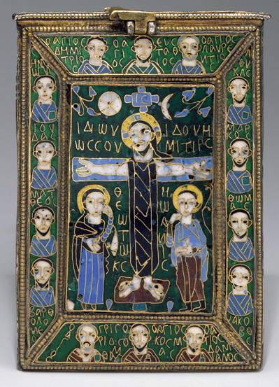
Stylized Icons
1350
9th century
Notes:
Enameled icon made in Constantinople

Slide 78
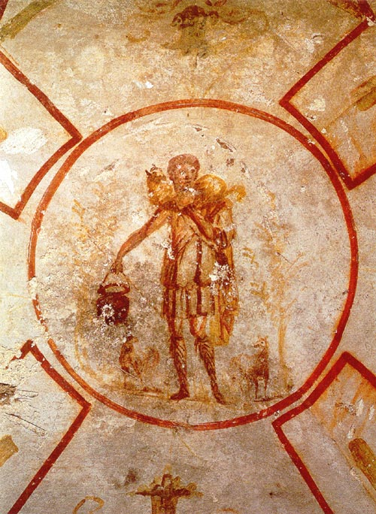
Christ in Art
The Good Shepherd, c. 4th c. AD. Catacomb of Saints Pietro and Marcellino, Rome.

Slide 79
Rise of Russia
Section Six

Slide 80
Blending Traditions
Midway through the 9th century, the Slavs began trading with Constantinople. As they traded, they began absorbing Greek Byzantine ideas. Russian culture grew out of this blending of Slavic and Greek traditions.
SLAVS: people from the forests north of the Black Sea
Russian legend says that the Slavs invited the Viking chief Rurik to be their king in the 9th century. In 862, Rurik founded Novgorod.
NOVGOROD: Russia’s first important city

Slide 81
Welcome to Kiev
Kiev was founded on the Dnieper River by Oleg
Easy access to trade with Constantinople
Kiev grew into a principality
PRINCIPALITY: small state ruled by a prince
Society was strictly divided between classes
BOYARS: nobles
Gradually the line between Slavs and Vikings vanished

Slide 82
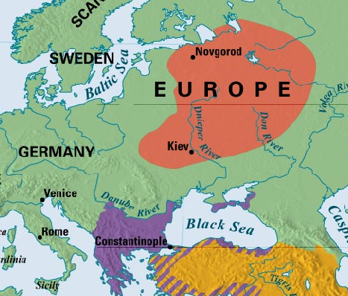

Slide 83
Kiev Becomes Orthodox
In 957, Princess Olga converted to Christianity
Olga’s grandson Vladimir converted to Christianity in 989 and made all of his subjects convert
Beliefs and traditions of Eastern Orthodoxy flourished in Kiev

Slide 84
Rise & Decline of Kiev
The rise of Kiev marked the appearance of Russia’s first important unified territory.
Vladimir, and his son Yaroslav the Wise, expanded Kiev’s power
Yaroslav created a legal code, built the first library in Kiev, and helped Christianity prosper
Kievan state began to decline when Yaroslav died
Yaroslav divided the state among his sons, causing civil war
Only contemporary image of Yaroslav the Wise. Taken from his seal.

Slide 85
Mongol Invasions
In the mid-1200s, the mongols slashed their way into Russia. They had exploded onto the world scene at the beginning of the 1200s under Genghis Khan, one of the most feared warriors of all time.
MONGOLS: ferocious group of horsemen from central Asia
Kiev fell in 1240 to Genghis Khan’s grandson, Batu Khan
Mongols (known as the Golden Horde) ruled much of Russia for the next 200 years

Slide 86
Mongol Rule in Russia
Mongols gave Russians freedoms, but demanded obedience and tribute
Russian nobles such as Alexander Nevsky supported the Mongols
Mongol rule isolated Russia from the rest of Europe
Nevsky defended Russia by collaborating with the powerful Golden Horde
Icon of Alexander Nevsky. He is venerated as a saint of the Russian Orthodox Church

Slide 87
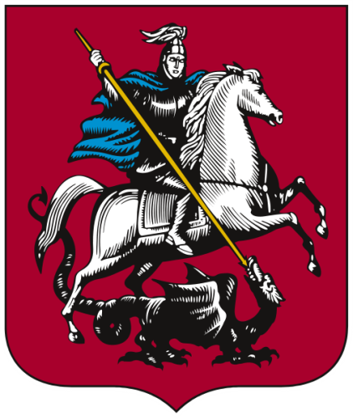
Russia Breaks Free
Moscow is founded in the 1100s, located near Russia’s 3 main rivers
Moscow’s princes grow strong under Mongol rule throughout the 1300s
Both the flag and coat of arms of Moscow uses the emblem of Saint George and the Dragon. This legend seems to be symbolical of Moscow throwing off its Mongol rulers.

Slide 88
An Empire Emerges
Late in the 1400s, Ivan III became Prince of Moscow and challenged Mongol rule
Took the name “czar,” which is Russian for “Caesar” and vowed to restore Russia
Russian and Mongol armies faced off in 1480 at the Ugra River
Both armies retreated and Russia gained freedom from Mongol rule

