Slide 1
India
Unit THREE

Slide 2
India’s Golden age
Section one

Slide 3
Rise of the mauryan empire
By the 6th century BC, several kingdoms existed in northeast India, on the great plain of the Ganges River. One of those kingdoms, the Magadha Kingdom, ruled the entire plain of the Ganges, and much of northern India.
Around 300 BC, Chandragupta Maurya seized power
Empire included all of northern India and part of present day Afghanistan
Empire had a strong central government

Slide 4
Reign of asoka
Around 269 BC, the empire passed to Chandragupta’s grandson, Asoka
Asoka was influenced by Buddhism
Proclamations were written in stone and carried throughout his empire

Slide 5
Breakup of Mauryan empire
Asoka has been judged one of the world’s greatest rulers
Death in 232 BC left a void in leadership
Over the next 500 years, northern and central India splintered

Slide 6
Rise of the gupta empire
Around 320 AD, the Gupta Empire was established
First emperor took the name Chandra Gupta
Last great Hindu empire
Often referred to as India’s Classical Age

Slide 7
Gupta Empire achievements
Literature showed importance of Hinduism in life
Produced plays and poetry in sanskrit
SANSKRIT: Indian language of literature
Astronomers, scientists and mathematicians were far ahead of the rest of the world

Slide 8
Fall of the gupta empire
Lasted for almost 200 years
In the middle of the 5th century, Huns began to raid the borders
By 500 AD, the northern part of India was once again broken into many kingdoms

Slide 9
Muslim rule
Section TWO

Slide 10
Setting the stage
Soon after the rise of Islam, the followers of this new religion set about conquering neighboring peoples. From the 700’s to the 1500’s, four different groups of Muslims invaded India. Eventually most of the Indian peninsula was united under Muslim rule. Although the majority of Indian people remained Hindu, Muslim rulers left a lasting mark on Indian society and culture.

Slide 11
Conflict between hinduism and islam
Two religions differed in basic principles – number of Gods and equality of people
Two faiths could not mix

Slide 12
Muslim invasions of india
In early 700’s, Muslim invaders claimed northern India for Muslim empire
In the 11th and 12th centuries, Muslims moved in and occupied all of India north of the Deccan
Indian territories became separate Muslim kingdom – a sultanate

Slide 13
Delhi sultanate
Named by the caliph of Baghdad
Ruled for over 300 years
Lived in great luxury – taxing non-Muslims
Gov’t was never stable
Delhi Sultanate fell in 1526

Slide 14
Mongol rule
Section three

Slide 15
Setting the stage
In the early 1500’s, Babur, a descendant of Genghis Khan, led his army into India. In 1526, the Delhi Sultanate fell. Though Babur died shortly after the conquest, he succeeded in establishing a new empire in India. This empire was called the Mogul Empire, coming from the Persian word for Mongol.

Slide 16
Reign of akbar
Akbar ruled for 49 years and controlled most of India
Well respected and supported
Allowed religious freedoms
Lessened conflict between Hindus and Muslims

Slide 17
Akbar’s Successors
Son and grandson continued policies of fairness, efficiency and compromise
Akbar’s grandson, Jahan, took the title of shah in 1628
SHAH: king
Shah Jahan built the Taj Mahal
TAJ MAHAL: architectural wonder of the world, built for Shah Jahan’s wife

Slide 18
End of mongol rule
Shah Jahan’s son seized the throne in 1658
By his death in 1707, Mongol empire had gained territory, but lost its strength

Slide 19
Southeast asia & korea
Section four

Slide 20
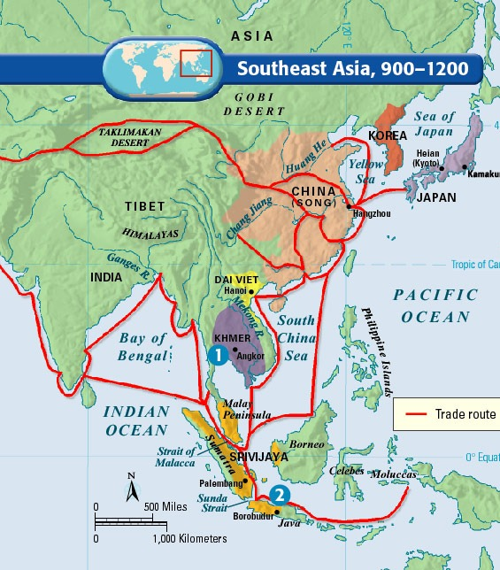

Slide 21
Khmer Empire
Main power on Southeast Asia mainland for centuries
Reached height around 1200 AD
Improved rice cultivation to remain wealthy
In capital of Angkor, rulers built city and temple complexes
ANGKOR WAT: city and temple complex; one of world’s greatest architectural achievements

Slide 22
Koryu Dynasty
To the northeast of India and the Khmer Empire was the Korean state. Korea is located on a peninsula that juts out from the Asian mainland toward Japan.
Around 935, a new king took power and established the Koryu Dynasty
Lasted from 935 to 1392
Modeled central government after China’s
Established a civil service system
Produced lasting achievements for Korea culture

