Slide 1
Japan
Unit Three

Slide 2
Japanese geography
Section One

Slide 3
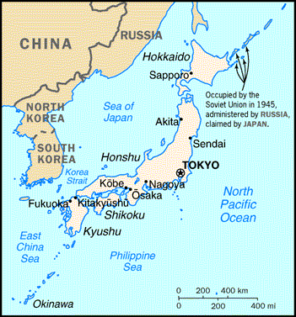
Growth of Japanese Civilization
Japanese were close enough to Korea and China to feel effects of their civilizations
Japanese were far enough from Korea and China be safe from invasion

Slide 4
Geography of Japan
About 4,000 islands make up the Japanese archipelago
ARCHIPELAGO: island group
The four largest islands are: Hokkaido, Honshu, Shikoku and Kyushu
ADVANTAGES OF JAPAN’S GEOGRAPHY: mild climate with plenty of rainfall
DISADVANTAGES OF JAPAN’S GEOGRAPHY: country is too mountainous to farm and natural resources are in short supply; natural disasters also threaten the area

Slide 5
Shinto & the Yamato Empire
Section Two

Slide 6
Early Japan
Japan began not as a united territory, but as hundreds of clans controlling their own territories
Varied customs and beliefs combined to form Japan’s earliest religion
SHINTO: way of the gods
Shinto is based on respect for forces of nature and worship of ancestors
Followers believe in kami
KAMI: divine spirits that dwelled in nature

Slide 7
The Yamato Emperors
Yamato clan became the leading clan by 400 CE
By the 7th century, they were calling themselves emperors of Japan
Many Yamato emperors lacked real power, but the dynasty survived
When rival clans fought for power, the winning clan claimed control and then ruled in the emperor’s name
Dual structure becoming enduring characteristic of the Japanese gov’t

Slide 8
Japanese feudalism
Section Three

Slide 9
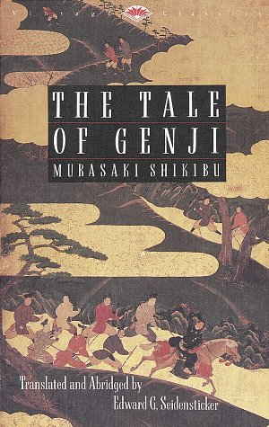
Life in the Heian Period
In the late 700s, imperial court moved to Heian (modern day Kyoto)
Growth of large estates
Arts and literature of China flourished in Japan
Highly refined and elaborate court life
A great novel, The Tale of Genji, was written by Lady Murasaki

Slide 10
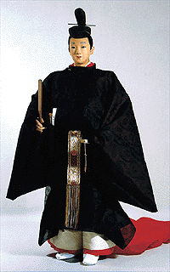
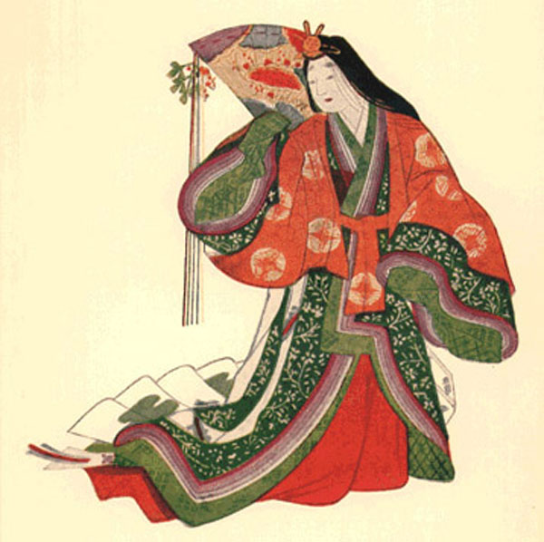
Heian Court Clothing

Slide 11
Decline of Central Authority
Large landowners living away from the capital set up private armies
Countryside became lawless and dangerous
Farmers and small landowners traded land to strong warlords for protection
With more land, the lords gained more power
In 1180, war broke out between two warrior families
The Minamoto Family, led by Yorimoto, won the war
Yorimoto gained the title of shogun and established the Kamakura Shogunate which lasted from 1185 to 1333
SHOGUN: barbarian-defeating general

Slide 12
Japanese Feudalism
FEUDALISM: a political, economic, and social system based on loyalty, the holding of land, and military service.
Samurai dominated society in feudal Japan
SAMURAI: warriors
Samurai spent a lifetime perfecting military skills
Lived by the samurai code
BUSHIDO: the samurai code; way of the warrior
Honor was extremely important to a samurai
If he was dishonored in any way, he was supposed to commit seppuku
SEPPUKU: ritual suicide

