Slide 1
AFRICA
1945 to Present Day

Slide 2
ACHIEVING INDEPENDENCE

Slide 3
SETTING THE STAGE
Throughout the first half of the 20th century, Africa resembled little more than a European outpost. The nations of Europe had marched in during the late-1800s and colonized much of the continent. Like the diverse groups of people living in Asia, however, the diverse people of Africa were unwilling to return to colonial domination after World War II. And so, in the decades following the great global conflict, they, too, won their independence from foreign rule and went to work building new nations.

Slide 4
IMPACT OF WORLD WAR II
African push for independence had begun before WW2
French-speaking Africans and West Indians had begun to express growing sense of pride in traditional Africa
They formed the Negritude movement – a movement to celebrate African culture, heritage and values
When WW2 erupted, African soldiers fought alongside Europeans to “defend freedom” and made them unwilling to accept colonial domination when they returned home
Many Europeans began to question the costs and morality of maintaining colonies abroad
These and other factors helped African colonies to gain freedom in the 1950s and 60s

Slide 5
PATHWAYS TO INDEPENDENCE
African nations achieved independence in many different ways
Colonies under indirect rule generally experienced an easier transition to self-rule
For colonies under direct rule, however, independence came with more difficulty
Some nations had to fight wars to gain power from the European settlers
No matter how they gained freedom though, most new African nations found the road to a strong and stable nation to be difficult
They dealt with creating new governments and establishing economies, and many were plagued by great ethnic strife, as while national borders separeted those with similar cultures, they also enclosed traditional enemies
For many African nations, all of this led to instability, violence and an overall struggle to deal with newly gained independence

Slide 6
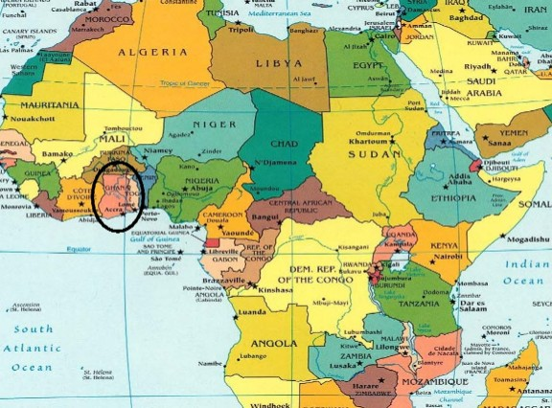
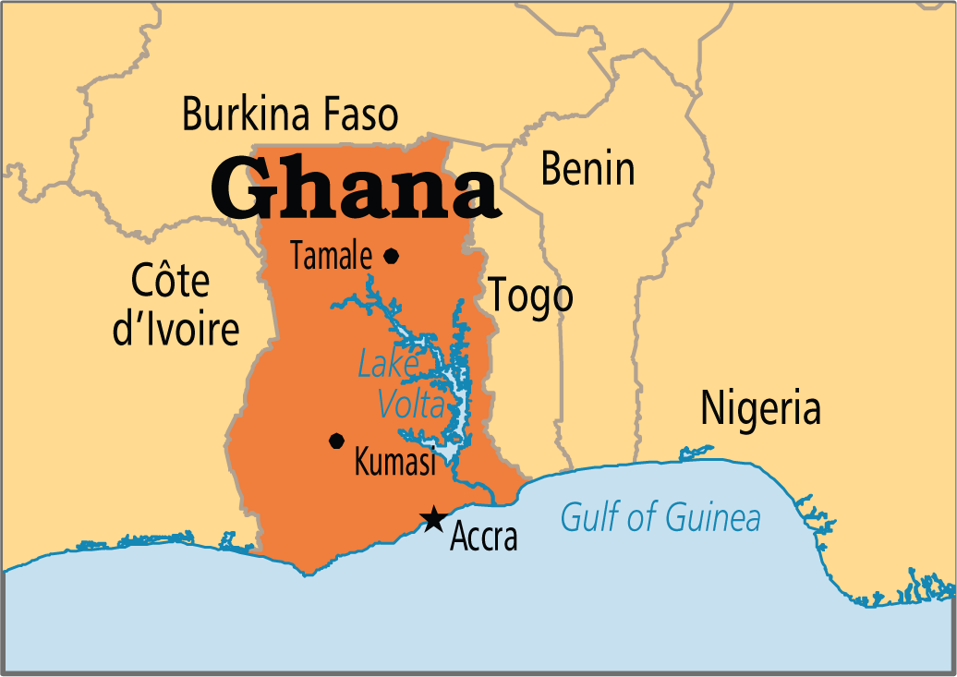
GHANA LEADS THE WAY
British colony of the Gold Coast was the first African colony south of the Sahara to achieve independence
British began to slowly turn over control after WW2, but Africans wanted full freedom
Kwame Nkrumah led the nonviolent movement and starting in 1947, organized strikes and boycotts
Received independence in 1957 and upon receiving it, the Gold Coast took the name Ghana

Slide 7
GHANA AFTER INDEPENDENCE
Nkrumah became the first prime minister of Ghana and pushed through new roads, schools and expanded healthcare
Costly projects began to cripple the economy
His intentions were good, but the expense undermined his leadership
Neglected problems in his own country and spent excess time on Pan-African efforts
In 1966, while Nkrumah was in China, the army and police seized power
After years of struggle between civilian and military rule, in 2000, Ghana held its first open elections
Today, Ghana is a regional power in West Africa and one of the world’s largest gold and diamond producers – and is projected to be the largest producer of cocoa in 2015

Slide 8
FIGHTING FOR FREEDOM
In contrast to Ghana, nations such as Kenya and Algeria took up arms against their European rulers in order to ultimately win their freedom, while others (Congo and Angola) have seen lasting civil war
Kenyans claimed independence from the British in 1963, but only after more than 10,000 Africans and 100 settlers had been killed
Today, Kenya is governed under a constitution and is divided into 47 semi-autonomous counties, governed by elected governors
Algerians claimed independence from the French in 1962, but only after the French had sent half a million troops to fight the Algerian National Liberation Front (FLN)
Today, Algeria continues to struggle with civil war between Islamic militants and the government

Slide 9
CHALLENGE OF DEMOCRACY

Slide 10
SETTING THE STAGE
As dozens of European colonies gained independence in Africa, the establishment of democracy in Africa proved difficult. In many cases, the newly independent nations faced a host of problems that slowed their progress toward democracy. The main reason for Africa’s difficulties was the negative impact of colonial rule. European powers had done little to prepare their African colonies for independence. The lingering effects of colonialism undermined efforts to built stable, democratic economies and states.

Slide 11
EUROPEAN POLICIES CAUSE PROBLEMS
One problem was the ethnic and cultural conflicts created by arbitrary boundaries
Other problems had a greater economic basis
European powers had viewed colonies as sources of wealth and had encouraged the export of one or two cash crops (coffee or rubber) rather than production of products to serve local needs
These policies left new African nations with unbalanced economies and a small middle class
Such economic problems lessened their chances to create democratic stability
European rule also disrupted African family and community life

Slide 12
SHORT-LIVED DEMOCRACIES
When Britain and France gave up colonies, they left fragile, democratic governments in their place
Soon, the aforementioned problems threatened those governments
Rival ethnic groups often fought for power
Strong militaries became tools for ambitious leaders
In many cases, a military dictatorship replaced the democracy

Slide 13
INDEPENDENCE IN NIGERIA
Nigeria, a former British colony, won its independence peacefully in 1960 but the country was ethnically divided and this soon led to war.
Three major ethnic groups live within Nigeria’s borders – the Hausa-Fulani (mostly Muslim), the Yoruba and the Igbo (who are mostly Christians, Muslims or animists)
After independence, Nigeria adopted a federal system
FEDERAL SYSTEM: a system where power is share between state governments and a central authority
The Nigerians set up three states, one for each region and ethnic group, with a political party in each

Slide 14
NIGERIAN CIVIL WAR
Although one group dominated each state, the states also had ethnic minorities
In 1963, non-Yoruba minorities in the Western Region tried to break away and form their own region which led to fighting
In January 1966, a group of army officers (mostly Igbo) seized power in the capital city of Lagos and declared martial law
MARTIAL LAW: temporary military rule
The Hausa-Fulani launched an attack from the north and persecuted and killed many Igbo but the survivors fled east
In 1967, the Eastern Region seceded from Nigeria and declared itself a new nation – Biafra, leading the Nigerian government into war to reunite the country and in 1970, the short-lived Biafra surrendered
Nigeria was reunited, but over a million Igbo died, most from starvation

Slide 15
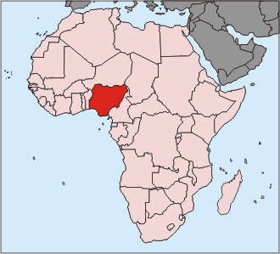
NIGERIAN NATION-BUILDING
After the war, Nigeria returned to the process of nation-building
The government did not punish the Igbo, but used federal money to rebuild the Eastern Region
The military governed Nigeria for most of the 1970s until they handed power back to civilian rulers in 1979
However, Nigerian democracy was short-lived and in 1983, the military overthrew the civilian government
A new military regime dominated by the Hausa-Fulani, took charge

Slide 16
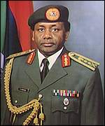
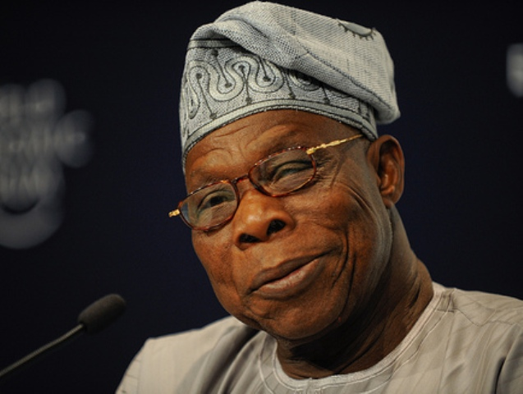
NIGERIA RETURNS TO CIVILIAN RULE
The army held elections in 1993, which resulted in the victory of popular leader Moshood Abiola
Military officers declared the results invalid and General Sani Abacha took control as a dictator
Abacha banned political activity and jailed dissidents
DISSIDENTS: government opponents
After Abacha’s death in 1998, General Abdulsalami Abubakar seized power and ended military rule
In 1999, Nigerians elected their first civilian president, Olusegun Obasanjo, in nearly 20 years

Slide 17
PRESIDENT OBASANJO
Obasanjo was an ethnic Yoruba and a critic of Nigerian military regimes, but as a former general, had support of the military
Worked for a strong, unified Nigeria
Made some progress against corruption and has asked for debt relief, seeing it as essential to relief of hunger and the future of democracy in Nigeria
The most recent election, held in March 2015, saw Muhammadu Buhari elected as President and Nigeria continues to increase its oil exports and economic growth

Slide 18
SOUTH AFRICA UNDER APARTHEID
In South Africa, racial conflict was the result of colonial rule. From its beginnings under Dutch and British control, South Africa was racially divided. A small white minority ruled a large black majority. In 1910, South Africa gained self-rule as a dominion of the British Empire. In 1931, it had become an independent member of the British Commonwealth. Although South Africa had a constitutional government, the constitution gave white power and denied the black majority its rights.

Slide 19
APARTHEID SEPARATES SOCIETY
In 1948, the National Party took power and promoted Afrikaner, or Dutch South African, nationalism
Instituted a policy of apartheid
APARTHEID: complete separation of the races
The minority government banned social contacts between whites and blacks and established segregated schools, hospitals and neighborhoods
In 1959, the minority government set up reserves, called homelands, for the country’s major black groups
Blacks were forbidden to live in white areas unless they worked as servers or laborers for whites
The homelands policy was completely unbalanced – although blacks made up 75% of the population, they were only given 13% of the land

Slide 20
BLACKS PROTEST APARTHEID
The Blacks of South Africa resisted the controls imposted by the white minority
In 1912, they formed the African National Congress (ANC) to fight for their rights
One ANC leader was Nelson Mandela
Troubles continued and riots broke out in 1976 and 1977
As protests continued to mount, the government declared a nationwide state of emergency in 1986

Slide 21
SOUTH AFRICA’S STRUGGLE FOR DEMOCRACY
By the late 1980s, South Africa was under great pressure to change. For years, a black South African bishop, Desmond Tutu, had led an economic campaign against apartheid. He asked foreign nations not to do business with South Africa. In response, many nations did impose trade restrictions. They also isolated South Africa in other ways, for example, by banning South Africa from the Olympics. In 1984, Tutu won the Nobel Peace Prize for his nonviolent methods.

Slide 22
FIRST STEPS FOR SOUTH AFRICA
In 1989, white South Africans elected F.W. de Klerk, whose goal was to transform South Africa and end its isolation
He legalized the ANC and released Nelson Mandela from 27 years in prison
Over the next 18 months, the South African parliament repealed apartheid laws
World leaders welcomed these changes and began to ease restrictions on South Africa
President de Klerk agreed to hold South Africa’s first univeral elections, in which people of all races could vote, in 1994

Slide 23
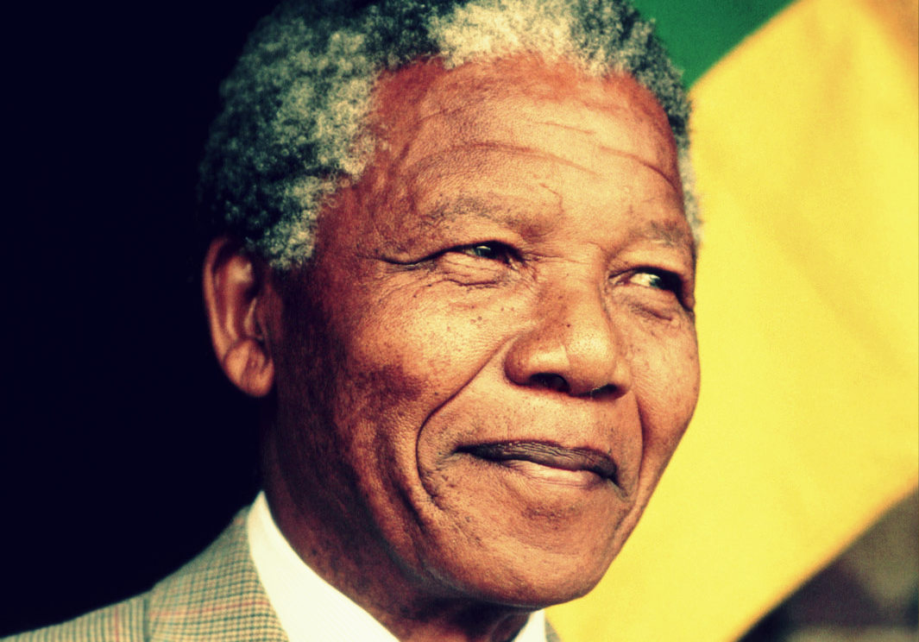
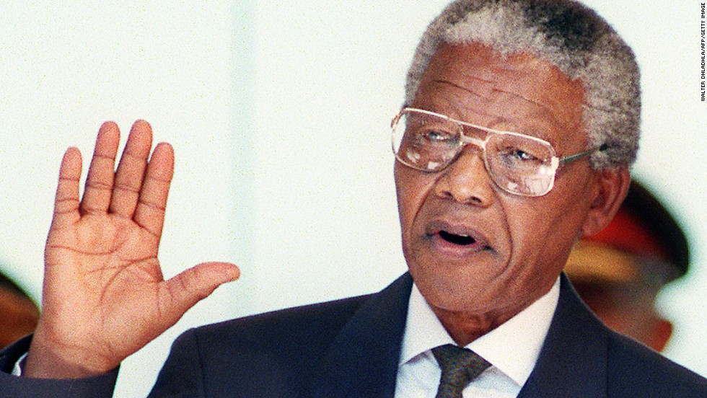
MAJORITY RULE
Nelson Mandela was elected president and continued to work to heal the damage done by apartheid
In 1996, after much debate, South African lawmakers passed a new, more democratic, constitution guaranteeing equal rights for all citizens
Mandela stepped down in 199, but the nation’s democratic government continued
He died in 2013 at the age of 95 and is remembered as a modern democratic hero

Slide 24
SOUTH AFRICA TODAY
In 1999, Thabo Mbeki won election as president in a peaceful transition of power
Mbeki promoted a free-market economic policy
One of the biggest problems facing South Africa is the AIDS epidemic, which the government has failed to take steps to address
South Africa is ranked as an upper-middle economy, however poverty and inequality remain widespread, with about ¼ of the population unemployed and living on less than $1.25/day
The current president is Jacob Zuma, originally elected in 2009 and then re-elected in 2014

Slide 25
HUMAN RIGHTS ISSUES

Slide 26
SETTING THE STAGE
As colonies began to gain independence from European countries, many atrocities occurred in the fights for independence. Some waged war against the Europeans and others waged war against one another, as the cultural divides between the African people were too big for some to accept. These atrocities included starvation and extreme poverty, but in some cases, also included the attempted murder of an entire race.

Slide 27
WHAT IS GENOCIDE?
GENOCIDE: the deliberate killing of a large group of people, especially those of a particular ethnic, national, racial or religious group, with the intent to destroy that group, in whole or in part.

Slide 28
RWANDAN GENOCIDE
Between April and June of 1994, an estimated 1 million Rwandans, from the ethnic group the Tutsis, were killed in the span of 100 days
70% of the Tutsi population, and 20% of Rwanda’s overall population were murdered
The genocide had a lasting, and profound, impact on Rwanda and its neighboring countries

Slide 29
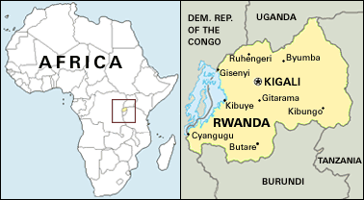
RWANDA

Slide 30
WHO ARE THE HUTUS AND TUTSIS?
The Hutus and Tutsis are 2 groups of people that settled in present day Rwanda 2,000 years ago
Overtime they worked together and united – developing a single language (Kinyarwanda) and one set of religious and philosophical beliefs
Tutsi meant warrior/farmer and Hutu meant peasant
While Tutsis had tended to be taller and lighter-skinned, intermarriage through the years had made distinction by sight impossible
Hutus, but accumulating enough property, could become Tutsis – the distinctions were fluid

Slide 31
COLONIAL RULE IN RWANDA
Germans were the first to colonize Rwanda in the early 1900s
After World War I, it was decided that Germany could no longer rule Rwanda and would instead be governed by Belgium
Both colonial powers sharpened the distinction between Tutsis and Hutus, and Belgium used it to their advantage
The Belgians favored the Tutsis and gave them privileges and western-style education because they thought it was easier to control Rwanda this way
Belgians favored the Tutsis because they appeared more European in their features

Slide 32
IDENTIFICATION CRISIS
After creating laws that gave special privileges to the Tutsis, the Belgians ran into a problem – how could they be sure who was a Tutsi and who was a Hutu?
In 1935, Belgium mandated that every single citizen must register and carry an identification card
This prevented any further movement between the classes
If a citizen had no proof of being a Tutsi or Hutu, the Belgians decided for them – if more European looking, a citizen was Tutsi and if features were less European looking, a citizen was Hutu

Slide 33
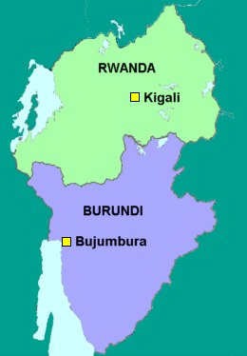
PARMEHUTU
In 1959, Hutus formed the Party for the Emancipation of the Hutus – called Parmehutu
Hutus rebelled against the Belgian colonial power and the Tutsi elite
150,000 Tutsis fled to Burundi (which at the time was a part of Rwanda)
In 1962, Belgium withdrew from Rwanda and Rwanda and Burundi split into 2 different countries

Slide 34
HUTUS FIGHT THE TUTSIS
Still angry at being repressed and discriminate against for so many years, the Hutus continue to fight the Tutsis for decades
Many Tutsis are massacred and many flee Rwanda
A well-known Hutu leader, Dr Leon Mugesera appeals to the Hutus to send the Tutsis “back to Ethiopia” and other Hutus said that they needed to clean up the “filth” and kill the Tutsi “cockroaches”
Following months of negotiations, President Habyarimana (a Hutu president) and the RPF (Rwanda Patriotic Front) signed a peace accord in 1993 calling for the return of the Tutsi refugees
2,500 UN troops were deployed to Kigali to oversee the peace accord

Slide 35
A FRAGILE PEACE
Despite the peace accord, the Rwandan president stalled in created a unified government with shared power
At the same time, the training of militias and violence intensified
Human rights groups warned the international community of an impending genocide
In March of 1994, human rights groups are forced to flee Rwanda due to the impeding calamity – only the Red Cross stayed behind
The UN is forced to leave as well

Slide 36
A DAY TO REMEMBER
On April 6, 1994, President Habyarimana and the president of Burundi, Cyprien Ntaryamira, are shot down in a plane and killed
No one knows who shot down the plane – some theories point at Hutus, and others point at the Tutsis
That night, the genocide begins

Slide 37
THE GENOCIDE
The Hutu militia, at one point 30,000 people strong, slaughtered any Tutsi they found
The militia encouraged regular Hutu civilians to do the same
In some cases, Hutus were forced to kill their Tutsi neighbors
In the span of 100 days, an estimated 500,000 to 1 million Tutsis were slaughtered
They were killed primarily with knives, machetes, and clubs
100,000 of those murdered were children

Slide 38
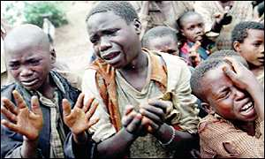
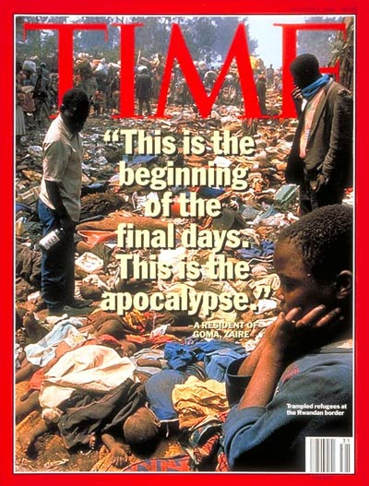
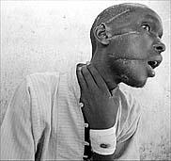
THE GENOCIDE

Slide 39
WHERE WAS THE HELP?
While the genocide was going on, the world sat back and watched
No troops or aide was sent by the Americans or any other country
The victims were left screaming for help, but no one came
During the events and in their aftermath, the UN, US, UK, and Belgium were harshly criticized for their inaction

Slide 40
END TO THE GENOCIDE
By July 1994, the RPF captured the city of Kigali
The government collapsed and the RPF declared a cease-fire
Close to 2 million Hutus fled to Zaire (now the Republic of Congo)
On July 19, 1994, a new multi-ethnic government was formed, promising all refugees a safe return to Rwanda
Pasteur Bizimungu, a Hutu, was inaugurated as president, while the majority of the cabinet posts were assigned to Tutsis

Slide 41
JUSTICE FOR RWANDAN GENOCIDE
The new government of Rwanda continues to seek justice for the innocent murder of close to a million people
Many people have been tried in court and found guilty of war crimes
500 people have been put to death for their war crimes, and another 100,000 are still in prison

Slide 42
OTHER ISSUES OF HUMAN RIGHTS
Overall, the situation of human rights in Africa is generally seen to be poor
Democratic governments seem to be spreading, but are not the majority yet
Extensive human rights abuses still occur in several parts of Africa, often under the oversight of the state
Notable countries with ongoing major violations include, but are not limited to, the Sudan and Cote d’Ivoire
Reported violations include extrajudicial execution, mutilation and rape

