Slide 1

Age of Imperialism
Unit Four

Slide 2
The Age of Imperialism
Industrialization stirred ambitions in many European nations. They wanted more resources to use towards their industrial production and they competed for new markets for their goods. European nations looked to Africa and Asia as sources of the raw materials and as markets for cloth, plows, guns, and other industrial products. In our fourth unit, as we explore the Age of Imperialism, we will do so in four sections:
Imperialists Divide Africa
Muslim Lands Fall to Imperialist Demands
British Imperialism in India
Western Powers Rule Southeast Asia

Slide 3
What is Imperialism?
IMPERIALISM: takeover of a country or territory by a stronger nation with the intent of dominating the political, economic and social life of people within that nation
Europeans were motivated by political, economic and social forces
Economic Motives | External Forces
Nationalism | Maxim gun
Economic competition | Railroads & steamships
European racism | Cure for malaria
Missionary impulse

Slide 4
What is Imperialism?
Because of advanced technology, Europeans believed they were better than other people
RACISM: the idea that one race is superior to others
SOCIAL DARWINISM: social theory asserting that those fittest for survival enjoyed wealth and success and were superior to others, “survival of the fittest”

Slide 5
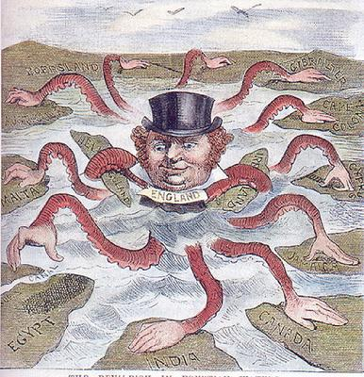

Slide 6
Imperialists Divide Africa
Section One

Slide 7
Pre-Imperialism in Africa
Prior to the Age of Imperialism, Europeans controlled very little of the land on the large continent of Africa. As late as 1880, Europeans controlled only 10 percent of the continent’s land, mainly on the coast.
Two factors kept Europeans mostly out of Africa:
Europeans could not travel into the interior of Africa due to the African rivers
Large networks of Africans conducted trade, keeping Europeans from controlling the sources of trade

Slide 8
Enabling Forces
External and internal forces contributed to the Europeans’ conquest of Africa
First automatic machine gun, The Maxim, gave Europeans an advantage
European countries had means to control their empire
Quinine (a drug) allowed Europeans to avoid malaria
Africans’ huge variety of languages and cultures discouraged unity among them, allowing Europeans to play rival groups against each other

Slide 9
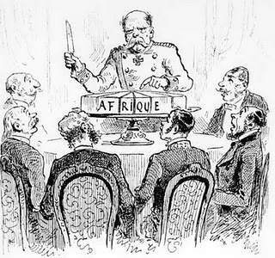
Berlin Conference
14 European nations met in 1884-1885 to lay down rules for division of Africa
Divided continent with no thought of how African groups were distributed
No African rulers attended the meetings

Slide 10
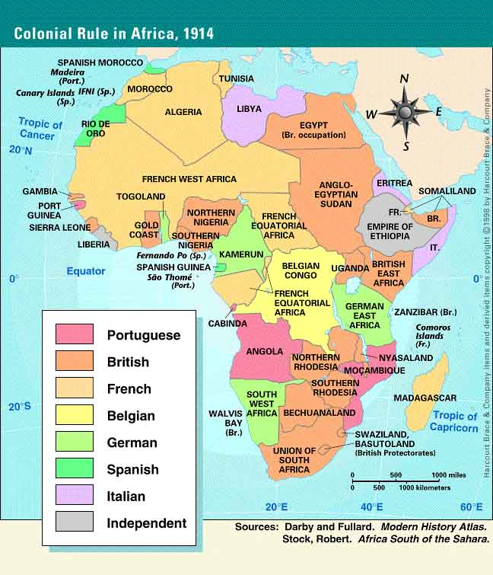
Effects of the Berlin Conference
Businesses developed cash crops plantations to grow peanuts, palm oil, cocoa and rubber
Products displaced food crops grown to feed families
Major source of wealth continued to be rich mineral resources

Slide 11
Three Groups Clash
AFRICANS: although lands seemed empty to the Europeans, huge areas had been claimed by ethnic groups – among them the Zulu people
DUTCH: Dutch settlers, known as Boers, gradually took over native Africans’ lands and established large farms; later clashed with the British
BRITISH: took over Cape Colony in the 1800s and fought with the Boers

Slide 12
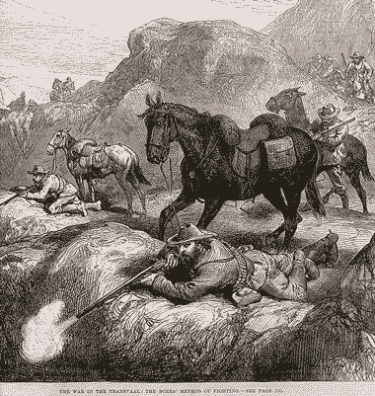
Boer War: 1899-1902
Diamond and gold were discovered in the 1860s and 1870s
Boers tried to keep others from gaining rights
An attempt to start a rebellion failed and Boers blamed the British
First modern “total” war
Britain won in 1902

Slide 13
Muslim Lands Fall to
Imperialist Demands
Section Two

Slide 14
The European powers who carved up Africa among themselves also looked elsewhere to see what other lands they could control. The Muslim lands that rimmed the Mediterranean had largely been claimed as a result of Arab and Ottoman conquests. Now the Muslim power in those areas was weakening. Europeans competed with each other to gain control of this strategically important area.
A series of weak rulers destroyed the political unity of the Empire. With this weakening, the economy began to collapse – currency was devalued, unemployment rose, and the different nationalities began to fight both their Turkish masters and each other.

Slide 15
Desire for Independence
Different groups began to want independence.
These groups included:
Greeks
Serbians
Bosnians
Romanians
Kurds
Armenians
Syrians

Slide 16
Europeans Grab Territory
GEOPOLITICS: interest in or taking of land for its strategic location or products
World powers were attracted to the strategic location of the Ottoman Empire
CRIMEAN WAR: war between Russians and Ottomans over land on the Black Sea; Ottomans supported by British and French won the war
Despite winning the Crimean War, the Ottoman Empire continued to lose land

Slide 17
In the Muslim lands, the European imperialists gained control by using economic imperialism and creating spheres of influence. Although some governments made attempts at modernization, in most cases it was too little too late. In other areas of the globe, imperialists provided the modernization. India, for example, became a colony that experienced massive change as a result of the occupation of the imperialist British.

Slide 18
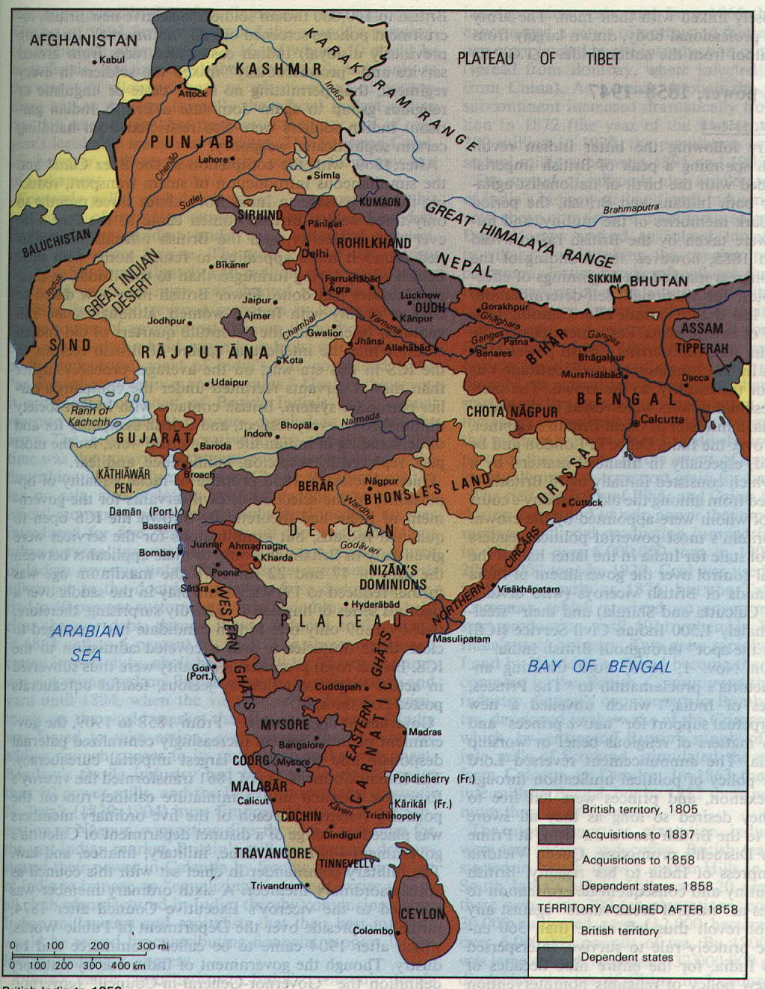
British Imperialism in India
Section Three

Slide 19
British Expand Control
British economic interest in India began in the 1600s , when the British East India Company set up trading posts in Bombay, Madras and Calcutta. At first, India’s ruling Mughal Dynasty kept European traders under control. By 1707, the Mughal Empire was collapsing. Dozens of small states, each headed by a separate ruler, broke away from Mughal control.
The East India Company quickly took advantage of the growing weakness of the Mughals. In 1757, Robert Clive led company troops in a decisive victory over Indian forces at the Battle of Plassey. From then on, the East India Company was the leading power in India. The area controlled by the company grew over time. Eventually, it governed directly or indirectly an area that included modern Bangladesh, most of southern India, and nearly all territory along the Ganges River in the north.

Slide 20
British Expand Control
East India Company Dominates
• British East India Company rules India until 1850s
• Company has its own army led by British officers
• Army is staffed by sepoys
SEPOYS: Indian soldiers
Britain’s “Jewel in the Crown”
• India is Britain’s most valuable colony
• Forced to produce raw materials for British manufacturing and buy British goods

Slide 21
Jewel of the British Crown
Population = 300 million making India a large market for the British
India was a major supplier of raw materials: tea, indigo, cotton, coffee, and opium
The British imposed restrictions on the Indians:
Indians produce raw materials
Indians must buy British goods
Indian manufacturers were not allowed to compete with British factories, crushing the Indian textile business

Slide 22
Impact of British Imperialism in India
Negatives
Positives
Britain restricted Indian ownership of industries
Place emphasis on cash crops
Missionaries
Racism
Railroads
Modern network of roads
Telephone and telegraph lines
Dams, bridges and irrigation canals
Schools and colleges

Slide 23
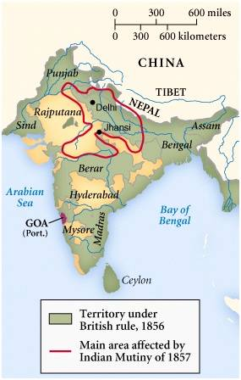
Sepoy Rebellion
1857: Sepoys revolt as a result of years of mistreatment:
Hindus and Muslims forced to use rifle cartridges greased with animal fat
Traditional class and religious differences are ignored by British
Force Sepoys to fight and defend their colonies abroad
Great Britain crushes rebellion and takes DIRECT CONTROL over India
RAJ: British rule over India until 1947

Slide 24
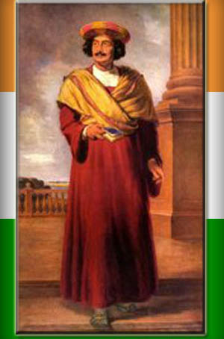
Calls for Reform
Ram Mohun Roy leads modernization movement
Many Indians adopt western ways and call for social reforms
Nationalist groups seek independence – the Indian National Congress (1885) and the Muslim League (1906)

Slide 25
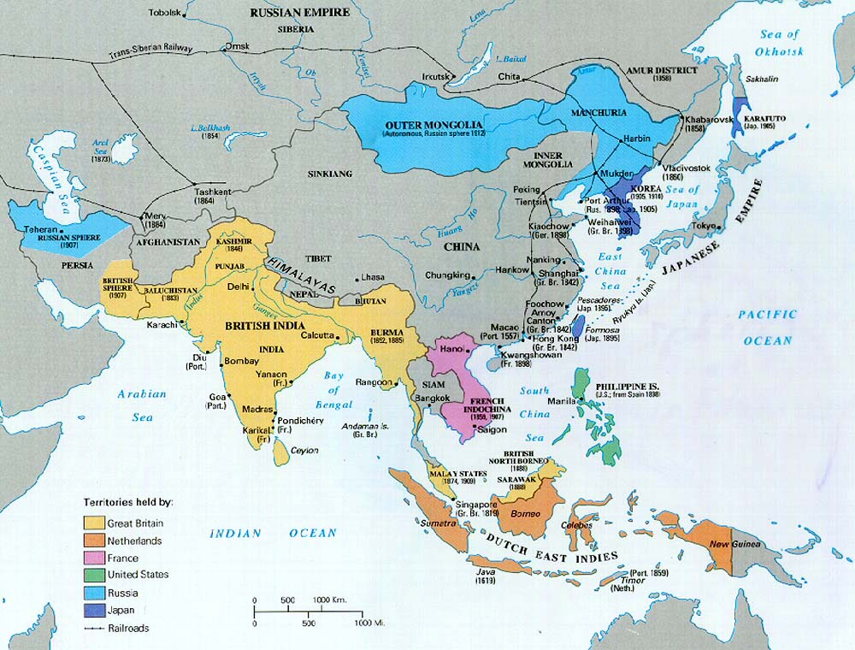
Western Powers Rule
Southeast Asia
Section Four

Slide 26
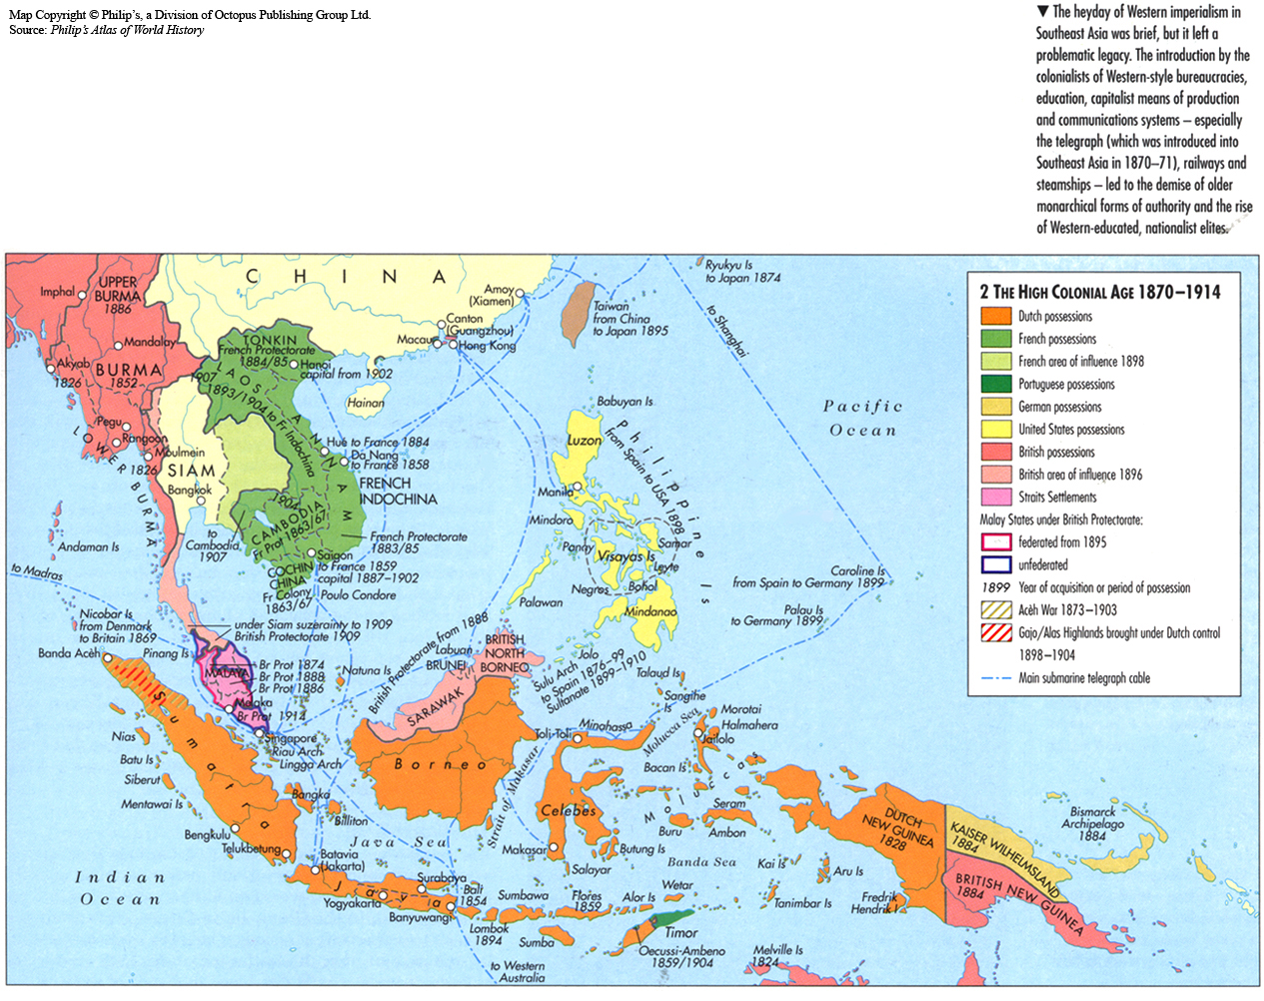
Europeans Race to Claim
Pacific Rim
Dutch, British, French, Germans and Americans
Raw materials: sugar cane, coffee, cocoa, rubber, coconuts, bananas, pineapple

Slide 27
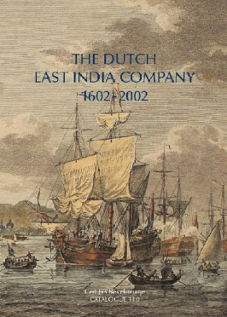
Dutch Expand Control
Controlled the island chain known as Indonesia
Wanted the oil and tin that were discovered there along with other natural resources
Dutch saw this area as there new home and thus created a rigid caste system:
Dutch
Wealthy & Educated Indonesians
Plantation workers

Slide 28
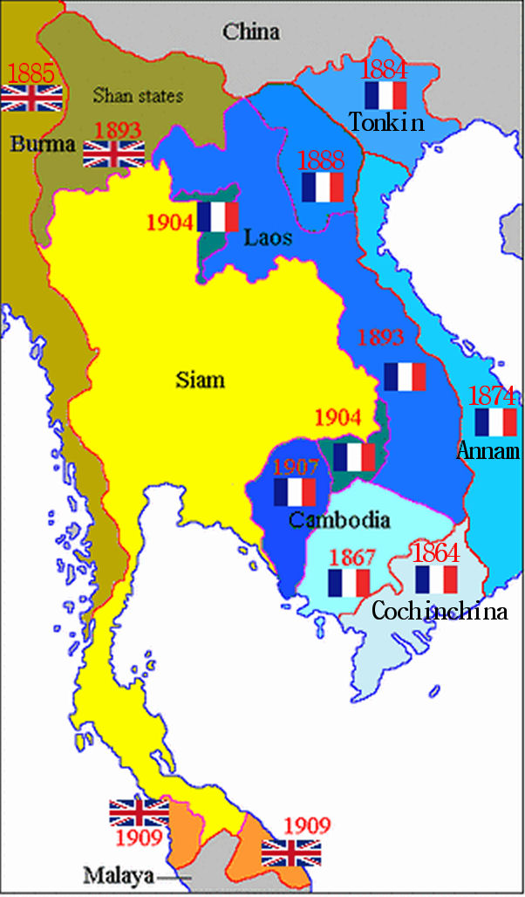
French in Indochina
Control Vietnam, Laos and Cambodia
Used direct control
Exported rice at the cost of the Vietnamese

Slide 29
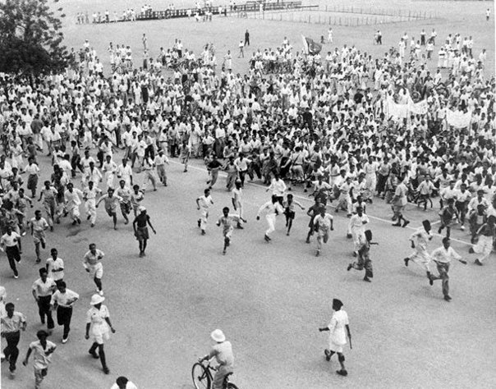
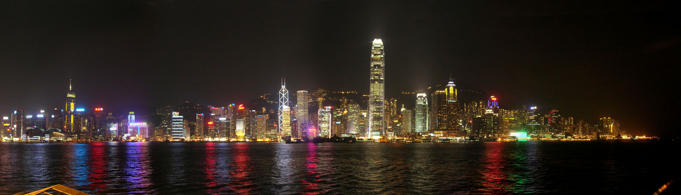
Colonial Impact
Modernization mainly helps European business at the cost of the colony
Education, health, and sanitation improve
Millions migrate to southeast Asia to work in mines and on plantations
Colonialism leads to racial and religious problems

