Slide 1
Post 9/11 and the war on terror
Unit 6

Slide 2
Al-qaeda
Section one

Slide 3
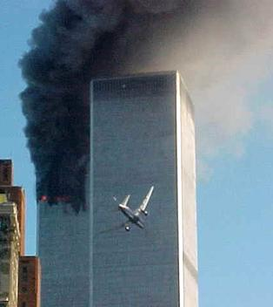
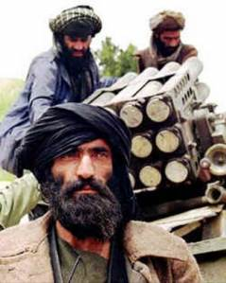
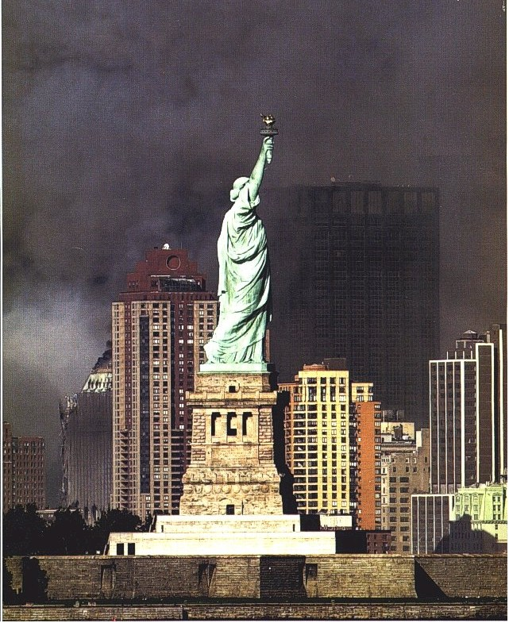
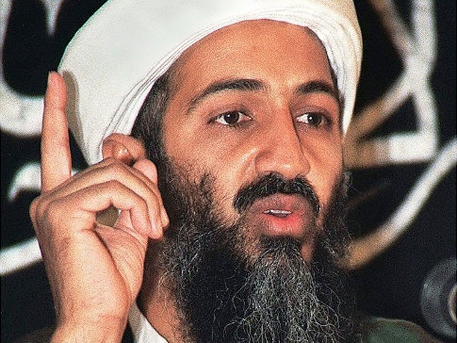

Slide 4
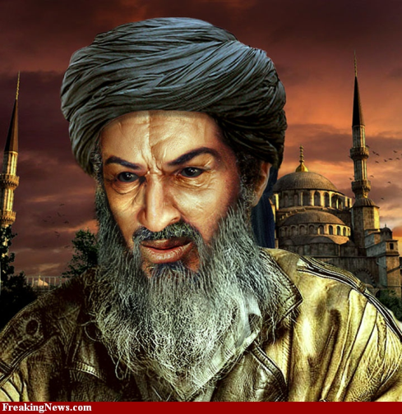
Founding of al-qaeda
Founded on August 11, 1988 by senior members of Egyptian Islamic Jihad in Pakistan
Senior members included Osama Bin Laden
Used Bin Laden’s money and experience with war to:
Get the Soviet Union out of Afghanistan
Continue fight for Islam elsewhere in the world

Slide 5
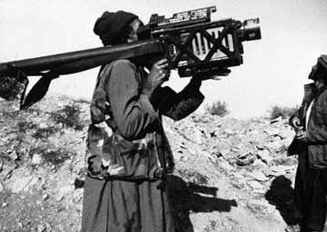
Afghanistan and al-qaeda
The Soviet Union attacked Afghanistan in December of 1979
The United States sided with and supported the Mujahideen—radical Muslim groups who fought the Soviets (Bin Laden among others)
The mujahideen was made up of fighters from many Arab countries
The war turned into a massive disaster for the Soviet Union, they pulled out in February 1989
Osama Bin Laden returned to his home country—Saudi Arabia

Slide 6
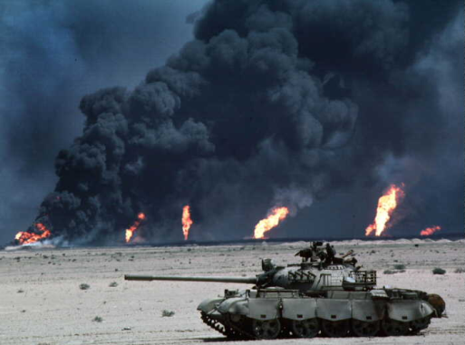
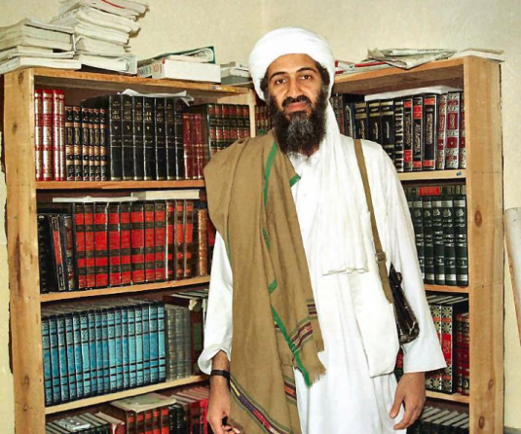
The Gulf War
Iraq attacked their neighbor, Kuwait
Saudi Arabia (and all their oil) was threatened
The USA responded by sending the army and kicking the Iraqis out of Kuwait
The US Military was based in Saudi Arabia
This made Osama Bin Laden very, very angry
He felt the US military was insulting Islam
He spoke against the royal family and was banished from Saudi Arabia—he moved to Sudan

Slide 7
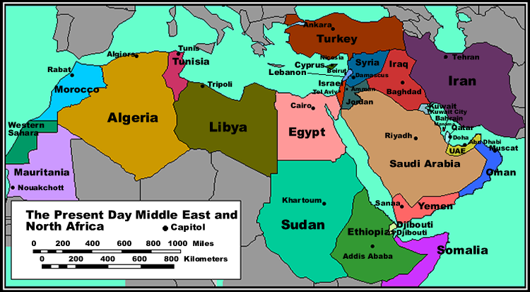

Slide 8
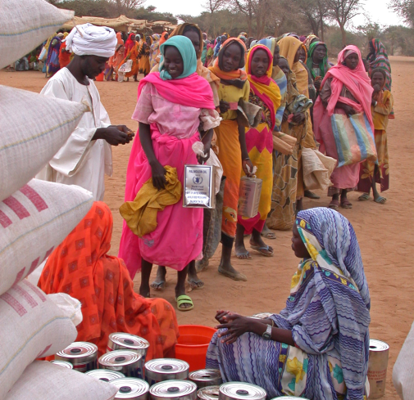
Al-qaeda in sudan
Al Qaeda and Bin Laden were in Sudan-a very poor African Country
Large Muslim population
Muslim government
Bin Laden used his money to help the Sudanese government, start businesses, and recruit new followers

Slide 9
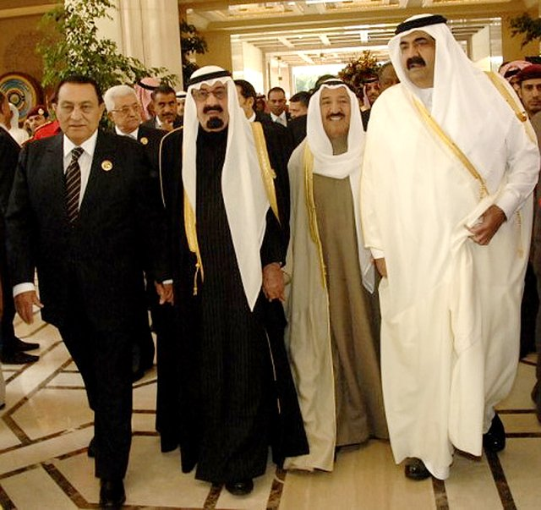
Bin Laden and the Saudis
In 1993, Saudi Arabia supported the Oslo Peace Accords —Enraged Bin Laden
His speeches against the Saudi Royal Family caused the king to revoke his citizenship
He lost his yearly stipend from his family - $10,300,000 a year
He had to return his Saudi passport
His family disowned him

Slide 10
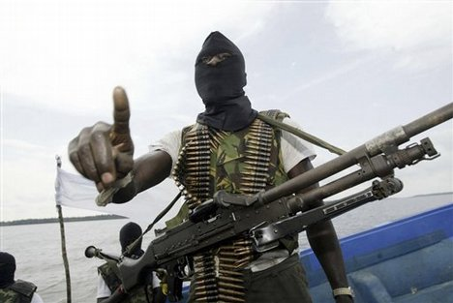
Al-qaeda turns to global war
Al Qaeda committed itself to kicking all non-Muslims out of Muslim lands
Bosnia
India (Kashmir)
Palestine
Bin Laden issued a Fatwa - a binding religious announcement - to expel foreign troops and interests from Islamic lands
This was a declaration of war against the USA and allies

Slide 11
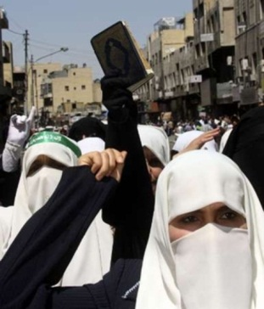
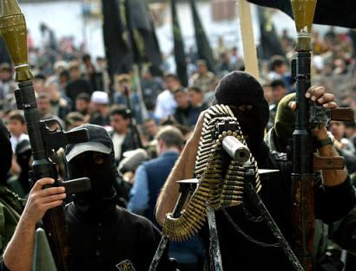
al-Qaeda in Yemen
December 29, 1992 - Yemen
Al Qaeda attacked two hotels housing American soldiers on their way to Somalia to assist with famine relief
Two people working at the hotel were killed and many injured
No American Soldiers were killed
Beginning of Al Qaeda’s change in direction — from fighting in wars to attacking civilians

Slide 12
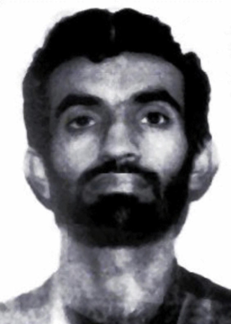
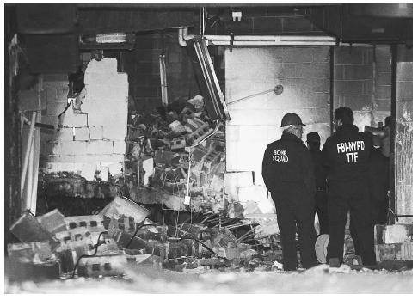
World Trade Center 1993
February 26, 1993 – an al-Qaeda operative drove an explosives packed truck into the basement parking garage
Planned by Ramzi Yousef
al-Qaeda hoped that Tower One would collapse into Tower Two, killing thousands
Six people were killed in the attack and 1,042 injured
Yousef was convicted in a NYC court in 1997 along with several others
Yousef is currently serving 2 consecutive life sentences at the supermax prison in Florence, CO

Slide 13
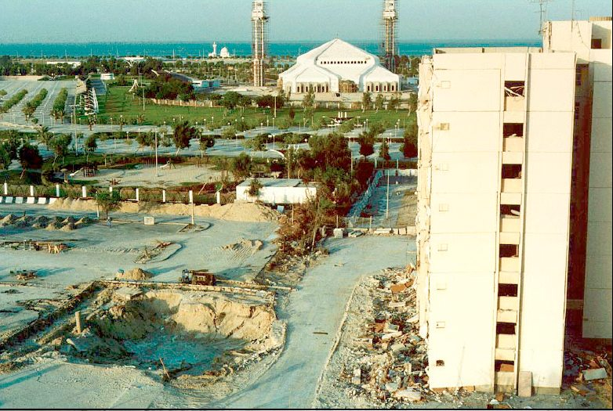
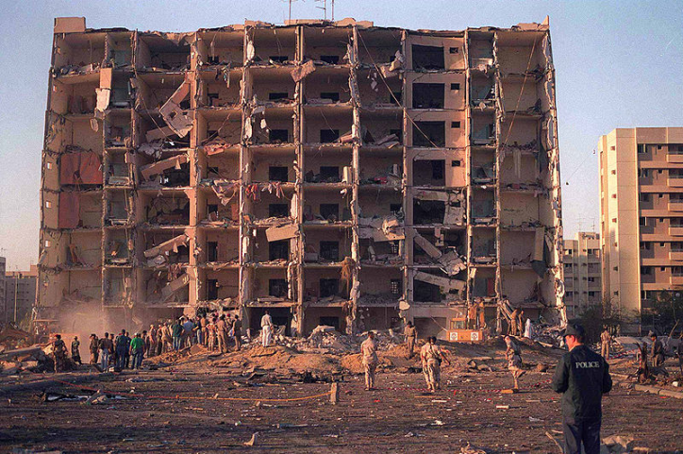
Khobar Towers attack
Large apartment building housing western oil workers and members of the US Air Force
On June 25, 1996, a truck filled with explosives killed 19 US Servicemen and one Saudi citizen
342 people were injured
al-Qaeda was implicated in the attack

Slide 14
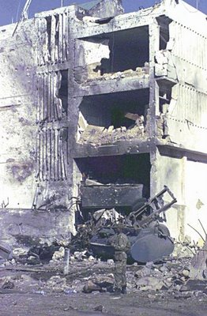
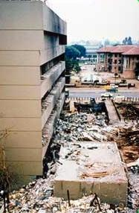
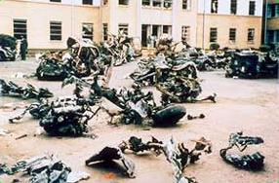
Embassy Bombings
On August 7, 1998, simultaneous bombings of US Embassies in East Africa were carried out
Tanzania - 11 people killed and 85 wounded
Kenya - 212 people killed and 4,000 wounded
12 Americans were killed
Americans started to pay attention to Osama Bin Laden and Ayman al-Zawahiri
In response, President Clinton launched missiles against Afghanistan and the Sudan - did not disrupt al-Qaeda’s activities

Slide 15
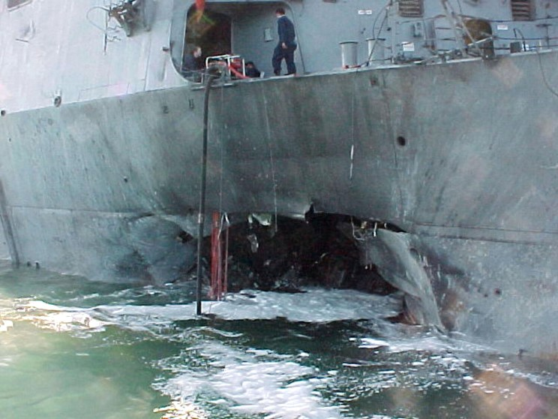
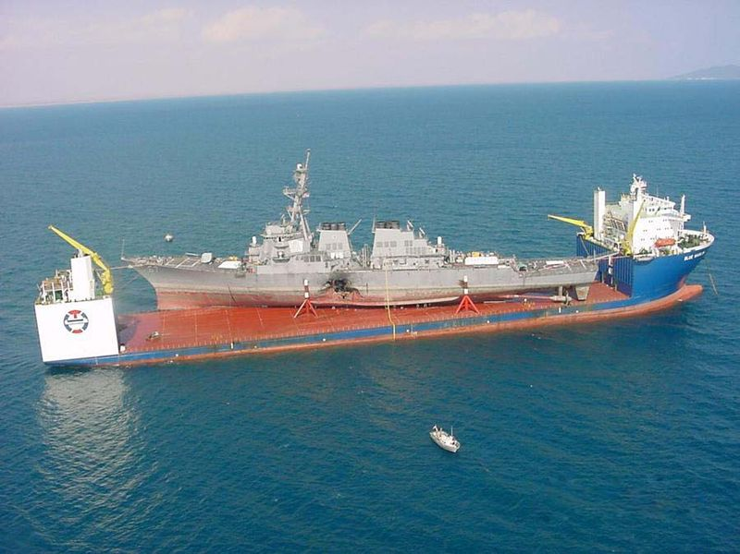
Attack on the USS Cole
October 12, 2000 - the USS Cole, a destroyer, was attacked while in the Yemeni port of Aden
Terrorists in a small boat approached the Cole and blew a large hole in the hull, killing themselves
Seventeen American sailors were killed and 39 injured
The success of the attack gave Al-Qaeda confidence to plan an attack on the USA

Slide 16
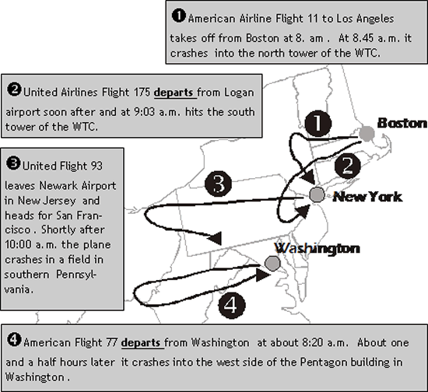
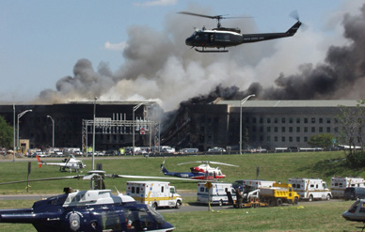
September 11, 2001
19 hijackers used 4 US airliners to attack
The World Trade Center - New York City - 2,752 killed
The Pentagon - Washington, DC - 184 killed
Another Washington DC target — Crashed in Pennsylvania – 44 killed
15 of the 19 hijackers were from Saudi Arabia, 2 were from the United Arab Emirates, 1 was from Lebanon and 1 was from Egypt

Slide 17
Afghanistan and the taliban
Section two

Slide 18
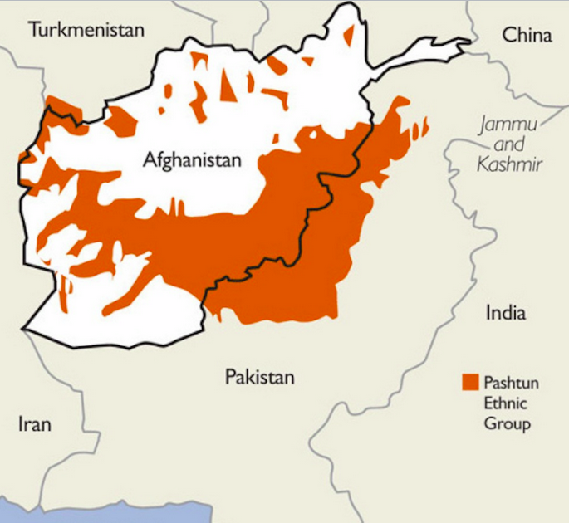
Who Are the Taliban?
The Taliban are a group of radical Muslims from the Pashtun ethnic background
The Pashtun is an ethnic group concentrated mainly along the border of Afghanistan and Pakistan
Ruled large parts of Afghanistan from 1996-2001, including capital city of Kabul
Leader is Mohammed Omar
Taliban are Sunni Muslims and do not consider Shia to be Muslim

Slide 19
Where Did the Taliban Come From?
Afghanistan was largely impacted by the Cold War in the battle for/against communism
US supported forces in Aghanistan known as the mujahideen, who were trying to keep the USSR out of Afghanistan
Between 1979 and 1989, country experienced a major war between mujahideen forces and USSR, that was immediately followed by a civil war
After the USSR left Afghanistan, and US support ended, Afghanistan was left with a “power vacuum” – no one strong was in power
The Taliban emerged to fill the space

Slide 20
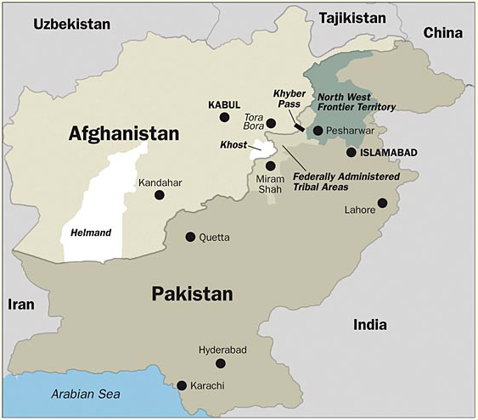
Map of Afghanistan and Pakistan

Slide 21
Taliban in Power
While in power, Taliban enforced a strict interpretation of Sharia – an interpretation of which many leading Muslims are highly critical
The Taliban has an extremely strict and anti-modern ideology
Interpreted Sharia law to forbid a wide variety of previously lawful activities in Afghanistan: satellite dishes, television, nail polish, and more
The Taliban also got rid of employment, education & sports for women, along with dancing, clapping during sports events and kite flying
Taliban has been condemned internationally for brutal treatment of women
During their rule, the Taliban committed massacres against Afghan civilians, denied UN food supplies to 160,000 starving civilians and burned vast areas of fertile land and destroyed tens of thousands of homes

Slide 22
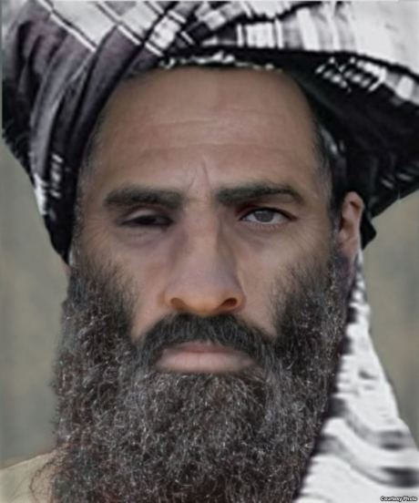
Muhammed Omar
Leader of the Taliban
Afghanistan’s head of state from late 1996-2001
Has been on the US Department of State’s wanted list since October 2001 for sheltering Osama Bin Laden and al-Qaeda militants
Believed to be currently directing the Taliban insurgency against the US and government of Afghanistan from Pakistan

Slide 23
Afghanistan War
War followed the 9/11 attacks and its goal was to dismantle al-Qaeda and remove the Taliban from power
Taliban was ousted from power in November 2001
In December 2001, UN Security Council created the International Security Assistance Force (ISAF) to oversee military operations and training in Afghanistan
US and its allies drove the Taliban from power and built military bases near most major cities
Many al-Qaeda and Taliban members were not captured, but escaped to neighboring Pakistan
In 2003, Taliban launched an insurgency against the government and ISAF and have been waging war through guerilla raids and suicide attacks

Slide 24
Taliban Today
Since being forced out of power in 2001, the Taliban have been accused of using terrorism as a specific tactic to further their ideological and political goals
Pakistan has been accused of continuing to support the Taliban since 9/11, although they continue to deny this claim
The Taliban continues to lead attacks against Afghan civilians and are believed to be mostly spread around the border area of Afghanistan and Pakistan

Slide 25
End to the Afghanistan War?
In May 2012, NATO leaders approved an exit strategy to withdraw forces
UN-backed peace talks have since taken place between Afghan government and the Taliban
In May 2014, US announced that combat operations would end in 2014, leaving just a small force remaining in the country until 2016
Britain officially ended their combat operations in the war in October 14

Slide 26
Government in Afghanistan today
In December 2001, number of Afghan citizens met with the UN to make a plan for governing the country – created the Afghan Interim Administration and the Afghan Transitional Administration to exist for two years until elections
Popular elections were held in 2004 and Hamid Karzai was elected president of the country, now named the Islamic Republic of Afghanistan
Parliament elections were then held in 2005 – several women hold seats in Parliament
Karzai was reelected in 2009
Elections in 2014 were won by Ashraf Ghani but disputed by Abdullah Abdullah who became the Chief Executive Officer in a created unity government

Slide 27
iraq
Section three

Slide 28
Constitutional Monarchy
CONSTITUTIONAL MONARCHY: form of government where a king or queen acts within limits set by a constitution
Iraq was created by the British in 1921 from 3 Ottoman Provinces – Mosul, Baghdad and Basra
Prince Faisal, from Arabia, became the 1st King of Iraq
Iraq gained formal independence in 1932
British maintained military bases
The Iraq Petroleum Co. was created (a joint British, French and American business)
Iraq oil helped Allies during WW2

Slide 29
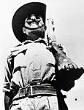
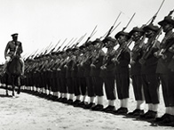
Iraq Military Gains Power
Weak monarchy
Seven military coups (takeovers) occurred between 1936 and 1941
The British occupy Iraq in 1941 and increase their authoritarianism

Slide 30
1958 Revolution
Violent overthrow of the monarchy
Creation of the Republic of Iraq
Reform and dictatorship under President Abd al-Karim Qasim
Purged his western advisors
Centralized authority
Included some Kurds and Shiites in the government
Some land reform
Public welfare projects

Slide 31
1963 and 1968 Coups
In 1952, the Baath Party was created
In 1963, the Baath Party forced out of the new government after the coup to remove Qasim
In 1968, the Baath Party returned and led a coup with Major General Ahmad Hasan al-Bakr at the head
Al-Bakr’s deputy was Saddam Hussein
At this point, violence became a vital part of Iraqi political culture

Slide 32
Saddam Hussein (1937-2006)
Born in Tikrit in a peasant family with influential army relatives
Joined the Baath Party at age 20
Aided in the failed assassination of Qasim at 1959
After the 1963 coup, he was put in charge of the security service for the Baath party
In 1979, he became President of Iraq when al-Bakr was persuaded to step down

Slide 33
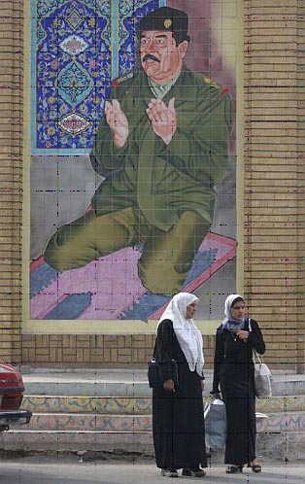
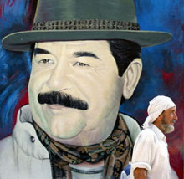
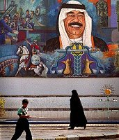
Cult of Personality

Slide 34
Saddam in Power
His Republican Guard was the elite presidential security force
Attacked the Kurds with chemical weapons
KURDS: an ethnic group in the Middle East
Kurds are often referred to as the largest ethnic group without a home state
Mass graves were created for the victims of Saddam’s chemical warfare against the Kurds

Slide 35
Persian Gulf War (1990-1991)
Iraq invaded Kuwait on August 2, 1990 – claimed assistance to revolutionaries in Kuwait
UN put forth Security Council Resolution 678, authorizing military force to be used against Iraq
The US led a coalition backed by the UN
During the period of negotiations and threats following the invasion, Saddam focused attention on the Palestinian problem by promising to withdraw his forces from Kuwait if Israel would relinquish the occupied territories in the West Bank, the Golan Heights, and the Gaza Strip
Saddam's proposal further split the Arab world, pitting U.S.- and Western-supported Arab states against the Palestinians
Allies ultimately rejected any linkage between the Kuwait crisis and Palestinian issues

Slide 36
End of the Persian Gulf War
Eventually, after lasting military pressure from the US led coalition, the out-numbered and under-equipped Iraqi army proved unable to continue fighting
Some 175,000 Iraqis were taken prisoner and casualties were estimated at over 85,000
As part of the cease-fire agreement, Iraq agreed to scrap all poison gas and germ weapons and allow UN observers to inspect the sites
UN trade sanctions would remain in effect until Iraq complied with all terms
Saddam publicly claimed victory at the end of the war

Slide 37
The Iraq War (2003-2011)
In early 2000s, Saddam denied access for UN weapons inspectors
WMD: Weapons of Mass Destruction
Saddam did not comply with the No-Fly Zone Limitations and he was a brutal dictator
US and Britain believed they needed to stop Saddam before he could launch nuclear weapons at Israel, Europe or even the US
At first, President Bush connected Saddam Hussein and Iraq to the September 11th attacks, which would later prove to be completely unrelated

Slide 38
Public Opinion of the Iraq War
Strong anti-war sentiment throughout the United States and globally
A 2007 BBC poll found that 73% of the global population disapproved of the US handling of the war
Many felt the war was unjustified
Polls taken in Iraq have been varied, with some polls showing a grateful majority and others believing the impact of the troops has been mainly negative

Slide 39
Capture & Trial of Saddam
Captured December 2003 – just 9 months after the start of the war
Put on trial beginning in 2004
Charged with crimes including the murder of 148 people, torture of women and children and the illegal arrest of almost 400 others
On November 5, 2006, found guilty of crimes against humanity and sentenced to death by hanging

Slide 40
Death of Saddam Hussein
Hanged on December 30, 2006
Had asked to be shot, but this was not given to him
Carried out at Camp Justice – an Iraqi army base in northeast Baghdad
Wrote a final letter saying goodbye to his country as his last words
Buried in Tikrit on December 31, 2006

Slide 41
Government in Iraq, 2003-2007
Provisional (temporary) government established after invasion
In January 2005, first elections since invasion took place
Constitution was approved in December 2005
In late 2006, US began focusing on training Iraqi military and in January 2007, President Bush announced a surge in US troops sent to Iraq
In May 2007, Iraq’s Parliament asked the US to set a timetable for withdrawal

Slide 42
Government in Iraq, 2008-Present
US troops handed over security duties to Iraqi forces in June 2009, but continued to work with Iraq
On December 18, 2011, final contingent (group) of US troops exited Iraq
Crime and violence initially spiked and Iraq suffered from political instability
In 2012, Iraqi Sunnis claimed the Shia dominated government was working to sideline Sunnis – led to further protests
During 2013, Sunni militant groups stepped up attacks against the Shia population to undermine the government
In 2014, Sunni insurgents belonging to the Islamic State of Iraq and the Levant (ISIL) seized large areas of land
Current PM is Haider al-Abadi

Slide 43
Ethnic Demographics, Present

Slide 44
Arab spring & Syria
Section three

Slide 45
What is the Arab Spring?
ARAB SPRING: a series of anti-government uprisings affecting Arab countries of North Africa and the Middle East that began in 2010
Initial wave of revolutions and protests slowed down by mid 2012, some refer to the ongoing conflicts in the Middle East as a continuation of the Arab Spring
By December 2013, rulers had been forced from power in Tunisia, Egypt (twice!), Libya and Yemen; civil uprisings erupted in Bahrain and Syria; and major protests could be seen in Algeria, Iraq, Jordan, Kuwait, Morocco, Israel and Sudan

Slide 47
Arab Spring Demonstrations
Shared techniques of civil resistance in sustained campaigns involving strikes, demonstrations, marches and rallies
Used social media to organize, communicate and raise awareness
Most demonstrations, although generally peaceful, were met with violent responses from authorities
Slogan is Ash-sha ‘b yurid isqat an-nizam, meaning “the people want to bring down the regime”

Slide 48
Arab Spring in Tunisia
Widespread discontent at economic hardship, decades of autocratic rule & corruption erupted in mass demonstrations in early 2011
Sparked when an unemployed man, Mohamed Bouazizi, set fire to himself on January 4, 2011 after officials stopped him from selling vegetables
President Zine al-Abidine Ben Ali resigned in January 2011, inspiring pro-democracy activists across Arab world
In October 2011, Tunisia held first democratic elections
Elected in December 2013, Mehdi Jomaa is prime minister

Slide 49
Arab Spring in Egypt
18 days of mass protests in February 2011 forced Hosni Mubarak to resign after 3 decades in power
Democratic elections held in 2011 and 2012 saw overwhelming victories for the Islamist Muslim Brotherhood’s Freedom & Justice Party and Salafist al-Nour party
In June 2012, Brotherhood’s Mohammed Morsi was elected president and quickly revoked decree limiting his power and dissolved Parliament
Morsi was deposed by the military in June 2013 and was replaced by an interim government
In December 2013, a constituent assembly finished drafted a new constitution, which was instituted by the interim government in January 2014
Elections held in May of 2014 saw Abdel Fattah el-Sisi (former head of the Egyptian Armed Forces) elected as president to a 4-year term

Slide 50
Arab Spring in Syria
Wave of popular unrest came late to Syria and its once peaceful uprising evolved into a brutal armed conflict
Pressure built against Syrian President Bashar al-Assad and in 2013, he was forced onto the defensive after a chemical weapons attack on the outskirts of Damascus left hundreds dead
al-Assad was forced to agree to destroy chemical weapons
al-Assad has refused to step aside and the war has created a humanitarian disaster, leaving more than 200,000 dead and forcing millions from homes – causing an international refugee crisis in Syria

Slide 51
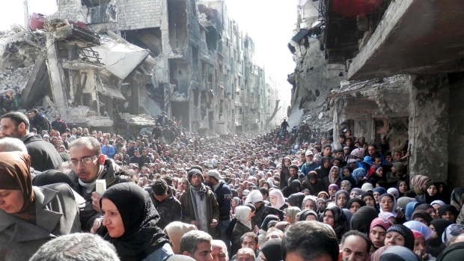
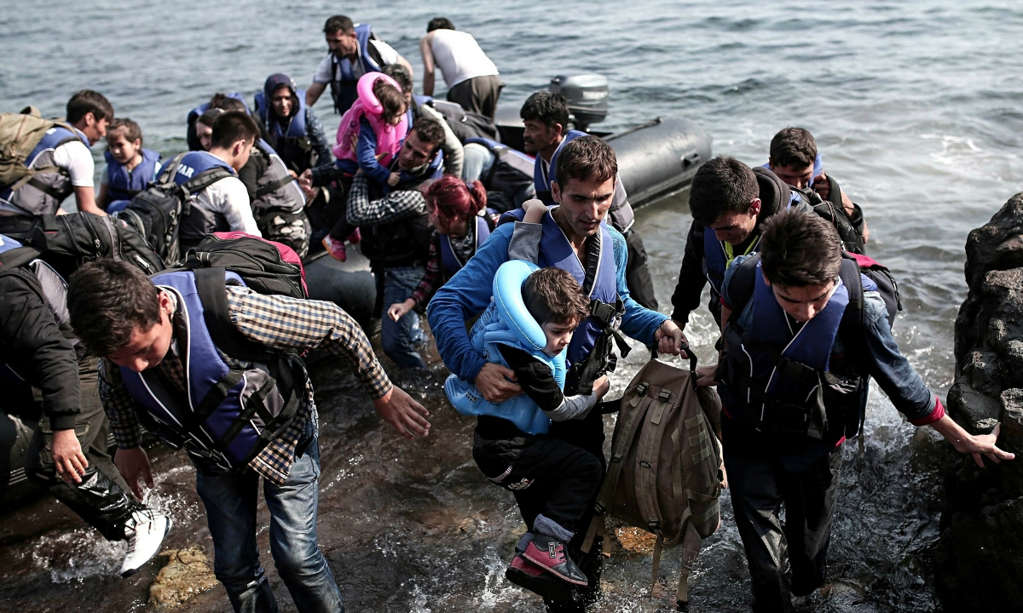
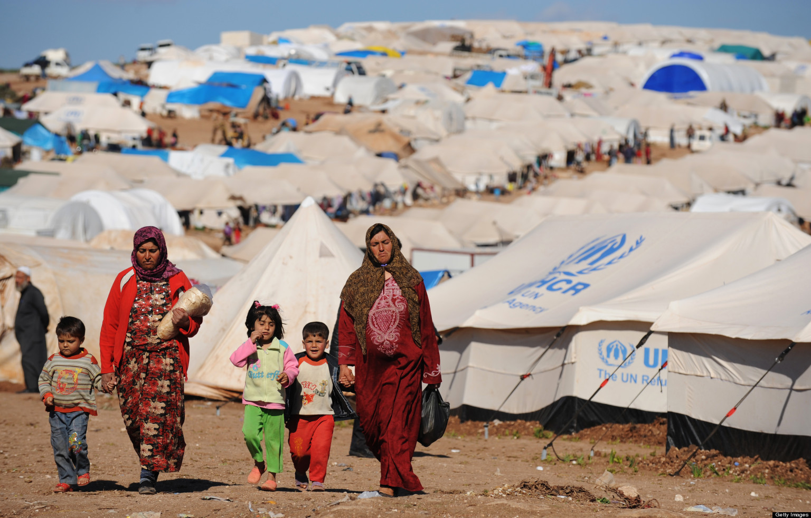
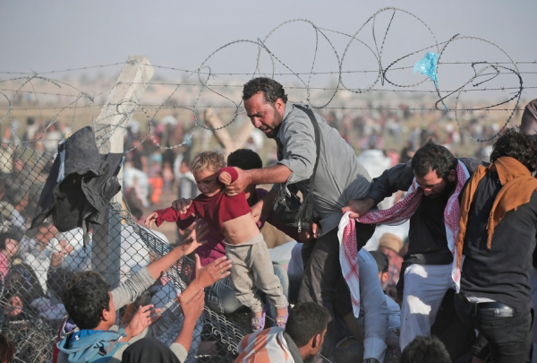
Syrian refugees
Notes:
armouk camp (unofficial refugee camp in SW Syria) became the scene of intense fighting in 2012 between the Free Syrian Army and the PFLP-GC supported by Syrian Army government forces. The camp then was consequently taken over by various factions and was deprived of supplies, resulting in hunger,^{[2]} diseases and a high death rate, which caused many to leave.

Slide 52
Isis
Section four

Slide 53
What is ISIS?
Known as ISIS (Islamic State of Iraq and Syria) or ISIL (Islamic State of Iraq and the Levant)
ISIS is a Sunni, extremist rebel group based in Iraq and Syria where it controls territory
Began as an al-Qaeda splinter group
Aim of ISIS is to create an Islamic state across Sunni areas of Iraq and Syria
Known for killing dozens of people at a time and carrying out public executions and crucifixions

Slide 54
ISIS Control
ISIS has taken over large areas in northern and western Iraq
Group currently controls hundreds of square miles and ignores international borders
Its largest presence runs from Syria’s Mediterranean coast to south of Baghdad
ISIS rules by Sharia law
Initial strategy for revenue was through extortion and robbery but it has shifted to large-scale attacks aimed at capturing and holding territory

Slide 55
Leader of ISIS
Leader is Abu Bakr al-Baghdadi
Very little is known about him, but according to some sources, he earned a doctorate in Islamic studies from a university in Baghdad
Formed ISIS north of Baghdad before joining al-Qaeda in Iraq
Was detained in a US run prison in southern Iraq for 4 years but was released in 2009
After ISIS formally declared its intentions, he began using the name Al-Khalifah Ibrahim
ISIS has declared themselves a worldwide caliphate and al-Baghdadi has been named caliph

Slide 56
Criticism of ISIS
UN has accused ISIS of human rights violations
Amnesty International has reported ethnic cleansing by the group on a “historic scale”
Group has been designated as a terrorist organization
Actions have been widely criticized around the world
Many Islamic communities have judged the group to be unrepresentative of Islam

Slide 57
ISIS Beheadings
In 2014, an unknown number of Syrians, several Lebanese soldiers, at least 10 Kurds, 2 American journalists, 1 American and 2 British aid workers were beheaded by ISIS
Videos were posted to social media
Some of the beheadings were conducted by a man speaking English with an English accent known as “Jihadi John”
Publicized beheadings are only a small portion of a larger total people killed by ISIS

Slide 58
ISIS Activities & Outside Response
ISIS is known for its violent propaganda
In July 2014, ISIS recruited more than 6,300 fighters
US launched humanitarian mission in August 2014 to aid the Yazidis – a Kurdish ethno-religious community
In October and November 2014, militant groups in Libya and Egypt have pledged support to ISIS
ISIS continues to capture cities
In December 2014, one of the leader’s wives and one of his daughters were arrested in Lebanon

Slide 59
Mapping ISIS Attacks Around the World

Slide 60
Attack on Paris
On the evening of November 13, 2015 a series of terrorist attacks occurred in Paris
Three suicide bombers first struck near a stadium, and this was followed by suicide bombings and mass shootings at cafes, restaurants and a theater
130 people were killed and 368 were injured during the attacks
ISIS claimed responsibility, stating that it was retaliation for French led airstrikes on ISIS targets in Syria and Iraq
All of the attackers were killed and the leader/coordinator of the group was found and killed a few days following the attacks

Slide 61
ISIS in 2015 and 2016
Advances have been made to gain territory throughout 2015, and now include more regions in Africa and Asia, including Libya, Yemen, Nigeria, Niger, Chad, Cameroon and Uzbekistan
US and EU led airstrikes continue to hurt ISIS and the US announced in June of 2015 that more than 10,000 members of ISIS have been taken out in airstrikes since September of 2014
There have been no direct attacks on US soil, but there have been a number of attacks inspired by ISIS, including the San Bernadino shooting that killed 14 people on December 2, the deadliest terrorist attack on US soil since 9/11
As of December 2015, ISIS is estimated to have a population of 2.8 million to 8 million people

