Slide 1
The Civil War
Unit 7

Slide 2
THE CIVIL WAR: AT-A-GLANCE
WHY IT MATTERS
The Civil War was a milestone in American history. The four-year struggle determined the nation’s future. With the North’s victory, slavery was abolished. During the war, the Northern economy grew stronger, while the Southern economy stagnated. Military innovations, including the expanded use of railroads and the telegraph, coupled with a general conscription, made the Civil War the first “modern” war.
THE IMPACT TODAY
The outcome of this bloody was permanently changed the nation. The thirteenth amendment was created to abolish slavery and the power of the federal government was strengthened.

Slide 3
The Opposing Sides
Section One

Slide 4
Choosing Sides
Robert E Lee was offered command of Union troops
Turned it down and offered services to the Confederacy
North’s larger population was an advantage
South had fewer men to fight and to work to support the war effort

Slide 5
Financing the War
Legal Tender Act passed by Congress
LEGAL TENDER ACT: created a national currency and allowed the government to issue paper money
GREENBACKS: nickname for paper money
Confederacy had no money
Forced to print paper money which became worthless

Slide 6
Party Politics in the North and South
Lincoln’s goal was always to preserve the Union – not to end slavery
Democrats were sharply divided over the issues
Major disagreements btwn parties incl civil liberties
CONSCRIPTION: forcing people into military service
Both Lincoln & Davis were criticized for this

Slide 7
First “Modern” War
Involved huge armies requiring vast amounts of supplies & equipment
Attrition played a huge role
ATTRITION: wearing down of one side by the other through exhaustion of soldiers and resources
Soldiers used trenches and barricades
South waged a defensive war of attrition
Many Southerners disliked being on the defensive
ANACONDA PLAN: North’s strategy to blockade the ports, thereby dividing the South & gradually making them run out of resources

Slide 8
The Early Stages of War
Section Two

Slide 9
Mobilizing the Troops
First Battle of Bull Run was a Union defeat
One of most effective Confederate commanders was Thomas Jackson – known as “Stonewall Jackson”
Made it clear that the North would need a large, well-trained army to defeat the South
At first men volunteered to enlist in large numbers
In 1863, Congress introduced national draft to raise troops

Slide 10
The Naval War
Union navy blockaded all Confederate ports
Union blockades were increasingly effective, but it was difficult to stop blockade runners
BLOCKADE RUNNERS: small, fast vessels the South used to smuggle goods past the blockade
In April of 1862, Union forces led by David Farragut won the Battle for New Orleans

Slide 11
Battle of Shiloh
Union army general was Ulysees S. Grant
Gained back all of Kentucky and most of western Tennessee
Confederate forces launched surprise attack on Grant’s troops on April 6, 1862
Grant replied with a surprise attack on April 7 and won
20,000 troops died in the Battle of Shiloh

Slide 12
War in the West
Union victory at Shiloh was good, but fighting wasn’t over
Confederate General Braxton Bragg tried to invade Kentucky
Bragg lost at the Battle of Perryville to Union General Buell
Buell was later replaced by Rosecrans who forced him to finally retreat across Tennessee

Slide 13
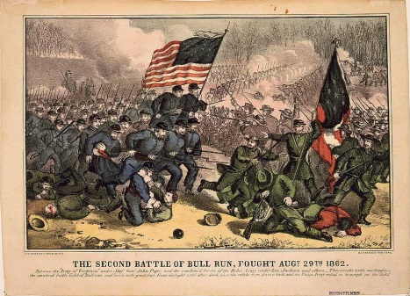
War in the East
General George McClellan leading army in the east
McClellan made a number of mistakes
Led to the Seven Days’ Battle – no decisive victor
McClellan retreated to Washington
Lee attacked, leading to the Second Battle of Bull Run
South forced the North to retreat and began invasion of the North

Slide 14
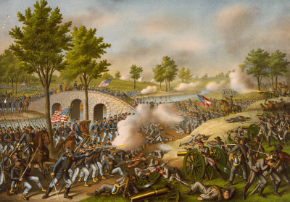
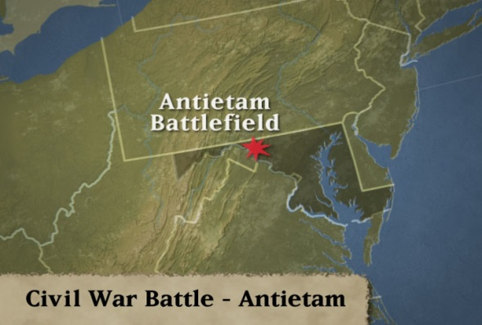
The Turning Point
Lee invaded the North because he and Davis believed that only an invasion would convince the North to accept Southern independence
Thought a victory on Northern soil would help with foreign aid
On September 17, 1862, McClellan attacked along Antietam Creek
Battle of Antietam became the bloodiest one-day battle in the war and American history – 6K killed and 16K wounded
Crucial victory for the Union
British decided not to support Confederacy
Convinced Lincoln that the time had come to end slavery in the South

Slide 15
Emancipation Proclamation
Purpose of the war was to save the Union
After the victory at Antietam, Lincoln announced he would issue the Emancipation Proclamation
EMANCIPATION PROCLAMATION: decree freeing all enslaved persons in states still in rebellion after January 1, 1863
Did not address slavery in the border states
Transformed the conflict over preserving the Union into a war of liberation

Slide 16
Life During the War
Section Three

Slide 17
Wartime Economies
Both North and South struggled to keep economies working
South suffered more from inflation and critical shortages
Food shortages hurt morale
North responded quickly to changes brought by war
North experienced economic boom
Women filled labor shortages in the North

Slide 18
African Americans in the Military
Emancipation Proclamation officially permitted African Americans to enlist in the Union army and navy
About 180K served in the Union army in the Civil War
Another 10-15K in the navy
54th regiment in MA was among the first offically organized African American regiments
54th was praised for heroism

Slide 19
Military Life
Self-denial and long marches proved to be harsh lessons for new soldiers
Meals often consisted of hardtack, potatoes & beans
HARDTACK: hard biscuit made of wheat flour
War produced large numbers of casualties
Doctors struggled to tend to the wounded

Slide 20
Role of Women in War
Women helped effort at home by managing family farms and businesses
Some women helped on the field as well
CLARA BARTON: famous nurse to soldiers on the battlefield during the war
Civil War was a turning point for the nursing profession in the US

Slide 21
The Turning Point
Section Four

Slide 22
Vicksburg Falls
City of Vicksburg was located on the east bank of the Mississippi River
Grant attacked from the west after capturing Jackson
FORAGING: searching and raiding for food
Only way to take the city was to put it under siege
SIEGE: military blockade to force surrender
Confederate commander surrendered on July 4, 1863
Union victory cut Confederacy in 2

Slide 23
Road to Gettysburg
Lincoln fired McClellan after Antietam
General Ambrose Burnside put in charge
In December 1862, Burnside ordered series of bloody assaults on Lee’s troops
Union troops suffered large defeats at Fredericksburg and Chancellorsville
Paved the way for Gettysburg

Slide 24
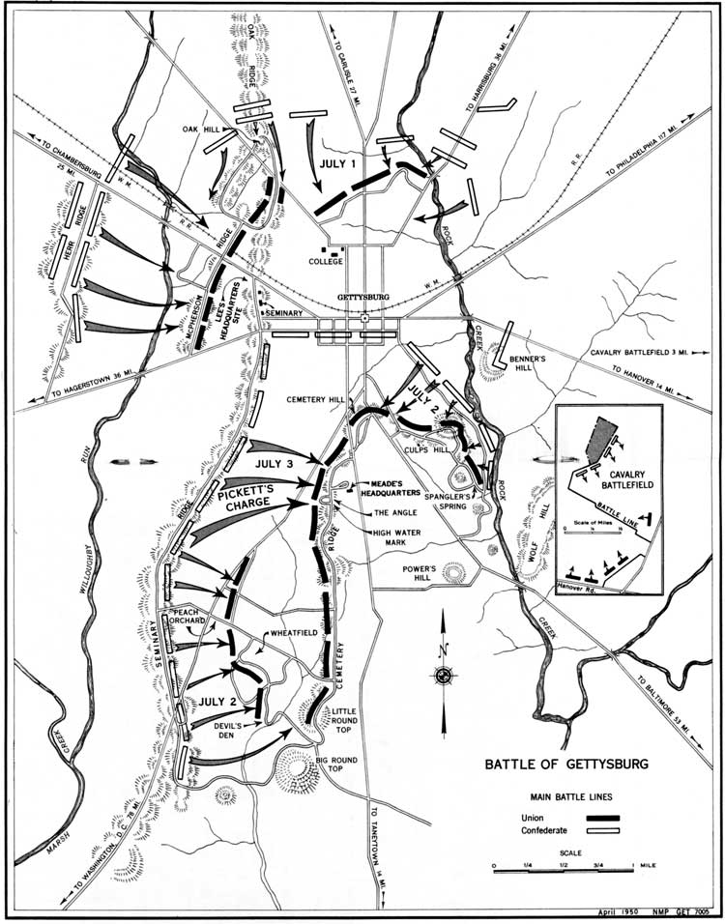
Battle of Gettysburg
End of June 1863, Lee moved forces into PA and into Gettysburg
PICKETT’S CHARGE: assault on July 3,1863 ordered by Lee; massive and bloody battle btwn forces
Lee withdrew on July 4, 1863
Union suffered 23K casualties, while the Confederacy lost 28K
Proved to be the turning point of the war
Union’s victory strengthened Republicans politically
Ensured that the British would not recognize the Confederacy

Slide 25
Gettysburg Address
Lincoln went to Gettysburg in November 1863 to dedicate portion of the battlefield as military cemetery
His speech became known as the Gettysburg Address
Explained the war was not a battle between regions but a fight for freedom

Slide 26
Grant Secures Tennessee
Fierce fighting erupted after Gettysburg in TN
Grant placed in command of all western troops in Fall of 1863
With the help of General William Tecumseh Sherman and General George Thomas, took Chattanooga
Had cleared way for invasion of Georgia
Appointed General-in-Chief of Union forces and promoted him to lieutenant general

Slide 27
The War Ends
Section Five

Slide 28
Grant Versus Lee
Grant put Sherman in charge of Union operations in the west
Grant would march south from DC and attack until the south surrendered
Met Lee at Petersburg
Grant put the city under siege

Slide 29
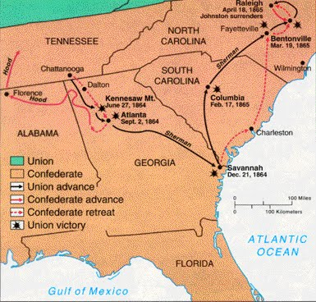
Sherman’s Victories in the South
Sherman marched from Chattanooga to Atlanta
In August 1864, Sherman sent his troops to cut the roads and railways into the city
SHERMAN NECKTIES: name for the railway steel heated and twisted by troops
Sherman ordered all civilians to leave Atlanta
Ordered his troops to destroy everything of military value
Built fires that quickly spread – burnt down more than 1/3rd of the city
MARCH TO THE SEA: Sherman’s march from Atlanta to Savannah

Slide 30
Election of 1864 and the 13th Amendment
Election of 1864 saw McClellan against Lincoln
Capture of Atlanta came in time to revitalize Northern support for the war and for Lincoln
Saw his election as a mandate to end slavery permanently by amending the constitution
MANDATE: clear sign from the voters
THIRTEENTH AMENDMENT: bans slavery in the United States

Slide 31
The South Surrenders
In April 1865, Lee’s attempt to escape Grant failed
Sheridan’s cavalry got ahead of Lee’s troops and blocked the road at Appomattox Courthouse
Lee surrendered to Grant on April 9, 1865
Terms of surrender included guarantee that the US would not prosecute confederate soldiers for treason

Slide 32
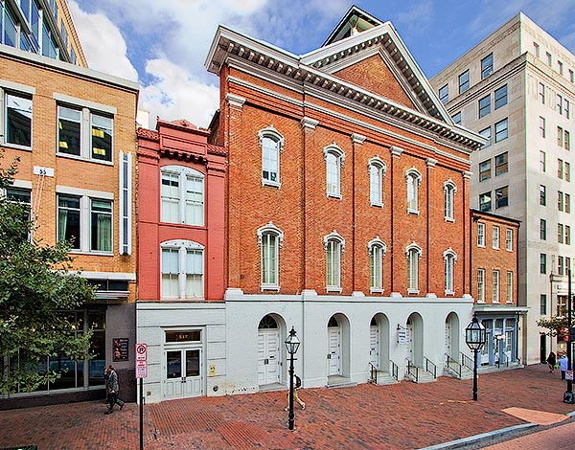
Lincoln’s Assassination
With the war over, Lincoln had a plan to restore Southern states to the union
This plan included having African Americans in Southern state gov’ts
President and his wife, Mary, went to Ford’s Theater on April 14, 1865 to see a play
During 3rd act, John Wilkes Booth slipped in behind him and shot him in the back of the head
Lincoln’s death shocked the nation

Slide 33
Aftermath of the Civil War
North’s victory strengthened the power of the federal gov’t over the states
Transformed American society by ending slavery
Left the South socially and economically devastated
Following the war, questions remained unresolved
Americans from the North and the South would work to answer these questions in the years following the Civil War – known as Reconstruction

