Slide 1
Effective Study Habits, MLA Format, & The House
Keys to a Successful Year

Slide 2
Effective Study Habits
Key to a Successful Year

Slide 3
Effective Study Habits
Organization
Time Management
Review
Self-Testing

Slide 4
Effective Study Habits: Organization
Staying organized is the key to success!
Binder
Planbook
Study Space

Slide 5
Effective Study Habits: Time Management
With as many as 6 other classes to worry about, along with extra curricular activities and/or part-time jobs, plus keeping up with your social life – it’s easy to run out of time to study!
Plan out your schedule ahead of time
Carve out time each week to review the past week, and look ahead to the next
Don’t forget to schedule time for breaks!

Slide 6
Effective Study Habits: Review
Review is a key component of any effective study plan. Whether it’s at the end of each day, or each week, take time to review what you’ve learned in class. By keeping up with review, you’ll have less to worry about before each test!
Re-read your notes
If there’s anything messy or illegible, take the time to re-write it
Use this time to figure out if there’s anything from class that you don’t understand, then take the time to ask your teacher to explain it

Slide 7
Effective Study Habits: Self-Testing
Self-testing is a great preparation tool to use in advance of quizzes or tests.
Flashcards
Sample Tests
Note-taking

Slide 8
MLA Format
Key to a Successful Year

Slide 9
Reasons to Use MLA Format
Keeps your writing consistent
Gives your writing credibility
Protects you from plagarism

Slide 10
Format Details
All papers should be double-spaced throughout – unless you are using a quote that is more than 4 lines, then that quote is single spaced while your paper remains double spaced
Heading goes on the front page, in the left corner
Pages are numbered using your last name in the upper right corner – ex. Estis 2

Slide 11
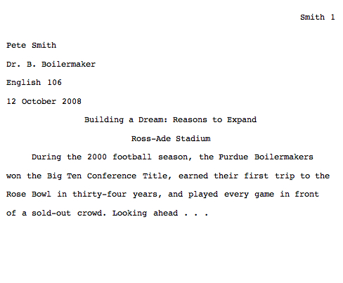
MLA Sample

Slide 12
Citing Your Source
No matter what, you must cite any outside source you use.
If the words are not your own, they must be cited.
Two Types of Citations:
Parenthetical Citations (within the paper)
Works Cited Page (at the end of the paper)

Slide 13
Parenthetical Citations
Use parenthetical citations when you are quoting any words that are not your own. If you copy without quotes, it is PLAGARISM.
When you summarize or paraphrase a source, you should cite the source.
Author’s last name and page number(s) of the quote
must appear in the text:
Romantic poetry is characterized by the “spontaneous overflow of powerful feelings” (Wordsworth 263).
or
Wordsworth stated that romantic poetry is characterized by the “spontaneous overflow of powerful feelings” (263).

Slide 14
Sometimes More Information is Needed
More than one author with the same last name
(W. Wordsworth 23); (D. Wordsworth 224)
More than one work by the same author
(Joyce, Portrait 121); (Joyce, Ulysses 556)
Different volumes of a multivolume work
(1: 336)
Citing indirect sources
(Johnson qtd. in Boswell 2:450)

Slide 15
Work Cited Page
A complete list of every source that you make reference to in your essay, (even if you don’t quote it directly)
Provides the information necessary for a reader to locate and retrieve any sources cited in your essay
Most citations should contain the following basic information: Author’s Name, Title of Work, Publication Information
Example:
Dickens, Charles. David Copperfield. New York: Modern Library, 2000.

Slide 16
Citing a Website
Dorrman, Dave. “The Hot Button.” Roughcut. 26 Oct. 1998. Turner Network Television. 4 Sept. 2013. (www.roughcut.com).
Note the author of the page is listed first. The title of the page is listed next, then the title of the website. The date of publication is next. The second date is the date you accessed the page. Every page may not have all of the necessary information, but you must include all of the information you have access to.

Slide 17
Additional MLA Information
MLA Website:
www.mla.org
OWL Website:
owl.english.purdue.edu
Ask a Teacher!

Slide 18
The House
Key to a Successful Year

Slide 19
5 Paragraph Essay Organization
INTRODUCTION
|
BODY
|
CONCLUSION

Slide 20
House Organization
Using The House as a tool allows you to:
Organize your brainstorming
Organize your writing
Have a built-in writing support system

Slide 21
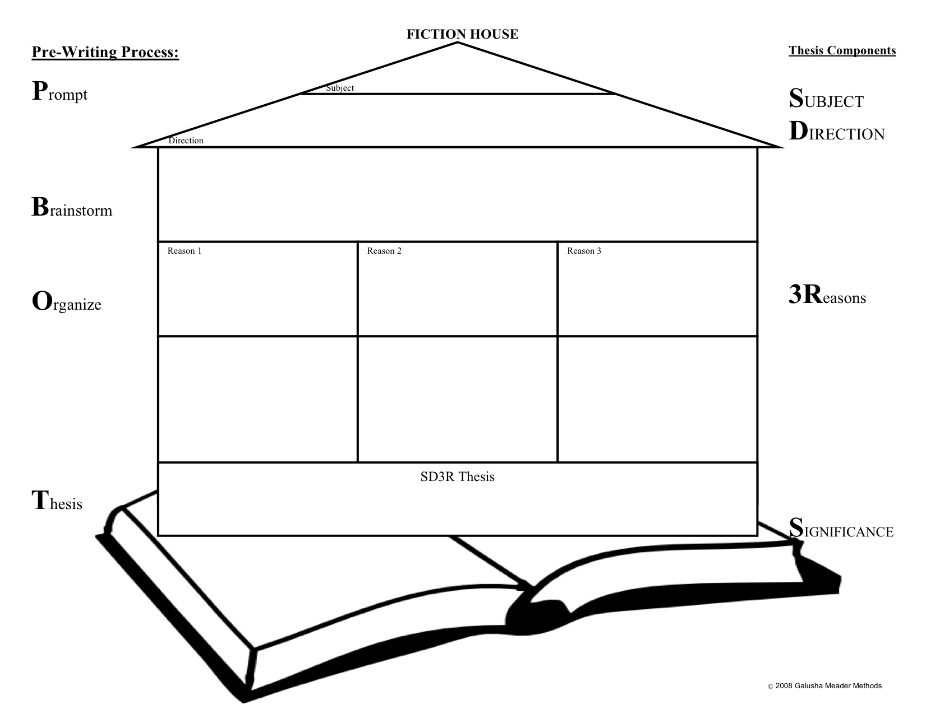
The House

Slide 22
Effective Study Habits, MLA Format, & The House
Keys to a Successful Year

