Slide 1
South asia since 1945
Unit Four

Slide 2
India gains independence
Section One

Slide 3
Setting the Stage
After World War II, as we have seen in our study of Europe, Arica, Latin America, and parts of Asia, dramatic political changes began to take place around the world. This was especially the case with regard to the policy of colonialism. Countries that held colonies began to question the practice.After the world struggle against dictatorship, many leaders argued that no country should control another nation. Others questioned the high cost and commitment of holding colonies. Meanwhile, the people of colonized regions continued to press even harder for their freedom. All of this led to independence for one of the largest and most populous colonies in the world – British-held India.

Slide 4
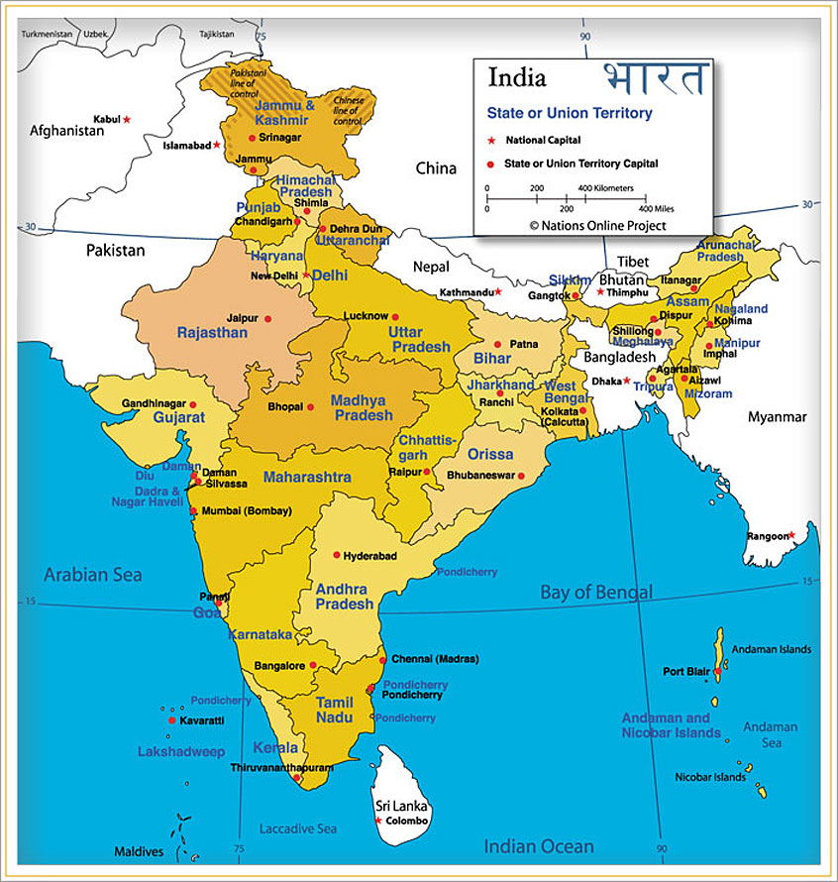

Slide 5
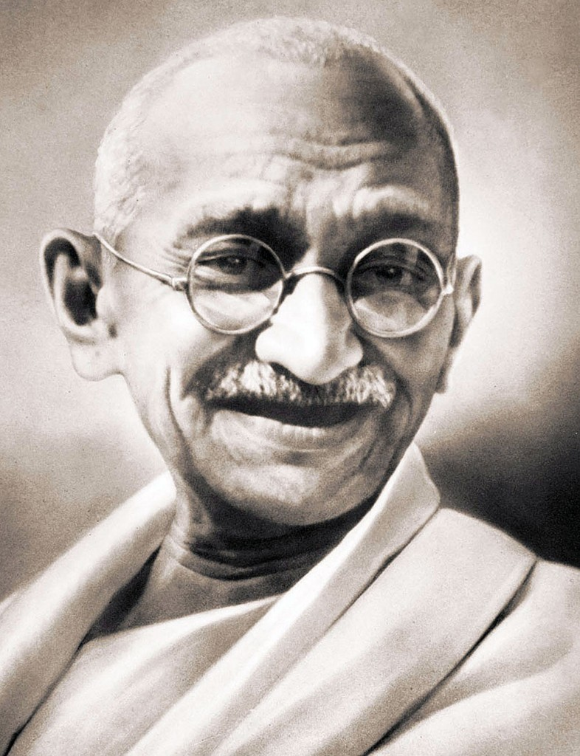
India Pre-1945
British ruled India for almost 200 years
Indian resistance to Britain (which was longstanding), began to intensify in 1939, when Britain committed India’s armed forces to fight in WW2 without consulting them first
Indian leader, Mohandas Gandhi, launched a nonviolent campaign of cooperation with the British

Slide 6
Struggle Within India
As the struggle against the British intensified, Indians struggled with each other
India is home to 2 main religious groups, Hindus and Muslims
The Indian National Congress, or the Congress Party, was India’s national political party
Most members of the Congress Party were Hindus, but did have Muslim members
In competition with the Congress Party was the Muslim League
MUSLIM LEAGUE: organizations founded in 1906 in India to protect Muslim interests
The Muslim League was led by Muhammad Ali Jinnah
Muslim League said that it would never accept Indian independence if it meant rule by the Hindu-dominated Congress Party

Slide 7
Freedom Brings Turmoil
When WW2 ended, Britain faced enormous war debts. As a result, British leaders began to rethink the expense of maintaining and governing distant colonies. With India continuing to push for independence, the stage was set for the British to hand over power. However, a key problem emerged: Who should receive the power?
Rioting between the two groups broke out in several Indian cities
In August 1946, 4 days of violence in Calcutta left 5,000 people dead and more than 15,000 injured
British officials soon became convinced that partition, an idea first proposed by India’s Muslims, would be the only way to ensure a safe and secure region
PARTITION: term given to the division of India into separate Hindu and Muslim nations
The northwest and eastern regions, where most Muslims lived, would become the new nation of Pakistan

Slide 8
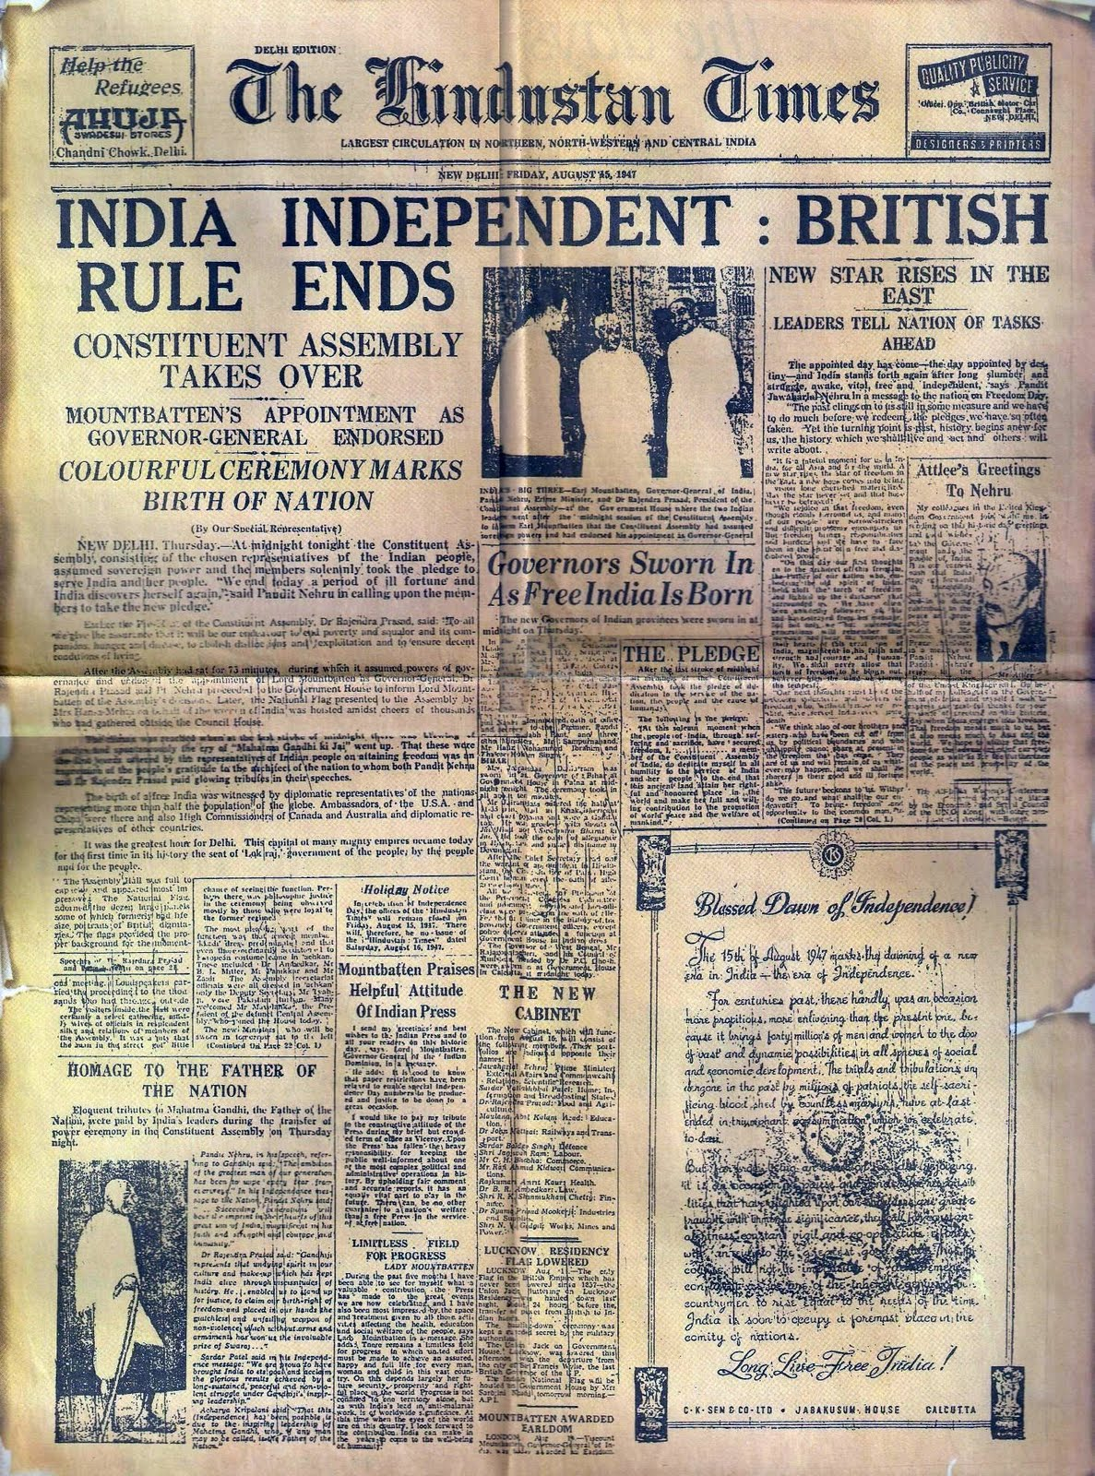
Partition: Decisions to Be Made
British House of Commons passed an act on July 16, 1947 that granted 2 nations – India and Pakistan – independence in one month’s time
Within that time, everything had to be divided into two
Most significantly, millions of Indian citizens – Hindus, Muslims and another group, the Sikhs – had to decide where to go

Slide 9
Violence Surrounding Partition
During the summer of 1947, 10 million people were on the move in the Indian subcontinent
As people scrambled to relocate, violence among the different religious groups erupted
Muslims killed Sikhs who were moving into India
Hindus and Sikhs killed Muslims who were headed into Pakistan
In all, an estimated 1 million people died
Gandhi personally went to the India capital of Delhi to plead for fair treatment of Muslim refugees
A Hindu extremist who thought Gandhi too protective of Muslims shot and killed him on January 30, 1948

Slide 10
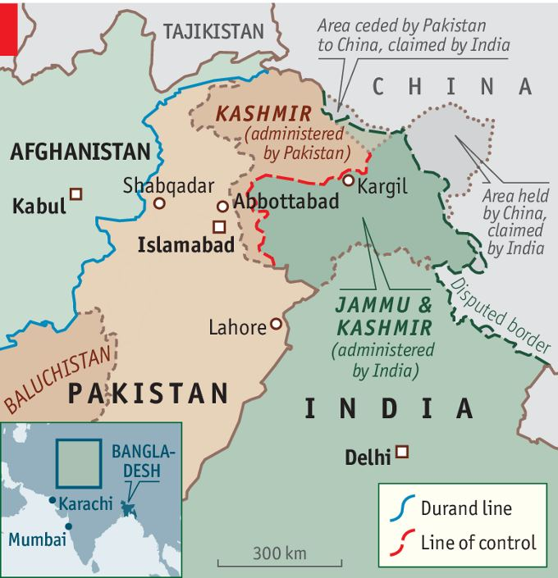
Battle for Kashmir
The Hindus and Muslims quickly squared off over the small region of Kashmir
Kashmir lay at the northern point of India next to Pakistan
Although the ruler was Hindu, Kashmir had a majority Muslim population
The fighting continued until the UN arranged a cease-fire in 1949 that left a third of Kashmir under Pakistani control and the rest under Indian control
The 2 countries continue to fight over the region today

Slide 11
Modern India
With the gaining of independence on August 15, 1947, India became the world’s largest democracy
JAWAHARLAL NEHRU: India’s first prime minister from 1947 to 1964
Nehru had been a devoted follower of Gandhi and won popularity among all groups in India
He emphasized democracy, unity, and economic modernization
He also tried to elevate the status of the lower castes, and helped women gain rights promised by the constitution
Nehru died in 1964 and left the Congress Party without a strong leader

Slide 12
Troubled Times
INDIRA GANDHI: Nehru’s daughter who in 1966 was chosen as prime minister
She ruled capably, but encountered many challenges – including a growing threat from Sikh extremists
Sikh nationalists ventured out from their religious center (the Golden Temple at Amritsar) to attack symbols of Indian authority
In June 1984, Indian army troops overran the Golden Temple, killing about 500 Sikhs and destroying sacred property
In retaliation, Sikh bodyguards assigned to Indira Gandhi gunned her down, setting off another murderous frenzy and causing the deaths of thousands of Sikhs

Slide 13
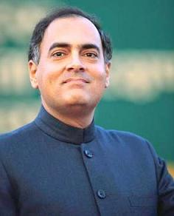
Rajiv Gandhi
In the wake of the murder of Indira Gandhi, her son Rajiv Gandhi took over as prime minister
His party lost its power in 1989 because of accusations of widespread corruption
In 1991, while campaigning again for prime minister, he was killed by a bomb
Members of a group opposed to his policies claimed responsibility

Slide 14
21st Century Challenges
An increasing population is expected to push India past China as the world’s most populous nation by 2035
The country is racked with social inequality and and constantly threatened by religious strife
Most troubling, however, are India’s tense relations with Pakistan – and the fact that both have become nuclear powers
The presence of these weapons in the hands of such bitter enemies and neighbors has become a matter of great international concern, especially in light of their continuing struggle over Kashmir

Slide 15
Pakistan copes with freedom
Section Two

Slide 16
Setting the Stage
The history of Pakistan since independence has been no less turbulent than that of India. Pakistan actually began as two separate and divided states, East Pakistan and West Pakistan. East Pakistan lay to the east of India and West Pakistan lay to the northwest. These regions were separated by more than 1,000 miles of Indian territory. In culture, language, history, geography, economics and ethnic background, the two regions were very different. Only the Islamic religion united them.

Slide 17
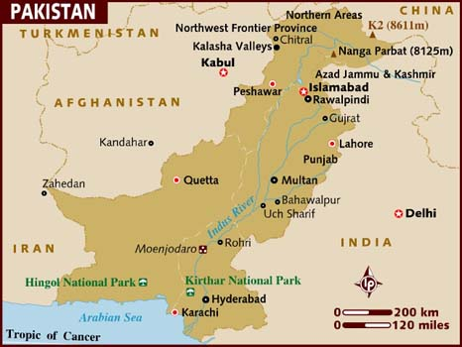

Slide 18
Civil War
East Pakistan had the larger population, but it was often ignored by West Pakistan, home of the central government
In 1970, a giant cyclone and tidal wave struck East Pakistan and killed approximately 266,000 citizens
International aid poured into Pakistan, but West Pakistan did not quickly transfer that aid to East Pakistan
Demonstrations broke out in East Pakistan and called for an end to all ties with West Pakistan
On March 26, 1971, East Pakistan declared itself an independent nation – Bangladesh
A civil war followed between Bangladesh and Pakistan, and eventually Indian forces sided with Bangladesh and Pakistan forces surrendered

Slide 19
Pattern of Instability
Pakistan could not dwell on its lost territory
Pakistan went through a series of military coups beginning in 1958
In the early 1970s, Ali Bhutto took control of Pakistan, but another coup in 1977 removed Bhutto and General Zia took office
Zia was later executed for crimes committed while in office, and Bhutto’s daughter, Benazir Bhutto, was twice elected prime minister
Nawaz Sharif became prime minister in 1997, but was ousted by army leaders in yet another coup in 1999
The nation continues to struggle with challenges from Muslim militants and ongoing disputes with India

Slide 20
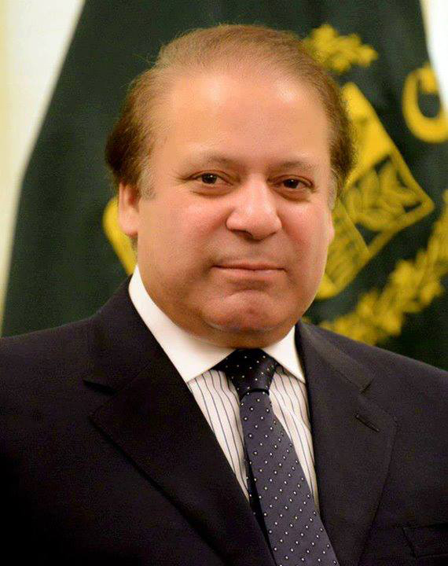
Modern Pakistan
Today, Pakistan has the 7th largest standing army in the world and is the only nuclear-powered nation in the Muslim world
By its own financial calculations, Pakistan's involvement in the war on terror has cost them almost $70 billion dollars, thousands of casualties and almost 3 million displaced civilians
The general election in 2013 saw Nawaz Sharif become prime minister for the third time in 14 years

