Slide 1
Solidifying a New Nation: Federalists and Republicans
Unit III

Slide 2
The time in which the United States began operating under the newly created United States Constitution was marked by the Presidency of George Washington, the development and growth of political parties, a rise in Judiciary power, and military tensions with Great Britain in the War of 1812. In this unit, we will explore the economic initiatives that guided the beginning of our new nations, the individuals that helped to shape our new nation’s policy, and the political parties that were created in light of these events.
Washington and Congress
Partisan Politics
Jefferson in Office
The War of 1812

Slide 3
Washington and Congress
Unit III, Part I

Slide 4
Quick Recap…
George Washington had 3 tasks when he took office in 1789:
Set up a bureaucracy to help advise him
Set up the judiciary system
Create the Bill of Rights
What were Washington’s FOUR Cabinet Positions & Who Held Them?
Department of State – Thomas Jefferson
Department of War – Henry Knox
Department of Treasury – Alexander Hamilton
Office of the Attorney General – Edmund Randolph

Slide 5
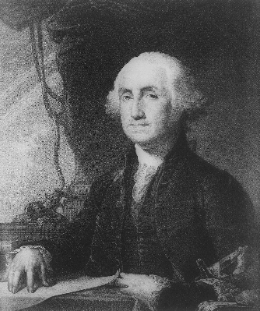
George Washington’s Precedents
Neutrality in Foreign Affairs
Creating a Cabinet
“Mr. President”
“So Help Me God”
2-term Presidency
Use of Force To Enforce The Law (Whiskey Rebellion)

Slide 6
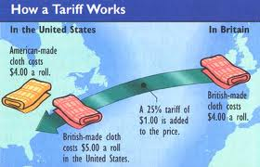
It’s All About The Money…
By the end of 1789, the government was up and running…
TARIFF OF 1789: required importers to pay percentage of their cargo’s value when they arrived in US
TONNAGE: additional tax based on how much a ship carried
This angered Southern planters because the shipping rates on the goods they purchased went up.

Slide 7
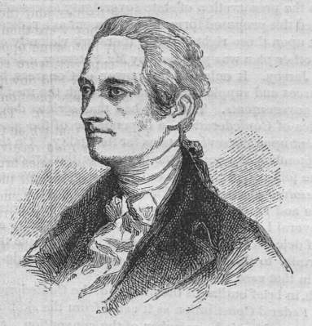
Hamilton’s 3-Part Plan
Asked Congress to Accept Debt at Full Value
The National Bank
Tax Revenue

Slide 8
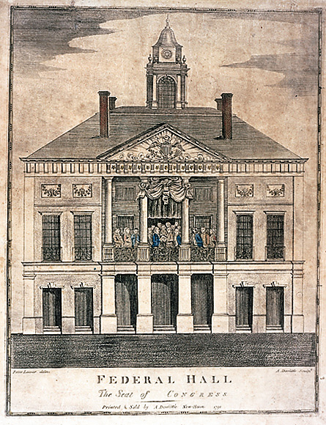
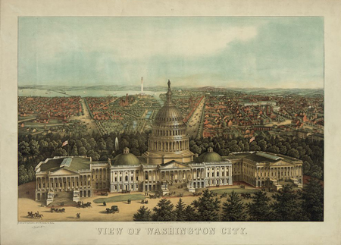
Hamilton’s Financial Program
In 1790, Hamilton asked Congress to accept the debts of the Continental Congress at their full value
Why? So that those who owned bonds would have a stake in government success and confidence to buy more bonds
Not everyone agreed this was the best idea, but in July of 1790, Hamilton made a deal with James Madison and other Southerners…
In return for approving Hamilton’s plan, the country’s capitol would be moved from New York City to its present day location in Washington, DC.

Slide 9
Hamilton’s Financial Program: The National Bank
Hamilton asked Congress to create a national bank, and again, Madison objected, claiming it was not an enumerated power. Washington could have vetoed it, BUT looked to the “Necessary and Proper Clause” to support the creation of the bank.
NECESSARY AND PROPER CLAUSE: Article I, Section 8, of the US Constitution gives the government the power “to make all laws which shall be necessary and proper”
These powers are also called implied powers
In 1791, the Bank of the United States was created for 20 years

Slide 10
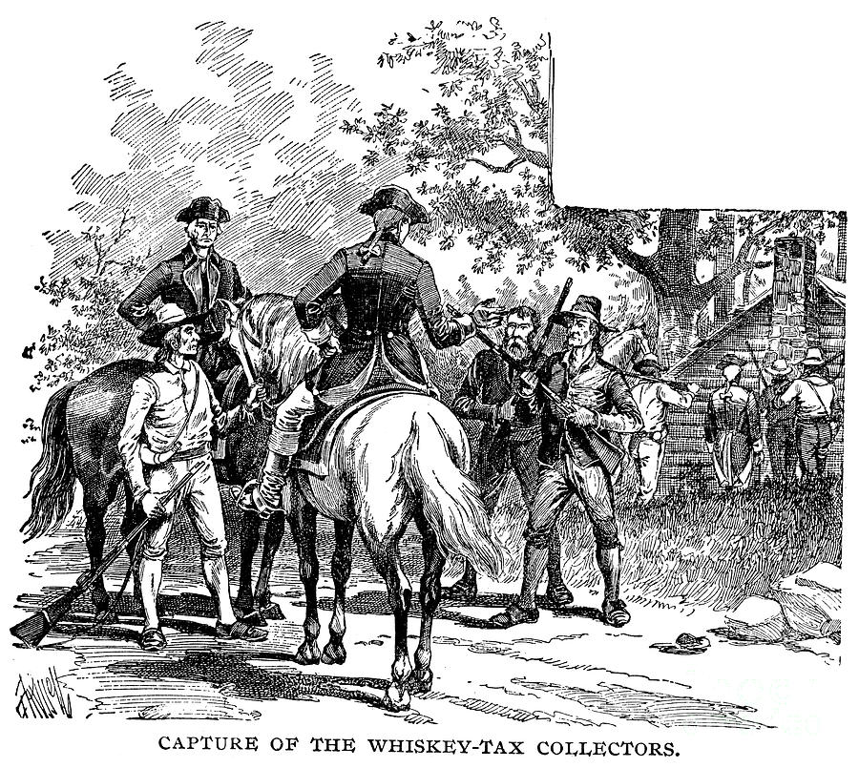
Whiskey Rebellion
In 1791, Congress imposed a tax on the making of whiskey.
Western farmers were enraged
By 1794, Rebellion erupted – farmers terrorized tax collectors, robbed the mail, and destroyed distilleries
To establish federal authority, Washington sent troops to stop rebellion

Slide 11
Partisan Politics
Unit III, Part II

Slide 12
Rise of Political Parties
FEDERALISTS
DEMOCRATIC-REPUBLICANS
Led by Alexander Hamilton
Favored strong federal government
Favored economic policies supporting manufacturing and trade
Supported by: artisans, merchants, manufacturers and bankers (and also urban workers and Eastern farmers)
Led by James Madison and Thomas Jefferson
Supported states’ rights over federal rights
Believed the strength of the US was in its independent farmers
Favored agriculture over commerce and trade
Supported by: rural South and West

Slide 13
Washington’s Foreign Policy
The French Revolution broke out in 1789 and then France declared war on Britain. The United States suddenly found itself involved. In 1793, Washington issued a proclamation to be “friendly and impartial.”
Set the Precedent of Neutrality
British began to blockade American ships and Washington sent John Jay to Britain to find a solution.
JAY’S TREATY: Said that the British could seize cargo heading to French ports but gave US “most favored nation status”
EFFECT OF JAY’S TREATY: Prevented war with Great Britain and protected American economy
In 1795, the Spanish signed Pinckney’s Treaty: allowed the US to navigate the Mississippi River and deposit goods at Port of New Orleans

Slide 14
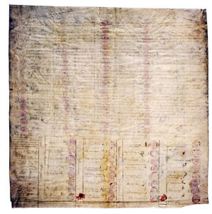
Westward Expansion
Area between Appalachians and Mississippi was growing rapidly
Confrontations with Native Americans
TREATY OF GREENVILLE: Native Americans agreed to give up part of land in exchange for $10,000/year
Increased the flow of people and by 1803 Ohio was a state

Slide 15
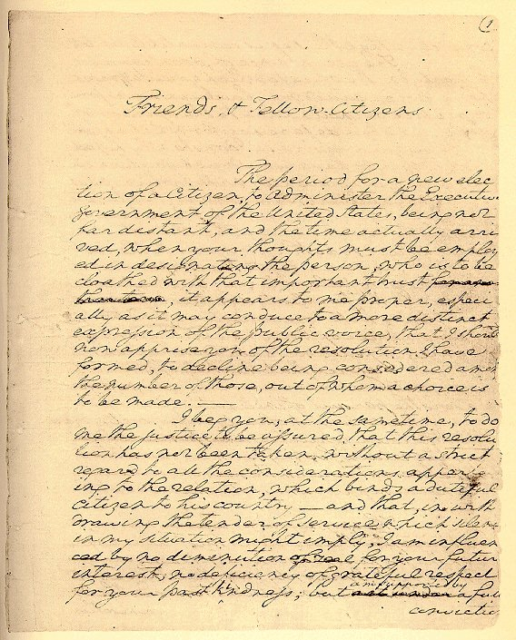
Washington Leaves Office
Washington’s Farewell Address warns about 3 things:
Against Sectionalism
Against Political Parties
Against Getting Attached to Any Foreign Nation
ELECTION OF 1796: First openly contested election
Federalist John Adams vs Democratic-Republican Thomas Jefferson
Adams wins & Jefferson becomes VP

Slide 16
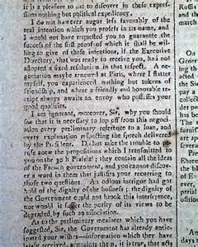
Quasi-War with France
France was upset with Jay’s Treaty & US sent Charles Pinckney, Elbridge Gerry & John Marshall to negotiate.
XYZ AFFAIR: French Minister of Foreign Affairs asked for a bribe of $250,000 and a $12M loan to initiate talks
By June 1798, Congress suspended trade with France and we were fighting an undeclared war at sea.
CONVENTION OF 1800: US gave up claims against France in return for release from the Treaty of 1778

Slide 17
Alien and Sedition Acts
At the height of the public anger at France in 1798, the Federalists pushed 4 laws through Congress. Together, they are known as the Alien and Sedition Acts.
ALIEN: people living in the country who were not citizens
SEDITION: incitement to rebellion
Law 1. Immigrants must wait 14 years to become citizens
Laws 2. and 3. Gave President power to deport without trial
Law 4. Made it a federal crime to say or print anything “false, scandalous or malicious” against the federal government

Slide 18
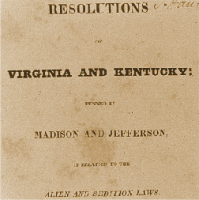
Virginia & Kentucky Resolutions
Two resolutions were passed criticizing the Alien & Sedition Acts.
INTERPOSITION: theory from the Virginia Resolution that argued that if the federal government did something unconstitutional the state could stop the illegal action
NULLIFICATION: theory from the Kentucky Resolution that if the federal government passed an unconstitutional law, the state could declare it invalid

Slide 19
Jefferson in Office
Unit III, Part III

Slide 20
Election of 1800
vs.
John Adams
Thomas Jefferson
with Aaron Burr
Jefferson and Burr TIED & election went to the House of Representatives
In 1801, Jefferson was elected by 1 more vote than Burr after promising to work with the Federalists
Showed that power could be peacefully transferred despite party disagreements
Thomas Jefferson referred to the election as the Revolution of 1800.
Notes:
Why Revolution? He wanted to LIMIT THE SCOPE OF FEDERAL POWER

Slide 21
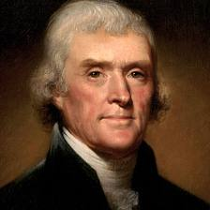
“Revolution of 1800”
Jefferson believed that Washington & Adams had acted too much like royalty
Jefferson wanted to limit the scope of federal power
Goal was to pay down the federal debt, cut spending, and lower taxes

Slide 22
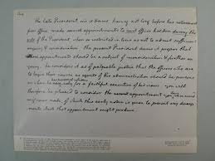
The “Midnight Judges”
JUDICIARY ACT OF 1801: Signed by Adams, created 16 new federal judge positions – appointed just before Adams left office
Judges were all Federalists
Act repealed by Jefferson

Slide 23
Marbury v. Madison
Marbury was appointed to be Justice of the Peace by President John Adams. Adams signed the papers to appoint him, but the papers were not delivered before Adams left office. Jefferson hoped Marbury would simply quit but instead Marbury asked the Supreme Court to issue an order telling James Madison to deliver the documents.
Supreme Court said it can’t issue order because it had no jurisdiction
Said that the Constitution was very specific about the type of cases that could be brought directly to the court
Made the Judiciary Act of 1789 unconstitutional and invalid
Strengthened the Supreme Court in asserting the right of Judicial Review
JUDICIAL REVIEW: power to decide whether laws passed down by the Congress were constitutional and strike down laws that were not

Slide 24
Westward Bound!
LOUISIANA PURCHASE: purchase of Louisiana territory from Napoleon (France) in 1803 for $11.25M
Negotiated by Robert Livingston
US more than doubled in size
Gained control of the entire Mississippi River

Slide 25
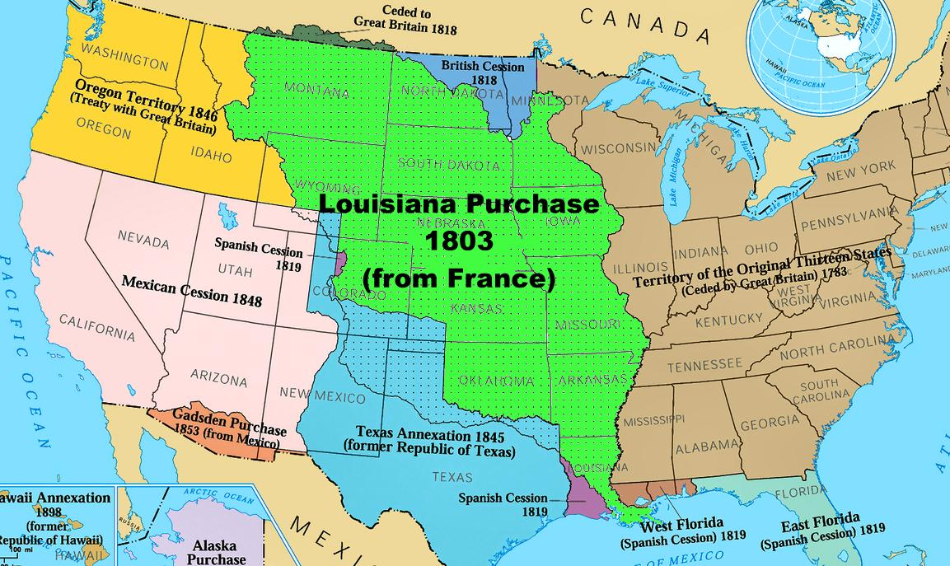

Slide 26
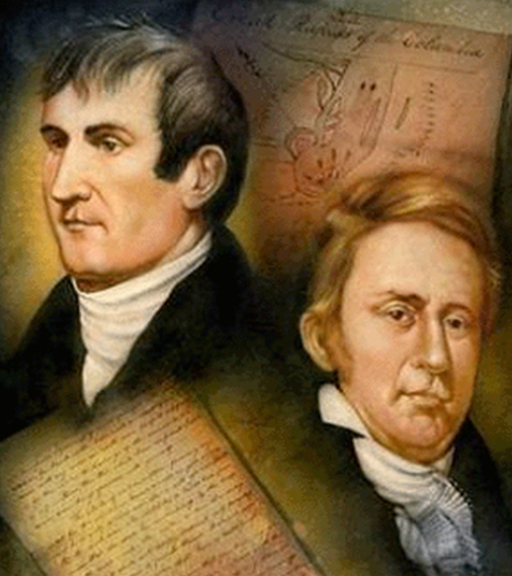
Explorers Wanted
Meriweather Lewis and William Clark were sent to trace the Mississippi and navigate a route to the Pacific Ocean.
Known as the “Corps of Discovery”
Joined by Sacagawea who acted as a guide and interpreter
Found a path through the Rockies
Increased American’s knowledge and gave US a claim to Oregon territory along the coast

Slide 27
Roadtrip Anyone?

Slide 28
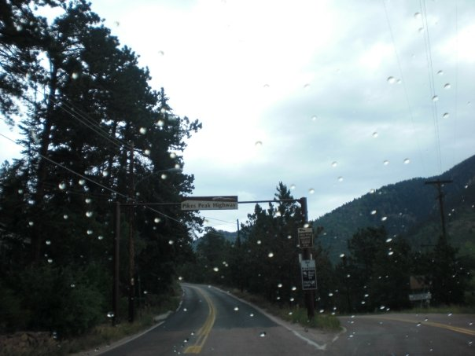
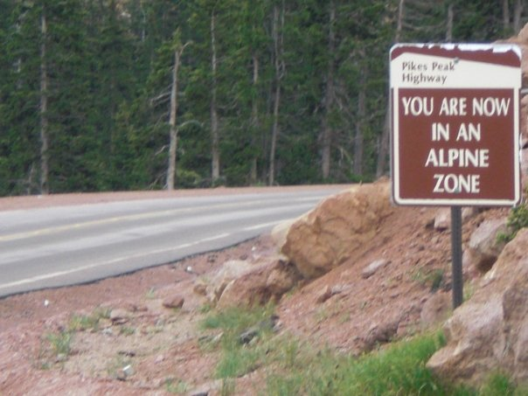
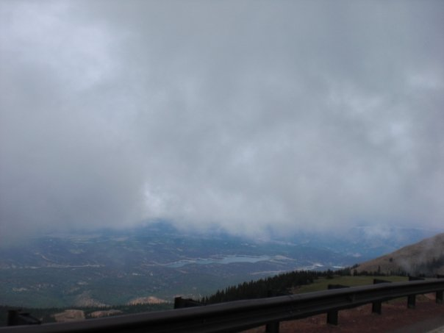
The Pike Expedition
Zebulon Pike mapped upper Mississippi, went to Colorado and mapped Pike’s Peak.

Slide 29
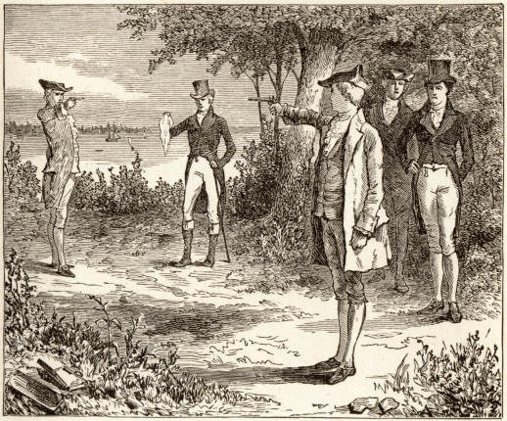
“I Challenge You to a Duel!”
After the Louisiana Purchase, a small group of New Englanders planned to secede from the Union and asked VP Burr to join them.
Hamilton called Burr a “dangerous man, and one who ought not be trusted with reins of government”
Burr challenged him to a duel
In the duel, Hamilton refused to fire and Burr shot and killed him on July 11, 1804

Slide 30
Rising International Tensions
Napoleon’s war in Europe broke the fragile peace between France and England and both countries made it impossible for American merchants to conduct trade.
The British Navy had low pay and terrible conditions, leading many of them desert the British for American vessels.
IMPRESSMENT: act of forcing people into military service; used by British to stop American ships and take American citizens
CHESAPEAKE INCIDENT: British ship, the Leopard, stopped a US ship, the Chesapeake, killed 3 Americans & seized 4 soldiers

Slide 31
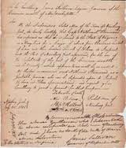
Embargo Act of 1807
Attack on Chesapeake enraged the American public
Jefferson asked Congress to pass the Embargo Act of 1807 – halting all trade between US and Europe
EMBARGO: government ban on trade with other countries
Hurt the US more than France or Britain and was repealed by Congress in 1809

Slide 32
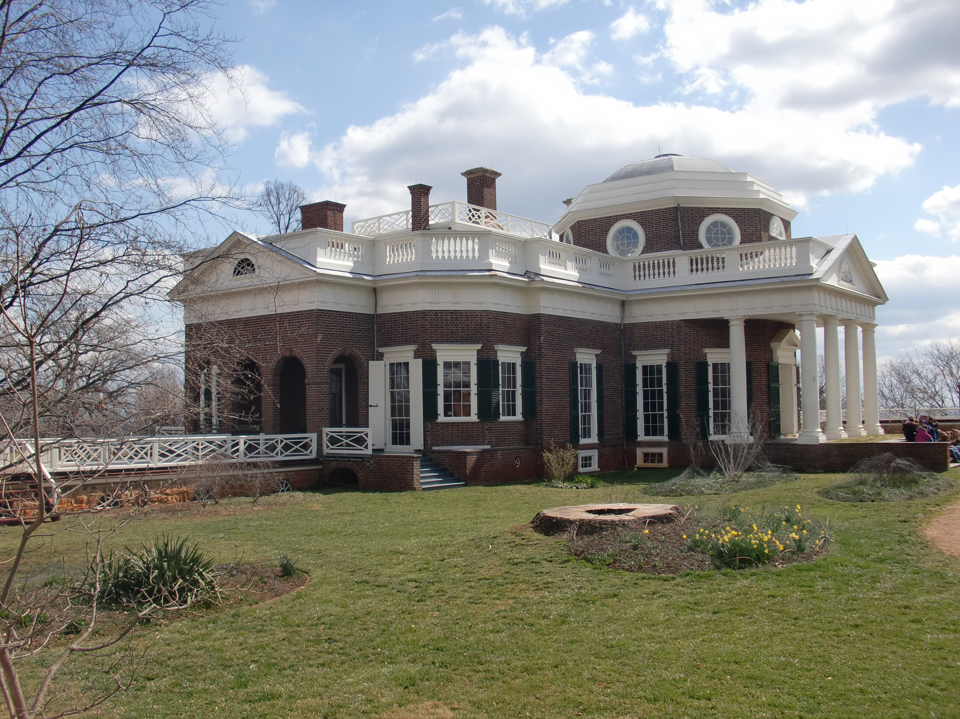
Jefferson Retires
After his second term, Jefferson leaves office and retires to his home in Virginia, Monticello.
JEFFERSON’S LEGACY: though an unpopular president, he limited power of federal gov’t and acquired vast new territory in the West

Slide 33
War of 1812
Unit III, Part IV

Slide 34
War Breaks Out
In June 1812, President Madison asked Congress to declare war on Britain
Reasons for war included impressment and encouraged Indian attacks on Americans
Americans were at a disadvantage but believed they could strike quickly

Slide 35
The Land War & The Naval War
By the end of summer 1812, British were winning
Managed some victories, but not powerful enough
Americans had more victories at sea
But eventually British blockaded the US coast

Slide 36
Burning of Washington, D.C.
In 1814, a fleet of British troops landed in Maryland
4,000 troops descended upon D.C.
James Madison and his wife Dolly Madison were warned of the attack and got out
British burned D.C. to the ground
Francis Scott Key wrote the Star-Spangled Banner about that night
American forces were able to turn back the British

Slide 37
The War Ends
British realized they couldn’t win
On December 24, 1814, representatives met in Belgium
Signed the Treaty of Ghent
TREATY OF GHENT: treaty ending the War of 1812; restored boundaries
Some called the war the “Second War of Independence”

Slide 38
Battle of New Orleans
Two weeks after the treaty was signed, one final battle was fought
News of the treaty did not to arrive until February 1815
In January 1815, General Andrew Jackson won a remarkable victory over the British at the Battle of New Orleans
Unified the country, restored patriotism and made Jackson a national hero

