Slide 1
Sectional conflict intensifies
Unit Six

Slide 2
Slavery & Western Expansion
Section One

Slide 3
Impact of War
Mexican War heightened opposing viewpoints on slavery
Amendment to a war appropriations bill was proposed by David Wilmot
WILMOT PROVISO: proposed that in any territory the US gained from Mexico, there would be no slavery
The proviso stirred passions on both sides
Proviso did not pass

Slide 4
Election of 1848
Groups of people from the Whigs and Democrats formed the Free-Soil Party in 1848
FREE-SOIL PARTY: opposed slavery in the “free soil” of the western territories
Whig Zachary Taylor won the election

Slide 5
Search for Compromise
Discovery of gold in California in 1848 led to application for statehood
By the end of 1849, the California Gold Rush was in full force
Decision had to be made about slavery in the new state
With Taylor’s help, California applied for admission as a free state

Slide 6
The Great Debate Begins
A few southern states began talking of secession
SECESSION: states leaving the Union
Senator Henry Clay began working to find a compromise
Proposed 8 resolutions to solve the crisis

Slide 7
Compromise of 1850
Congress did not pass Clay’s resolutions
Senator Stephen Douglas of Illinois divided the original bill into several smaller ones
By the fall of 1850, Congress had passed all of the original proposal made by Clay
For a short time, the Compromise of 1850 eased tensions over slavery

Slide 8
Mounting violence
Section Two

Slide 9
Fugitive Slave Act
FUGITIVE SLAVE ACT: law under which a person claiming that an African American had escaped from slavery had only to point out that person as a runaway to bring him or her into custody
Law included financial incentive for federal officers
Hurt the Southern cause by creating active hostility toward slavery among Northerners

Slide 10
Underground Railroad
Whites and free African Americans worked to help thousands of enslaved persons escape
Members, called “conductors,” transported runaways north in secret
HARRIET TUBMAN: most famous conductor and a former slave
The Underground Railroad deepened Southern mistrust of Northern intentions

Slide 11
Transcontinental Railroad
Opening of western territory convinced Americans that a transcontinental railroad should be built to connect the West Coast to the rest of the country
Broad appeal for the railroad
Southerners and Northerners disagreed over the starting point and route placement

Slide 12
Kansas-Nebraska Act
Senator Stephen Douglas wanted to open Nebraska as a new territory
Issue of slavery arose again
Southerners wanted to repeal the Missouri Compromise
Douglas proposed dividing the region into two – Nebraska as a free state and Kansas as a slave state

Slide 13
Bleeding Kansas
Kansas became the first battleground between those for and against the extension of slavery
Rush of settlers went to claim land
By March 1856, Kansas had 2 separate governments
Named “Bleeding Kansas” by newspapers, it became the scene of a territorial civil war between pro-slavery and antislavery settlers

Slide 14
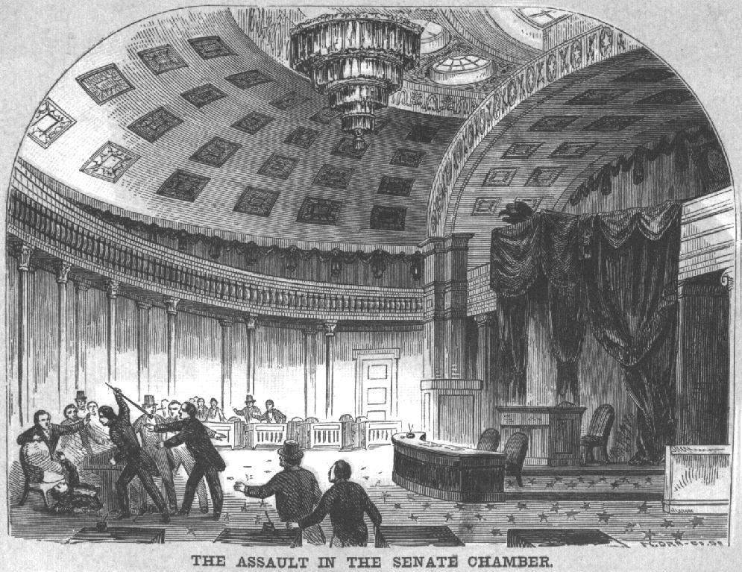
Caning of Charles Sumner
In mid-May 1856, Senator Charles Sumner of MA delivered a speech accusing pro-slavery senators of forcing Kansas to be a slave state
Singled out Senator Andrew Butler
Days later, Butler’s cousin, Representative Preston Brooks approached Sumner, yelled at him, and began beating him with a cane
Growing violence over slavery had literally come to the very center of government

Slide 15
The crisis deepens
Section Three

Slide 16
Birth of the Republican Party
After the KS-NE Act, new coalition took form
Known as the Republican Party
Republicans did not agree on whether slavery should be abolished altogether
Republicans did agree that slavery should be kept out of the territories

Slide 17
Election of 1856
Republicans nominated John C. Fremont
Democrats nominated James Buchanan
American Party chose former president Millard Fillmore
James Buchanan won on the idea that he could save the union

Slide 18
Dred Scott Decision
Supreme Court ruled on slavery in the territories
Dred Scott was a slave whose owner took him to a free territory
Scott sued to end his slavery because of time in the free territory
Supreme Court ruled against Scott
Ruling claimed that African Americans were not citizens and count not sue
Further intensified conflict

Slide 19
Lecompton Constitution
Frustration fueled with Bleeding Kansas
Lecompton Const legalized slavery in the territory
Buchanan accepted this and asked Congress to admit KS as a slave state
Congress blocked statehood
Constitution went back to KS for another vote
Settlers in KS decided to reject the Lecompton Constitution

Slide 20
Lincoln and Douglas
In 1858, Republican Abraham Lincoln ran for the Senate against Stephen Douglas
Took part in series of debates before the election
Had differing views on slavery
Douglas won the election, but Lincoln established principles of the Republican Party
Lincoln made a name for himself on a national level

Slide 21
John Brown’s Raid
JOHN BROWN: abolitionist who led rebellion at Harpers Ferry
Planned to seize the federal arsenal at Harpers Ferry, VA and begin a rebellion against slaveholders
36 hours after seizing the arsenal, Brown was captured
Was tried and sentenced to death
North viewed him as a martyr
South viewed him as proof that Northerners were plotting against them

Slide 22
The union dissolves
Section Four

Slide 23
Election of 1860
John Brown’s raiding was a turning point for the south
In 1860, debate over slavery split Democratic party apart
Republicans nominated Lincoln
Campaigned as more than just anti-slavery
Republican proposals angered Southerners
Vote between Democrats was split and Lincoln won without Southern support

Slide 24
Secession
With Lincoln’s election, many Southerners felt there was no choice but to secede
Dissolution began with South Carolina
State legislature called for convention and unanimously voted for the Ordinance of Secession
By February 1, 1861, 6 more states voted to secede
Southerners felt secession was in the Revolutionary tradition and they were fighting for their American rights

Slide 25
Compromise Fails
Congress tried to find a compromise to stop secession
Secessionists ignored Congress and seized federal property in their states
CRITTENDEN’S COMPROMISE: proposed adding new amendments to the Const protecting slavery in certain areas
Lincoln asked Republicans to be firm and it did not pass
Virginia proposed a peace conference but it was unsuccessful

Slide 26
Founding the Confederacy
Delegates met in Alabama and declared themselves to be a new nation
CONFEDERACY: the Confederate States of America
Created a constitution that declared each state was independent and guaranteed slavery
JEFFERSON DAVIS: president of the Confederacy

Slide 27
Civil War Begins
Lincoln took office in March 1861
Lincoln wanted reconciliation with the Southern states
Davis decided to take Fort Sumter in SC
Confederate forces bombarded Fort Sumter for 33 hours – wrecking the fort but killing no one
The Civil War had begun

Slide 28
Fate of the Border States
Lincoln worried about Kentucky, Maryland and Missouri seceding
Maryland and Missouri stayed with the Union
Kentucky became part of the Confederacy
Once the Union had been divided, the issue of preservation shifted to the battlefield

