Slide 1
Unit I: The Revolutionary Era

Slide 2
The French and Indian War set a series of events in motion which would alter the course of American life. Beginning with this war, and moving through the growing unrest amongst the colonies, the start of the Revolutionary War and the events that unfold throughout it, and finally ending with the immediate effects of the war, we will examine how and why American life was forever changed through the Revolutionary Era.
Colonial America
The Road to Revolution
The Revolution Begins
The War for Independence
The War Changes American Society

Slide 3
Colonial America
Section One

Slide 4
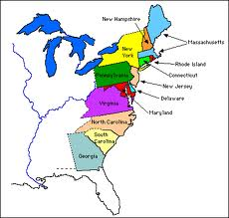
Thirteen
Original
Colonies

Slide 5
Early Colonial Life
Colonists quickly worked to create settlements
Population grew quickly
Colonists built their lives around trades
Regional economies created

Slide 6
Economy in the Colonies
Region | Colonies | Economy
Northern Colonies | Massachusetts, New Hampshire, Rhode Island, Connecticut, New York | Shipbuilding, merchants, trade
Middle Colonies | New Jersey, Pennsylvania, Maryland, Delaware | Farming - wheat
Southern Colonies | Virginia, North Carolina, South Carolina, Georgia | Cash Crops Plantations/Slavery
Notes:
Southern colonies used indentured servants and then slaves – almost 5 million slaves came to North America through the slave trade

Slide 7
Mercantilism
Mercantilism: active support of the establishment of colonies to supply raw materials & lessen dependence on other countries
These ideas became popular in the 1600s and 1700s, and were primarily beneficial to Britain, but also to the colonies that produced goods. This is because it gave the colonists both a reliable market for their raw materials as well as a constant supplier of manufactured goods. However, it prevented colonies from selling goods to other nations and they could not acquire gold or silver for the raw materials Britain did not need. This became a serious problem for colonists in New England.

Slide 8
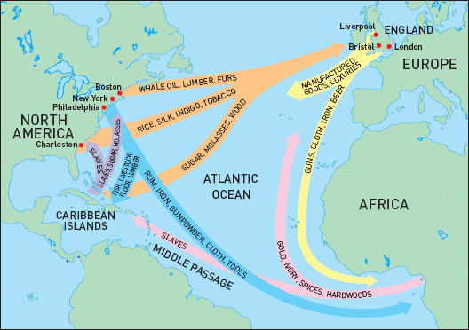
Navigation Acts: Triangle Trade

Slide 9
The Road to Revolution
Part 1

Slide 10
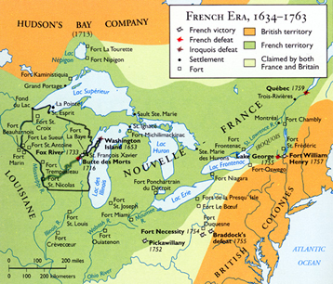
Setting the Stage for War
FRENCH & INDIAN WAR: war between the British and French over a land/border dispute
France and England wanted to expand their land holdings in North America and constant disagreements came up about who could claim what land.
Notes:
Sounds like between French and Indians, but really between the French and the British over land in North America. The French and the Indians were on the same side.

Slide 11
Start of the War
George Washington led troops against the French in 1754
Troops fight the Battle of Jumonville Glen
Washington built Fort Necessity
French ambushed the fort& forced Washington to surrender

Slide 12
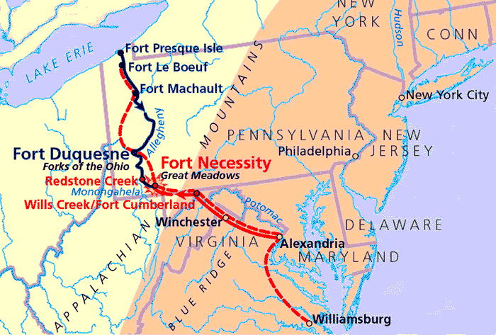

Slide 13
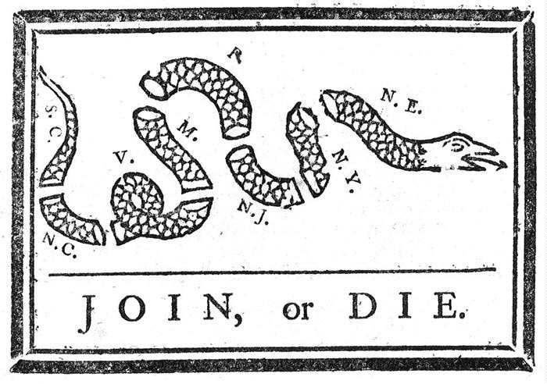
Albany Plan of Union
Proposed by Ben Franklin & Thomas Hutchinson
Plan called for colonial unity, but no colonies approved
Notes:
By the summer of 1954, it was clear that a war was coming
In July of 1954 more than 20 representatives from the colonies met in Albany, NY to try to figure out a response to the war.
This was a political cartoon made by Benjamin Franklin to demonstrate what would happen if the colonies did not unite together in the war effort

Slide 14
Alliances in the French and Indian War
ALLIANCE: formal agreement by 2 or more nations to act together in a cause
France
Algonquins
Hurons
Spain (1762)
Great Britain
Iroquois
4 Advantages of the French side:
3 Advantages of the British side:
1. Land Area
1. Increased Settlers
2. Single Government
2. Land Structure
3. Professional Military Aid
3. Settlers Willing to Fight
4. Indian Assistance

Slide 15
A Snapshot of Fort Ticonderoga

Slide 16
The Treaty of Paris/End of the War
1. Britain gained Canada and all French land east of the Mississippi River
2. Spain gained all French land West of the Mississippi River
3. Spain gave Florida to Britain
Major Effect of the War for the Colonists:
Colonists gained military experience and confidence, learned to cooperate, and learned to depend less on England.
Notes:
Later, we will see French gain a bit of this territory back in 1800 through Napoleon Bonaparte, but then in 1803 Thomas Jefferson will purchase it in an event called the Louisiana Purchase.
Guadeloupe is an island in the Caribbean that is still part of France today, and part of the European Union.

Slide 17
Prior to the French and Indian War
After the French and Indian War
Notes:
Point out boundary of the colonies in 1763, explain that after the war, in the spring of 1763, an indian chief named Pontiac attacked several british forts in western Pennsylvania and so in the fall of 1763, King George issued the Royal Proclamation of 1763 – which drew a line from north to south along the Appalachian mountains and declared the colonists could not settle west without British govt permission (this angered farmers and land speculators who wanted to access the land)

Slide 18
Increasing Tensions In Colonies
After the French & Indian War, the British attempted to tighten their connection with the colonies. Between 1763 and 1776, King George III and the British Parliament issued a series of laws to increase the profitability of the colonies. One reason for this was the need to pay the costs of the previous war.
While the colonies had accepted Parliament’s power to regulate trade, they objected to it’s new assertion of authority to raise revenue. As British citizens, they believed that without the approval of the colonial legislatures, such taxation violated their rights as Englishmen. By ignoring the colonists’ objections, King George III and the British Parliament prepared the way to a war for independence.

Slide 19
Stamp Act (1765)
Raised funds for defense through tax of paper goods.
Paper goods included all legal documents, newspapers, playing cards, etc.
This impacted ALL social groups
Colonists protested the Stamp Act
Opposed by the Stamp Act Congress and the Sons of Liberty
Notes:
Currency Act of 1751, later extended to all colonists in 1764, prohibited the colonies from issuing their own paper money
Stamp Act Congress (October 1765)
9 of 13 colonies sent representatives to New York (MA, CT, RI, NJ, NY, PA, DE, MD, SC)
Demand repeal of Sugar and Stamp Acts
Protested increased power of Admiralty Courts
Significant step towards unifying colonies

Slide 21
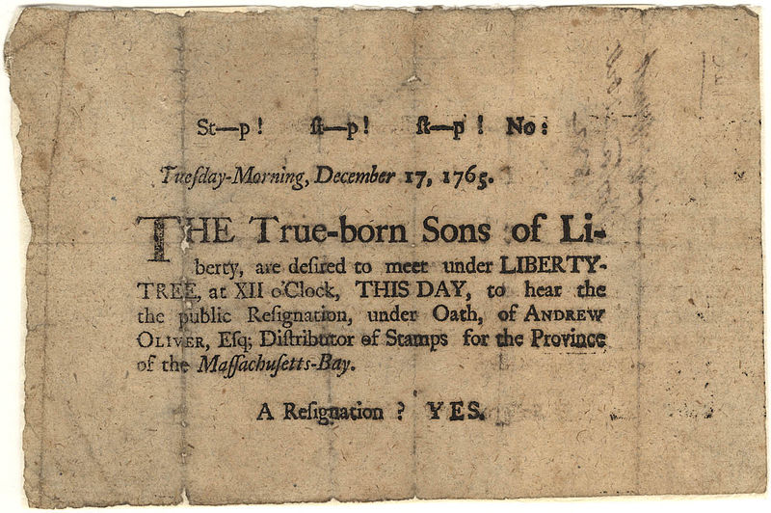
Sons of Liberty
Made by shopkeepers & merchants protesting the Stamp Act
Samuel Adams was a leader
Secret organization to terrorize tax collectors

Slide 22
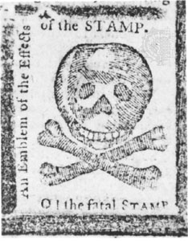
Further Assertion of Authority
Declaratory Act repealed the Stamp Act
Townshend Acts taxed imported items and reorganized tax collection

Slide 23
Reactions to Townshend Acts
Colonists’ Reaction
Britain’s Reaction
Argued that acts violated constitutional rights and that British could regulate but not tax
Sent soldiers to the colonies to protect officials

Slide 24
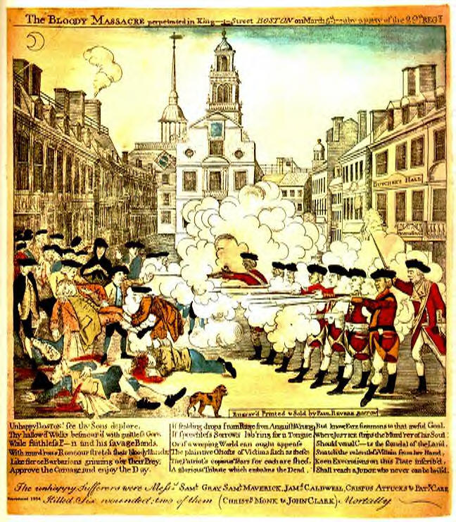
Boston Massacre
WHEN: March 5, 1770
WHAT: a group of Bostonians taunted soldiers, 1 of the soldiers fired and others began firing into the crowd
EFFECTS: some Townshend Act Taxes were repealed

Slide 25
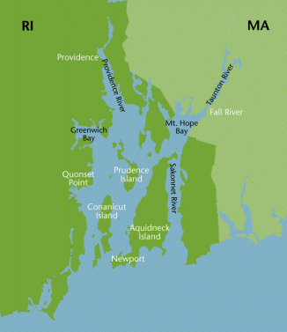
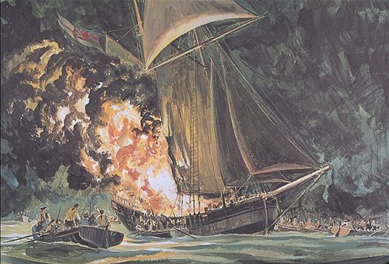
The Gaspee Incident
British ship seized by RI residents dressed as Natives
Sank it in Narragansett Bay
British put accused on trial in England

Slide 26
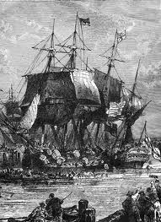
Boston Tea Party (December 16, 1773)
TEA ACT: Britain gave British East India Company full control of the tea trade in America
In protest, colonists boarded ships in Boston and threw tea into harbor
Notes:
The tea symbolized British tyranny
Governor Hutchinson of MA refused to be intimated by the colonists’ – he believed in rule of law even though he disagreed with the tax

Slide 27
Intolerable (Coercive) Acts (1774)
Boston Port Act: Closed Boston port
Massachusetts Government Act: Reduced power of assembly
Administration of Justice Act: Officials & soldiers would be tried in England
Quartering Act: Expanded power of gov’t to house soldiers
Notes:
Reduced power of colonial assembly → Banned town meetings
Quartering Act allowed government to house soldiers in public OR PRIVATE buildings
Most government positions were appointed by King or royal governor

Slide 28
A Letter to King George…
Write a letter to King George about your reaction to the Intolerable Acts. Include in your letter the following:
Do you support the Intolerable Acts? Why or why not?
What will you do in response to the Acts? (Grudgingly obey? Refuse to adhere to them? Secretly begin to revolt? Be specific.)
Do you support British rule in the colonies?

Slide 29
The Revolution Begins
Part 2

Slide 30
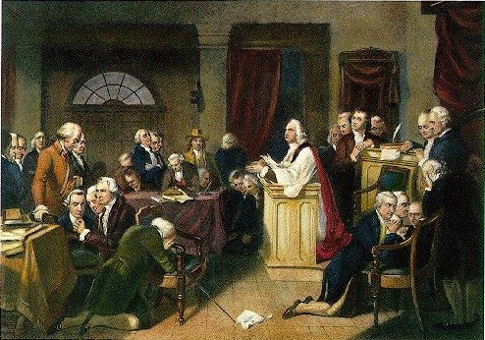
First Continental Congress (September 5 - October 26, 1774)
12 colonies sent 56 delegates to discuss response to Britain’s actions
Wrote Declaration of Rights and Grievances
Britain ignored or rejected all American petitions
Notes:
Major Players included Patrick Henry, Sam Adams, and John Adams
The only colony not to attend was Georgia – because they were hoping for aid from the British to deal with a problem with Indians on their frontier
The Congress agreed to reconvene in May 1775 if their demands had not been met
Dec of Rights and Grievances argued that colonies could only be taxed by themselves (NOT PARLIAMENT)
British rejection pushed Americans to rebellion

Slide 31
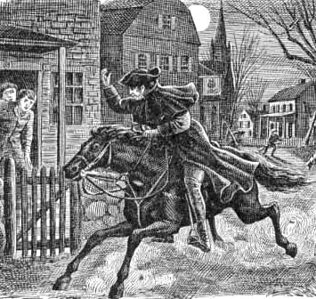
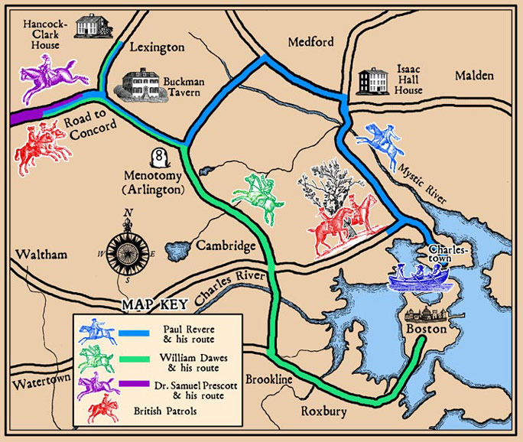
“The British(!?) ARE COMING!”
On the night of April 18, 1775, Paul Revere, William Dawes and Samuel Prescott rode out from Boston to spread the word that 700 British troops were marching to Concord.
Notes:
Colonists in Boston were keeping watch over the British troops moves.
Night of April 18, 1775 – Paul Revere, William Dawes, and Samuel Prescott rode out to spread the word
700 British troops were headed for Concord
From there pre-arranged signals were sent from town to town that the British were coming.

Slide 32
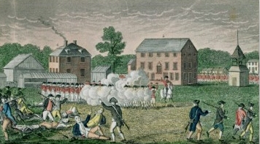
Battle of Lexington
British Troops meet the Minutemen
British commander asks for surrender
A shot was fired, British fired, colonists fled
No one knows who shot the first shot
Notes:
Today, still, NO ONE KNOWS who fired the first shot
8 minutemen killed, 9 wounded, 1 British soldier injured
Lasted only 15 minutes

Slide 33
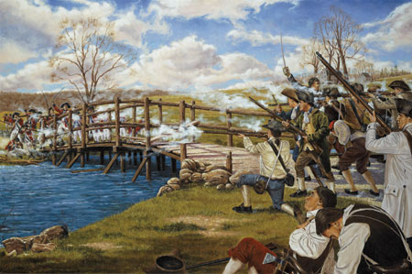
The Battle of Concord
British march to Concord and fight at the North Bridge
British retreat to Boston
Notes:
Arsenal: a place where military equipment and weapons are stored or made

Slide 34
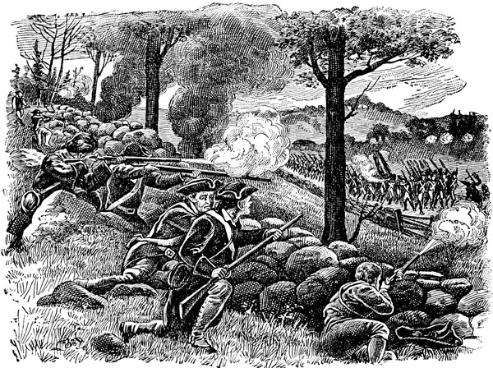
The Return March to Boston
Minutemen work together to attack the British
Colonists hold Boston under siege

Slide 35
Second Continental Congress (May 1775)
Established army and navy
Named Washington General and Commander-In-Chief of Continental Army
Notes:
Met in Philadelphia
All 13 colonies present
No demand for Independence but demanded for rights

Slide 36
May 1775 – March 1776 Timeline
Colonists capture Fort Ticonderoga
Invasion of Canada
June 17, 1775
May 1775
Battle of Bunker (Breed’s) Hill: British attack but colonists learn strength
Fall 1775

Slide 37
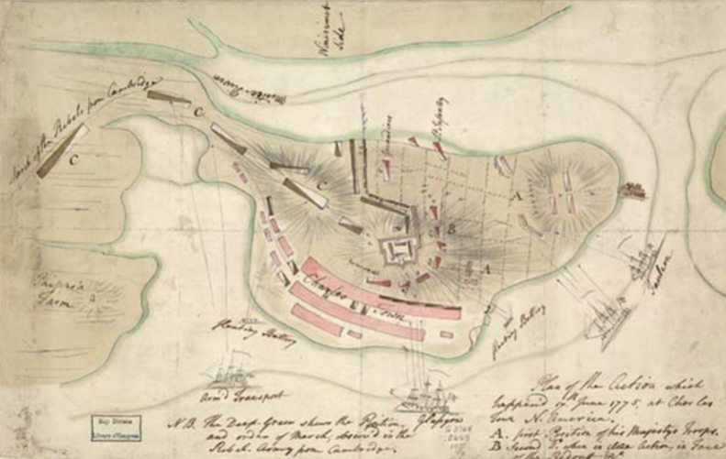
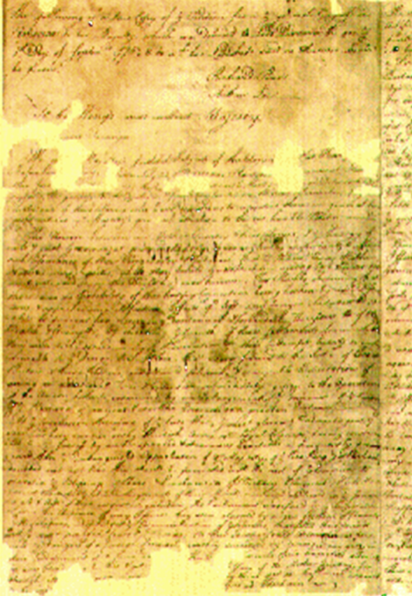
Fort Ticonderoga (May 1775)
Colonists captured the fort and brought cannons to Boston
Battle of Bunker (Breed’s) Hill (June 17, 1775)
British attacked fort but learned colonists were stronger than they thought
Olive Branch Petition (July 1775)
Asked King George to stop Parliament’s actions
Stated American loyalty to Britain
Notes:
Declared colonies in rebellion, therefore guilty of treason
Hired Hessian mercenaries to fight Americans

Slide 38
Fighting Increases
Invasion of Canada (Fall 1775)
Colonists invaded Canada and this contradicted their claim of a defensive war.
British Flee Boston (March 17, 1776)
Washington puts cannons from Ticonderoga on Dorchester Heights
Forced British General Howe to abandon Boston

Slide 39
Common Sense (January 15, 1776)
Written by Thomas Paine
Made argument for independence
Ideals of Republicanism
Colonies were receptive
Notes:
Had roots in ancient Greece and Rome
Popular with British politicians who wanted to limit King’s power
Angry at King’s treatment
Experience with colonial assemblies, town meetings, churches, social mobility
Willing to sacrifice self interest for public good
Conservative republicans opposed social equality

Slide 40
Declaration of Independence
Congress writes a formal statement of the reasons for independence
Thomas Jefferson was the primary writer
Stated the rights of life, liberty and the pursuit of happiness
Notes:
The declaration addresses not just Britain, but the world
Richard Henry Lee proposed resolution for Independence on June 7, 1776 which was passed on July 2, 1776
Stated what everyone already believed
Used phrases from British legal history and “natural rights”
After giving explaining why people may rebel in general, the declaration has a long list of specific reasons why they SHOULD rebel
Concluded by stating America did everything it could to avoid this step
Ignored Parliament only focused on King

Slide 41
We hold these truths to be self evident, that all men are created equal, that they are endowed by their Creator with certain unalienable Rights, that among these are Life, Liberty, and the Pursuit of Happiness

Slide 42
The War for Independence
Part 3

Slide 43
A Closer Look at Two Sides
Patriots
Loyalists
Whigs
Minority of population
Militia controlled country areas
Presbyterians and Congregationalists
Tories
Believed they would be rewarded
Tended to be wealthy, educated
Anglicans
Notes:
Militia controlled country areas and places where Britain lacked ability to have strong military presence
Responsible for “educating” people about the necessity of the Cause

Slide 44
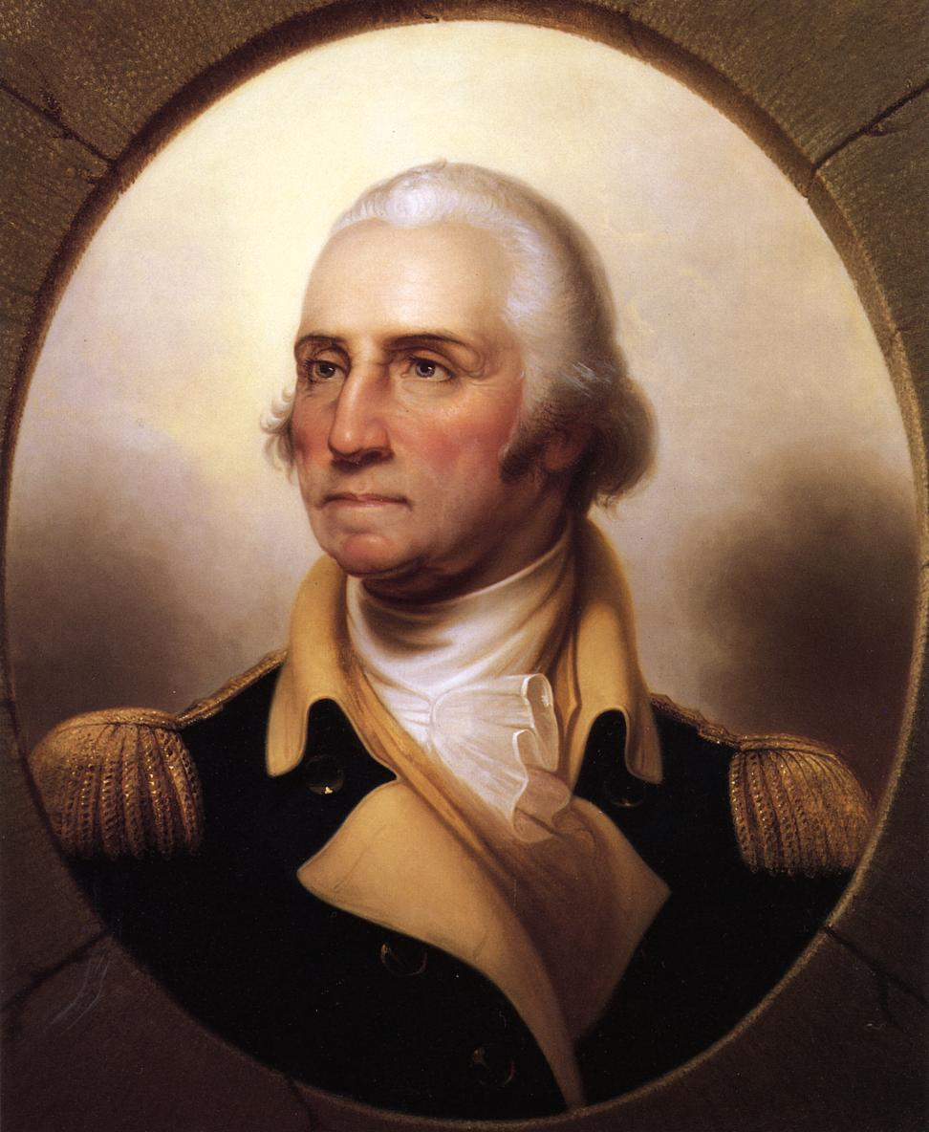
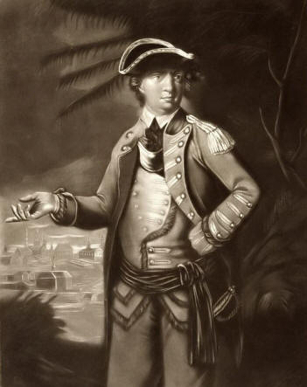
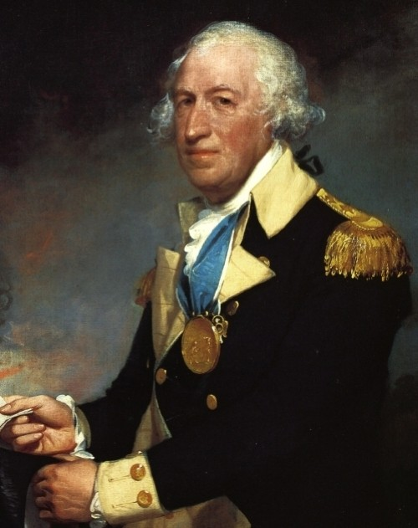
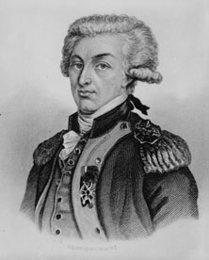
Key Players in the Revolution
American General responsible for the victory at Battle of Saratoga
French officer who served as a General for the Americans and helped win the Battle at Yorktown
Horatio Gates
Marquis de Lafayette
George Washington
Benedict Arnold
General and Commander-in-Chief of Continental Army
General who originally fought for the Americans but later defected to the British Army

Slide 45
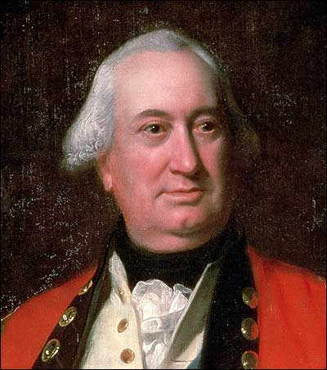
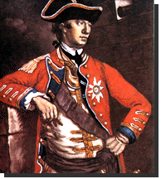
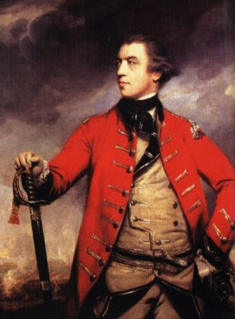
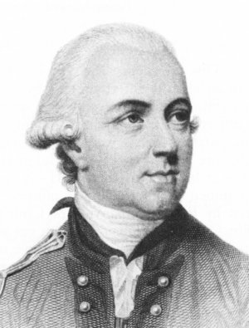
Key Players in the Revolution
General Charles
Cornwallis
General
William
Howe
General & Commander of British troops from 1775-1778 & was shared fault for the loss at Saratoga
British General who surrendered after the Battle of Yorktown
General
John
Burgoyne
Sir
Henry
Clinton
General primarily responsible for loss at Saratoga, forced to negotiate with Horatio Gates
General & Commander of British troops from 1778-1782

Slide 46
Two Phases of Revolution
1776-1778
fighting mostly in North
1779-1781
fighting mostly in South, British hoped Loyalists would help

Slide 47
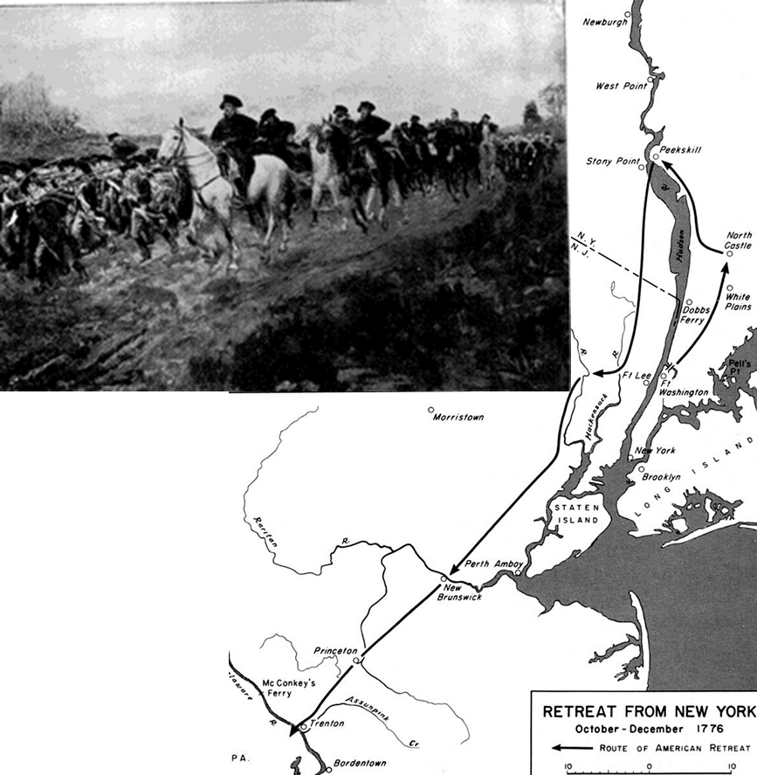
Battle of Long Island (August 1776)
British army retreat from Boston to NYC in March 1776, British navy arrive July 1776
Washington moved army to NYC after British leave Boston
Washington’s army was re-routed and retreated across Manhattan into New Jersey
If Britain destroyed army, revolution would have ended
Retreat across New Jersey
(November-December 1776)
Many militia deserted
Enlistments for regular army would end December 31st
Continental Army almost fell apart

Slide 48
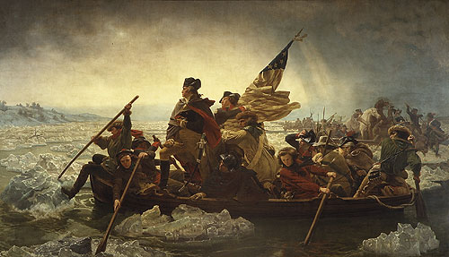
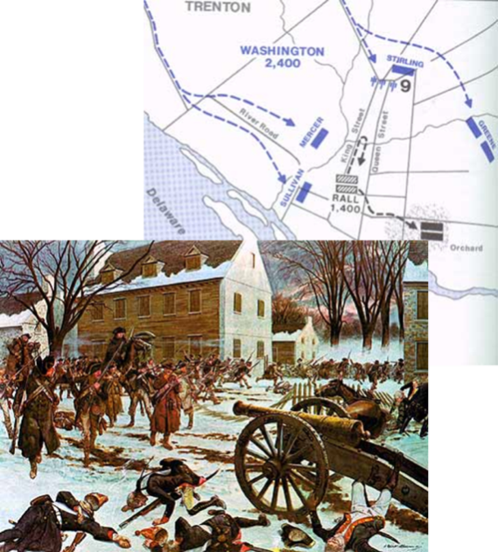
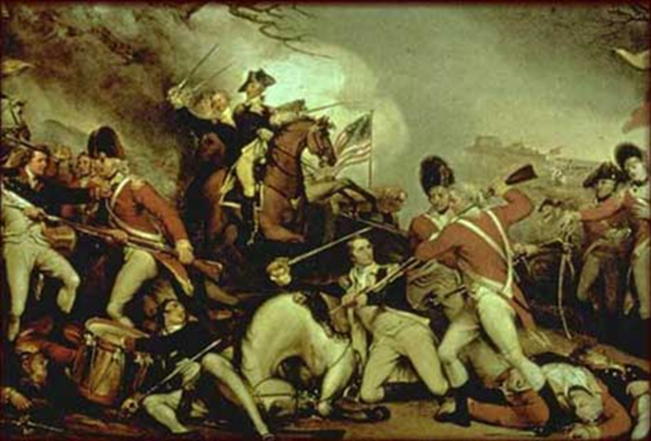
Crossing the Delaware (December 25, 1776)
Washington needed a victory before enlistments lapsed on December 31 to restore faith of troops
Decided to attack Trenton, NJ
George Washington Crossing the Delaware, 1851 Emanuel Gottlieb Leutze, American
Battle of Trenton (December 25, 1776)
Washington surprised and defeated the Hessians
Encouraged soldiers to re-enlist
Battle of Princeton (January 3, 1777)
Washington maneuvered to attack rear of British army in Princeton
Forced Britain to retreat from New Jersey
Victories increased enlistments and morale
Revolution was saved
Notes:
Hessians: German soldiers hired by the British Army

Slide 49
Burgoyne’s March on Albany (June-October 1777)
The purpose of the plan was to isolate the New England Colonies from the middle and Southern colonies.
British Three Part Plan
General Burgoyne was to invade from Montreal via Lake Champlain and Hudson River
Lt. Col. St. Leger was to invade along Mohawk River from Western NY
General Howe was to invade from NYC along Hudson River

Slide 50
Failure of Burgoyne’s plan
St. Leger
Loyalist and Indian allies defeat Americans at Battle of Oriskany
British hear Benedict Arnold was arriving with reinforcement
Causes St. Leger to abandon fort and stop invasion
Howe
Decided to chase Washington and attack Philadelphia
Defeated Washington at Brandywine and Germantown in 1777
Did not support Burgoyne’s invasion of Albany
Settled down in Philadelphia instead
Burgoyne
Marched from Montreal expecting to meet with St. Leger and Howe but moved very slowly
Militia used guerilla attacks against Burgoyne along march
Burgoyne’s army surrounded and defeated by General Horatio Gates at Saratoga (north of Albany) on Oct 17, 1777
Considered turning point of war
Britain offers America home rule following the defeat

Slide 51
Valley Forge
Continental Army spent winter quarters at Valley Forge
Most men died of disease, starvation, exposure
Symbolizes suffering of colonists during Revolution
Washington heard of Saratoga victory at Valley Forge
Baron von Steuben used time at Valley Forge to drill and train American soldiers into a professional army

Slide 52
Aid from France
France and Spain wanted to help America to weaken Britain
American foreign policy objectives
Wanted to end mercantilism and colonialism globally
Wanted freedom of seas and trade
Victory at Saratoga convinces French to join the colonists’ side
February 6, 1778: Colonists and France sign Treaty of Alliance
Offered formal recognition of American independence
Transforms American Revolution into a world war
Notes:
Treaty is a military alliance

Slide 53
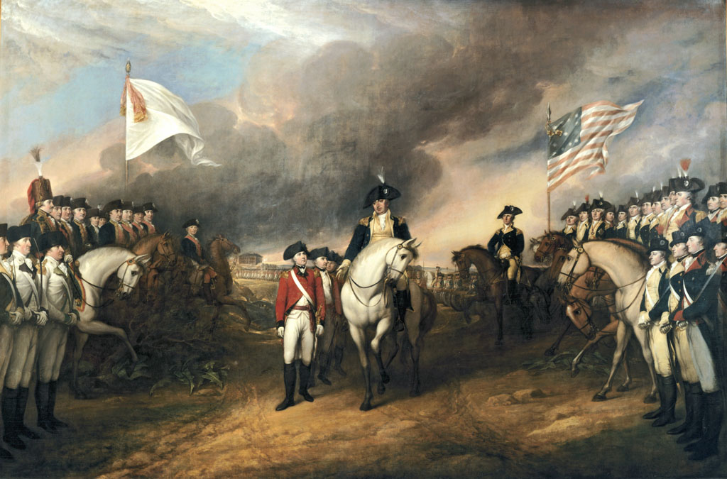
Battle of Yorktown
British led towards Yorktown: Marquis de Lafayette forced British led by Cornwallis toward Yorktown, VA
Cornwallis hoped to be resupplied via sea and the British navy
French Navy blockaded Yorktown from sea
Attack on Cornwallis – Americans led by Washington and French by Rochambeau
Cornwallis army forced to surrender October 19, 1781
Effectively ended the war
Washington had to keep army in field to ensure adequate peace

Slide 54
Treaty of Paris 1783
American delegates
Benjamin Franklin, John Adams, John Jay
Agreed to treaty without French against orders from Congress
France wanted America weak, so it could be controlled
Jay secretly contacted British to arrange a peace treaty
Peace Treaty signed September 3, 1783
Britain, France, Spain and United States agreed

Slide 55
Treaty of Paris 1783
England recognized US independence
US boundaries set at Mississippi River
Americans could fish off Canada
America should pay debts owed to Britain
Congress agreed to recommend returning Loyalist property

Slide 56
The War Changes American Society
Part 4

Slide 57
Effect of War on Women
Women ran farms, businesses and families during war
Women supported troops during battle
Abigail Adams – John Adams’ wife
Gave him information about home front while he was in Congress
Wrote “Remember the Ladies”
Molly Pitcher at
Battle of Monmouth 1778

Slide 58
Effect of War on Blacks
British promised freedom to blacks who fought for crown
Many slaves joined British
Americans eventually allow Blacks to join Continental army
Detail from "The Death of Major Pierson," 1782-84, oil painting by John Singleton Copley depicting a black soldier fighting for the British during the American Revolution. Black soldiers in Dunmore's Royal Ethiopian Regiment had "Liberty to Slaves" embroidered on their uniforms. Tate Gallery

Slide 59
Effect of War on Loyalists
Fled to western territories
60,000 joined British Army
Went to England or Canada
Reduced French influence in Canada
Had homes and property taken by Patriots
William Franklin – Governor of New Jersey son of Benjamin Franklin
Notes:
William Franklin was imprisoned during the war and in 1782 sent to exile in Britain where he lived in London until his death in 1813

Slide 60
Why Britain Lost
Problems communicating across ocean
Loyalist support not as strong as expected
America had too much land for Britain to occupy and control
No single capitol of US
America succeeded by making the war long

