Slide 1
World War II
Unit Eight

Slide 2
Overview of Unit Eight
During the 1930s, Hitler played on the hopes and fears of the Western democracies. Each time the Nazi dictator grabbed new territory, he would declare an end to his demands. Peace seemed guaranteed – until Hitler started to expand again. By October of 1939, both France and Germany had declared war on Germany and soon Europe was engulfed by war again. In 1941, attempting to carve out an empire, Japan attacked Pearl Harbor in Hawaii, bringing the United States into the war. This action would eventually change the course of the war as the United States became a major player.
In this unit, we will also explore the Holocaust, how the Allies won the war, and the eventual devastation of both Europe and Japan. We will study this unit in four main sections:
Hitler’s Lightning War
Japan Strikes the Pacific
The Holocaust
World War Two Ends

Slide 3
Hitler’s Lightning War
Section One

Slide 4
Setting the Stage
After his moves into the Rhineland in March 1936, Austria in March 1938 and Czechoslovakia in September 1938 and March 1939, Hitler turned his eyes to Poland. On April 28, 1939, Hitler spoke before the government and demanded that land taken from Germany by Poland in World War I be returned.
Germany then signed a nonaggression pact with the Soviet Union on August 23, 1939 – promising not to attack each other. After signing this pact, Hitler moved ahead with plans to conquer Poland and invaded Poland on September 1, 1939. The invasion of Poland unleashed World War II.

Slide 5
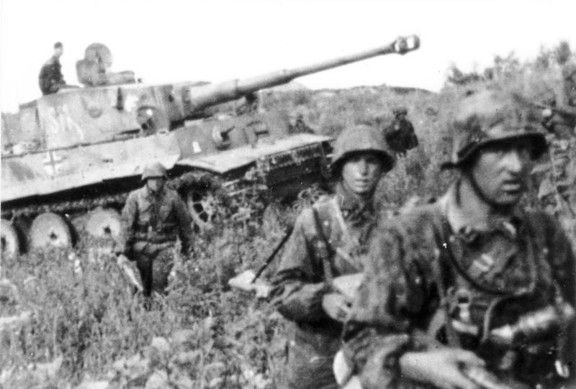
Hitler’s Lightning Attack
Poland fell to Germany in just 3 weeks
BLITZKRIEG: military strategy – “lightning war”
Hitler then took the western half of Poland and Stalin took the eastern half
Stalin then invaded from Lithuania to Finland
Suddenly, on April 9, 1940, Hitler launched a surprise invasion of Denmark and Norway. He planned to build bases along the Norwegian and Danish coasts to strike at Great Britain. In just four hours after the attack, Denmark fell. Two months later, Norway surrendered as well.
Notes:
Blitz in football: defensive player rushes the qb – defensive move while the blitzkrieg is an offensive move

Slide 6
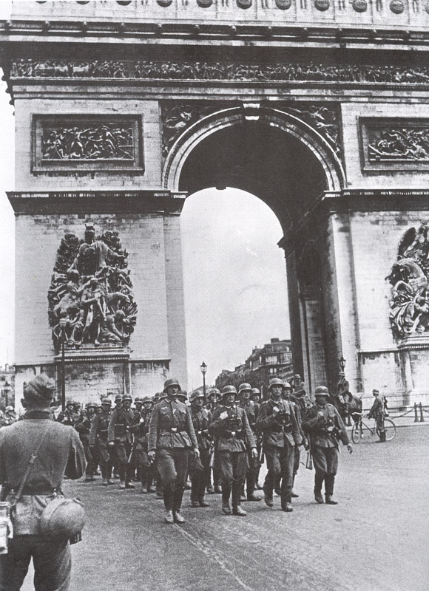
Battle for France
Belgium surrendered in May 1940
On June 10, 1940, Mussolini joined Hitler in the war
Italy attacked France
By June 14th, Paris had fallen to the Germans
France surrendered on June 22, 1940

Slide 7
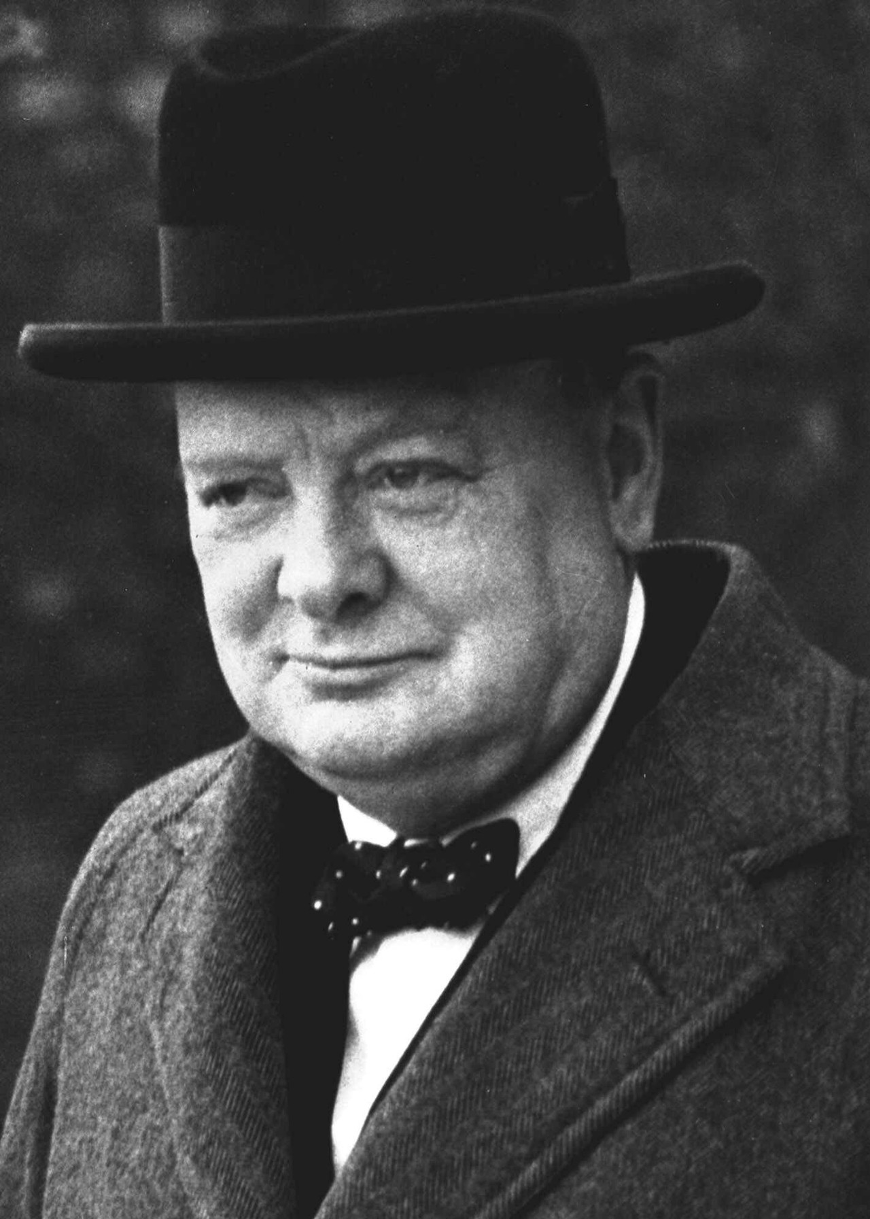
Battle for Great Britain
Great Britain stood alone against the Nazis
WINSTON CHURCHILL: British prime minister
Germany fought with massive air strikes
BATTLE OF BRITAIN: air strikes from Sept 1940 to May 1941 by Germany on Britain
Ended when Hitler gave up

Slide 8
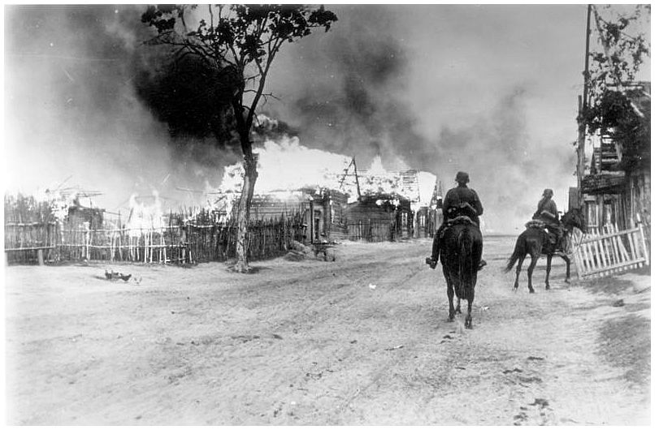
The Eastern Front
The stubborn resistance of the British in the Battle of Britain caused a shift in Hitler’s strategy in Europe. Although the resistance surprised Hitler, it did not defeat him. He would deal with Great Britain later. Instead, he turned his attention east to the Balkans and the Mediterranean area – and to the ultimate prize, the Soviet Union.
Hitler invaded USSR on June 22, 1941
Could not take Leningrad or Moscow
In Winter of 1943, Germans began to retreat
By March 1943, Moscow was saved and Germans lost 50,000 men
Notes:
Union of Soviet Socialist Republics

Slide 9
Japan Strikes the Pacific
Section Two

Slide 10
Setting the Stage
Like Hitler, Japan’s military leaders also had dreams of empire. Japan was overcrowded and face shortages of raw materials. To solve these problems – and to encourage nationalism – the Japanese began a program of empire building that would lead to war.
Japan’s expansion began in 1931. In that year, Japanese troops took over Manchuria in northeastern China. Six years later, Japanese armies swept into the heartland of China. They expected quick victory, but Chinese resistance caused the war to drag on. This strained the Japanese economy and to increase their resources, Japanese leaders looked toward other areas.

Slide 11
Attack on Pearl Harbor
US sent aid to China
Japan’s activities caused FDR to cut off oil shipments in July 1941
On December 7, 1941, Japanese attacked Pearl Harbor in Hawaii
Known as “a date that will live in infamy”
US joins the war

Slide 12
Allies Strike Back
After a string of victories, the Japanese seemed unbeatable. Nonetheless, the Allies – mainly Americans and Australians – were anxious to strike back in the Pacific. In 1942, the US bombed Tokyo, demonstrating that Japan was not invincible. Slowly, Japan’s newly acquired vast empire was becoming difficult to defend and control.
Allies began to turn tide of war
BATTLE OF MIDWAY: battle between Americans and Japanese over Midway Island in June 1942 that turned the war in the Pacific against the Japanese
General Douglas MacArthur commanded Allied land forces in Pacific

Slide 13
The Holocaust
Section Three

Slide 14
Setting the Stage
As Japan worked to establish a new order in Southeast Asia and the Pacific, the Nazis moved ahead with Hitler’s plan for a new order in Europe. Hitler’s goal was not only the conquest of Europe, he also aimed at enslaving Europe’s people and forcing them to work for Germany’s prosperity. In particular, Hitler had plans for dealing with those he considered unfit for the Third Reich.
As part of their new order for Europe, Nazis proclaimed that Aryans, or Germanic people, were the “master race.” They claimed that Jews and other non-Aryan people were inferior. This racist message would eventually lead to the Holocaust.

Slide 15
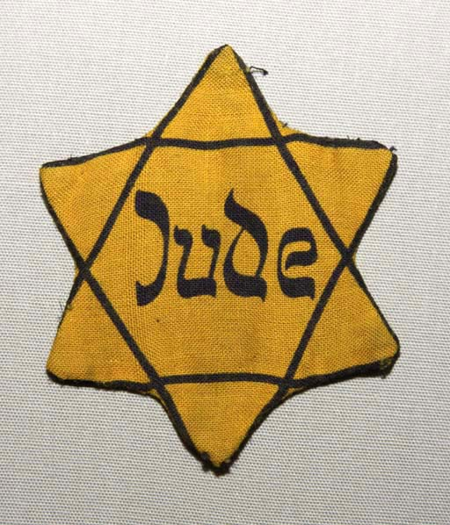
Holocaust Begins
HOLOCAUST: the mass slaughter of civilians, especially Jews
Nazis blamed Jews as the cause of their failures
Nuremberg Laws deprived Jews of their rights to German citizenship
Jews wore a bright yellow star for easy identification
Notes:
Jude (Yude) is German for Jew

Slide 16
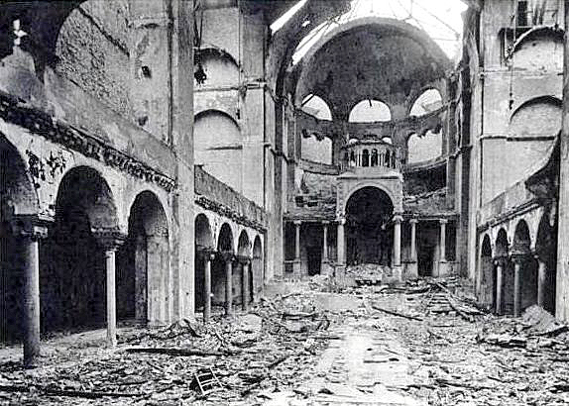
Kristallnacht: “Night of Broken Glass”
November 9, 1938
Nazi storm troopers attacked Jewish homes, businesses and synagogues across Germany
Murdered 100 Jews
Streets were littered with broken glass
Notes:
After Kristallnact, number of Jews began to flee for safety to other countries

Slide 17
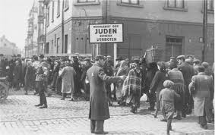
Isolating the Jews
Hitler ordered Jews to be moved into certain cities in Poland
GHETTOS: segregated Jewish areas
Ghettos were dismal and overcrowded
Germans hoped Jews would would die from starvation or disease

Slide 18
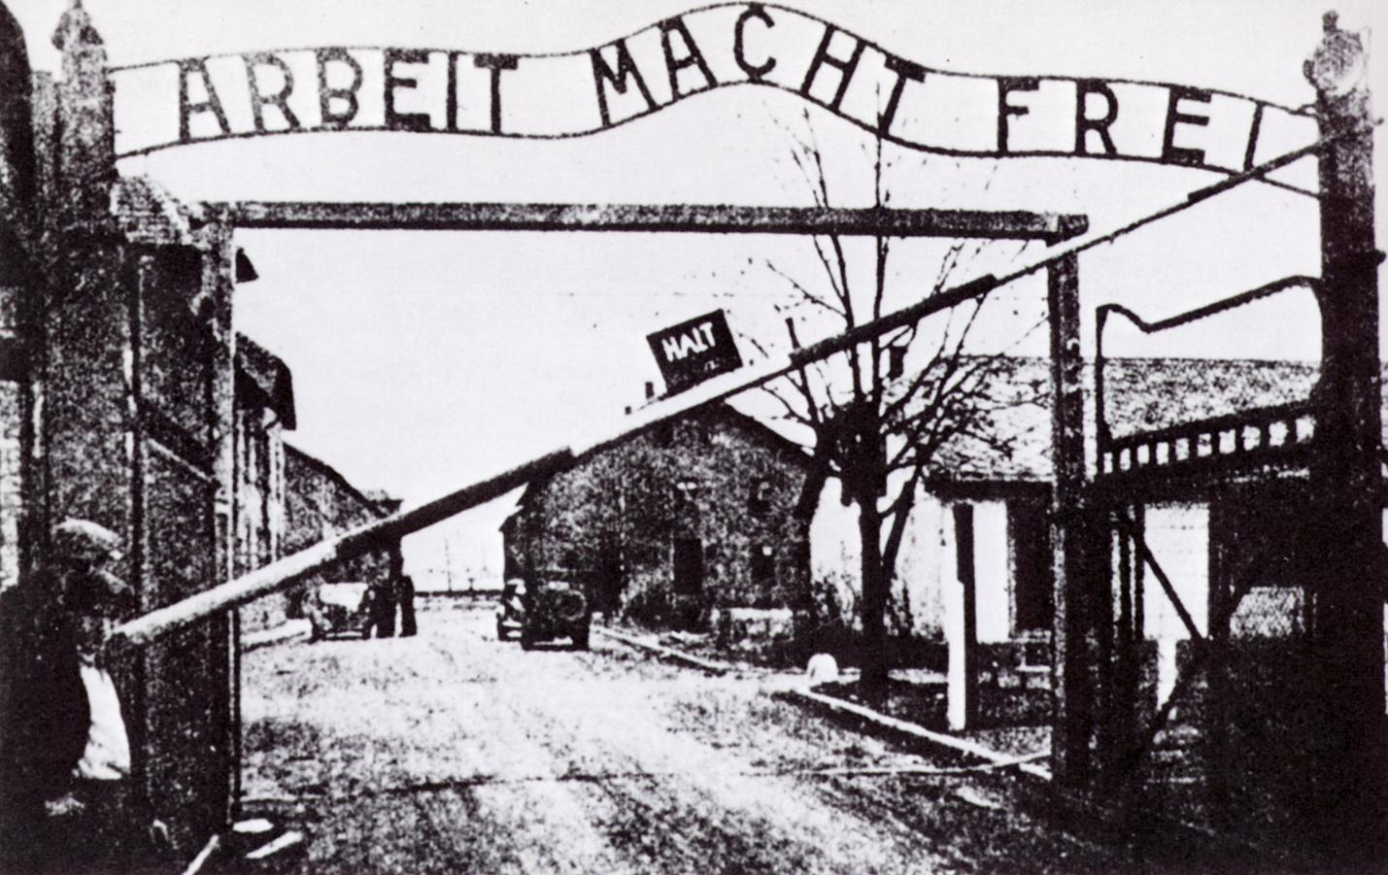
Hitler’s Final Solution
Hitler created concentration camps
CONCENTRATION CAMPS: slave-labor prisons
In early 1942, Nazis built extermination camps
EXTERMINATION CAMPS: prisons equipped with gas chambers for mass murder
Six million Jews were killed in the death camps and Nazi massacres
Notes:
Less than 4 million European Jews survived the horrors of the holocaust
Many who survived had help from non-Jewish people who were against the Nazis’ treatment of the Jews
"Arbeit macht frei" is a German phrase meaning "work makes free". The slogan is known for having been placed over the entrances to a number of Nazi concentration camps during World War II,

Slide 19
World War Two Ends
Section Four

Slide 20
Setting the Stage
On December 22, 1941, just after the attack on Pearl Harbor, Churchill and FDR met at the White House to develop a joint war policy. Stalin asked his allies to relieve German pressure on his armies in the east by opening a second front in the west.
In August 1942, German forces captured Stalingrad. As the Battle of Stalingrad raged, Stalin urged British and Americans to invade France. In January 1943, FDR and Churchill decided to attack Italy first. Their conquest of Sicily toppled Mussolini from power and on September 3, Italy surrendered. Fighting in Italy would continue, however, until Germany officially fell in May 1945.

Slide 21
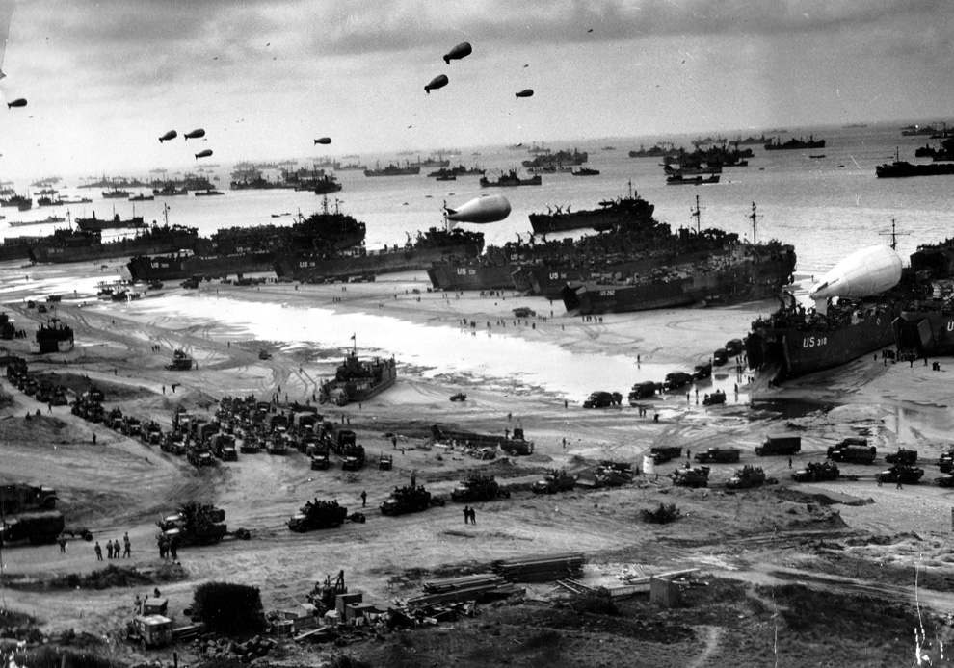
Allied Victory in Europe
By end of 1942, war began to favor Allies
D-DAY: invasion of Normandy by the Allied powers on June 6, 1944
D-Day allowed Allies to weaken German defenses
By end of August, Allies took back Paris

Slide 22
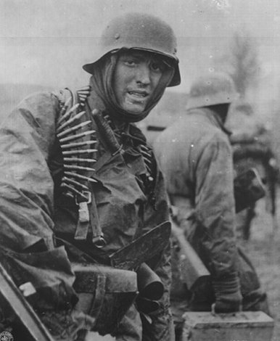
Germany’s Surrender
Hitler now faced war on two fronts
Pushed through Allied lines in the Battle of the Bulge
Allies eventually pushed back German army
Hitler committed suicide on April 30, 1945
Germany surrendered on May 7, 1945
Notes:
Surrender signed in Berlin on May 8
Celebrated V-E Day – Victory in Europe Day
Image: german soldier in battle of the bulge

Slide 23
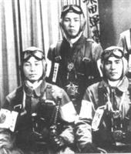
Victory in the Pacific
Although the war in Europe was over, the Allies were still fighting the Japanese in the Pacific. With the Allied victory in the Pacific, however, the Japanese advances had been stopped. For the rest of the war, the Japanese retreated before the counterattack of the Allied powers.
Allied moved in on Japan
Danger in kamikaze pilots
KAMIKAZE: Japanese suicide pilots
Japanese lost bloody battle at Okinawa on June 22, 1945

Slide 24
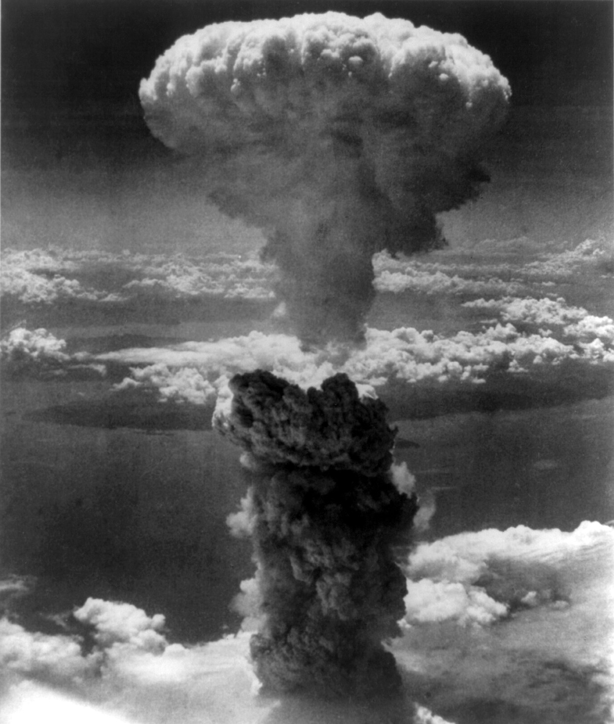
Decision to Drop the Bomb
President Truman had to decide whether to drop the atomic bomb
A-Bomb would bring war to quickest possible end
Developed by the top secret Manhattan Project
August 6, 1945: A-Bomb dropped on Hiroshima, Japan, killing 73,000
August 9, 1945: A-Bomb dropped on Nagasaki, Japan, killing 37,500
Japanese surrendered, officially ending the war
Notes:
Image: a-bomb in nagasaki on august 6

Slide 25
Europe in Ruins
Allied victory in the war had been achieved at a high price. World War II caused more death and destruction than any other conflict in history. It left 60 million dead, 50 million uprooted from their homes, and property damage costing billions of dollars.
By the end of World War II, Europe lay in ruins. Close to 40 million Europeans had died – two-thirds of them civilians. Constant bombing and shelling had reduced hundreds of cities to rubble. The ground war had destroyed much of the countryside and displaced persons struggled to return home.

Slide 26
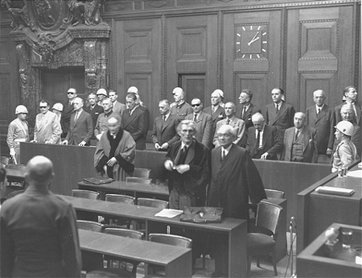
Post-War Politics
Nuremberg Trials held charging 22 Nazi leaders
Charged with waging a war of aggression
Accused of violating laws of war
12 of 22 sentenced to death

Slide 27
Effects of Defeat in Japan
The defeat suffered by Japan in World War II left the country in ruins. Two million lives had been lost in the war. The country’s major cities had been largely destroyed by Allied bombing raids, including Tokyo, the capital. The atomic bomb had left Hiroshima and Nagasaki as blackened wastelands. The Allies had stripped Japan of its colonial empire and even took away areas that had belonged to the Japanese for centuries.
In September 1951, the US and 48 other nations signed a formal peace treaty with Japan – officially ending the war.

