Slide 1
World Between The Wars
Unit Seven

Slide 2
Unit Seven Overview
At the end of World War I, Europe had been largely torn apart by the war. The next two decades were marked by revolutions in both Russia and China, a rise of nationalism throughout India and Southeast Asia, and global depression. As the world battled this depression, Europe saw the rise of fascism. By the mid-1930s, Germany and Italy seemed set on military conquest, and it seemed the world was moving towards war once again. We will explore this unit in five main sections:
Revolution in Russia
End of Chinese Imperial Rule
India Gains Independence
Depression & The Rise of Fascism
Europe Between the Wars

Slide 3
Revolution in Russia
Section One

Slide 4
Setting the Stage
The Russian Revolution was like a firecracker with a very long fuse. The explosion came in 1917, but the fuse had been burning for nearly a century. The cruel, oppressive rule of most 19th-century czars caused widespread social unrest for decades. Anger over social inequalities and the ruthless treatment of peasants grew. In 1881, revolutionaries assassinated Czar Alexander II and Russia was headed toward a full-scale revolution.

Slide 5
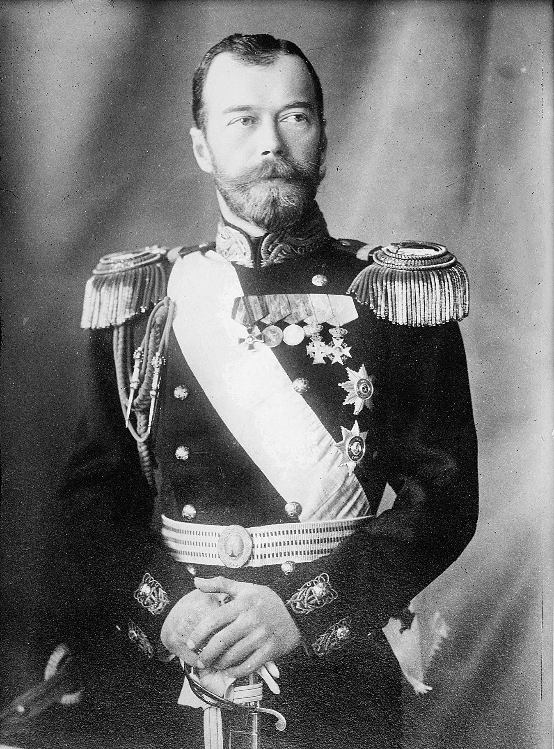
Romanov Dynasty
Nicholas II became czar in 1894
Reform programs were successful
Built the Trans-Siberian Railway – world’s largest continuous rail line
Growth brought new problems

Slide 6
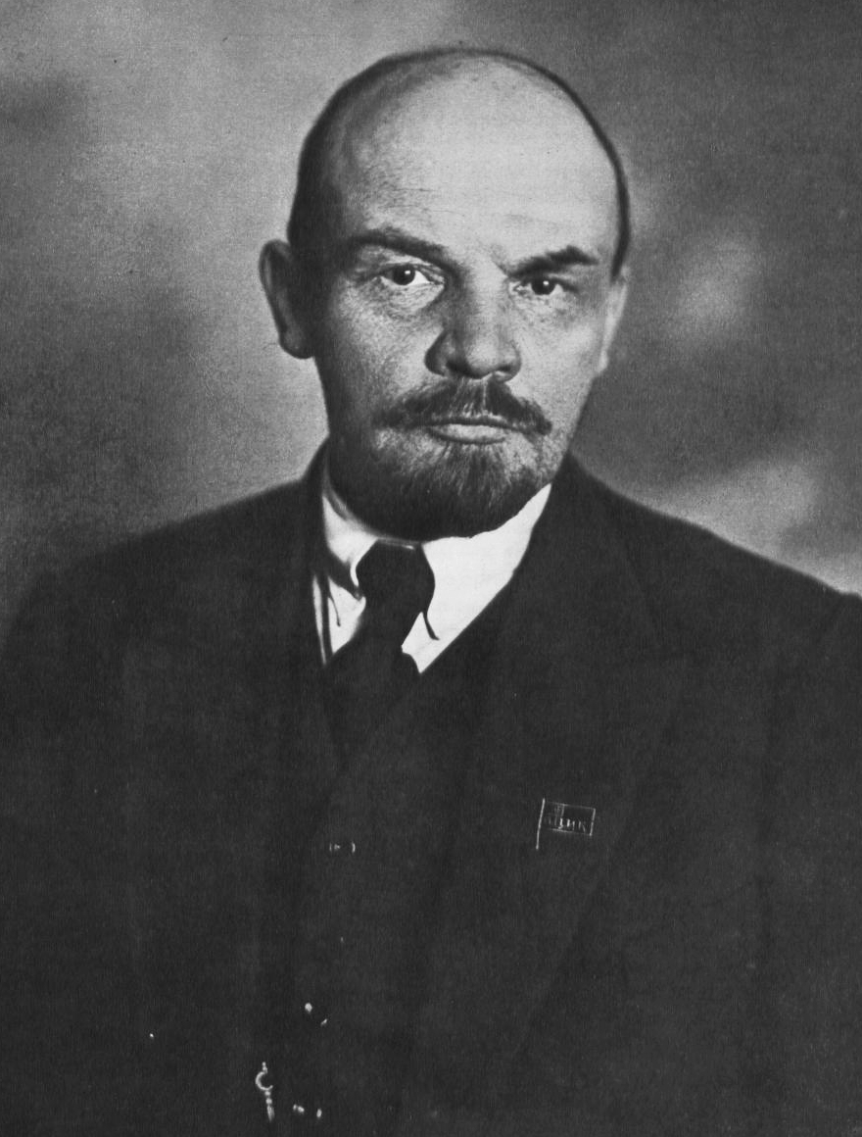
Growth of Revolutionaries
In 1903, Russian Marxists split into 2 groups
MENSHEVIKS: broad base of popular support for revolution
BOLSHEVIKS: supported small number of committed revolutionaries
LENIN: leader of the Bolsheviks
Lenin fled Russia in early 1900s to avoid arrest

Slide 7
The Romanov Dynasty Faces Crisis
Between 1904 & 1917, Russia faced a series of crises, including:
Russo-Japanese War
Bloody Sunday: Revolution of 1905
World War I
In 1915, Czarina Alexandra ran the government and fell under influence of Rasputin
RASPUTIN: self-described “holy man” who claimed to have magical healing powers
Alexandra allowed Rasputin to make key political decisions
Notes:
1 – war between Russia and Japanese for control of Korea and Manchuria – Japanese defeated Russian soldiers
2 – workers and families went to the Winter Palace in St Petersburg to ask for better working conditions, Nicholas II wasn’t there, but general and police chiefs ordered soldiers to fire and 500-1,000 unarmed people were killed
3 – Russia was unprepared to handle military and economic costs, revealing weaknesses of czarist rule and military leadership

Slide 8
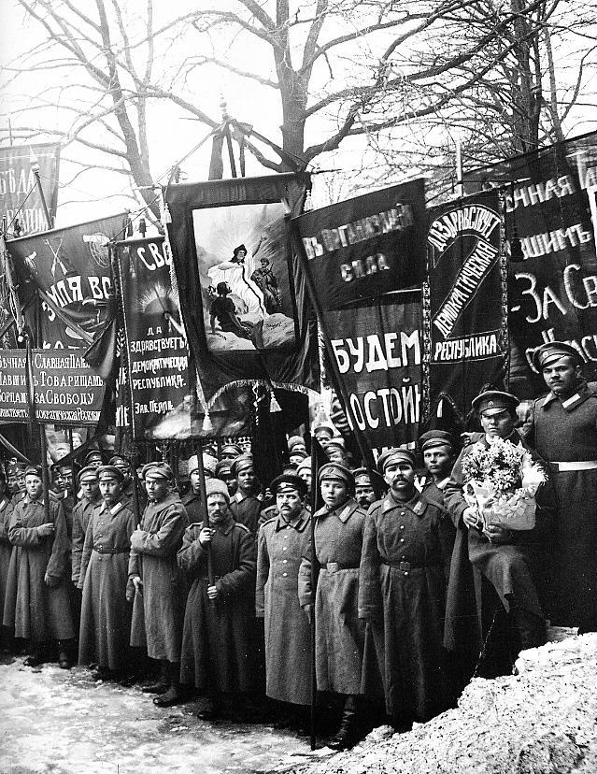
March Revolution
In March 1917, women textile workers led a strike
Soldiers later joined with the workers
Forced Czar Nicholas II to give up the throne
One year later, czar and his family were killed
A temporary gov’t was set up
Lenin returned in April 1917

Slide 9
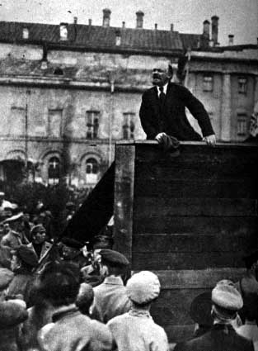
Bolshevik Revolution
In November 1917, Bolshevik Red Guards stormed the palace and took over
Lenin distributed farm land to peasants
Signed Treaty of Brest-Litovsk with Germany
Renamed party the Communist Party
USSR slowly recovered

Slide 10
Stalinist Russia
JOSEPH STALIN: successor to Lenin; dictator of Russia from 1928 to 1953
Stalin focused on Russian development
TOTALITARIANISM: government that takes total, centralized state control over every aspect of public and private life
Economic plan limited production of consumer goods, causing severe food, housing and clothing shortages
Stalin transformed USSR into industrial & political power

Slide 11
End of Chinese Imperial Rule
Section Two

Slide 12
Setting the Stage
In the early 1900s, China was ripe for revolution. China had faced years of humiliation at the hands of outsiders. Foreign countries controlled China’s trade and economic resources. Many Chinese believed that modernization and nationalism held the country’s keys for survival. They wanted to build up the army and navy, to construct modern factories and to reform education; yet others feared change. They believed that China’s greatness lay in its traditional ways.

Slide 13
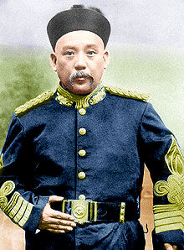
Overthrow of the Qing Dynasty
Qing Dynasty ruled from 1644 to 1912
In 1912, the Nationalist Party took over
Sun Yixian became President of the new Republic of China
Yuan Shikai became dictator by 1913
In 1916, Yuan died and civil war broke out

Slide 14
Communism in China
In 1921, group met in Shanghai to organize the Chinese Communist Party (CCP)
Mao Zedong became the leader of the CCP
In 1928, Jiang Jieshi became President of the Nationalist Republic of China
Many peasants began to support the CCP
By 1930, Nationalists & Communists were fighting a bloody civil war
By 1938, Japan controlled much of China – forced an uneasy truce in the civil war

Slide 15
India Gains Independence
Section Three

Slide 16
Setting the Stage
Indian nationalism had been growing since the mid-1800s. Many upper-class Indians who attended British schools learned European views of nationalism and democracy. They began to apply these political ideas to their own country. Well educated Indians began to resent the two centuries of British rule.
Two groups formed to rid India of foreign rule, the Indian National Congress in 1885 and the Muslim League in 1906. Though deep divisions existed between Hindus and Muslims, they found common ground. They shared the heritage of British rule and an understanding of democratic ideals. These two groups both worked toward the goal of national independence.

Slide 17
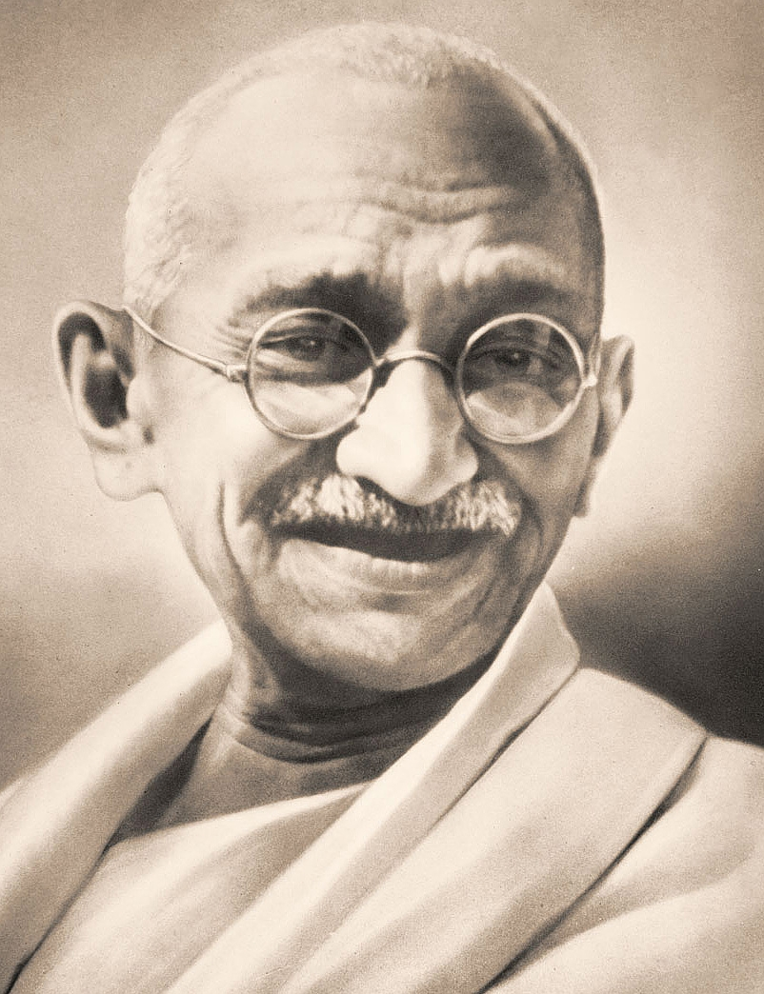
Emergence of Mohandas Gandhi
Mohandas Gandhi emerged as the leader of the independence movement
Called Mahatma, meaning “Great Soul”
Developed principle of civil disobedience
CIVIL DISOBEDIENCE: deliberate and public refusal to obey unjust law

Slide 18
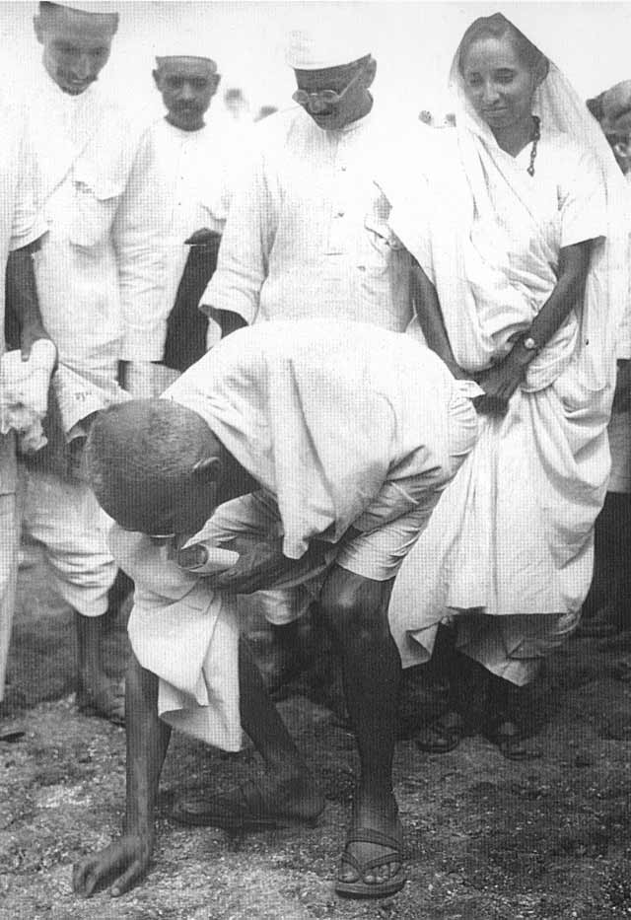
Campaign for Independence
Gandhi launched civil disobedience campaign to weaken British authority
Organized the Salt March
Demonstrations for independence were widespread
In 1935, British Parliament passed Government of India Act
Complete independence was not granted until 1948
Notes:
Salt March – protest of the Salt Acts – walked 240 miles to the sea – there they began to make own salt by collecting seawater and letting it evaporate
Govt of India Act: provided local self-government and limited democratic elections

Slide 19
Europe Between the Wars
Section Four

Slide 20
Setting the Stage
In both human suffering and economic terms, the cost of World War I was immense. The Great War left every major European country nearly bankrupt. Only the United States and Japan came out of the war in better financial shape than before. Neither had been a wartime battlefield. In fact, both had expanded their trade during the war. In addition, Europe’s domination in world affairs had declined since the war. The long and brutal fight had drained the continent’s resources.
Many democracies, including the United States, Britain, and France, remained strong despite the economic crisis caused by the Great Depression. However, millions of people lost faith in democratic government. In response, they turned to an extreme system of government called fascism.

Slide 21
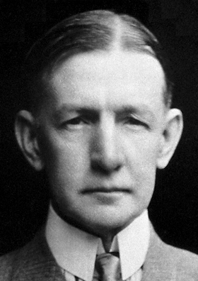
Europe After the War
Germany’s new democratic government was called the Weimar Republic
DAWES PLAN: $200 million loan from US to help Germany’s economy
German economy began to recover
Notes:
Weimar Republic had serious weaknesses from the start and most Germans blamed the Weimar Government for country’s defeat and postwar humiliation since they had signed the Treaty of Versailles
- Picture is charles dawes

Slide 22
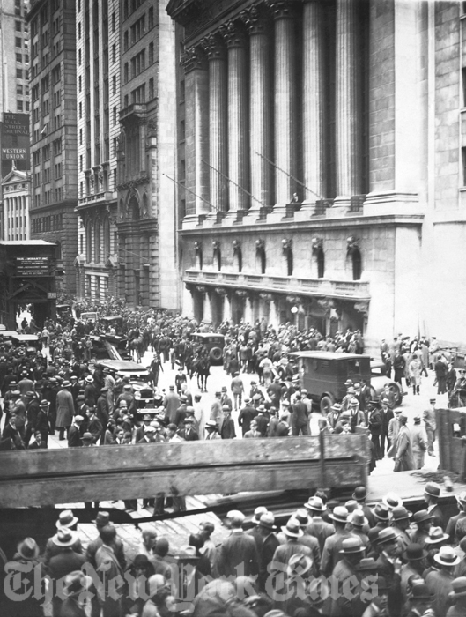
The Great Depression
In 1929, stock market crashed
Caused the Great Depression – touched every corner of the American economy
Collapse of American economy sent shockwaves around the world

Slide 23
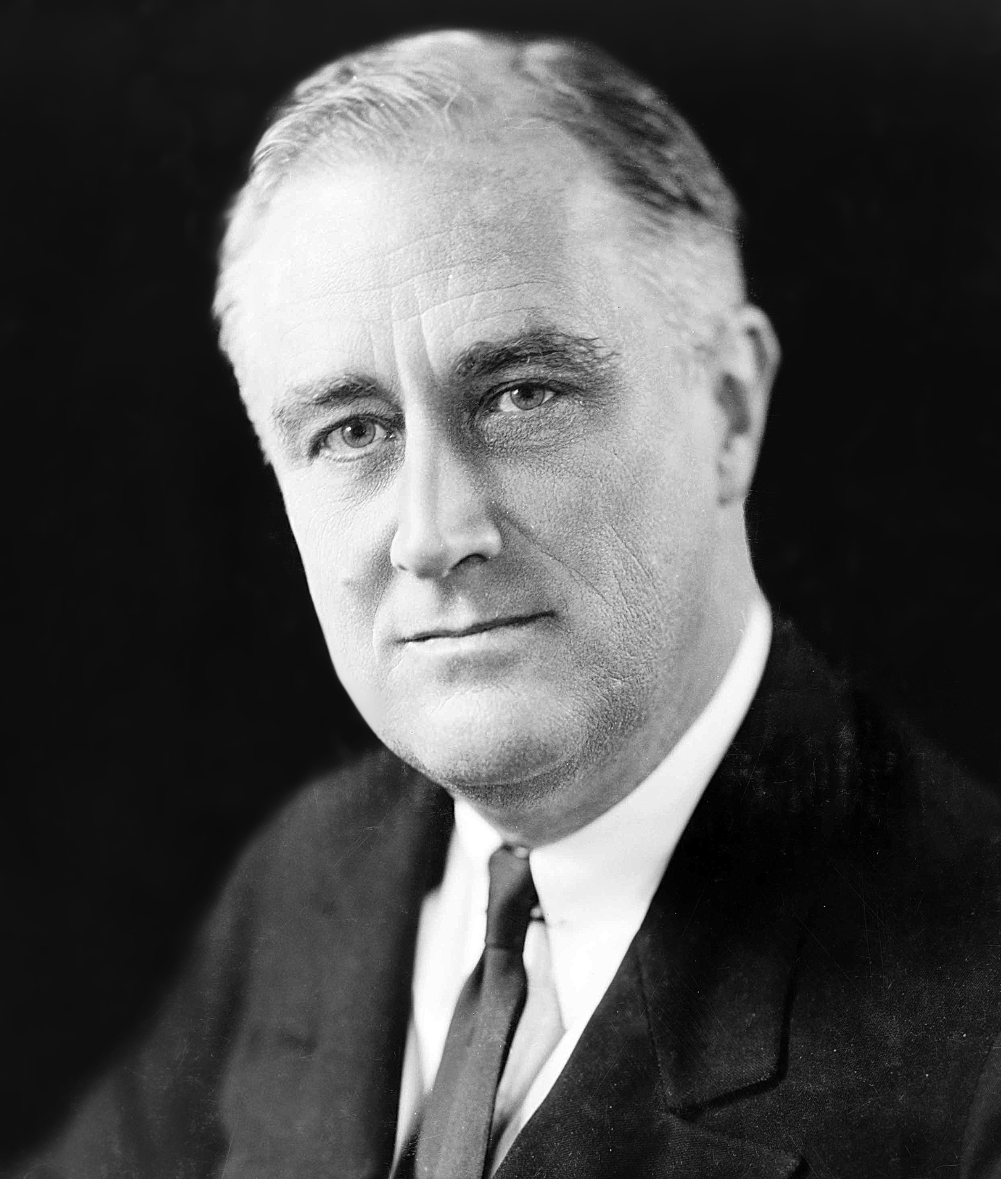
World Responds to Crisis
Depression presented serious challenge to economic and political systems
Countries met the crisis in own ways
US voters elected Franklin D. Roosevelt
FDR was established as leader of democracy

Slide 24
Rise of Fascism
FASCISM: militant, political movement that emphasized loyalty to the state and obedience to its leader
Benito Mussolini founded the Fascist Party in 1919 and gained popularity
In October 1922, Mussolini became Il Duce
Italy became the model for fascists in other countries

Slide 25
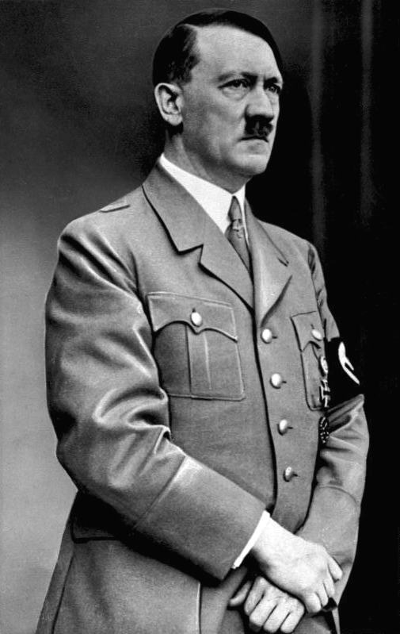
Hitler Takes Control
ADOLF HITLER: leader of Nazi Party; supreme German leader
Nazism is a brand of fascism
Arrested in 1923 for treason, but released in 1924 and revived the Nazi Party
Largest party by 1932
In January 1933, named Chancellor of Germany

Slide 26
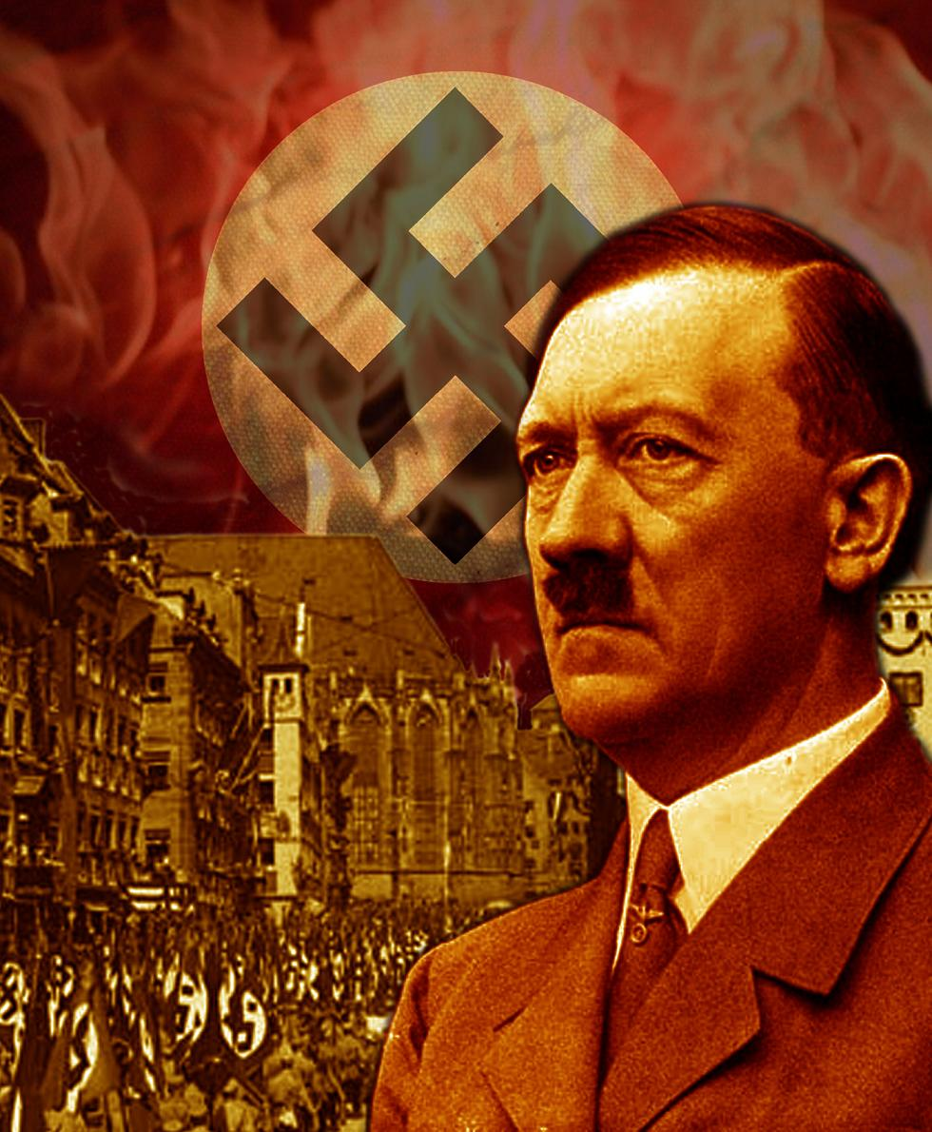
Hitler Defies Versailles Treaty
Pledged to undo the treaty
In March 1935, Hitler announced Germany would not obey military restrictions
Germany reoccupied Rhineland – turning point
British urged appeasement
APPEASEMENT: giving in to an aggressor to keep peace
Germany & Italy allied in 1936

Slide 27
Western Democracies Fail
Instead of taking a stand against Fascist aggression in the 1930s, Britain and France repeatedly made concessions, hoping to keep peace. Both nations were dealing with serious economic problems as a result of the Great Depression. In addition the horrors of World War I had created a deep desire to avoid war. Allowing Hitler and Mussolini small territorial gains seemed a small price to pay for peace.
Americans supported isolationism
Hitler absorbed Austria and Czechoslovakia into the Third Reich on November 5, 1937
THIRD REICH: German Empire

