Slide 1
Industrial Revolution
Unit Four

Slide 2
The Industrial Revolution
Our fourth unit in Modern World will focus on the Industrial Revolution in four sections:
Beginnings of Industrial Revolution in Britain
Rise of Modern Industry
Effects of Industrialization
Responses to the Industrial Revolution

Slide 3
The Industrial Revolution
The Industrial Revolution began in Britain in the 18th century, and eventually spread to the rest of the world throughout the 19th century, and the start of the 20th century. The revolution is broken into two distinct stages:
1750 – 1850: Great Britain took the lead by shifting to new methods of production
Mid-1800’s – 1914: Western Europe & the United States developed into modern industrial powers

Slide 4
Beginnings of the Industrial Revolution in Britain
Section One

Slide 5
Agricultural Revolution
Agricultural variety increased with new crops from America and new ways of using land
Invention of machines also increased food production

Slide 6
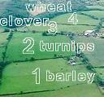
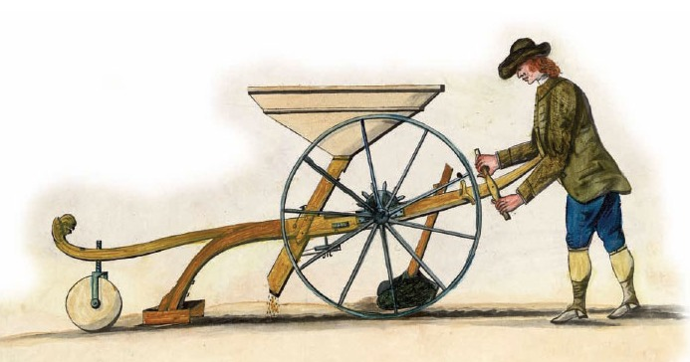
Agricultural Inventions
Charles Townshend created the four-crop field rotation system
Jethro Tull invented the seed drill

Slide 7
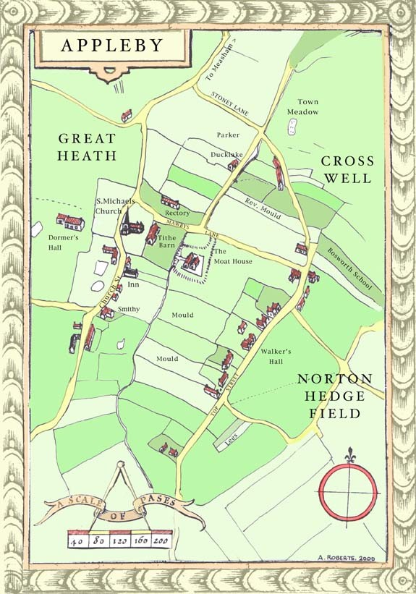
Enclosure Movement
ENCLOSURE MOVEMENT: fencing off of public lands by individual landowners
Two major effects of the movement were:
Made agriculture more efficient because wealthy landowners farmed more land with new crops
Pushed small farmers off land – leading to the formation of a large labor force

Slide 8
Changes in the Textile Industry
New demands for laborers in the British textile industry
New inventors improved the manufacture of cloth
New machines were expensive and had to be set up near rivers – mills were built and hundreds were hired
FACTORY SYSTEM: workers and machines in one place to manufacture goods
Notes:
Each new invention triggered other new inventions
Early textile mills were examples of the factory system in place

Slide 9
Industrial Development
Steam became a major source of energy and the steam powered engine was improved in the 1760’s
Iron production and steel production improved and increased
Steel production was made easier with the Bessemer Process

Slide 10
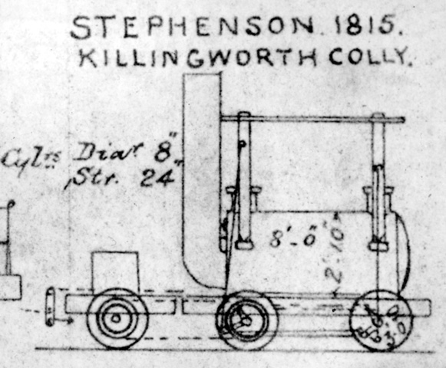
Advances in Transportation & Communication
Canal building connected mines and factories
Road building increased
Railroad industry developed
Railroads brought raw materials, factories and markets together
Railroad and the steamship improved communication within nations and around the world

Slide 11
Follow the Leader
Britain led the Industrial Revolution
for six main reasons:
Agricultural Revolution
Plentiful iron and coal resources
Leading commercial power in Europe
Large colonial empire to provide raw materials
Adopted policies to encourage industry growth
Intellectual and social climate in Britain encouraged industrialization
Notes:
Individuals could improve social standing

Slide 12
Rise of Modern Industry
Section Two

Slide 13
Rise of Modern Industry
The pace of industrialization quickened after 1850 and the Industrial Revolution went into its second stage. Industry grew rapidly in western Europe, especially in Belgium, France and Germany. In the rest of the world, industry began to grow more rapidly in the United States and in Japan.

Slide 14
Spread of Industrialization
Other nations began to challenge British leadership in the Industrial Revolution.
Belgium was first to industrialize, followed by France
The US followed, using their natural resources
In the US, railroad building fostered rapid economic growth

Slide 15
Advances Science & Technology
Scientific research resulted in new inventions
Scientific research brought sweeping changes to various industries – textiles & electricity
1866: 1st underwater telegraph across Atlantic
1876: Alexander Graham Bell invented the telephone
1900: Marconi developed the radio

Slide 16
Revolution in Transportation
Dramatic advances made in late 1800s
Development of internal combustion engine revolutionized transportation industry

Slide 17
New Production Methods
New machines & technology improved worker productivity
INTERCHANGEABLE PARTS: identical component parts that can be used in place of one another in manufacturing
ASSEMBLY LINE: series of workers and machines where identical items are progressively assembled in order
DIVISION OF LABOR: complex jobs broken down into a series of small tasks
Efficiency allowed for reduced costs and lower prices
Manufacturers introduced mass production
MASS PRODUCTION: turning out large amounts of identical goods

Slide 18
Financing Industrial Growth
New ways of financing developed
CORPORATION: business owned by many investors who each have a share in the business
MONOPOLY: total control over the market for a particular product
Banks played a prominent role in financing the industry
By late 1800s, an international economy existed

Slide 19
Effects of Industrialization
Section Three

Slide 20
Population Explosion
Beginning of the revolution is marked by a population explosion
Between 1750 and 1914, population of Europe more than tripled
Increase due to agricultural and industrial revolutions
Notes:
Radically changed patterns of life
140 mil to 463 mil (x3 = 420)

Slide 21
Problems in Growing Cities
The nature of cities changed
Cities grew rapidly around mill and factory sites
Rapid growth had problems:
Overcrowding
Inadequate water
No sanitation system

Slide 22
Factory Work
Miserable working conditions
Wages were very low
Children began working at age 5
People worked 6 days a week without paid holidays or sick time
Factories were unhealthy and dangerous

Slide 23
New Social Structure
Europe’s social structure was transformed
Middle class expanded and challenged the landowning aristocracy
Produced a new social class of industrial workers

Slide 24
Changing Roles for Women
Women’s traditional roles changed
Women went to work in factories to help support families
Women (only lower class) worked outside of the home, but still took care of the home
Demand for domestic servants grew

Slide 25
Responses to the Industrial Revolution
Section Four

Slide 26
Demands for Change in Britain
Workers in Britain protested against bad conditions
Protests were sometimes violent
Support for reform helped by journalists and writers
FACTORY ACT OF 1833: limited working day for children
MINES ACT: passed in 1842, barred boys under 13 and women from working in mines
TEN HOURS ACT: limited work day for children under 18 and women to 10 hours a day
Notes:
Early in the industrial rev, members of the middle class were indifferent to the suffering of workers
As industrialization continued, people began to call for reforms to improve conditions
journalists and writers described in vivid detail the conditions in the factories and mines
ten hours act eventually extended to everyone

Slide 27
Rise of Labor Unions
Workers formed associations to gain a better position
Government saw labor unions as dangerous
Laws were passed to outlaw unions, but were later repealed
Slowly local unions formed larger associations
By 1900, union membership was growing rapidly

Slide 28
Gains for Workers
Between 1870 and 1914, work conditions dramatically improved in a number of ways:
Raise in wages
Cheaper goods
Employers came to believe that productivity could occur in a safe environment
Factory codes were established for safety
Governments set up insurance and pension funds
By 1914, standard of living was better than 100 years before

Slide 29
Improving City Life
City governments worked to improve conditions
Better streets and homes constructed
Cities became safer with street lights
By 1900s, cities had become increasingly attractive places to live

