Slide 1
The Enlightenment
Unit Two

Slide 2
The Enlightenment
The Enlightenment was a period in history when European philosophers emphasized the use of reason (logical thinking) as the best method of learning truth. This period followed the Middle Ages and came about during the age of absolutism, a period in time when authority controlled the government and limited education.
Enlightenment thinkers relied on the scientific method, with its emphasis on experimentation and careful observation. They produced many important advances in fields such as anatomy, astronomy, chemistry, mathematics and physics. These thinkers organized knowledge in encyclopedias and founded scientific institutes, and explored issues in education, law, philosophy, and politics. The enlightenment thinkers attacked oppression, social injustice, superstition and ignorance.

Slide 3
The Enlightenment Unit Breakdown
As we explore the Enlightenment, we will do so in 2 sections:
The Enlightenment in Europe
Spread of Enlightenment Ideas

Slide 4
The Enlightenment in Europe
Section One

Slide 5
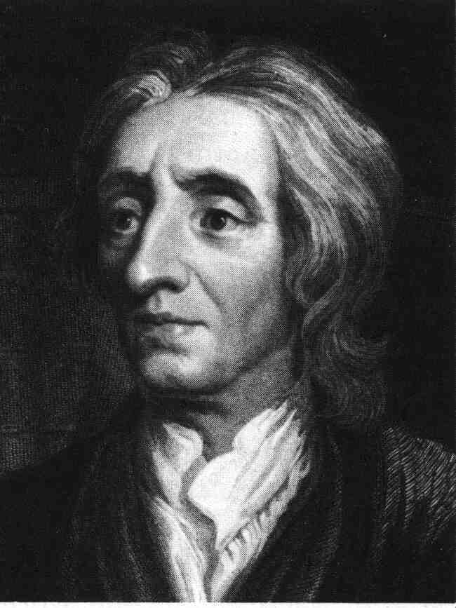
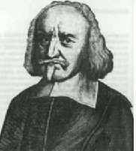
Thomas Hobbes vs. John Locke
Two Visions of Government and Rights
Discussion:
How would life in Boston be different if there was no mayor?

Slide 6
Social Contract Theory
Imagine two situations:
Government (the state)
No government (the state of nature)
Which would you choose?

Slide 7
Enlightenment Vocabulary
Social Contract: the agreement by which people define and limit their individual rights, thus creating an organized society or government
Natural Rights: the rights that all people are born with – according to John Locke, the rights of life, liberty, and property

Slide 8
Thomas Hobbes (1588-1679)
Wrote Leviathan
Didn’t believe in Revolutions
Believed in Absolute Monarchy
Believed that life in the state of nature would be “solitary, poor, nasty, brutish, and short”

Slide 9
Hobbes’s Social Contract
You would give up
Liberty
To gain
Security

Slide 10
John Locke (1632-1704)
Wrote Two Treatises of Government
Believed in Natural Rights from nature or God
Believed in Limited Government that protected people’s Natural Rights

Slide 11
Locke’s State of Nature
You have natural rights in the state of nature:
Rights to life, health, liberty, and property
Right of self-preservation
Right to execute the law of nature
This is not a state of war.

Slide 12
Locke’s Social Contract
You would give up
Your right to execute the law of nature
To gain
Impartial judgment
Notes:
Problem: finding an impartial arbitrator— who shall be judge?
You do not give up natural and social rights in the social contract
Slavery would be wrong even if voluntary

Slide 13
Natural vs. Civil Rights
Locke: “Bottom-up” Model
Some rights are natural, independent of government
Government gets its power from the individuals that allow the government to have control

Slide 14
The Philosophes Advocate Reason
The Enlightenment reached its height in France in the mid-1700s. Paris became the meeting place for people who wanted to discuss politics and ideas. The social critics of this period in France were called philosophes, the French word for philosophers. The philosophes believed that people could apply reason to all aspects of life – just as Isaac Newton had applied reason to science.

Slide 15
1. Reason
Enlightened thinkers believed truth could be discovered through reason or logical thinking
Reason is the absence of prejudice in one’s thinking
With reason society could be set free

Slide 16
2. Nature
What was natural was also good and reasonable
Natural laws of economics and politics existed

Slide 17
3. Happiness
A person who lived by nature’s laws would find happiness
Wanted well-being on earth and believed it was possible
Notes:
Impatient with the notion that people should accept misery

Slide 18
4. Progress
Believed in progress for society
With the scientific approach, society and humankind could be perfected

Slide 19
5. Liberty
Wanted no restriction on personal liberties – such as speech, religion, trade and personal travel

Slide 20
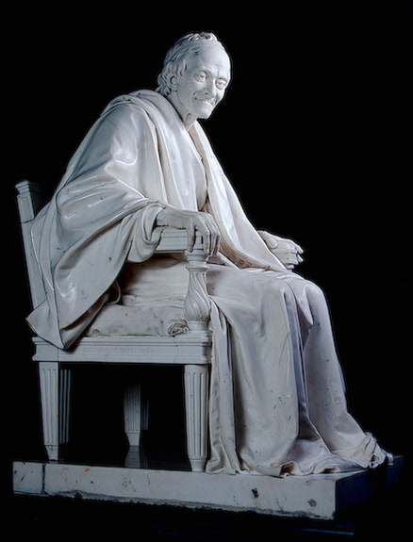
Voltaire
Born Francois Marie Arouet
Published more than 70 works
Used satire against opponents
Fought for freedom of religious belief and freedom of speech

Slide 21
Voltaire’s Wisdom
“Judge a man by his questions, not by his answers.”
“The way to become boring is to say everything.”
“If God did not exist, it would be necessary to invent him.”

Slide 22
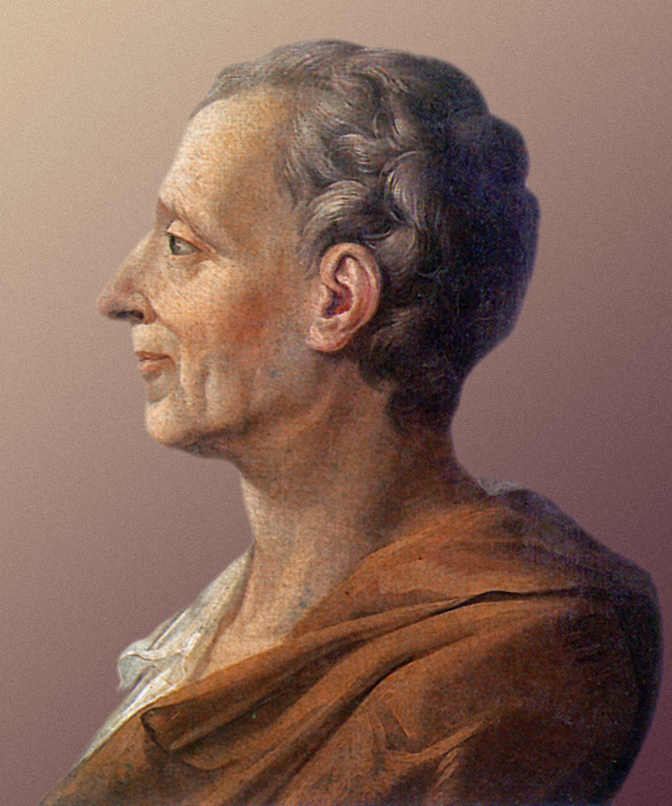
Baron de Montesquieu
Devoted to the study of political liberty
Believed that separation of powers was key to government success
Checks and balances
Wrote On The Spirit of Laws

Slide 23
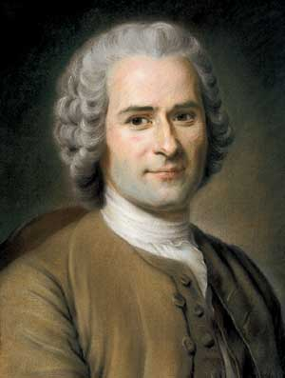
Jean Jacques Rousseau
Committed to individual freedoms
Believed that civilization corrupted natural goodness
Believed only good government was a direct democracy
Notes:
“Man is born free and everywhere he is in chains.”

Slide 24
Cesare Bonesana Beccaria
Focused on justice system
Railed against common abuses of justice
Wrote On Crime and Punishments
Notes:
Felt the accused should receive a speedy trial and punishments should not be arbitrary or cruel
No use of torture
Wanted capital punishment to be abolished

Slide 25
Mary Wollstonecraft
Wrote A Vindication of the Rights of Woman
Believed that women had a right to participate in politics
Argued that women needed an education

Slide 26
Impact of the Enlightenment
Enlightenment thinkers challenged long-held ideas about society. The philosophes mainly lived in a world of ideas, forming and popularizing new theories. Through the work of the philosophes, Enlightenment thinking produced three important long-term effects for society:
Belief in Progress
More Secular Outlook
Importance of the Individual

Slide 27
Belief in Progress: allowed for growth of scientific knowledge; urged an end to the practice of slavery and argued for more social equality and improvements in education
A More Secular Outlook: people began to openly question their religious beliefs and the teachings of the church
Importance of the Individual: people were encouraged to use their own ability to reason in order to judge what is right or wrong; emphasis was placed on the individual

Slide 28
Spread of Enlightenment Ideas
Section Two

Slide 29
Spread of Ideas
While the views of the philosophes were not always welcomed by European monarchs, Enlightenment ideas spread throughout Europe.
In the 1700s, Paris was the cultural and intellectual capital of Europe – the brightest minds of the age gathered there. From their circles radiated the ideas of the Enlightenment.

Slide 30
World of Ideas
SALONS: social gatherings where discussion about Enlightenment ideas was at its height
ENCYCLOPEDIA: large set of books, imagined by Denis Diderot, to which all the leading scholars of Europe would contribute articles and essays
Enlightenment thinkers considered themselves to be a part of an intellectual community
Attracted the attention of a growing literate middle class

Slide 31
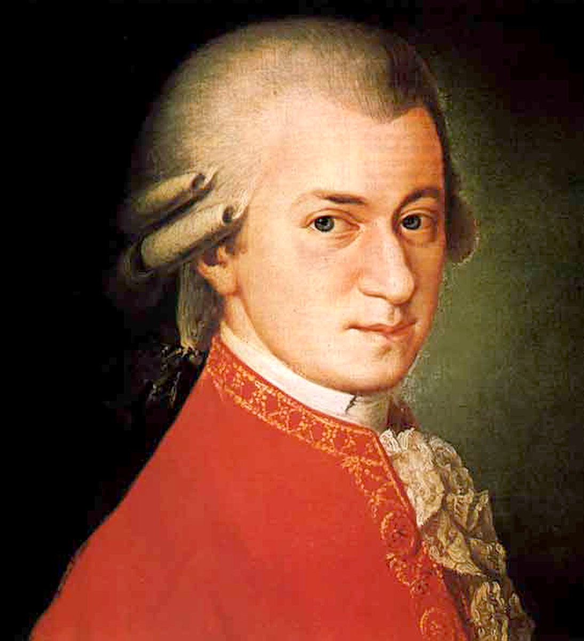
Art & Literature
BAROQUE: grand, ornate style in Enlightenment art
NEOCLASSICAL: simple and elegant style popular in the late 1700s
Classical musicians grew popular
Novelists developed the modern novel
Notes:
Classical musicians: haydn, mozart, beethoven
Novels: daniel defoe’s robinson crusoe

Slide 32
Enlightenment & Monarchy
From the salons, artists’ studios, and concert halls of Europe, the Enlightenment spirit also swept through Europe’s royal courts. Many philosophes, including Voltaire, believed that the best form of government was a monarchy in which the ruler respected the people’s rights. The philosophes tried to convince monarchs to rule justly. Some monarchs embraced the new ideas and made reforms that reflected Enlightenment spirit. They became known as the enlightened despots.
Notes:
Despot means absolute ruler

