Slide 1
The Constitution and Founding Documents
Unit II

Slide 2
The transition from a federation of American colonies to the United States of America was marked by extraordinary events: sincere attempts at diplomacy, violent conflict, thoughtful consideration of the rights of man, passionate debate about the role of government, and ultimately, the construction of the system of republican government under which we still live.
The Confederation
A New Constitution
Ratification
First Tasks of New Government
In other words, a group of passionate men worked together to create a lasting system of government that still exists today.

Slide 3
The Confederation
Part I

Slide 4
Articles of Confederation
Adopted by the Continental Congress in November 1777 and ratified by the states in 1781
Confederation Congress met once a year
Confederation Congress had the power to:
Declare war
Raise armies
Sign treaties
Confederation Congress was not given the power to:
Impose taxes
Regulate trade
The Articles of Confederation established a WEAK central government
Notes:
Why weak government? Spent years fighting for independence and did want to give up newly held independence to a new central government that may become tyrannical

Slide 5
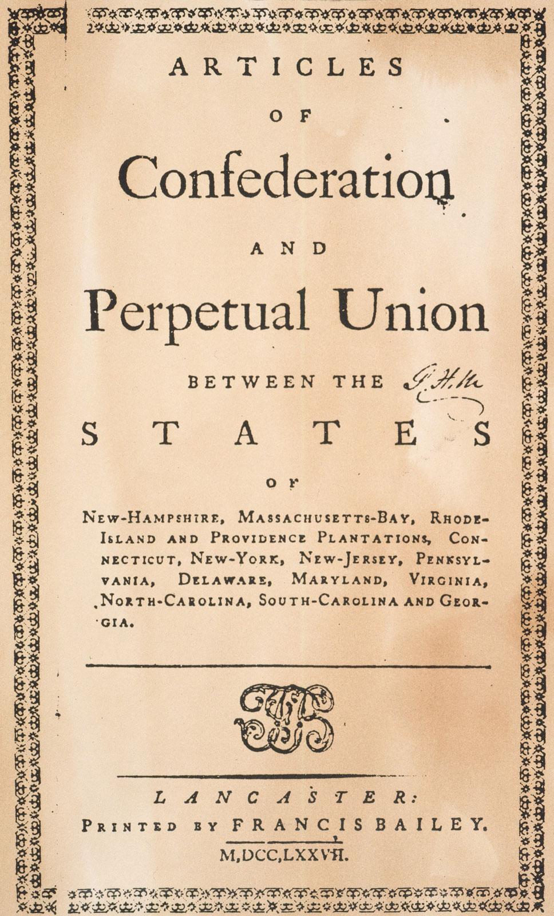
Successes of Articles of Confederation
The Articles of Confederation were not a complete failure, as they found success in 2 major areas:
Negotiated Commercial Treaties
Developed System of Settling the West

Slide 6
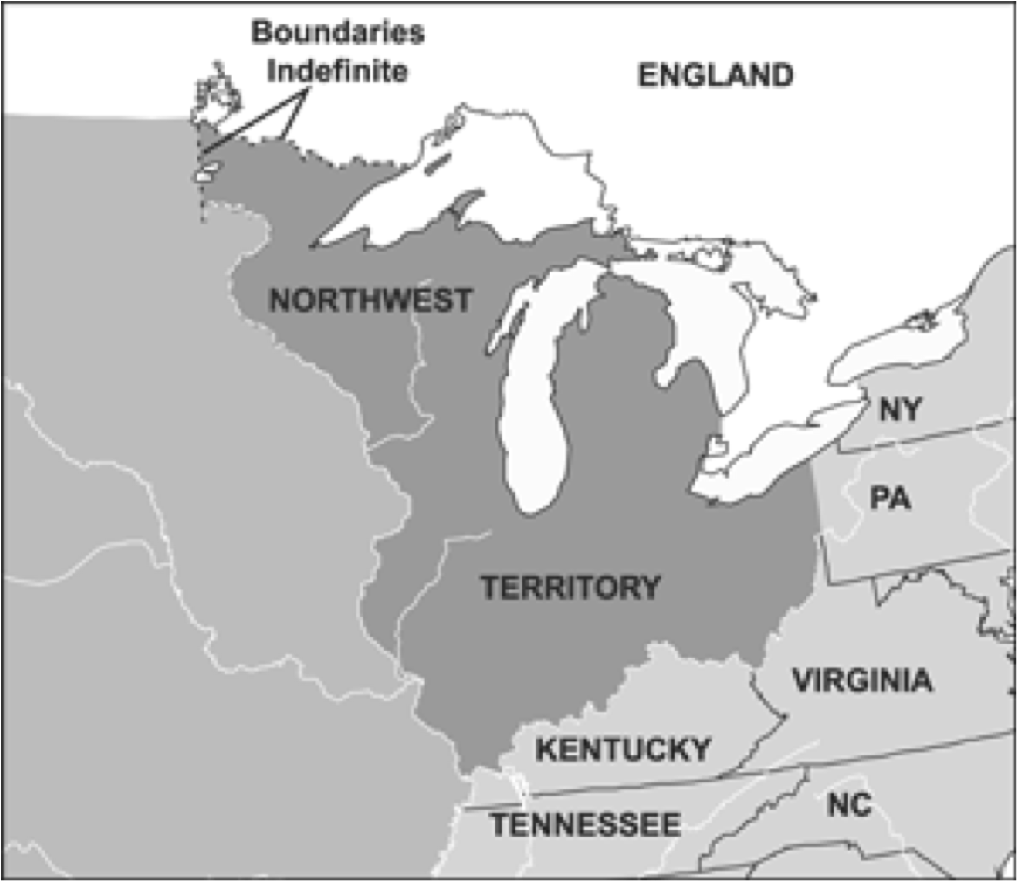
Northwest Ordinance of 1787
To raise $ and pay debts, the Confederation sold land West of the Appalachians
Congress passed Northwest Ordinance in 1787
NW Ordinance provided basis for governing Western territory
Maintained there would be no slavery in this area

Slide 7
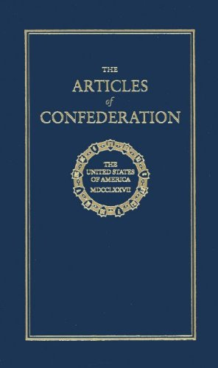
Failures of Articles of Confederation
However, although there was some success, the Articles of Confederation failed in many ways.
No Tax Power
Foreign Policy Issues
Recession

Slide 8
1. No Tax Power
States restricted British imports, but British found ways around the duties
States regulated and taxed each other
Each state acted independently and this threatened the unity of the United States
DUTIES: taxes on imported goods

Slide 9
2. Foreign Policy Issues
Gov’t could not force states to pay debt or return property
British refused to evacuate American soil
Rising issues with Spain involving border dispute

Slide 10
3. Recession
The end of the war and slowdown of economic activity with Britain plunged the United States into a severe recession.
RECESSION: economic slowdown
People wanted to redeem bonds for gold and silver
States could raise taxes to pay debts but people wanted them to issue more paper money
Paper money wasn’t backed up by gold or silver and inflation began – by 1785, 7 states were issuing paper money.
INFLATION: decline in value of money

Slide 11
Shay’s Rebellion
Who: Farmers in Western MA led by Daniel Shays
What: Rebellion because the MA government raised taxes
Where: Western and Central Massachusetts
When: 1786 – 1787
Effect: Showed that the republic was at risk and led to argument for stronger central government

Slide 12
A New Constitution
Part II

Slide 13
In 1786, James Madison convinced Virginia’s state assembly to call the Annapolis Convention of all states to discuss trade and taxes, but only 5 states participated.
Alexander Hamilton then recommended that the Confederation Congress call for another convention to be held in May 1787 in Philadelphia. This became known as the Constitutional Convention.

Slide 15
Constitutional Convention: By the Numbers
55 Delegates from 12 Colonies (0 from Rhode Island)
Majority were lawyers, others were planters and merchants
Most had colonial, state or national experience
7 had been, or were, governors
39 were members of the Confederation Congress
8 were signers of the Declaration of Independence

Slide 16
Constitutional Convention
55 Delegates from 12 colonies attend the Constitutional Convention. Rhode Island did not attend.
George Washington: Presiding Officer of the Convention
Benjamin Franklin: Honorary Delegate at the Convention
Alexander Hamilton: Led Annapolis Convention; co-authored The Federalist
Roger Sherman: Created the Connecticut and 3/5ths Compromises
James Madison: Known as the “Father of the Constitution” and was a co-author of The Federalist; later a key champion and author of the Bill of Rights

Slide 17
Virginia Plan
Virginia arrived with a detailed plan for the new national government. They proposed getting rid of the Articles of Confederation entirely and replacing it with the new government.
The Virginia Plan called for:
3 Branches of Government: Legislative, Executive & Judicial
2 Houses for Legislative Branch:
1st House: Determined by Number of Voters in Each States
2nd House: Nominated by State Governments but elected by 1st House
The Plan was welcomed in part, but smaller states objected.
Notes:
Animation is funny on this one

Slide 18
New Jersey Plan
William Paterson, from New Jersey, came up with the NJ Plan. The plan proposed modifying the Articles of Confederation without completely replacing them.
Congress would have a single legislative body
Each state would be equally represented
Legislature would have power to raise taxes and regulate trade

Slide 19
Need for Compromise
Delegates had to choose one plan to further negotiate on. The delegates chose the Virginia Plan and began to work on developing a completely new constitution.
2 Issues Arose:
Small states didn’t want to be overrun by larger states
Slavery
To solve these problems, the Convention agreed on two compromises: the Connecticut Compromise and the 3/5ths Compromise.

Slide 20
Connecticut Compromise
The Connecticut Compromise proposed a legislature with two houses:
One based on representation (House of Representatives)
One with two representative from each state (Senate)
3/5ths Compromise
Decided how to count slaves for representation
For every 5 slaves, the state count 3 people for representation and tax purposes
Agreed the slave trade would stay open until at least 1808

Slide 21
The New Constitution
The new constitution was based on popular sovereignty and created a new system of government known as federalism.
POPULAR SOVEREIGNTY: authority of the government is created and sustained by the will of the people
FEDERALISM: political concept stating that group of members are bound together by a covenant with governing representative head
The Constitution provided for Separation of Powers between the Legislative, Executive and Judicial Branches and would operate under a System of Checks and Balances.
Created a system for amendments to the constitution

Slide 22
Branches of Government

Slide 23
The Presidency
Established in Article II
Term is for 4 Years and there is a 2 term limit
Vice President is chosen for the same Term and acts as President of the Senate
Notes:
Framers wanted strong executive
Inspired by MA governor’s response to Shay’s Rebellion

Slide 24
Congress
Powers established in Article I of the Constitution.
House of Representatives
Senate
Referred to as the House
435 representatives
2 year term, no term limit
Led by the Speaker of the House, who is elected by the 435 representatives
Current Speaker is John Boehner
MA has 9 Representatives and ours, in the 8th District, is Stephen Lynch
Each state is represented by 2 senators, regardless of size
Staggered 6 year terms
Led by the Vice President, who is currently Joe Biden
The two senators in MA are Elizabeth Warren and Ed Markey

Slide 25
The Supreme Court
Justices appointed for life
9 Justices on the Court
Chief Justice Roberts
Can declare laws and actions unconstitutional

Slide 26
Ratification
Part III

Slide 27
Choosing Sides
Each state would elect a convention to vote on the Constitution.
Federalists
Anti-Federalists
Supported the new constitution
Hoped to remind people that power would be DIVIDED between central and regional gov’t
Supporters included large landowners, merchants, artisans, and farmers near the coastline
Opposed the new constitution
Accepted the need for national government, but questioned state’s power
Some believed a Bill of Rights should be added
Supporters included Western farmers

Slide 28
Factors Working Against the Anti-Federalists
Campaign was Negative
Anti-Federalists had no alternate solution to issues at hand
Federalists were better organized

Slide 29
The Federalist
85 Articles/Essays
Written by Alexander Hamilton, James Madison and John Jay
Argued for Ratification of the US Constitution

Slide 30
Ratification Process
Began in December 1787 and January 1788
Massachusetts met in 1788 and ratified with the promise of the Bill of Rights
Anti-Federalists had majority in Massachusetts BUT the Federalists promised to add the Bill of Rights
The promise of the Bill of Rights also won over other states, including Virginia and then New York
By the end of 1788, all states except Rhode Island (RI) and North Carolina (NC) had ratified but new government could launch without them

Slide 31
First Tasks of New Government
Part IV

Slide 32
3 Main Tasks of New Government
As the new government started in 1789, many were confident in it because George Washington had been elected as the first President. After the election, Washington had 3 immediate tasks.
Provide President with Bureaucracy to Handle Presidential Responsibilities
Organize Judiciary Branch
Introduce and Ratify Bill of Rights

Slide 33
1. Provide President with Bureaucracy
In 1789, 4 offices were created:
Department of State (Thomas Jefferson)
Department of War (Henry Knox)
Department of Treasury (Alexander Hamilton)
Office of the Attorney General (Edmund Randolph)
This became known as the President’s CABINET.

Slide 34
2. Organize Judiciary Branch
Established 13 District Courts, 3 Courts of Appeal and one Supreme Court
With the consent of the Senate, Washington chose the federal judges
Named John Jay the first Chief Justice of the Supreme Court
Notes:
Who is the chief justice today? John Roberts.

Slide 35
3. Bill of Rights
The first 10 amendments to the United States Constitution
Drafted by James Madison
Inspired by the English Bill of Rights and the ideas of John Locke

Slide 36
First Amendment
Congress shall make no law respecting an establishment of religion, or prohibiting the free exercise thereof; or abridging the freedom of speech, or of the press; or the right of the people peaceably to assemble, and to petition the Government for a redress of grievances.
Freedom of:
Religion
Speech
Press
To Assemble
To Petition
Notes:
Notes:

Slide 37
Second Amendment
A well regulated Militia, being necessary to the security of a free State, the right of the people to keep and bear Arms, shall not be infringed.
Right to Keep and Bear Arms
Notes:
Notes:

Slide 38
Third Amendment
No soldier shall, in time of peace be quartered in any house, without the consent of the Owner, nor in time of war, but in a manner to be prescribed by law.
Inspired by the Quartering Acts and not used today
Notes:
Notes:

Slide 39
Fourth Amendment
The right of the people to be secure in their persons, houses, papers, and effects, against unreasonable searches and seizures, shall not be violated, and no Warrants shall issue, but upon probable cause, supported by Oath or affirmation, and particularly describing the place to be searched, and the persons or things to be seized.
Reasonable Search and Seizure
Probable Cause
Notes:
Exceptions:
consent
plain view
open fields (areas)

Slide 40
Fifth Amendment
No person shall be held to answer for a capital, or otherwise infamous crime, unless on a presentment or indictment of a Grand Jury, except in cases arising in the land or naval forces, or in the Militia, when in actual service in time of War or public danger; nor shall any person be subject for the same offence to be twice put in jeopardy of life or limb; nor shall be compelled in any criminal case to be a witness against himself, nor be deprived of life, liberty, or property, without due process of law; nor shall private property be taken for public use, without just compensation.
Grand Jury Indictment
Double Jeopardy
Self-Incrimination
Due Process
Public Use of Private Property
Notes:
Notes:

Slide 41
Sixth Amendment
In all criminal prosecutions, the accused shall enjoy the right to a speedy and public trial, by an impartial jury of the State and district wherein the crime shall have been committed, which district shall have been previously ascertained by law, and to be informed of the nature and cause of the accusation; to be confronted with the witnesses against him; to have compulsory process for obtaining witnesses in his favor, and to have the Assistance of Counsel for his defence.
Speedy and Public Trial
Confrontation
Right to Attorney
Notes:
Notes:

Slide 42
Seventh Amendment
In Suits at common law, where the value in controversy shall exceed twenty dollars, the right of trial by jury shall be preserved and no fact tried by a jury, shall be otherwise re-examined in any Court of the United States, than according to the rules of the common law.
Civil Law: Trial by Jury
Notes:
Notes:

Slide 43
Eighth Amendment
Excessive bail shall not be required, nor excessive fines imposed, nor cruel and unusual punishments inflicted.
Excessive Bail and Fines
Cruel & Unusual Punishment
Notes:
Notes:

Slide 44
Ninth Amendment
These rights do not allow for denial of other rights
ENUMERATION: numbered list; declaration of
The enumeration in the Constitution, of certain rights, shall not be construed to deny or disparage others retained by the people.
Notes:
Notes:

Slide 45
Tenth Amendment
The powers not delegated to the United States by the Constitution, nor prohibited by it to the States, are reserved to the States respectively, or to the people.
States’ Rights / State Sovereignty
Notes:
Notes: What are some important 10th Amendment issues?
Healthcare
Physician Assisted Suicide
Medical Marijuana
Gun Laws & Regulations

Slide 46
Lasting Effects of the Bill of Rights
In September 1789, after much debate, Congress agreed to send 12 amendments to the states for their approval and ratification. The first 10 were approved and they became known as the Bill of Rights. These amendments went into effect in 1791.
Since then, 17 more amendments have been added to the Constitution. Of these 17, there are 5 we will focus on:
13th Amendment: Abolishes Slavery and Indentured Servitude
14th Amendment: Defines citizenship and has Privileges and Immunities Clause, Due Process Clause, & Equal Protection Clause
15th Amendment: Prohibits Denial of Suffrage Based on Race/Color
18th Amendment: Establishes Prohibition of Alcohol (Repealed by 21st)
19th Amendment: Establishes Women’s Suffrage
Notes:
The 2 not accepted are :
1. 27th Amendment: Prevents laws affecting Congressional salary from taking place until next Congressional session
2. Congressional Apportionment Amendment: Would ensure a minimum representation for the common people in the new government

