Slide 1
Cold War Era
Overview, 1945-1985

Slide 2
From World War to Cold War
Appalling costs of war emerged at the war’s end
75 MILLION people killed and the USSR suffered the most casualties with more than 22 MILLION dead
Allies set up the United Nations to ensure peace with 5 permanent members (US, USSR, Britain, France & China) to oversee decisions
New power structure emerged as the US and USSR became superpowers and then tense rivals in an increasingly divided world

Slide 3
The Ideological Struggle
Soviet & Eastern Bloc Nations [“Iron Curtain”]
US & the Western Democracies
GOAL → spread world-wide Communism
GOAL → “Containment” of Communism & the eventual collapse of the Communist world.
METHODOLOGIES:
Espionage [KGB vs. CIA]
Arms Race [nuclear escalation]
Ideological Competition for the minds and hearts of Third World peoples [Communist govt. & command economy vs. democratic govt. & capitalist economy] → “proxy wars”
Bi-Polarization of Europe [NATO vs. Warsaw Pact]

Slide 4
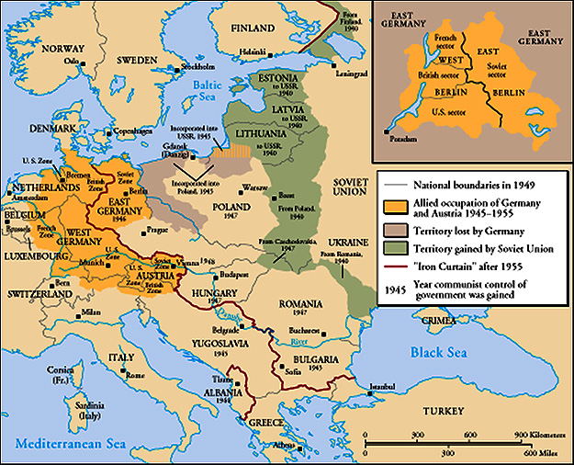
The Iron Curtain
From Stettin in the Balkans, to Trieste in the Adriatic, an iron curtain has descended across the Continent. Behind that line lies the ancient capitals of Central and Eastern Europe.
-- Sir Winston Churchill, 1946

Slide 5
The Truman Doctrine (1947)
Civil War in Greece between communist rebels and a right-wing monarchy
Turkey was under pressure from the USSR for concessions in the Dardanelles (the strait linking the Russian Black Sea coasts and the Mediterranean)
“I believe that it must be the policy of the United States to support free people who are resisting attempted subjugation by armed minorities or outside pressures.” – Truman
US gave Greece and Turkey $400 Million in aid

Slide 6
The Marshall Plan (1948)
“European Recovery Program” put in place to help European countries rebuild
Put forward by Secretary of State, George Marshall
Marshall said that the U. S. should provide aid to all European nations that needed it – “This move is not against any country or doctrine, but against hunger, poverty, desperation, and chaos.”
$12.5 billion of US aid to Western Europe extended to Eastern Europe & USSR, [but this was rejected].

Slide 7
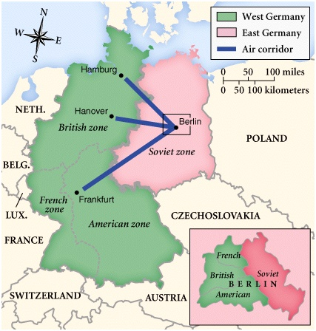
Post-War Germany

Slide 8
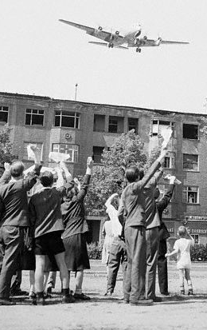
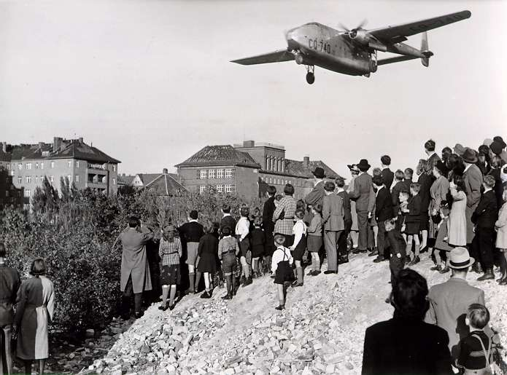
Berlin Blockade & Airlift (1948-1949)

Slide 9
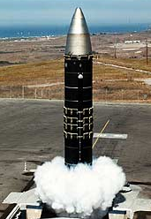
The Arms Race: A Missile Gap?
The USSR exploded its first atomic bomb in 1949
Now there were 2 nuclear superpowers

Slide 10
Brinkmanship
BRINKMANSHIP: each side was willing to go to nuclear war if provoked – they were on the “brink,” or edge, of war
Either side could easily be provoked over the Berlin situation
Both sides commitment to brinkmanship lead to many near misses

Slide 11
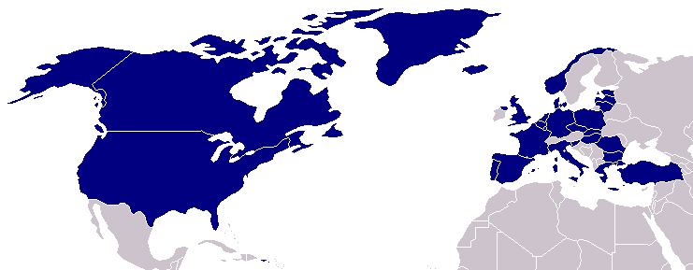
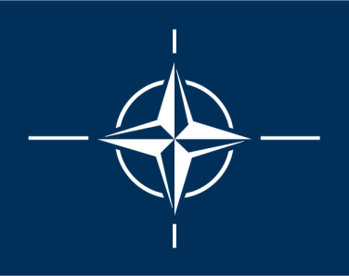
North Atlantic Treaty Organization (1949)
United States
Belgium
Britain
Canada
Denmark
France
Iceland
Italy
Luxemburg
Netherlands
Norway
Portugal
1952: Greece & Turkey
1955: West Germany
1983: Spain

Slide 12
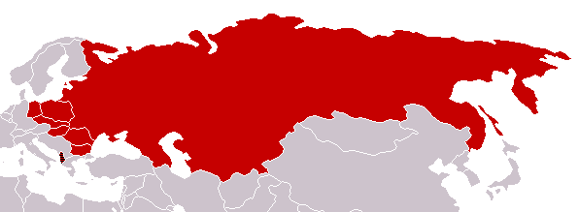
Warsaw Pact (1955)
U. S. S. R.
Albania
Bulgaria
Czechoslovakia
East Germany
Hungary
Poland
Romania

Slide 13
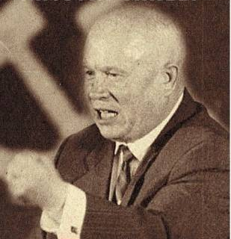
Premier Nikita Khrushchev
About the capitalist states, it doesn't depend on you whether we (Soviet Union) exist. If you don't like us, don't accept our invitations, and don’t invite us to come to see you. Whether you like it our not, history is on our side. We will bury you. -- 1956
De-Stalinization Program

Slide 14
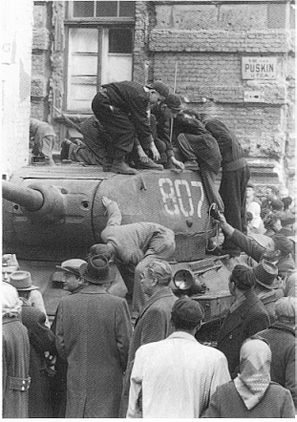
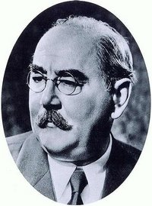
The Hungarian Uprising (1956)
Imre Nagy was the Hungarian Prime Minister
Promised free elections
Could lead to the end of communist rule in Hungary

Slide 15
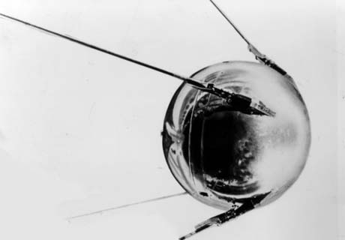
Sputnik I (1957)
The Russians beat America into space – they had the technological edge!

Slide 16
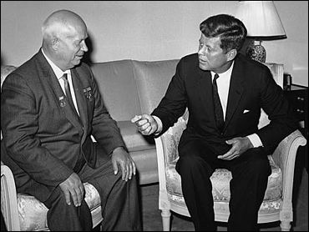
Paris in 1961
Khrushchev & JFK met to discuss Berlin and nuclear proliferation. Khrushchev thought JFK was too young and inexperienced.

Slide 17
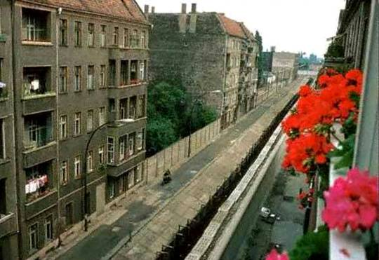
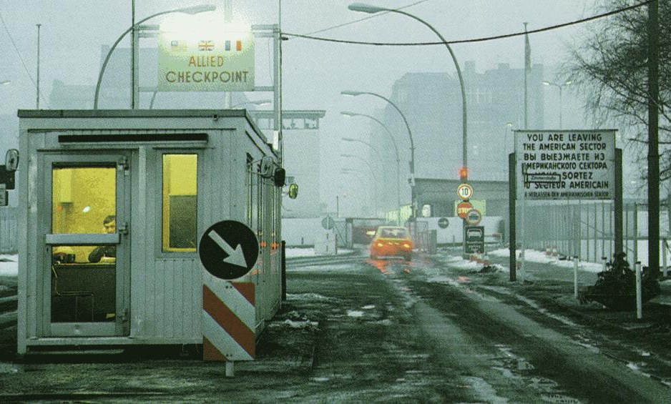
The Berlin Wall Goes Up

Slide 18
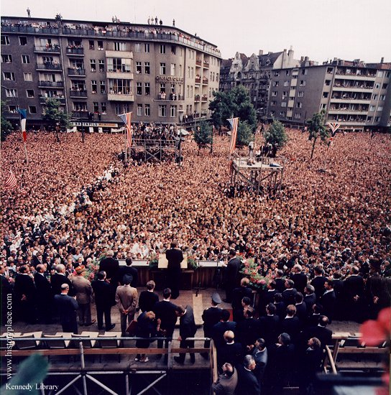
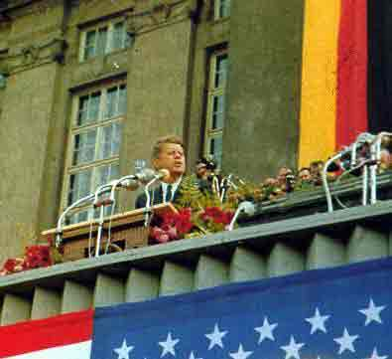
Ich bin ein Berliner!
President Kennedy told Berliners that the West was with them!

Slide 19
Détente
The commitment to brinkmanship broke down after the near catastrophe of the Cuban Missile Crisis
DÉTENTE: new idea that put forward the policy of lessening Cold War tension
Old time communist fighter Richard Nixon was President of the United States

Slide 20
Détente in Action
Nixon visited China and the USSR
SALT-Strategic Arms Limitation Talks
SALT I treaty signed in 1972 limited the amount of intercontinental ballistic and submarine launched missiles each country could have
In 1975, 33 more countries made a commitment to Détente and singed the Helsinki Accords

Slide 21
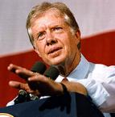
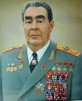
The End of Détente
In 1979 President Carter and Soviet Premier Brezhnev signed SALT II
When the Soviets invaded Afghanistan, the US Senate refused to ratify the treaty
More nations (China, India, and others) began to build nuclear arsenals

Slide 22
Reagan the Anti-Communist
Ronald Reagan was elected president of the United States in 1980—very conservative and anti-communist
Increased defense spending, which put economic and military pressure on the Soviets
Announced the Strategic Defense Initiative (SDI) aka Star Wars-a program to protect against enemy missiles

Slide 23
Towards the End of the Era
Tensions continued to increase due to the situations in Nicaragua and Eastern Europe
Change became possible with new leadership in the Soviet Union in 1985

